Slide 1
EN.580.428 Genomic Data Visualization Lesson 4 Non-linear Dimensionality Reduction: T-distributed Stochastic Neighbor Embedding
Prof. Jean Fan

Slide 2
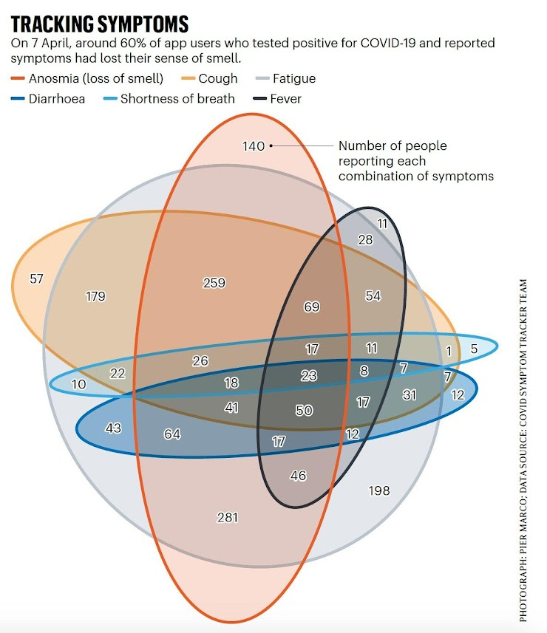
Quiz review
Even though there are lines,
is the data really being encoded by lines?

Slide 3
Quiz review
Overlapping area versus position?

Slide 4
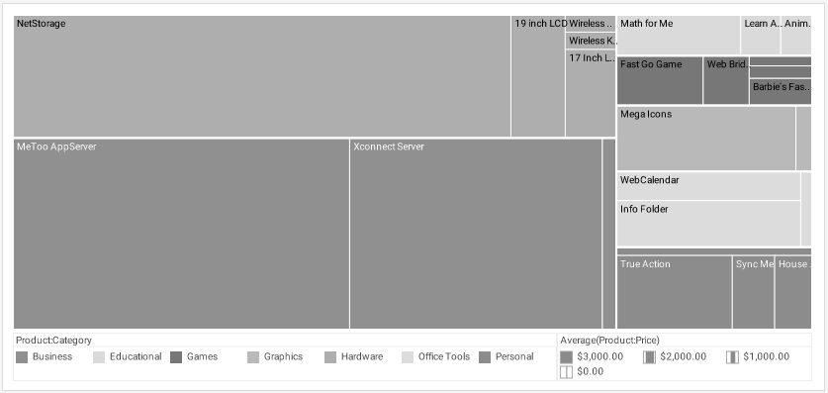
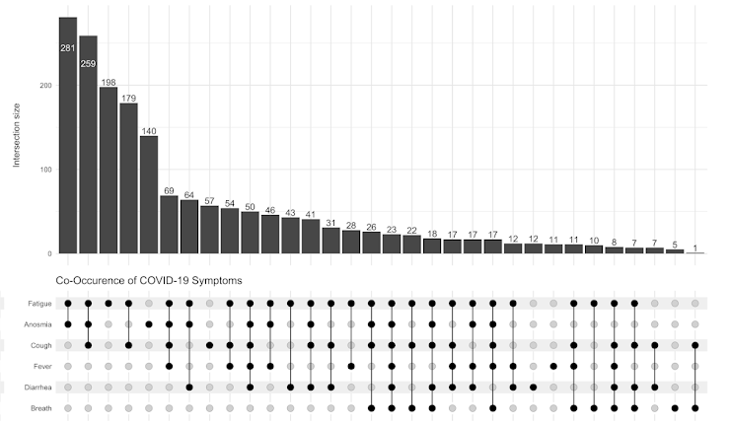
Size or position?
Position
Change position, change data
Change size, can keep data same

Slide 5
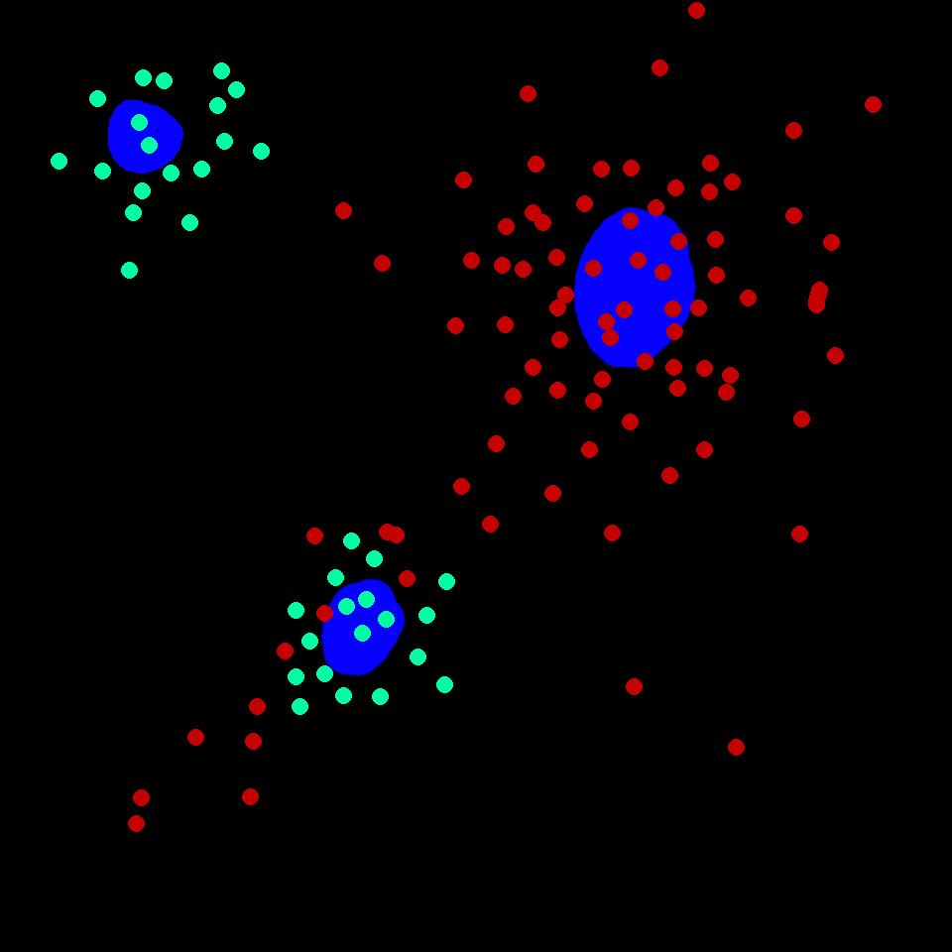
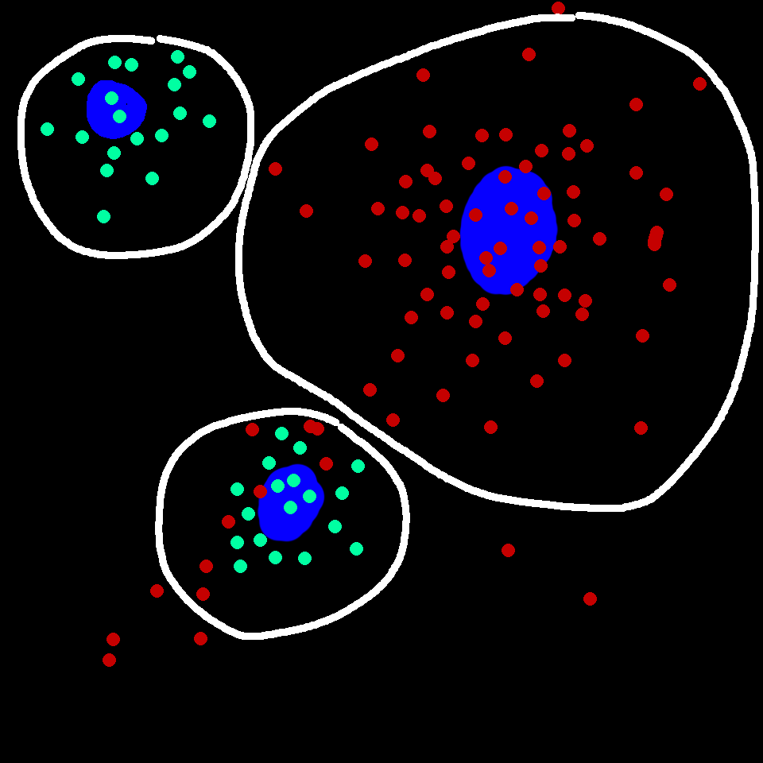
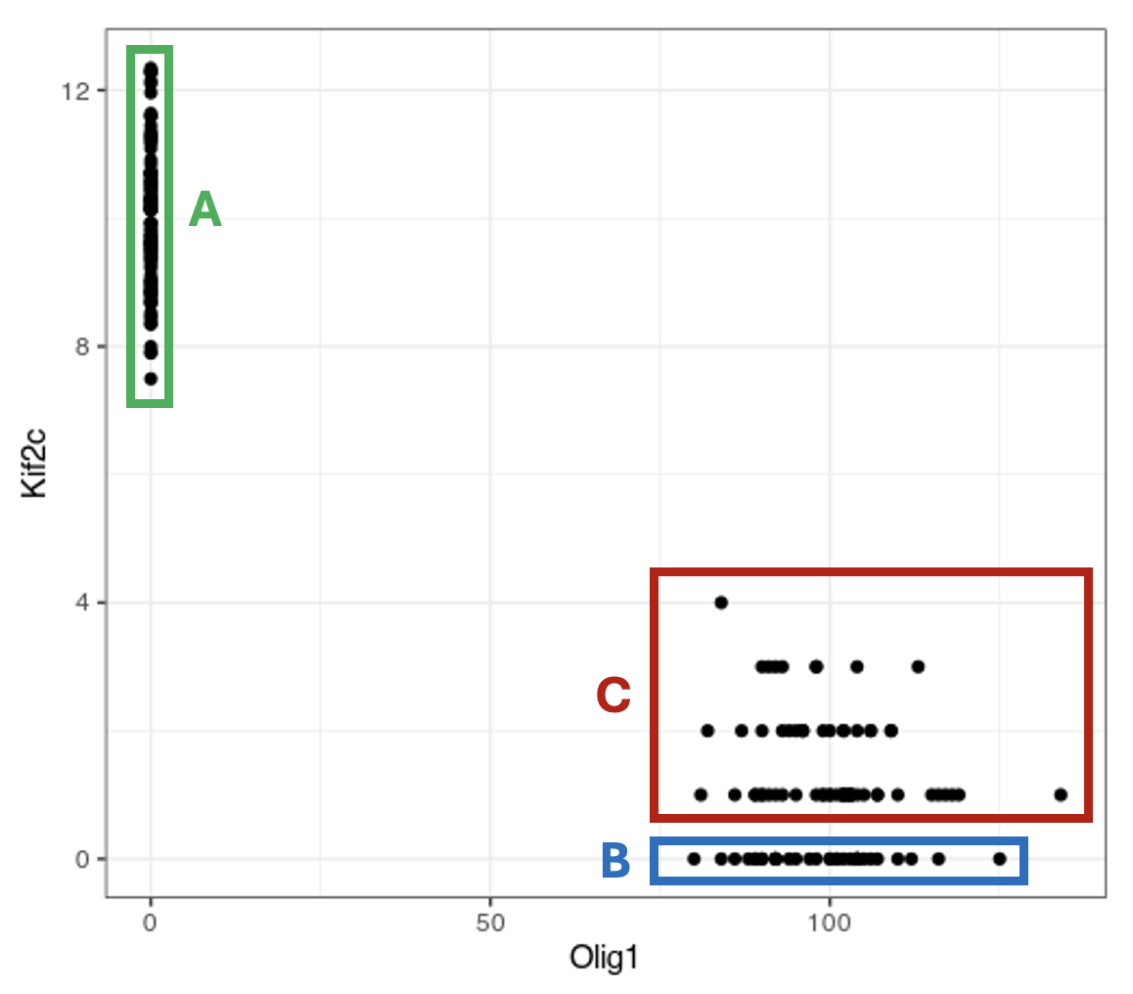
Multiplexed smFISH

Slide 6

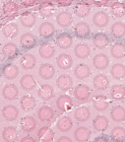
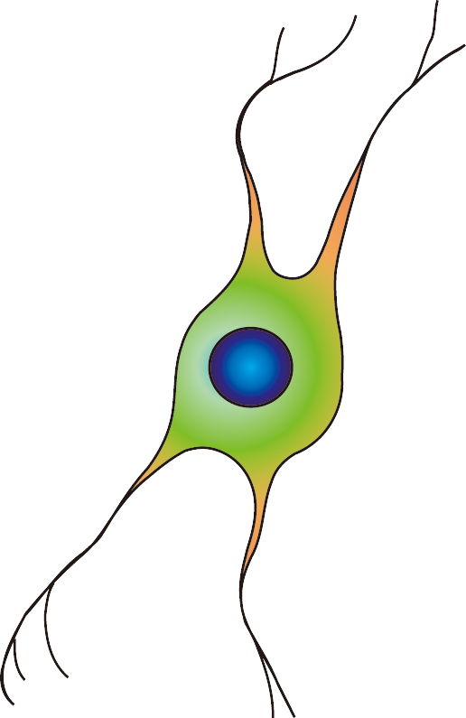
Spot-based capture + sequencing

Slide 7
Remotivating Dimensionality Reduction
Gene B
Gene A

Slide 8
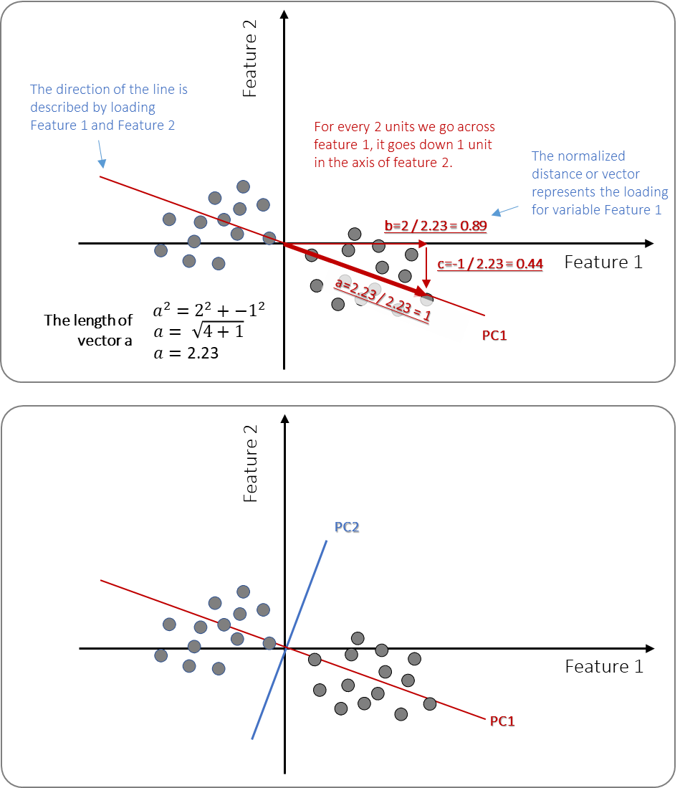
PCA review

Slide 9
PCA review

Slide 10
PCA review

Slide 11
PCA review

Slide 12
PCA review
Practice
The loading value of geneA on PC1 is 1
What is the loading value of all other genes on PC1?

Slide 13
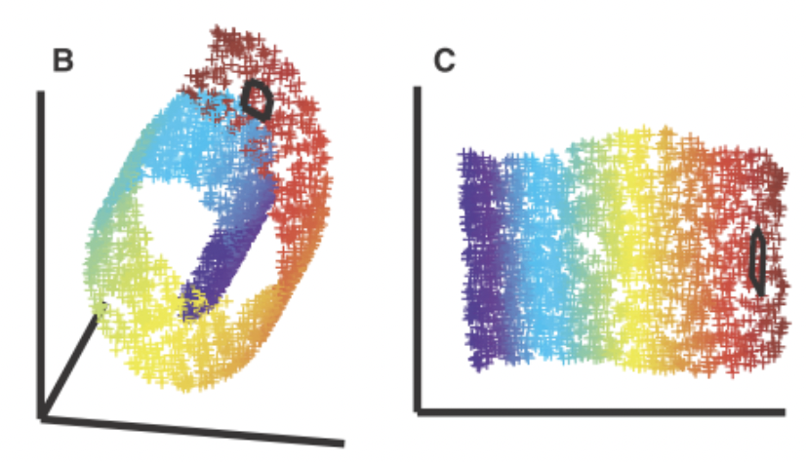
Motivating non-linear dimensionality reduction → linear dimensionality reduction insufficient
3D
Nonlinear 2D

Slide 14
T-distributed Stochastic Neighbor Embedding

Slide 15
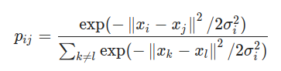
Step 1: compute scaled similarity P in high-dimensional space
Gene B
Gene A

Slide 16

Step 2: place cells into low dimensional space and compute another scaled similarity metric Q
tSNE-1

Slide 17

Step 3: P is fixed. Iteratively find a Q to minimize the KL divergence between P and Q

Slide 18
Given P, which Q has a smaller KL divergence?
Practice
P
Q₁
Gene B
tSNE-1
Q₂
tSNE-1
Gene A

Slide 19
Given P, which Q has a smaller KL divergence?
Practice
P
Q₁
Gene B
tSNE-1
Q₂
tSNE-1
Gene A

Slide 20
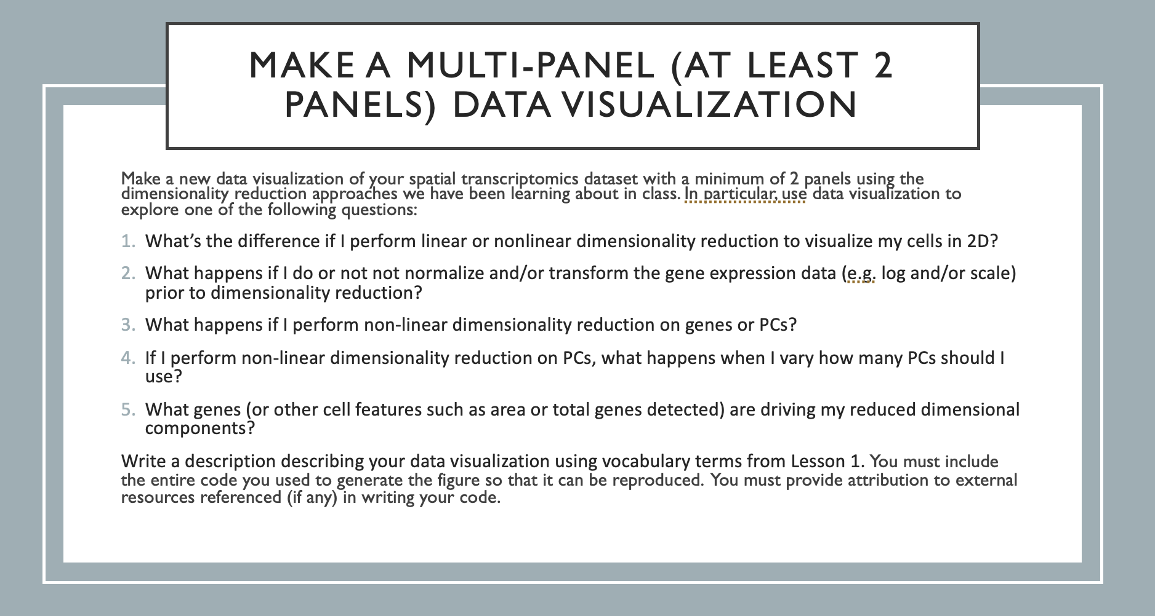
Homework 3 – due Monday midnight

Slide 21
Reflection card
https://bit.ly/GDV24_rc

