Slide 1
EN.580.428 Genomic Data Visualization Lesson 0 Welcome and Introductions
Prof. Jean Fan

Slide 2
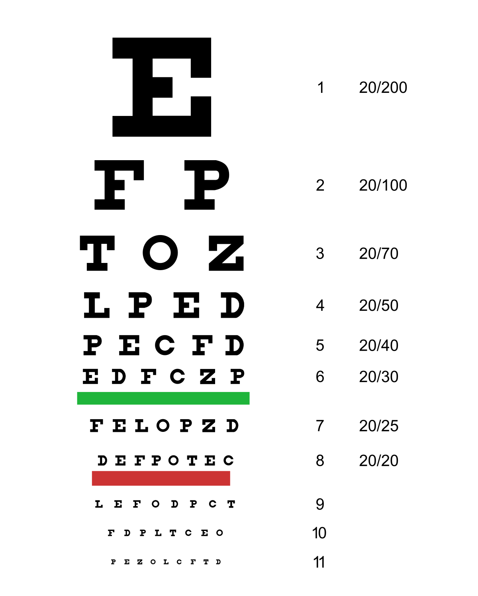
Announcements
Recording
Eyesight check
Ground rules

Slide 3
Lesson learning objectives
Introduce ourselves
Set expectations
Make sure you know how to submit your HW

Slide 4
Course website
https://jef.works/genomic-data-visualization-2024

Slide 5
Pre-survey
https://bit.ly/GDV24_presurvey

Slide 6
Reflection card
https://bit.ly/GDV24_rc

