Slide 1
EN.580.428 Genomic Data Visualization Lesson 7 Differential Expression
Prof. Jean Fan

Slide 2
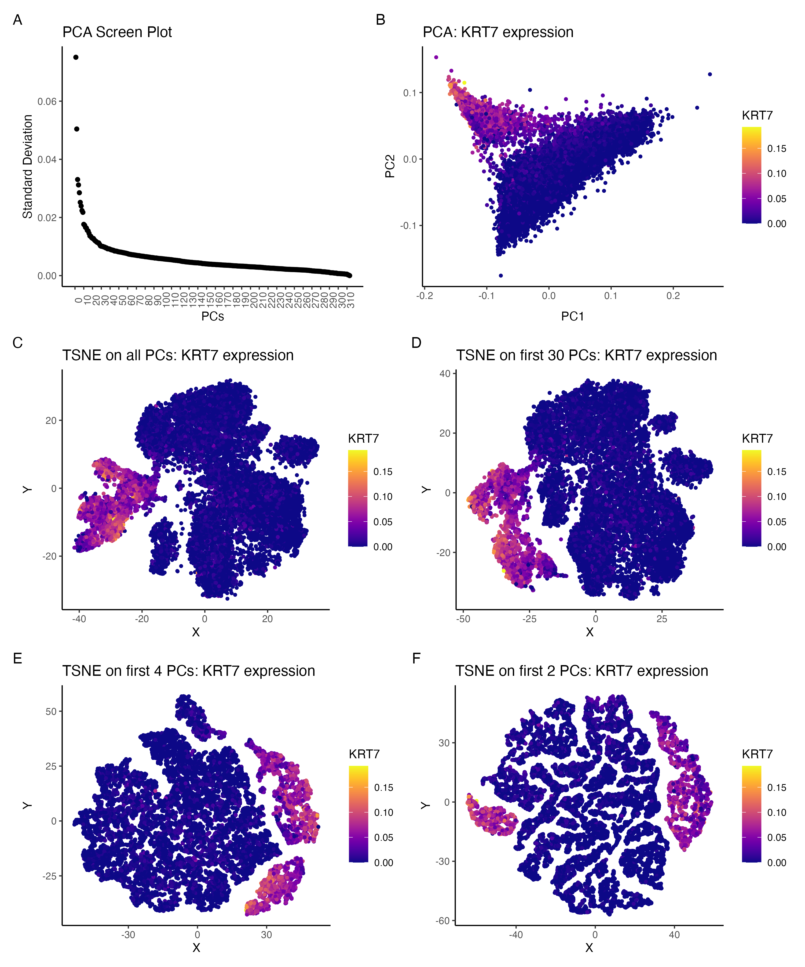
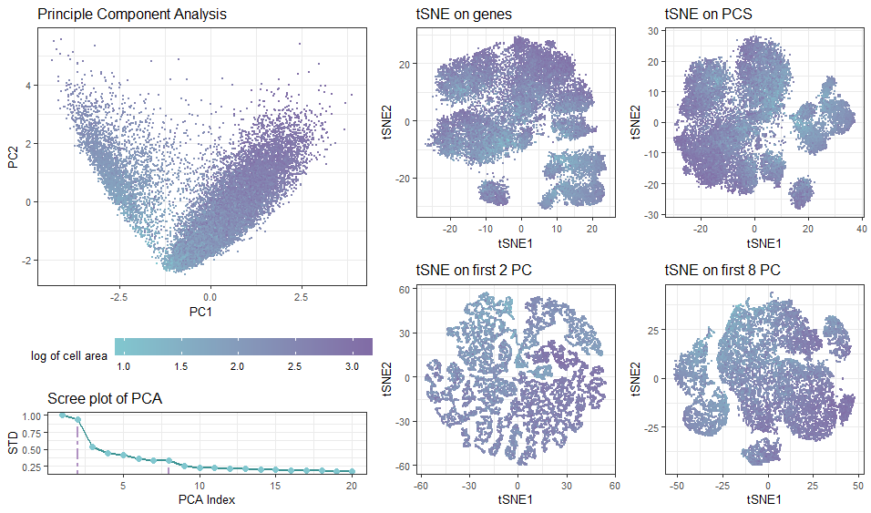
Linear vs non-linear dimensionality reduction

Slide 3
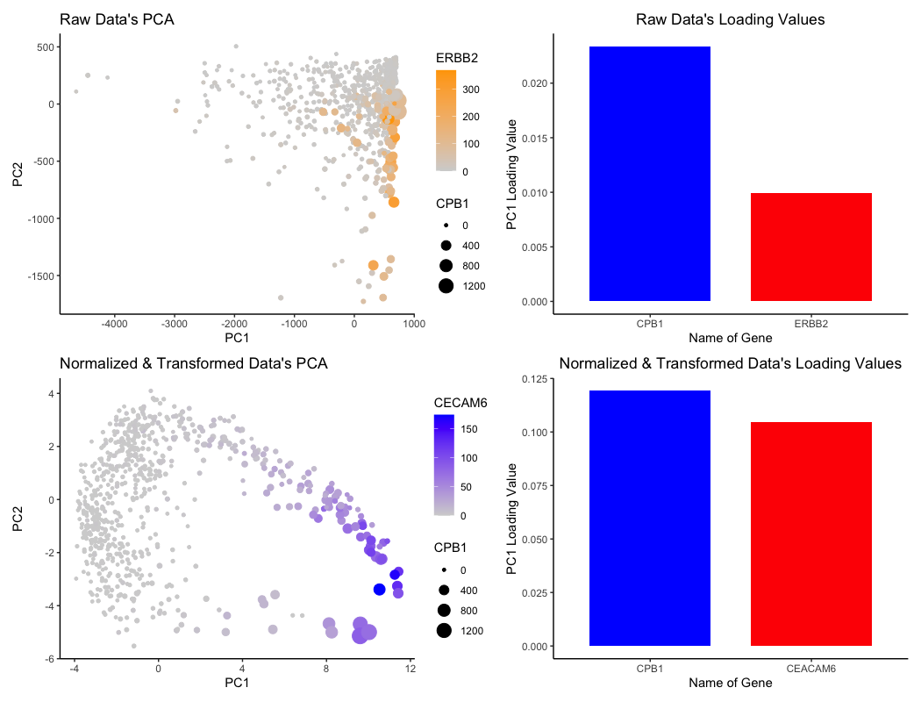
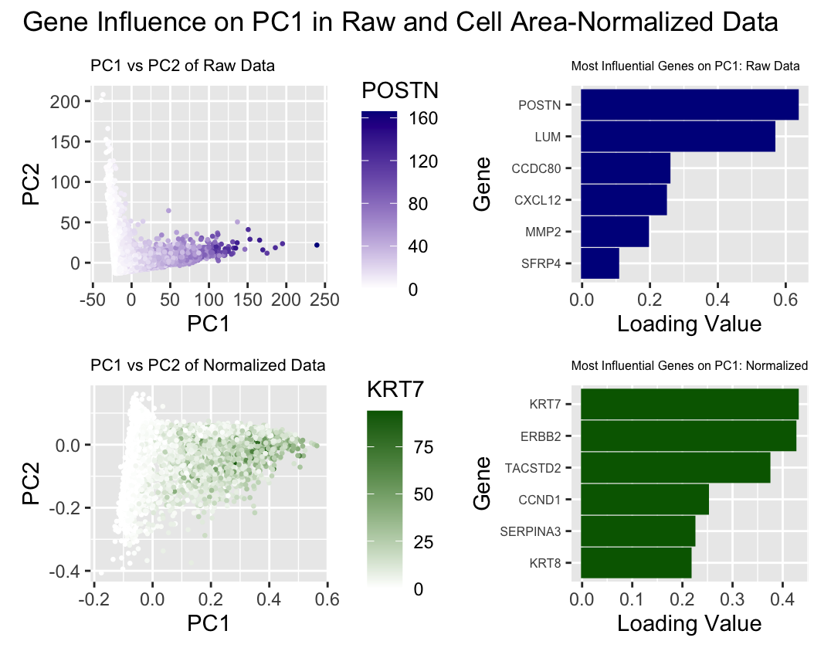
Loading values with normalized vs. non-normalized data

Slide 4
Few notes
Position along PC1, PC2, tSNE1, tSNE2 are quantitative but not spatial (not a physical interpretation)

Slide 5
Quiz 2 Friday
Move to take home
~1.5 hours
Coding element may take some students longer
Will be due Saturday at noon
If you have a preapproved accommodation, due date will be Sunday at noon
Will cover everything up to k-means (not including today’s material)
If there is certain material you want to make sure we cover in the review, please let me know in your reflection cards

Slide 6
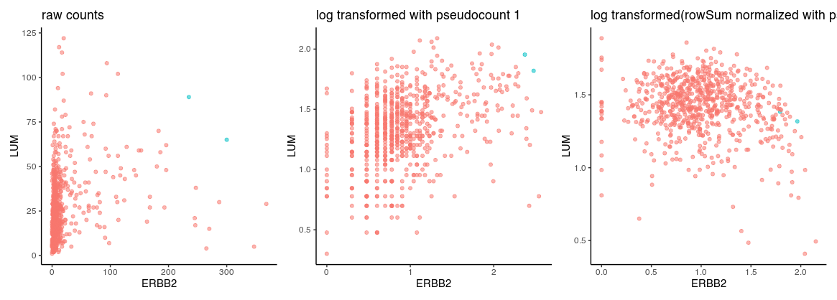
Normalized versus non-normalized data
library(ggplot2)
data <- read.csv('~/Desktop/genomic-data-visualization-2024/data/eevee.csv.gz', row.names=1)
dim(data)
data[1:5,1:5]
pos <- data[,2:3]
gexp <- data[, 4:ncol(data)]
rownames(pos) <- rownames(gexp) <- data$barcode
ct <- as.factor(gexp[,'ERBB2'] > 200 & gexp[,'LUM']>50)
table(ct)
df <- data.frame(ERBB2=gexp[,'ERBB2'], LUM=gexp[,'LUM'], celltype=ct)
p1 <- ggplot(df) + geom_point(aes(x=ERBB2, y=LUM, col=celltype, alpha=0.5), show.legend = FALSE) +
theme_classic() + ggtitle('raw counts')
gexpnorm <- log10(gexp+1)
df <- data.frame(ERBB2=gexpnorm[,'ERBB2'], LUM=gexpnorm[,'LUM'], celltype=ct)
p2 <- ggplot(df) + geom_point(aes(x=ERBB2, y=LUM, col=celltype, alpha=0.5), show.legend = FALSE) +
theme_classic() + ggtitle('log transformed with pseudocount 1')
gexpnorm2 <- log10(gexp/rowSums(gexp)*mean(rowSums(gexp))+1)
df <- data.frame(ERBB2=gexpnorm2[,'ERBB2'], LUM=gexpnorm2[,'LUM'], celltype=ct)
p3 <- ggplot(df) + geom_point(aes(x=ERBB2, y=LUM, col=celltype, alpha=0.5), show.legend = FALSE) +
theme_classic() + ggtitle('log transformed(rowSum normalized with pseudocount 1)')
p1+p2+p3

Slide 7
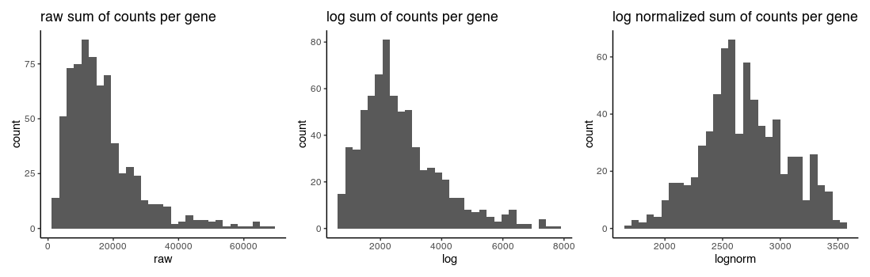
Normalized versus non-normalized data
df <- data.frame(raw = rowSums(gexp),
log = rowSums(gexpnorm),
lognorm = rowSums(gexpnorm2))
p1 <- ggplot(df, aes(x=raw)) + geom_histogram() + theme_classic() + ggtitle('raw sum of counts per gene')
p2 <- ggplot(df, aes(x=log)) + geom_histogram() + theme_classic() + ggtitle('log sum of counts per gene')
p3 <- ggplot(df, aes(x=lognorm)) + geom_histogram() + theme_classic() + ggtitle('log normalized sum of counts per gene')
p1+p2+p3

Slide 8
Learning objectives
Learn about and apply statistical approaches to identify differentially expressed genes

Slide 9
Definitions
Gene B
Differentially expressed genes
Differentially upregulated genes
Gene A

Slide 10
Motivation
Why identify differentially expressed genes?
Notes:
Differentially expressed genes
Differentially upregulated genes

Slide 11
T-test: testing a difference of means

Slide 12
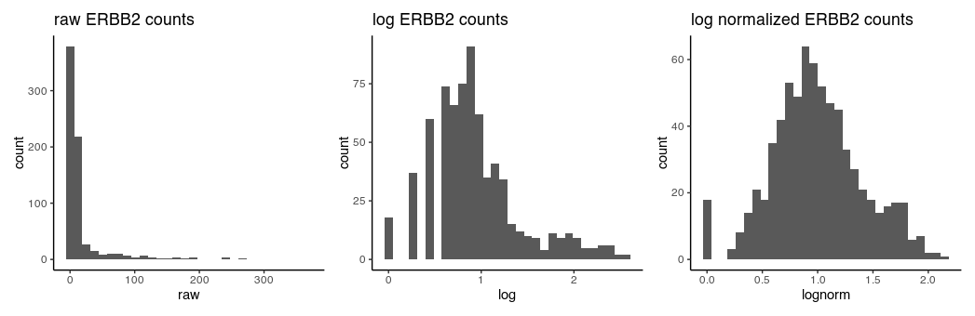
T-test assumptions and data visualization
that the data are quantitative and plausibly Gaussian
that the two samples come from distributions that may differ in their mean value, but not in the standard deviation

Slide 13
Wilcoxon Rank Sum Test (Mann–Whitney U test ): testing a difference in ranks

Slide 14
Consider I want to check if gene X is differentially upregulated in cluster 1 in my data
Practice
Cluster 1
100
50
20
10
5
Other cells
0
1
2
3
4
6
What happens to my U-statistic if I run my rank-sum test on the raw counts versus the log-transformed counts?
What happens to my T-statistic if I run my rank-sum test on the raw counts versus the log-transformed counts?
c1 = c(100,50,20,10,5)
other = c(0,1,2,3,4,6)
wilcox.test(c1, other)
wilcox.test(log10(c1+1),log10(other+1))
t.test(c1, other)
t.test(log10(c1+1),log10(other+1))

Slide 15
Other statistical tests
Many other tests that incorporate different normalizations, error modeling, Bayesian approaches, etc
Goal is to improve our statistical power in detecting true positives and true negatives while minimizing false positives and false negatives
Often becomes a trade-off with speed and computational complexity

Slide 16
Discussion (no right answer)
In a spatial transcriptomics experiment, we perform k-means clustering to identify 10 cell clusters. For one cell cluster, there is only 1 gene significantly upregulated. Do you believe this cell cluster represents a distinct cell-type? Why or why not?

Slide 17
Discussion (no right answer)
In a spatial transcriptomics experiment, we perform k-means clustering to identify 10 cell clusters. For one cell cluster, there are are 100 genes significantly upregulated. But this cell cluster only has 2 cells. Do you believe this cell cluster represents a distinct cell-type? Why or why not?

Slide 18
Reflection card
https://bit.ly/GDV24_rc

Slide 19
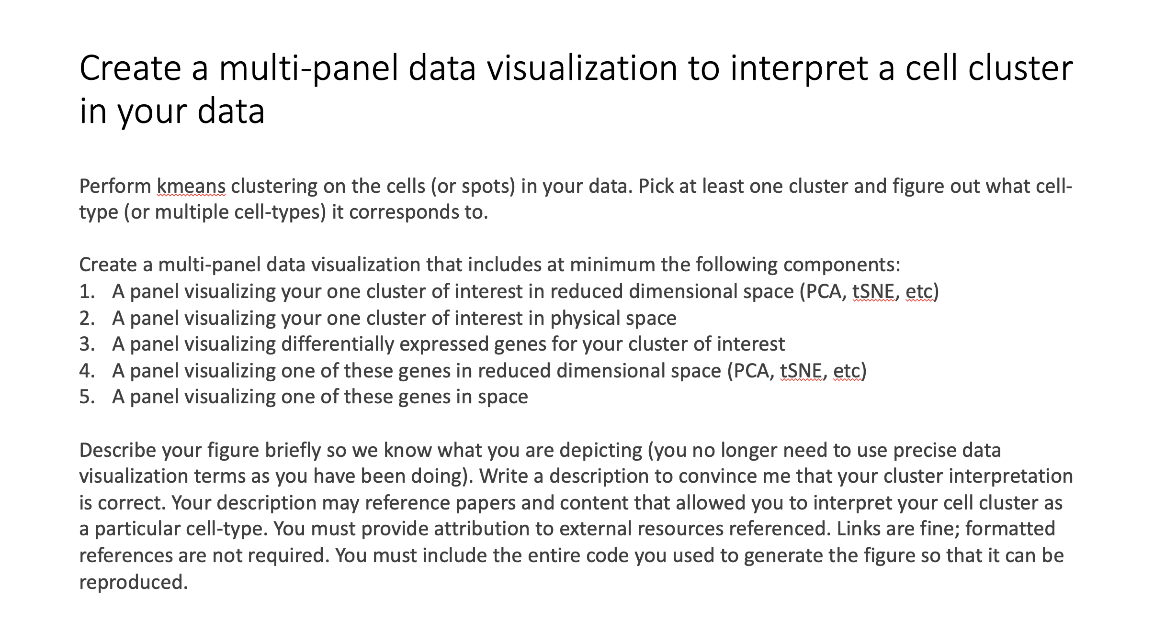
HW3 assigned (due next Wednesday)

