Slide 1


Understanding Deadlock
Deadlock occurs when two or more processes block each other indefinitely.
Each waits for a resource held by the other, causing system halt.
Common in databases and operating systems with concurrent resource access.
By: SEHER FATIMA

Slide 2
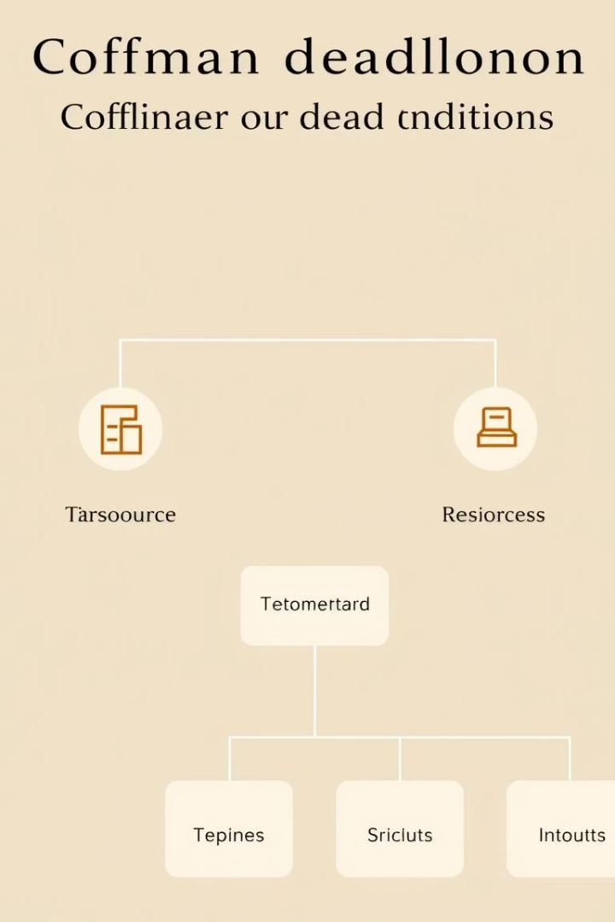
Conditions for Deadlock
Mutual Exclusion
Resources cannot be shared (e.g., printers).
Hold and Wait
Processes hold one resource while requesting others.
No Preemption
Resources can’t be forcibly taken from processes.
Circular Wait
Processes wait in a circular chain for resources.

Slide 3

Breaking Mutual Exclusion
Make resources sharable
Example
Allow multiple reads to the same file but restrict writes.
Convert exclusive resources to sharable when possible.
Limitation
Some resources must remain exclusive, like printers.

Slide 4
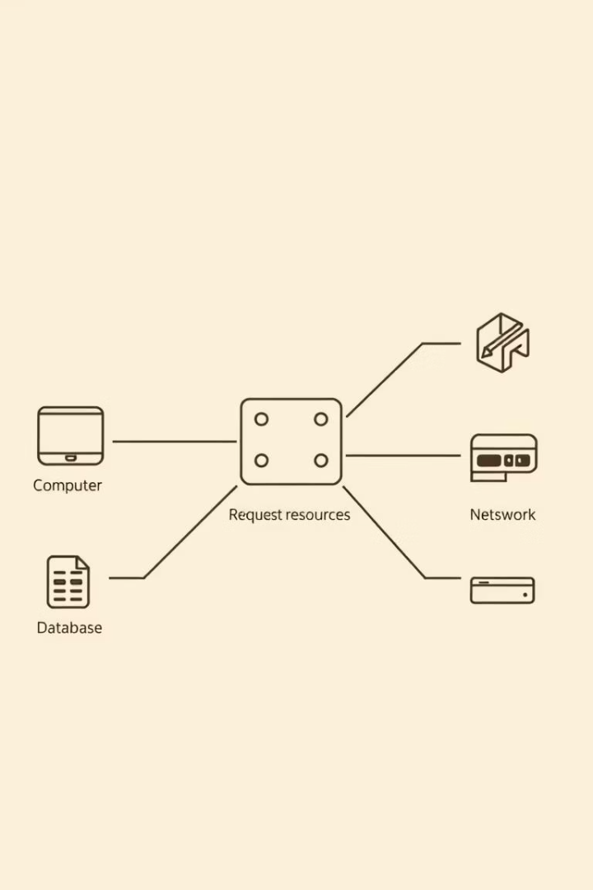



Breaking Hold and Wait
Request all resources upfront
This prevents holding some while waiting for others.
Release before requesting more
Processes free resources before acquiring new ones.
Challenges
Can lead to resource wastage and possible starvation.

Slide 5
Breaking No Preemption
Allow resource preemption
Example
Conditions
OS can forcibly take resources if safe to do so.
Memory or CPU can be reallocated; printers cannot.
Preemption applies where resource state can be saved and restored.

Slide 6
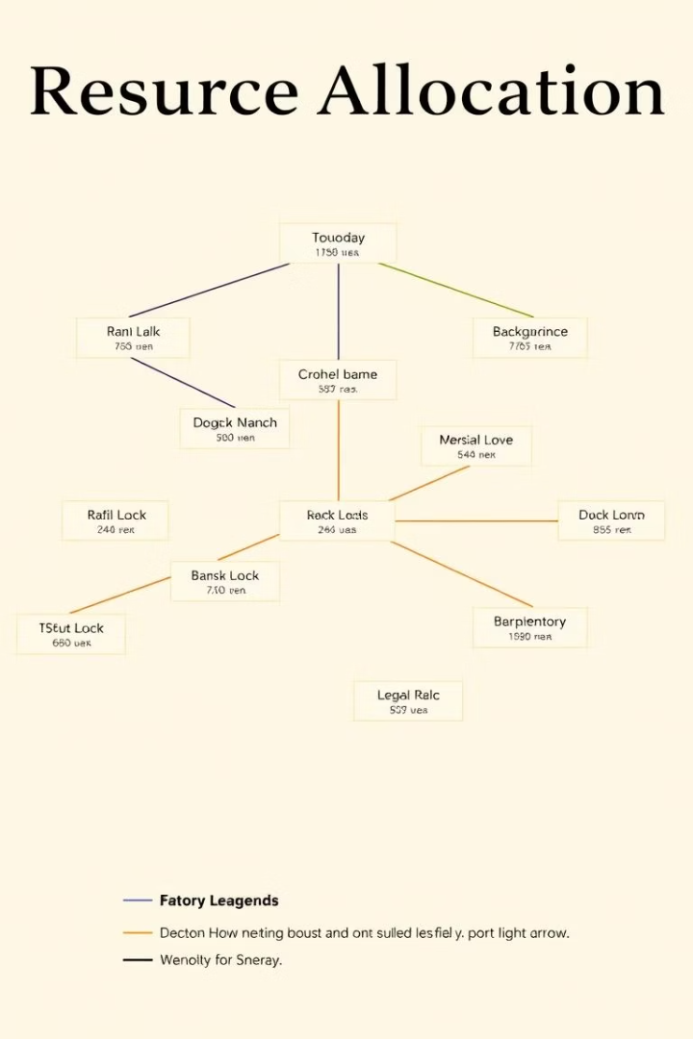
Breaking Circular Wait
1
Impose ordering on resources
Assign numbers to resource types and acquire in order.
2
Benefits
Prevents cyclic waiting and simplifies resource management.
3
Example
Processes must request Lock 1 before Lock 2 consistently.

Slide 7




Deadlock Detection and Recovery
Detection
Recovery
Cost
Algorithms identify cycles in resource allocation graphs.
Processes may be aborted or resources preempted to resolve.
Extra CPU time and possible disruption to running processes.

Slide 8
Summary: Averting Deadlock
Deadlock means processes stuck waiting forever.
Effective deadlock management requires balancing resource sharing, system performance, and complexity.
Break Coffman conditions to prevent deadlocks.
Detection finds cycles; recovery frees stuck resources.
Understanding these strategies improves robust system design.
No perfect solution; each method has trade-offs.

