Slide 1
ZAN
Zangar Kenes, Alizhan Kuanyshbekov,
Nurlan Mukhametzhan

Slide 2
Roles
Backend: Zangar Kenes
Frontend: Nurlan Mukhametzhan
Designer: Alizhan Kuanyshbekov

Slide 3
Brainstorming results
Book exchange
VR game
Work searches
Mortgage calculator
Weather forecast
GPA app
Assistant to pensioners
Speed reading training
Messenger
Charity app for the needy
Video hosting
Student assistant
Clothing store
City navigator
Apps Instructor for Senior Citizens

Slide 4
Our idea: News App
We have chosen the theme of the news application, which will collect all the news and events of the city. Here everyone can find an event that will be interesting to him. And tags will help them in this, with the help of which the application itself will find suitable news for a particular user. Also in this application, everyone can create or attend events to search for people of common interests, or just relax
We chose this idea because we ourselves need such an application and see the need for other people. everyone has their own hobbies, but not everyone has the time to find like-minded people and share their achievements with them or ask questions that interest you.
The main problem we may face is writing the code and making everything work in the best possible way. We also cannot decide on the design of the site, we would like it to look equally good for people of all ages. And since we're reviewing a news app, the challenge will be fighting fake news.

Slide 5
Market overview
We watched the news market. and came to the conclusion that there are few applications in this subject. and they are inconvenient in that all the news is in a chaotic order and inconvenient for the average layman.
Possible ways to monetize
The main method of monetization is paid subscriptions. they will allow you to create more events and attend them.

Slide 6
Prototype of the site
Prototype of the site has been done by wix.com because of it’s availability and easy-to-use constructor. Also, thanks to wix.com, we can properly see it’s future design and further implementations.
Here is the link for the prototype: https://alijankuanyshbekov.wixsite.com/my-site

Slide 7
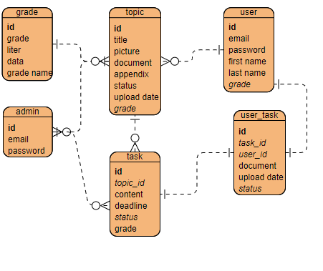
Data model
We are going to make our database by using phpmyadmin and here is it’s model for it.

