Slide 1
H1B VISA
The H1B visa is an employment-based, non-immigrant visa for temporary workers.
The H1B visa is issued for a specialty occupation, requires theoretical and practical application of a body of specialized knowledge and requires the visa holder to have at least a Bachelors degree or its equivalent
The United States Citizenship and Immigration Services sets a limit on how many H1B visas are issued each year.

Slide 2

Big Data

Slide 3
Big Data Definition
No single standard definition…
“Big Data” is data whose scale, diversity, and complexity require new architecture, techniques, algorithms, and analytics to manage it and extract value and hidden knowledge from it…

Slide 4
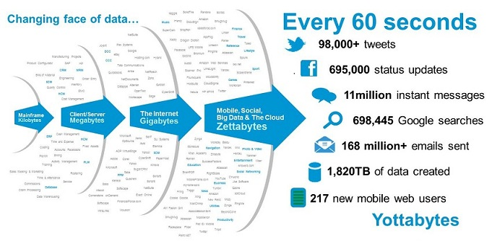

Slide 5
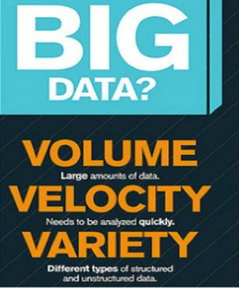
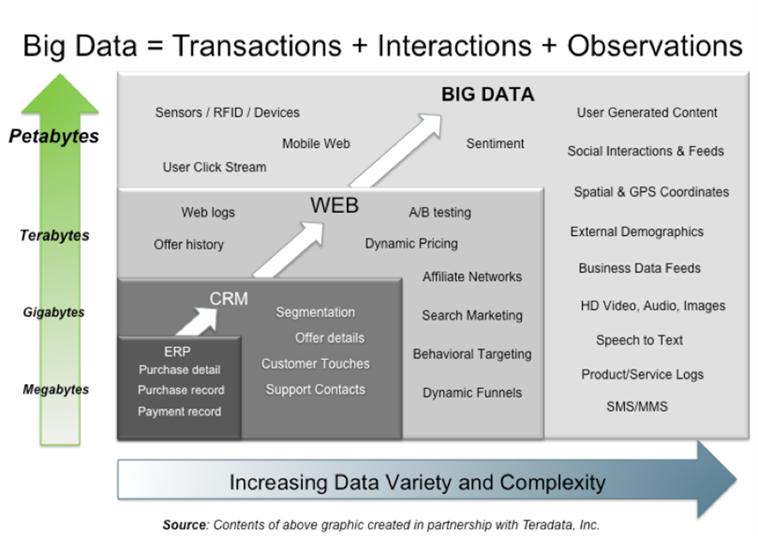
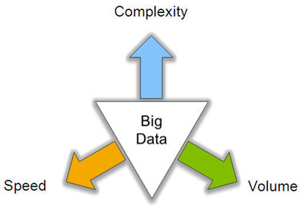
Big Data: 3V’s

Slide 6
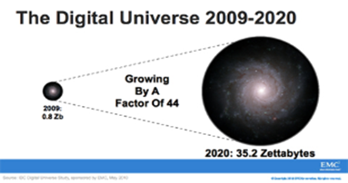

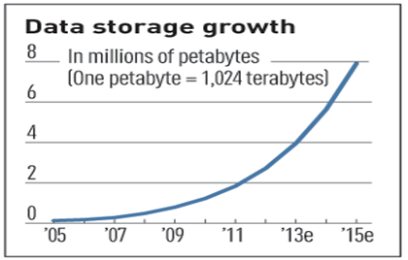
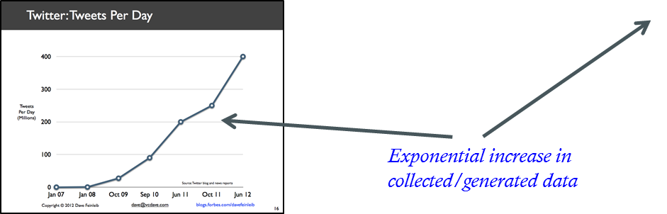
Characteristics of Big Data: 1-Scale (Volume)
Data Volume
44x increase from 2009 2020
From 0.8 zettabytes to 35zb
Data volume is increasing exponentially

Slide 7

Characteristics of Big Data: Speed (Velocity)
Data is begin generated fast and need to be processed fast
Online Data Analytics
Late decisions missing opportunities
Examples
E-Promotions: Based on your current location, your purchase history, what you like send promotions right now for store next to you
Healthcare monitoring: sensors monitoring your activities and body any abnormal measurements require immediate reaction

Slide 8
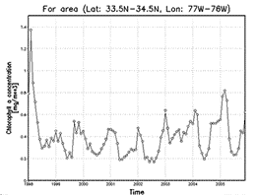
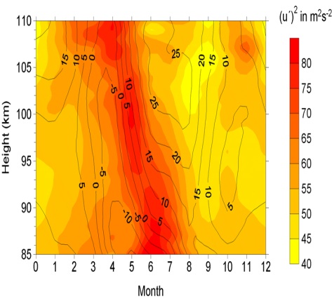



Characteristics of Big Data: Complexity (Varity)
Various formats, types, and structures
Text, numerical, images, audio, video, sequences, time series, social media data, multi-dim arrays, etc…
A single application can be generating/collecting many types of data
To extract knowledge➔ all these types of data need to linked together

Slide 9
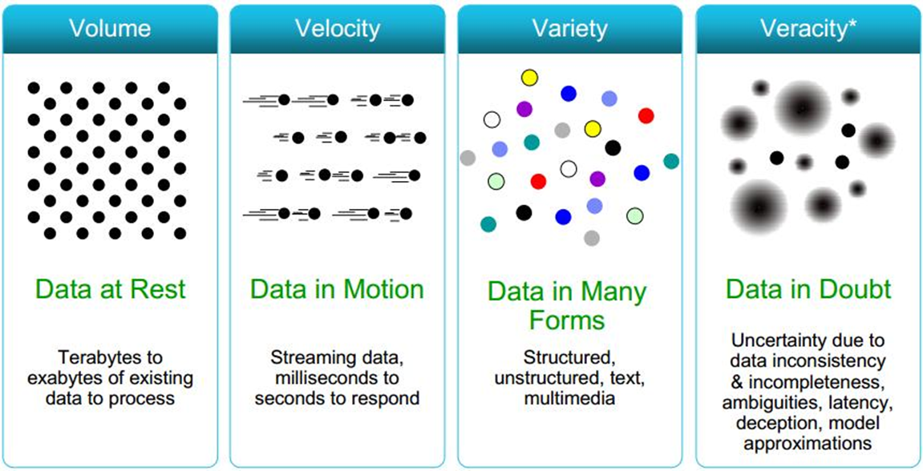
Some Make it 4V’s

Slide 10
HADOOP
It is an open-source framework developed in Java, dedicated to store and analyze the large sets of unstructured data.
Allows multiple concurrent tasks to run from single to thousands of servers without any delay.
Consists of a distributed file system that allows transferring data and files in split seconds between different nodes.
Able to process efficiently even if a node fails

Slide 11
MAPREDUCE
MapReduce is useful for batch processing on terabytes or petabytes of data stored in Apache Hadoop.
MapReduce is the original framework for writing applications that process large amounts of structured and unstructured data stored in the Hadoop Distributed File System (HDFS).
Apache Hadoop YARN opened Hadoop to other data processing engines that can now run alongside existing MapReduce jobs to process data in many different ways at the same time.

Slide 12
HIVE
Hive is a data warehouse infrastructure tool to process structured data in Hadoop. It resides on top of Hadoop to summarize Big Data, and makes querying and analyzing easy.
Hadoop was built to organize and store massive amounts of data of all shapes, sizes and formats.
Because of Hadoop’s “schema on read” architecture, a Hadoop cluster is a perfect reservoir of heterogeneous data—structured and unstructured—from a multitude of sources.
Data analysts use Hive to query, summarize, explore and analyze that data, then turn it into actionable business insight.

Slide 13
PIG
APACHE PIG is a platform for analyzing large data sets that consists of a high-level language for expressing data analysis programs, coupled with infrastructure for evaluating these programs.
The salient property of Pig programs is that their structure is amenable to substantial parallelization, which in turns enables them to handle very large data sets.
Pig's language layer currently consists of a textual language called Pig Latin.

Slide 14
SQOOP
Apache Sqoop efficiently transfers bulk data between Apache Hadoop and structured datastores such as relational databases.
Sqoop helps offload certain tasks (such as ETL processing) from the EDW to Hadoop for efficient execution at a much lower cost. Sqoop can also be used to extract data from Hadoop and export it into external structured datastores.
Sqoop works with relational databases such as Teradata, Netezza, Oracle, MySQL, Postgres, and HSQLDB.

Slide 15


Slide 16

Thank You
BY: ALI JAVAD BUKHARI S171167600070

