Slide 1
CF Matrix Multiplication
R
U
I
User Movie Ratings
K-factors
Items
u/m | m1 | m2 | m3 | m4 | ⋯
u1 | 4.5 |  |  | 3.3
u2
u3 |  |  | 2.9 | 4.9
u4 |  |  | 3.1 | 4.2
⋮
x
K-factors
≈
K x M
Users
U x M
U x K

Slide 2


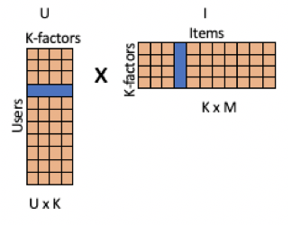

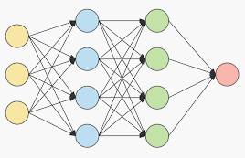
App Events
Ratings
Storage
Data
preparation
Matrix
Factorization
Model
Content Delivery
App Events
Ratings
Storage
Data
preparation
Collaborative
Filter
Predictive Model
Content Delivery
asfsdf

Slide 3
K1
s
e111, e112, e113, …
e121, e122, e123, …
…
e1K1, e1K2, e1K3 …
U
e2:[ e1i1, e1i2, … ]
X = (U, I, D, … )
^
K2
y
s
e211, e212, e213, …
e221, e222, e223, …
…
e2n1, e2n2, e2n3 …
e2:[ e2i1, e2i2, … ]
Output Layer
I
Sigmoid
KD
Hidden Layers
s
eK:[ ei1, ei2, ei3, … ]
RELU
D
eij
.
.
.
(Input Variables)
(Embeddings Layer)
(Fully connected layers)

Slide 4
Deep-Learning Collaborative Filter
s
e1:[ e1i1, e1i2, … ]
U
X = (U, I, D, … )
s
e2:[ e2i1, e2i2, … ]
^
I
y
Sigmoid
s
eJ:[ ei1, ei2, ei3, … ]
D
.
.
.
RELU
Hidden Layers
RELU
Embeddings
Input Layer
Fully connected
layers
Output
Layer

