Slide 1

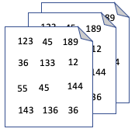
ML Sentiment Classification
Sentiment
Tokenize
& Vectorize
Classification
Document(s)
Pre-process
POS -or- NEG
text
numeric
Step 1 Load & Pre-process
Step 2 Tokenize & Vectorize
Step 3 Sentiment Classification

Slide 2
DL Sentiment Classification with LM
Pre-process
Tokenize
& Vectorize
+
Document(s)
Classification
-
Embedding
RNN, LSTM
Classifier
Language Model

Slide 3
123
45
189
123
45
189
123
45
36
133
12
36
189
12
133
36
133
12
144
55
45
144
55
45
144
55
45
143
136
36
143
136
36
143
136
36

