Slide 1

AI for Link Adaptation and Energy Prediction in Realistic 5G Networks
Alka Valiparambil Narendran
Supervisor : Evgeny Osipov
Collaboration : Effnet AB

Slide 2
Table of contents
01
04
02
05
03
06
Introduction
Analysis
Problem statement
Research Objectives
Link Adaptation
Future work
Literature Review
Methodology
Results
Energy Prediction
Conclusion
Literature Review
Methodology
Results

Slide 3
01
Introduction

Slide 4
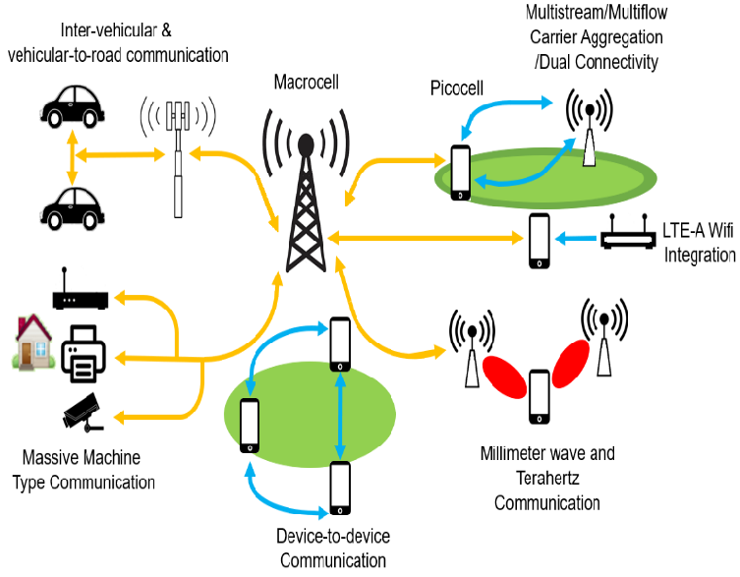
Introduction
5G is complex—dense networks, low latency, high energy demands.
Challenges
Complex scenarios that are hard to model
Gathering even simple data is difficult
Legacy networks not designed for AI, need to rethink/rebuild

Slide 5
Problem Statement
Despite the potential of Artificial Intelligence, its application to critical 5G operational components—specifically, predictive link adaptation (MCS selection) under realistic conditions and granular energy consumption forecasting—remains underdeveloped. This research addresses this gap by developing and evaluating AI models for each of these distinct tasks, aiming to demonstrate their individual efficacy and pave the way for more intelligent network management.

Slide 6
Research Objectives
Data Extraction & Modelling
RO1: Identify and extract relevant KPIs from 5G-LENA simulations, including SNR, CQI, transmission power, and buffer size, to support AI-based MCS prediction.
RO2: Develop and evaluate an AI model to predict MCS values based on historical network states, targeting im proved robustness in the absence of frequent CSI updates.
RO3: Design a separate AI model to estimate energy consumption under varying transmission parameters using an external dataset.
Analysis & Validation
Practical Relevance

Slide 7
Research Objectives
Data Extraction & Modelling
Analysis & Validation
RO4: Analyze and compare energy efficiency patterns derived from the energy model, highlighting trade-offs with performance.
RO5: Integrate findings to formulate practical recommendations for optimizing 5G link adaptation strategies with sustainability considerations.
Practical Relevance

Slide 8
Research Objectives
Data Extraction & Modelling
Analysis & Validation
Practical Relevance
RO6: Investigate the practical utility of AI-driven optimization techniques for 5G systems, demonstrated within the 5G-LENA simulation framework, and identify path ways for their integration or enhancement in alignment with the objectives of industry partner Effnet.

Slide 9



SDG

Slide 10
02
Link Adaptation

Slide 11
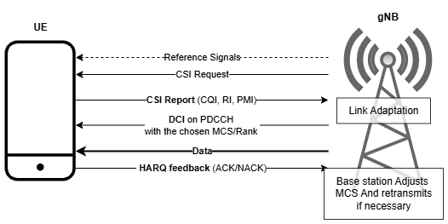
Link Adaptation
Adjusts modulation and coding scheme (MCS) based on channel quality
Aims to maximize throughput while keeping error rate acceptable
Decision made at the gNB, based on UE feedback (SINR, CQI, HARQ)

Slide 12
Traditional Approaches
AMC (Adaptive Modulation and Coding)
Inner Loop Link Adaptation (ILLA)
Outer Loop Link Adaptation (OLLA)
Hybrid Automatic Repeat Request (HARQ) with AMC
Uses instantaneous SINR or CQI feedback from the receiver to select the best Modulation and Coding Scheme (MCS) based on a predefined lookup table
Adjusts an SINR offset dynamically using ACK/NACK feedback to ensure the target Block Error Rate (BLER) is met. Works on top of ILLA.
Retransmits failed packets with additional coding redundancy (incremental redundancy or chase combining) while also adapting MCS dynamically to improve reliability.

Slide 13



Link Adaptation- Traditional
Excessive Feedback Dependency
Lack of Predictive Insight
Reactive Adjustment

Slide 14
Al Optimisation for Link Adaptation
Direct vs Indirect MCS Prediction[1]
Direct: Models predict MCS from features like SINR, CQI [1][2]
Indirect: First predict channel metrics (e.g., SNR), then map to MCS
Temporal Models Perform Better[3]
Recurrent models (e.g., LSTM, GRU) outperform CNNs and MLPs in dynamic channels
These models capture short-term channel memory better, especially in mobile scenarios
[1] M. Elwekeil, S. Jiang, T. Wang and S. Zhang, "Deep Convolutional Neural Networks for Link Adaptations in MIMO-OFDM Wireless Systems," in IEEE Wireless Communications Letters, vol. 8, no. 3, pp. 665-668, June 2019, doi: 10.1109/LWC.2018.2881978.
[2] J.-E. Oh, A.-M. Jo, and E.-R. Jeong, ‘MCS Selection Based on Convolutional Neural Network in Mobile Communication Environments’, in 2023 Fourteenth International Conference on Ubiquitous and Future Networks (ICUFN), Jul. 2023, pp. 684–686. doi: 10.1109/ICUFN57995.2023.10201063.
[3]O. Stenhammar, G. Fodor, and C. Fischione, ‘A Comparison of Neural Networks for Wireless Channel Prediction’, IEEE Wireless Communications, vol. 31, no. 3, pp. 235–241, Jun. 2024, doi: 10.1109/MWC.006.2300140.

Slide 15
Al Optimisation for Link Adaptation
Simulation Data Dominates[1]
Due to lack of real-world datasets, most research uses simulators (NYUSIM, MATLAB, custom tools)
Realism varies widely: many simplify SINR traces or skip HARQ logic
Single-Direction Traffic
Most studies target downlink, since MCS is gNB-controlled
Uplink-focused works are rarer; datasets are harder to obtain
[1] M. Elwekeil, S. Jiang, T. Wang and S. Zhang, "Deep Convolutional Neural Networks for Link Adaptations in MIMO-OFDM Wireless Systems," in IEEE Wireless Communications Letters, vol. 8, no. 3, pp. 665-668, June 2019, doi: 10.1109/LWC.2018.2881978.
[2] J.-E. Oh, A.-M. Jo, and E.-R. Jeong, ‘MCS Selection Based on Convolutional Neural Network in Mobile Communication Environments’, in 2023 Fourteenth International Conference on Ubiquitous and Future Networks (ICUFN), Jul. 2023, pp. 684–686. doi: 10.1109/ICUFN57995.2023.10201063.
[3]O. Stenhammar, G. Fodor, and C. Fischione, ‘A Comparison of Neural Networks for Wireless Channel Prediction’, IEEE Wireless Communications, vol. 31, no. 3, pp. 235–241, Jun. 2024, doi: 10.1109/MWC.006.2300140.

Slide 16
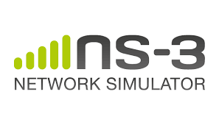

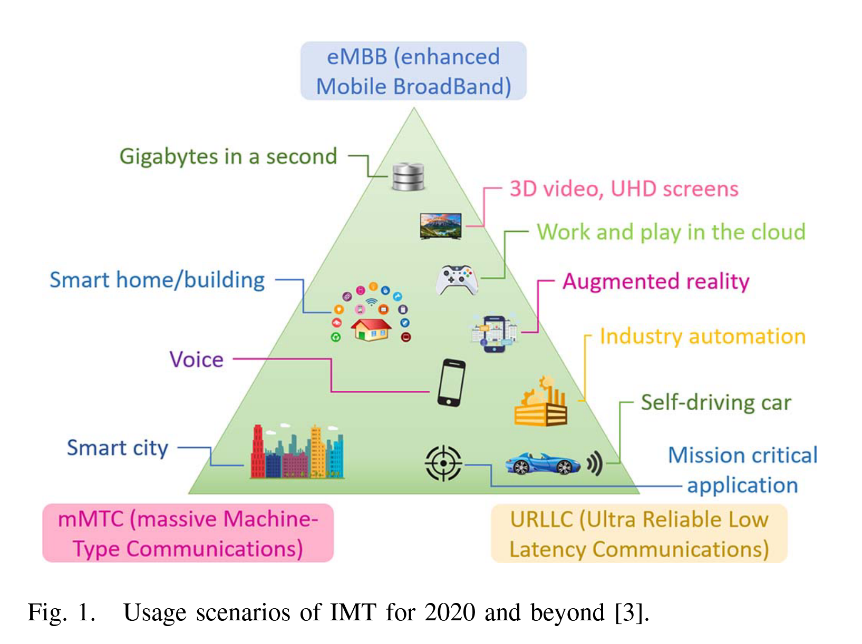
Simulation
1 gNB, 4 Ues
3GPP UMa Channel Model (NLOS)
Frequency: 30.5 GHz
Bandwidth: 100 MHz
Random Walk mobility
Gaming traffic over UDP
Logged: SINR, CQI, MCS, HARQ
10 seeds × 3 runs → ~21,000 samples

Slide 17
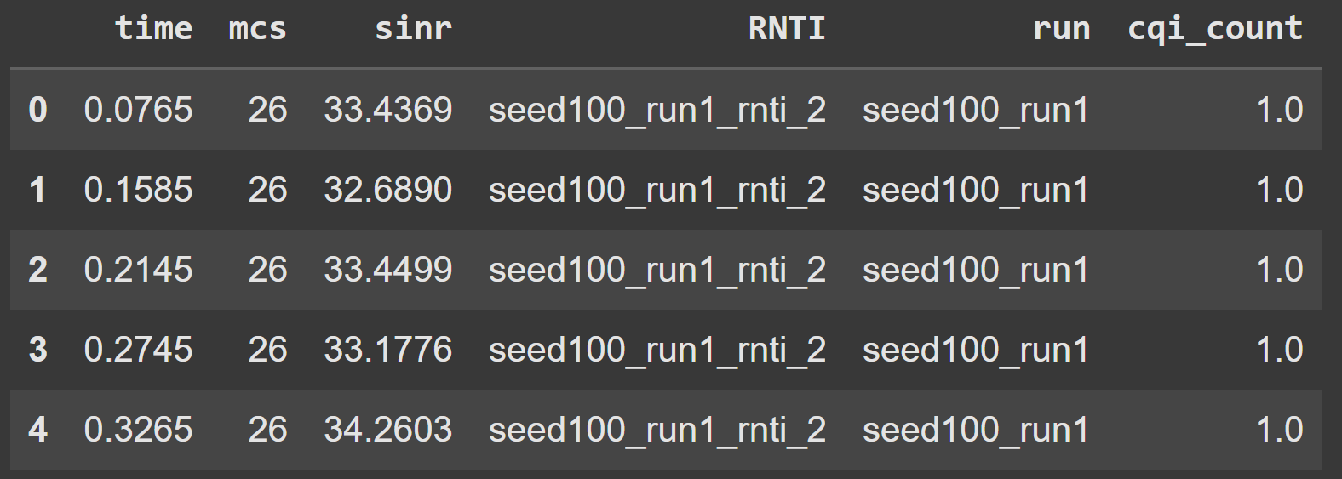
Data Preprocessing
Simulation Output
NrDlMacStats.txt (MCS assignments)
DlDataSinr.txt (downlink SINR events)
RxedGnbMacCtrlMsgsTrace.txt (CQI reports)
70% Training
30% Validation
Notes:
The main preprocessing step involved merging these files and aligning the event-triggered SINR and CQI data with the MCS assignments using timestamps as anchors."

Slide 18
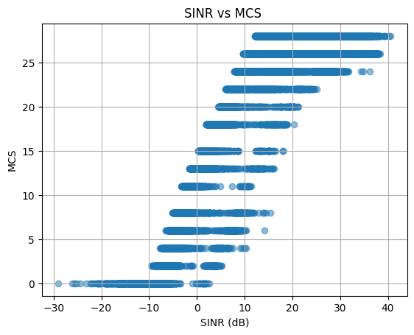
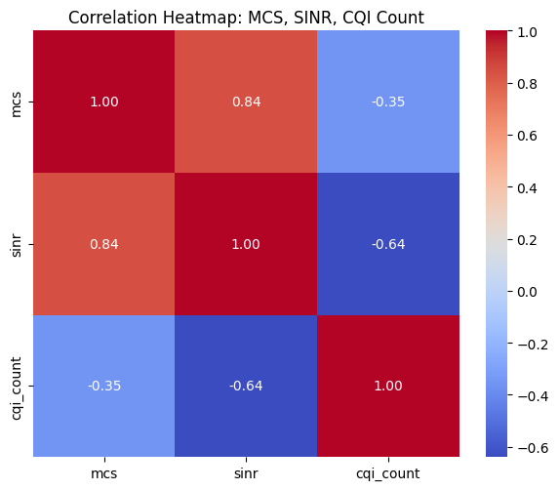
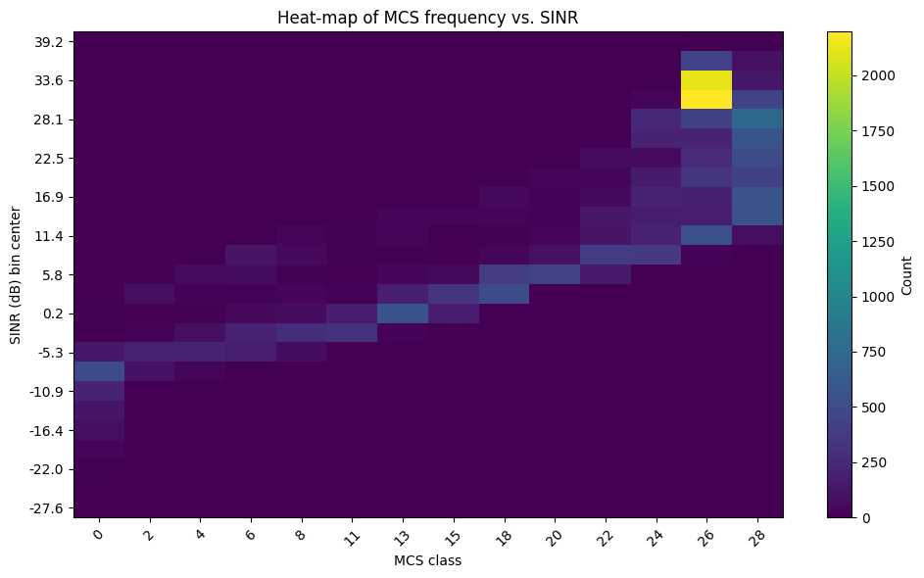

Slide 19
AI Modelling
Input
Output
Sequences of SINR (and CQI, in some versions), with T = 10
Next MCS
Models
CNN (baseline – sliding window of SINR)
CNN + CQI (adds feedback)
CNN + CQI + Masking (simulates missing feedback)
LSTM (captures longer temporal dependencies)
Training Details
Optimizer: Adagrad
Loss: Cross-Entropy
Epochs: 50.
Handled Class Imbalance: Weighted Random Sampler.
Hyperparameter Tuning: Basic sweep performed (12 configs for CNN, identified best params like 128 filters, 8D RNTI embedding, LR 0.005 leading to ~53.5% Acc).

Slide 20
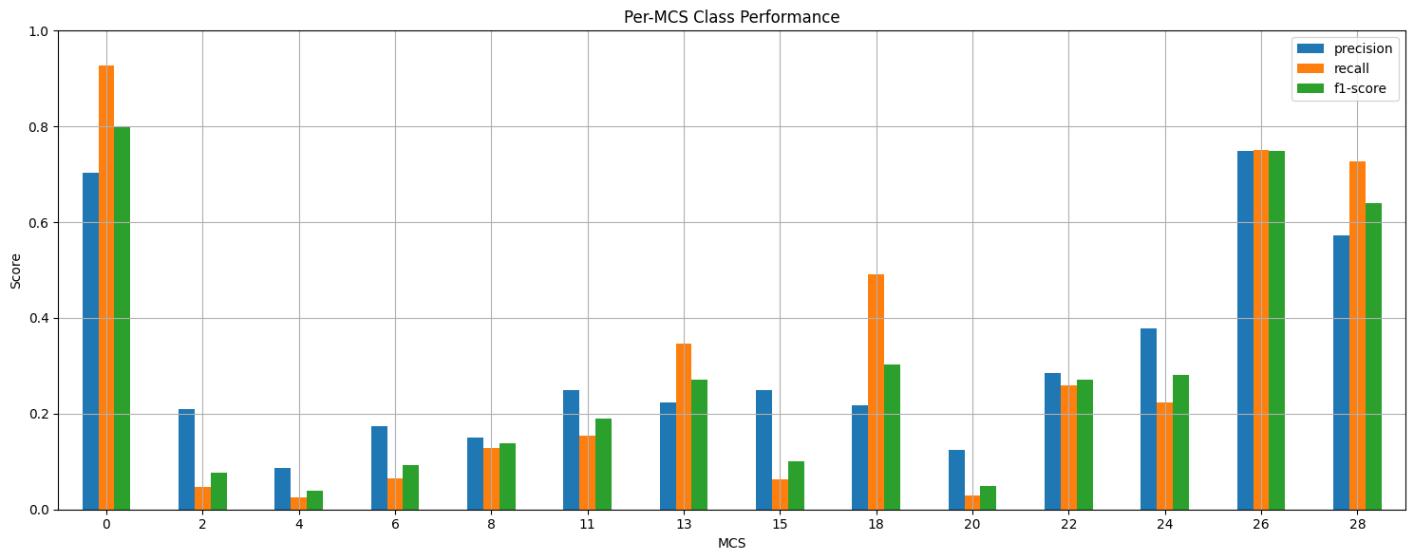
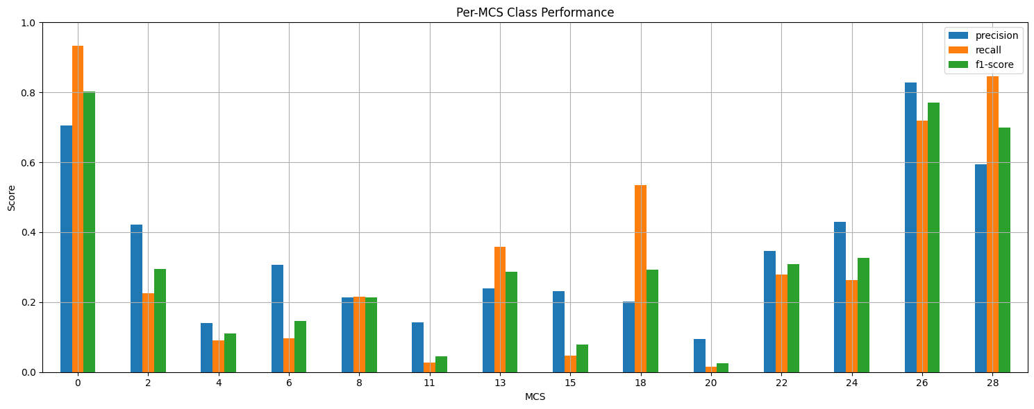
Result
Model | Input Features | Architecture | Accuracy
CNN | SINR only | Conv1D + Dense | 52.3%
CNN + CQI | SINR + CQI | Conv1D + Dense | 53.7%
CNN + Masking | SINR + CQI + mask | Conv1D + Dropout | 54.1%
LSTM | SINR + CQI | LSTM layers | 55.1%
CNN
LSTM

Slide 21
03
Energy Prediction

Slide 22



Literature Review
Energy Optimization are Often Reactive & Rule -Based
AI Models Are Rare – And Often Use Synthetic or Simplified Data
Underuse of Temporal and Contextual Features

Slide 23
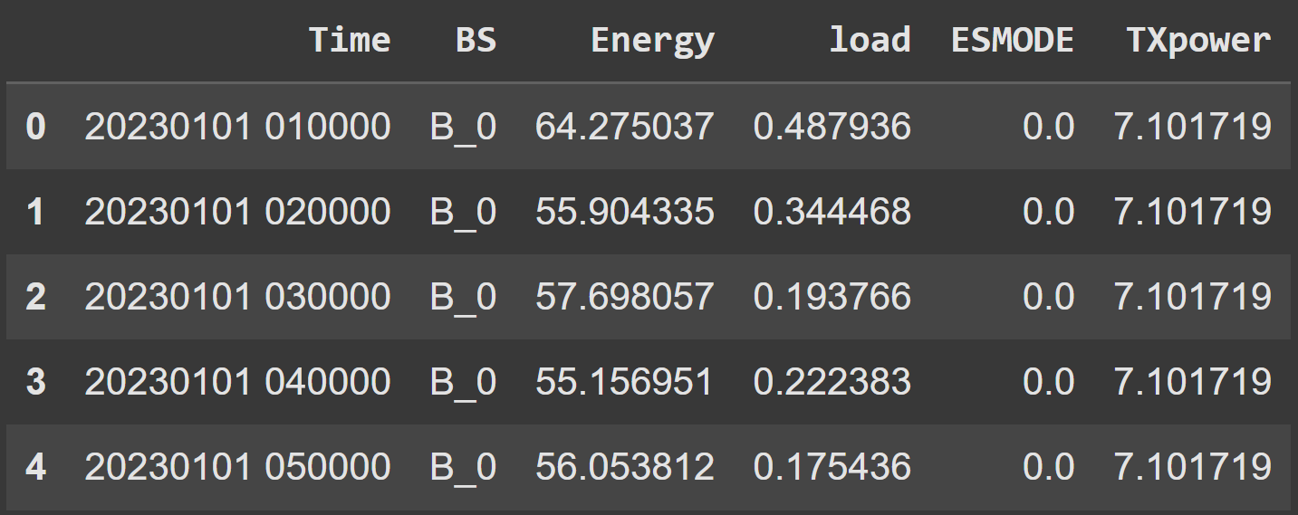
Dataset
Key Features
Energy (Watt-hours)
Load (traffic load)
TXpower (transmission power)
ESMODE (energy-saving mode)
BSID
Timestamp
Source: dataset that was provided by the international telecommunication union (ITU) in 2023 as part of a global challenge[1]
Size: 92,629 entries from 1,019 base stations
Granularity: Hourly logs
[1]‘5G-Energy consumption Dataset’. Accessed: May 20, 2025. [Online]. Available: https://www.kaggle.com/datasets/nadiatriki/5g-energy-consumption-dataset
Notes:
realistic operational data for modeling. This is a real-world dataset capturing hourly energy consumption across over a thousand base stations. It gave me access to operational metrics like transmission power and load, but lacked configuration details like antenna count or frequency. Still, it was rich enough to model coarse-grained energy behavior and test contextual AI models.

Slide 24
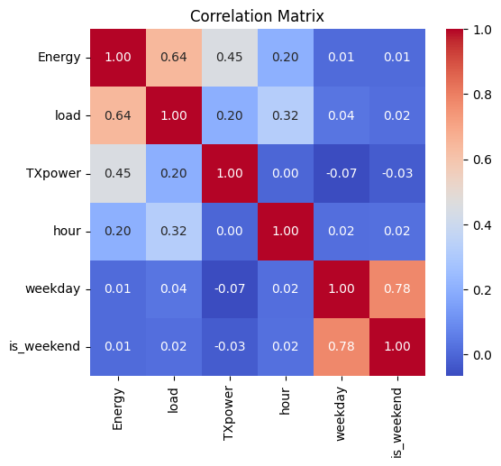
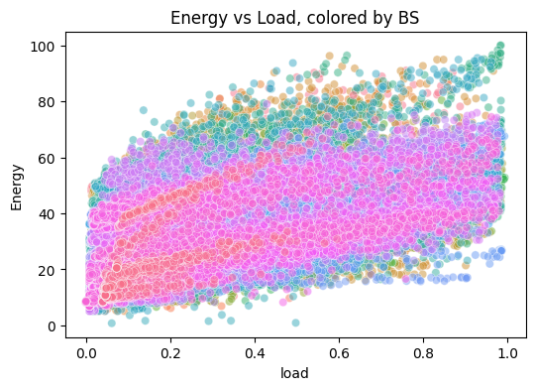

Slide 25
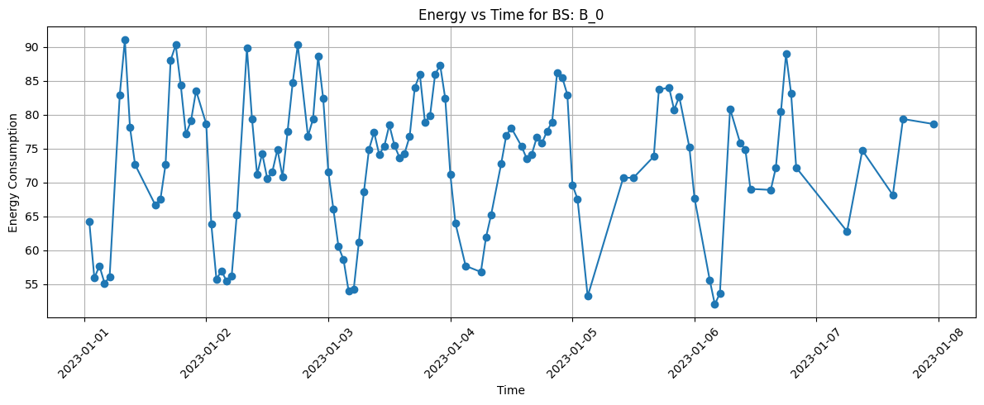

Slide 26
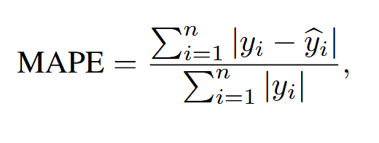
AI Modelling
Input
Load, TXpower, ESMODE
Time-based features (hour, weekday/weekend)
Encoded Base Station IDs (one-hot or learned embeddings)
Target
Hourly energy consumption of base stations
Loss
Function
Mean Absolute Percentage Error (MAPE)

Slide 27
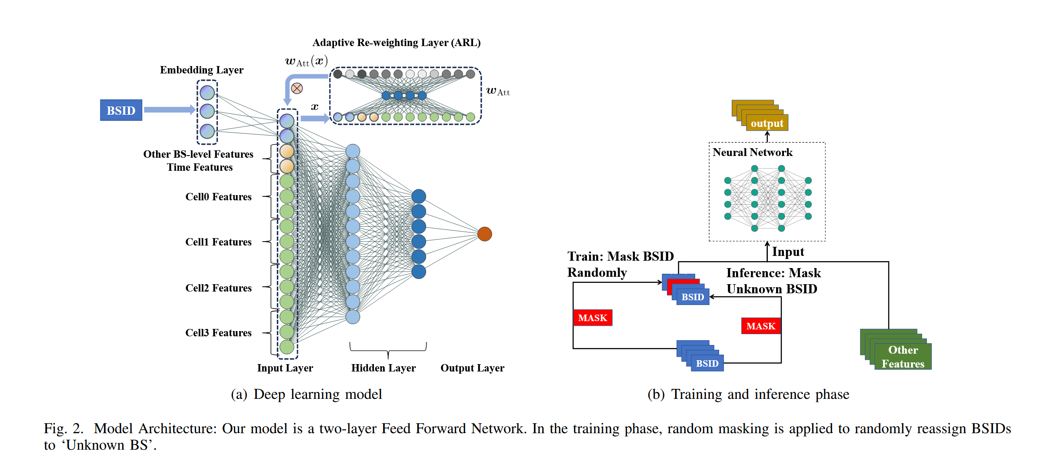
AI Modelling
Models
Linear Regression
3-layer Neural Network
Masked Neural Network
Chen, Tingwei, et al. "Modelling the 5G Energy Consumption using Real-world Data: Energy Fingerprint is All You Need." arXiv preprint arXiv:2406.16929 (2024).

Slide 28
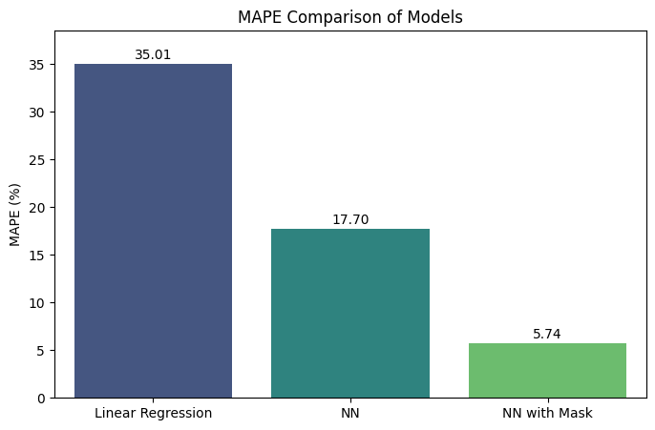
Result

Slide 29
04
Analysis

Slide 30
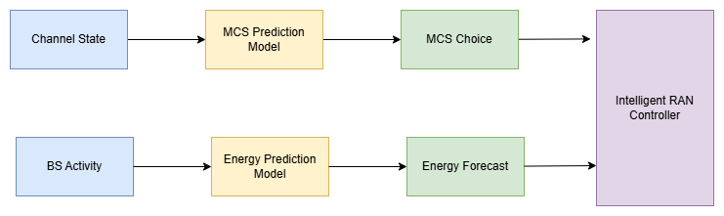
Analysis
Link Adaptation: AI (LSTMs/tuned CNNs) show promise (~55% acc.) in learning temporal channel dynamics for MCS prediction, outperforming simpler methods.
Energy Prediction: Advanced AI (Masked NN) achieved high accuracy (5.5% MAPE) in forecasting real-world BS energy use.
Though not yet integrated, these findings lay a foundation for dual-objective (Performance & Sustainability) optimization.

Slide 31
Analysis
Realistic and useful 5g Dataset is difficult to acquire
Link Adaptation :
Temporal models are crucial
Data imbalance is a real-world challenge.
Energy Modelling:
AI models can learn from structure in data, but results depend heavily on data realism and balance.

Slide 32
05
FutureWork

Slide 33
Future Work
Explore temporal architectures like GRU, MiniROCKET, and Hyperdimensional Computing (HDC) to improve MCS prediction under volatile channel conditions
Simulate denser, more diverse network scenarios to address MCS class imbalance and improve generalizability
Use richer energy datasets with detailed BS configurations (e.g., antenna count, RU type, deployment mode)
Integrate link adaptation with energy modeling, enabling joint optimization of throughput and consumption

Slide 34
06
Conclusion

Slide 35

To Conclude
Have successfully developed and evaluated AI models for both MCS prediction (simulation-based) and energy estimation (real-world data)
Addressed key challenges in preprocessing, temporal modeling, and dataset realism
All research objectives were successfully met
This thesis demonstrates the potential of AI to support smarter, greener 5G networks, even when working with real-world complexity
RO6
RO4
RO5
RO1
RO2
RO3

Slide 36
References
Abubakar, A.I., Omeke, K.G., Ozturk, M., Hussain, S., and Imran, M.A. (2020). The role of artifi cial intelligence driven 5g networks in covid-19 out break: Opportunities, challenges, and future outlook. Frontiers in Communications and Networks, 1. doi: 10.3389/frcmn.2020.575065.
Balasubramanian, B. et al. (2021). Ric: A ran intel ligent controller platform for ai-enabled cellular net works. IEEE Internet Computing, 25(2), 7–17. doi: 10.1109/MIC.2021.3062487.
Chen, T., Wang, Y., Chen, H., Zhao, Z., Li, X., Piovesan, N., Zhu, G., and Shi, Q. (2024). Modelling the 5g energy consumption using real-world data: Energy fingerprint is all you need. arXiv preprint arXiv:2406.16929. Elgabroun, H.M.A.I. (2019).
Machine Learning Technique for Uplink Link Adaptation in 5G NR RAN at Millime ter Wave Frequencies. Master’s thesis, Lund University. Http://lup.lub.lu.se/student-papers/record/9118249.
Gigayasa Wireless (2025). Link Adaptation — 5G Toolkit R24a Documentation. Accessed March 4, 2025. doi:
Herath, J.D., Seetharam, A., and Ramesh, A. (2019). A deep learning model for wireless channel qual ity prediction. In ICC 2019- IEEE Interna tional Conference on Communications, 1–6. IEEE, Shanghai, China. doi:10.1109/ICC.2019.8761934. Https://ieeexplore.ieee.org/document/8761934/.
Kojima, S., Maruta, K., and Ahn, C.J. (2019). Adaptive modulation and coding using neural net work based snr estimation. IEEE Access, 7, 183545–183553. doi:10.1109/ACCESS.2019.2946973. Https://ieeexplore.ieee.org/document/8865038/.
Lee, H., Jang, Y., Song, J., and Yeon, H. (2021). O ran ai/ml workflow implementation of personalized net work optimization via reinforcement learning. In 2021 IEEE Globecom Workshops (GC Wkshps), 1–6. doi: 10.1109/GCWkshps52748.2021.9681936.
Li, Y., Xu, Y., Li, G., Wang, X., Xu, Y., Liu, S., and Yue, L. (2024). Turning adversity into advantage: Robust mcs selection utilizing the uncertainty of channel prediction neural networks. IEEE Wireless Communications Letters, 13(10), 2632–2636. doi:10.1109/LWC.2024.3393939. Https://ieeexplore.ieee.org/abstract/document/10654736.
Nadia Triki (2025). 5g-energy consumption dataset. Https://www.kaggle.com/datasets/nadiatriki/5g energy-consumption-dataset (Accessed: May 20, 2025). Norolahi, J. and Azmi, P. (2023). A machine learning based algorithm for joint improvement of power control, link adaptation, and capacity in beyond 5g communica tion systems. Telecommunication Systems, 83(4), 323 337. doi:10.1007/s11235-023-01017-1.
Oh, J.E., Jo, A.M., and Jeong, E.R. (2023). Mcs selection based on convolutional neural network in mobile communication environments. In 2023 Fourteenth International Conference on Ubiquitous and Future Networks (ICUFN), 684 686. doi:10.1109/ICUFN57995.2023.10201063. Https://ieeexplore.ieee.org/abstract/document/10201063.

Slide 37
References
Parsa, A., Moghim, N., and Salavati, P. (2022). Joint power allocation and mcs selection for energy-efficient link adaptation: A deep reinforcement learning ap proach. Computer Networks, 218, 109386. 10.1016/j.comnet.2022.109386. doi:
Rezazadeh, F. et al. (2023). On the specialization of fdrl agents for scalable and distributed 6g ran slicing orches tration. IEEE Transactions on Vehicular Technology, 72(3), 3473–3487. doi:10.1109/TVT.2022.3218158.
Sahu, R. and Sahu, V. (2024). An energy-efficient algo rithm for resource allocation in h-cran (ee h-cram) for 5g networks. Wireless Personal Communications, 138(3), 1483–1499. doi:10.1007/s11277-024-11545-x.
Seeram, S.S.S.G.S. (2022). Link adaptation in 5G Net works: Reinforcement Learning framework based ap proach. Master’s thesis, KTH Royal Institute of Tech nology. Stenhammar,
O., Fodor, G., and Fischione, C. (2024). A comparison of neural networks for wireless channel prediction. IEEE Wireless Communications, 31(3), 235 241. doi:10.1109/MWC.006.2300140.
Tran, N.B.L. et al. (2024). Ai-driven rapps for reducing radio access network interference in real world 5g deployment. In IEEE INFOCOM 2024- IEEE Conference on Computer Communications Workshops (INFOCOM WKSHPS), 1–2. 10.1109/INFOCOMWKSHPS61880.2024.10620743.
Tsipi, L., Karavolos, M., Papaioannou, G., Volakaki, M., and Vouyioukas, D. (2024). Machine networks. learning-based methods for mcs prediction in 5g Telecommunication Systems, 86(4), 705–728. doi:10.1007/s11235-024-01158-x. Https://link.springer.com/article/10.1007/s11235-024 01158-x.
Varshney, R., Gangal, C., Sharique, M., and Ansari, M.S. (2023). Deep learning based wireless channel prediction: 5g scenario. Procedia Computer Science, 218, 2626–2635. doi:10.1016/j.procs.2023.01.236. Https://www.sciencedirect.com/science/article/pii/S1877050923002363.
Yun, W., Hong, S., and Jeong, E. (2024). Gru based mcs selection for uav communication in 5g en vironment. In 2024 Fifteenth International Confer ence on Ubiquitous and Future Networks (ICUFN), 472–475. doi:10.1109/ICUFN61752.2024.10625063. Https://ieeexplore.ieee.org/document/10625063.
Zhang, C.K., Hossain, E., and Kim, D.I. (2018). Deep convolutional neural networks for link adaptations in mimo-ofdm wireless systems. IEEE Transactions on Wireless Communications, 17(4), 2621–2633. doi:10.1109/TWC.2018.2804958. Https://ieeexplore.ieee.org/document/8540019.
Zhao, Z., Feng, C., Yang, H.H., and Luo, X. (2020). Federated-learning-enabled intelligent fog radio access networks: Fundamental theory, key techniques, and fu ture trends. IEEE Wireless Communications, 27(2), 22 28. doi:10.1109/MWC.001.1900370

Slide 38
Thanks ☺
Questions???

Slide 39
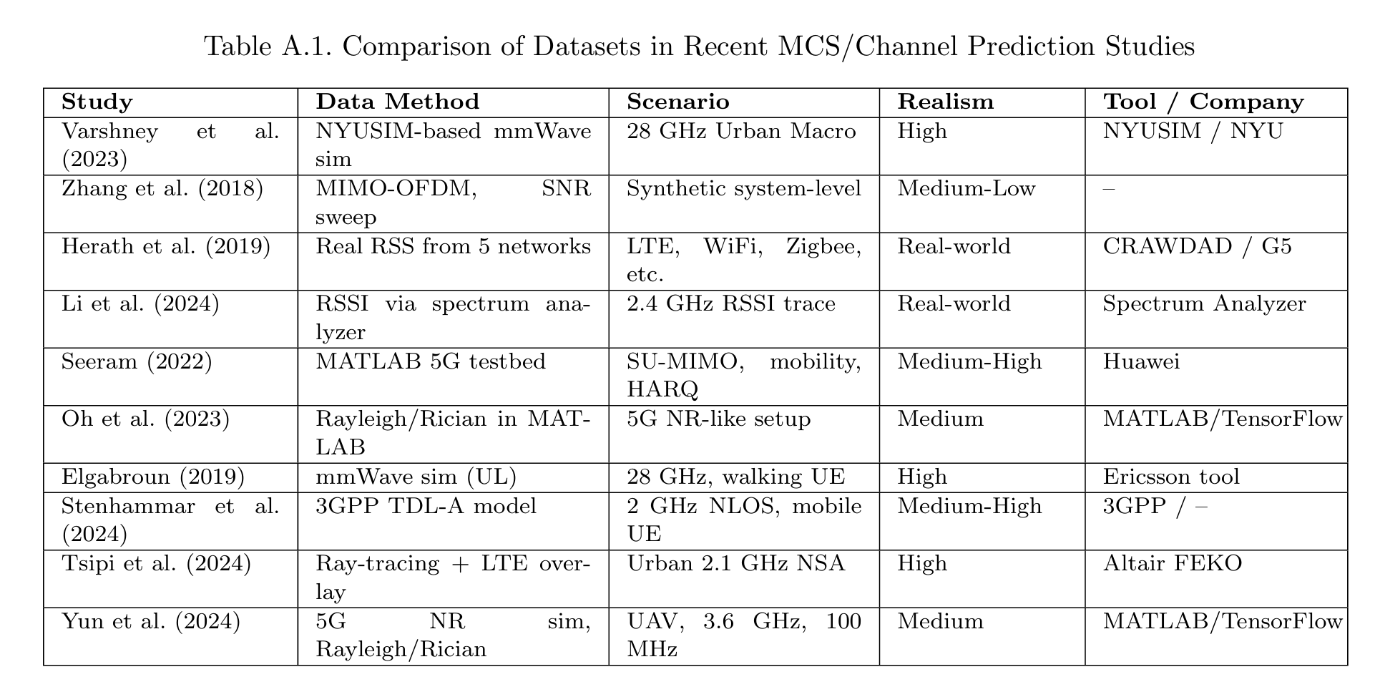
Appendix A1

Slide 40
mcs | count
26 | 6965
28 | 4132
24 | 1677
0 | 1143
18 | 1030
22 | 968
13 | 880
20 | 674
6 | 658
15 | 610
8 | 577
11 | 529
4 | 439
2 | 436

Slide 41
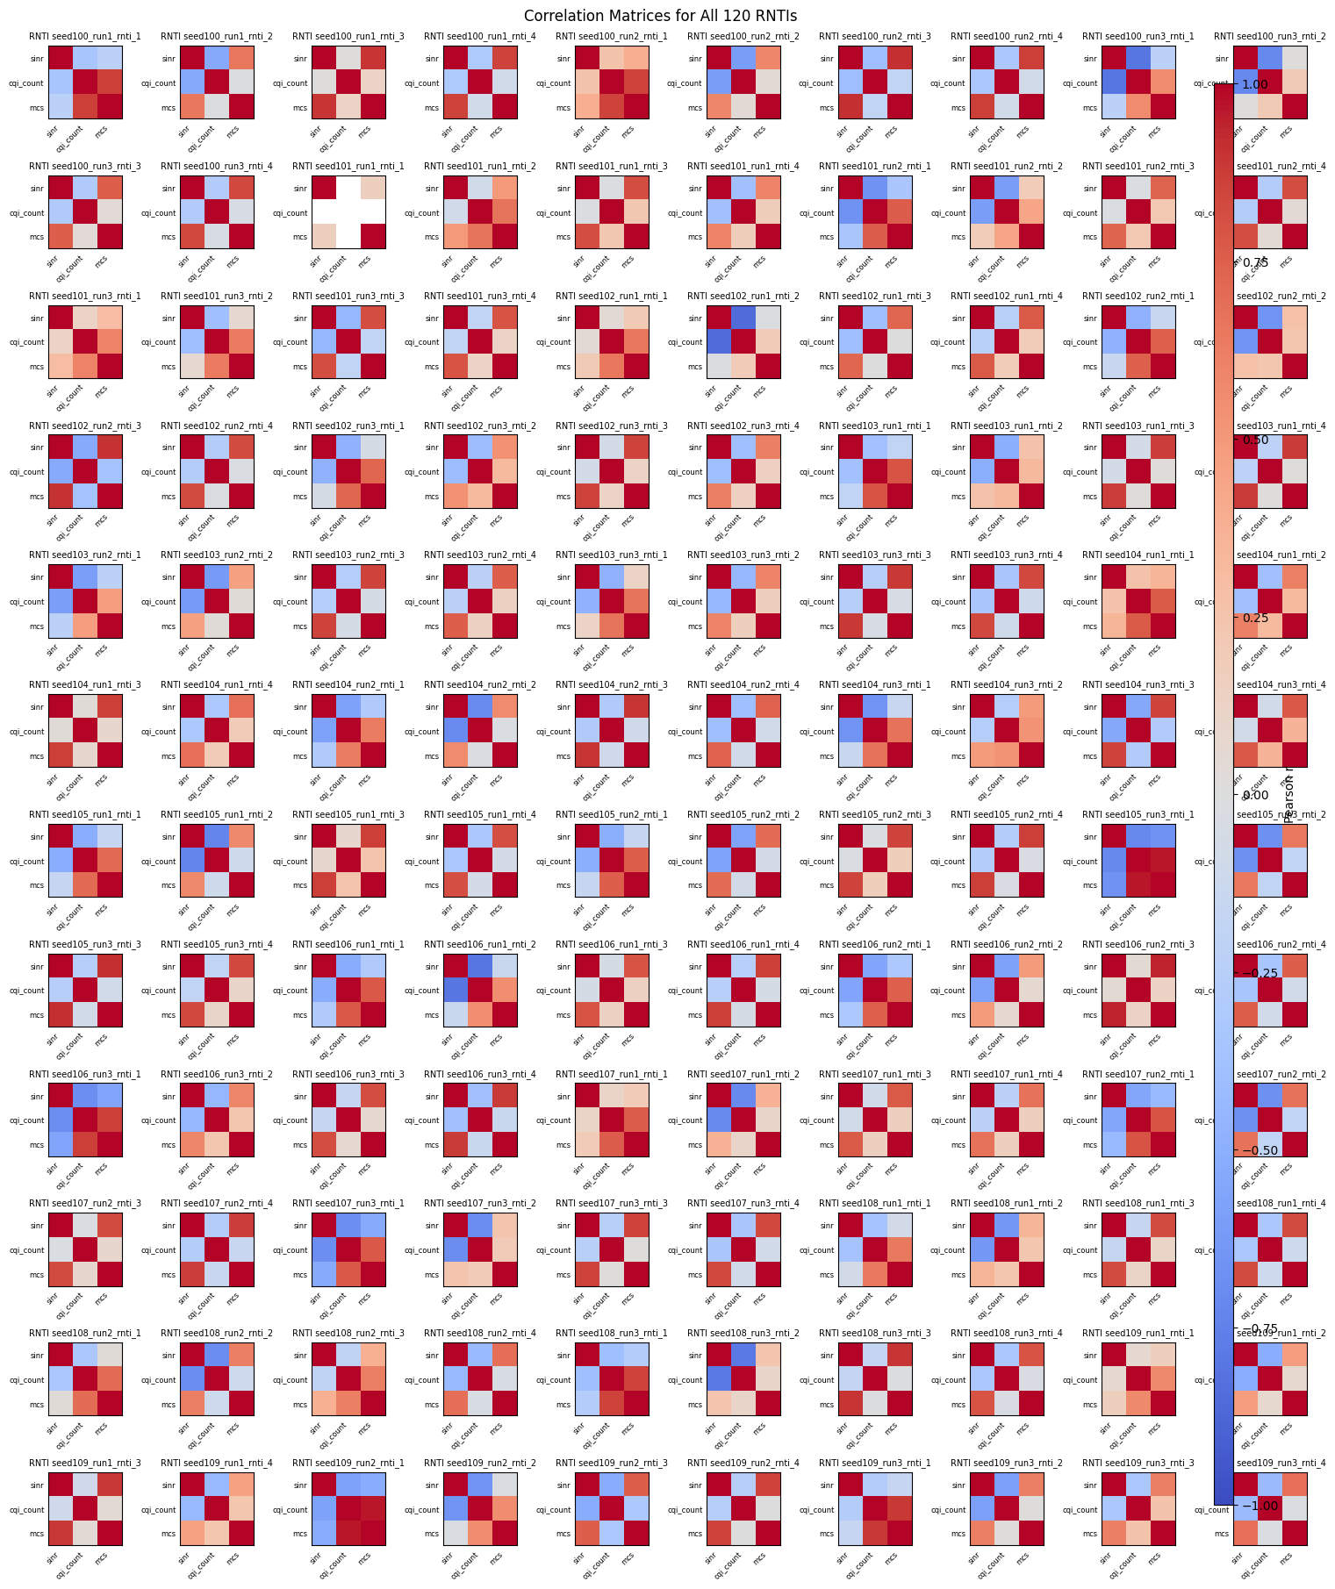
Appendix B1

