Slide 1

计软智学院研究生学术论坛答辩
GER-LLM: Efficient and Effective
Geospatial Entity Resolution
with Large Language Model
School of Computer Science and Engineering, Southeast University, Nanjing, 210096
April 8, 2026

Slide 2
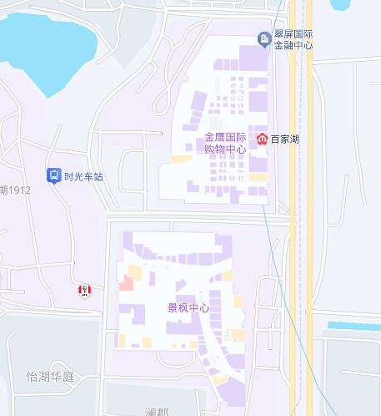
















Background & Motivation
Geospatial Entity Resolution (GER):
aims to identify which spatial entities refer to the same physical entity.
(118.8259, 31.9391)
Data Source 1
$$e_{1}$$
Starbucks, 327 Main St
(118.8263, 31.9373)
$$e_{2}$$
Sbux Coffee, 101 Main St
(118.8261, 31.9365)
Data Source 2
$$e_{3}$$
Burger King, 37-A Main St
(118.8271, 31.9353)
$$e_{4}$$
Starbucks, 101-A Main St
Rule-based methods
PLM-based methods
EditDist($e_{1}$, $e_{4}$) < $θ$
$$e_{1}=e_{4}$$
$$e_{1},{ e}_{4}$$
PLM
EditDist($e_{2}$, $e_{4}$) >$θ$
$e_{2},$ $e_{4}$
MLP
require handcrafted
rules and thresholds
require labeled data
Our Goal:
Integrate LLMs into GER accurately, efficiently, zero-shot
Challenges of Integrating LLM:
Limited spatial understanding
High inference cost

Slide 3
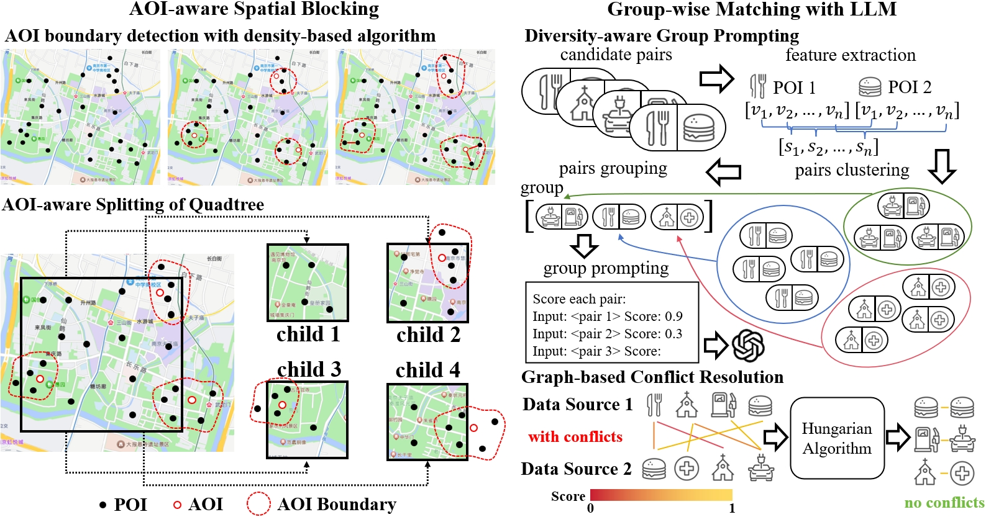
Framework Overview

Slide 4
AOI-aware Spatial Blocking
Identify functional Areas of Interest (AOIs) via a lightweight classifier.
Detect AOI boundaries using a
density-based algorithm.
Perform adaptive quadtree partitioning
that preserves both spatial proximity
and semantic continuity.
→ Reduces candidate pairs while keeping spatially related POIs together.

Slide 5
Group-wise Matching with LLM
Feature Extraction: compute textual and spatial similarity for each candidate pair.
HDBSCAN Clustering: cluster pairs by similarity vectors.
Diversity-aware Group Prompting: sample diverse pairs from different clusters and evaluate them jointly.
Graph-based Conflict Resolution: apply the Hungarian algorithm to enforce one-to-one global alignment.
→ Fewer LLM calls, better consistency, and higher reasoning quality.

Slide 6
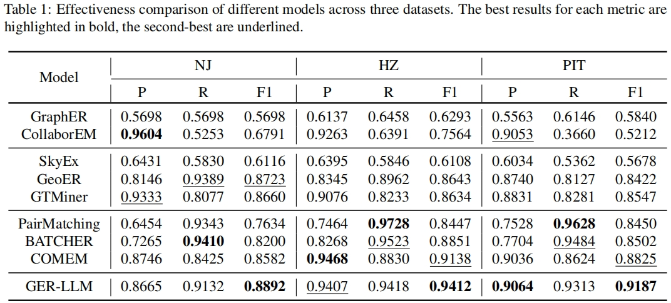
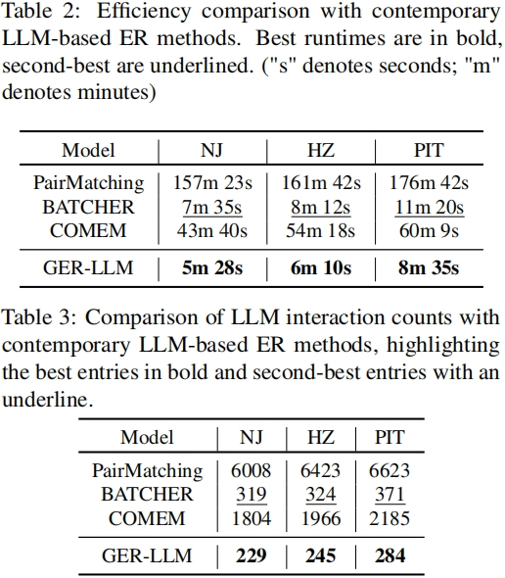
Experimental Results

Slide 7
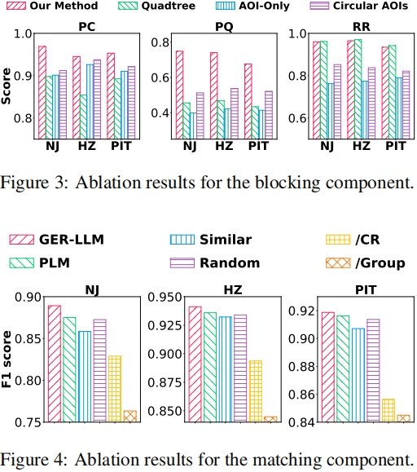
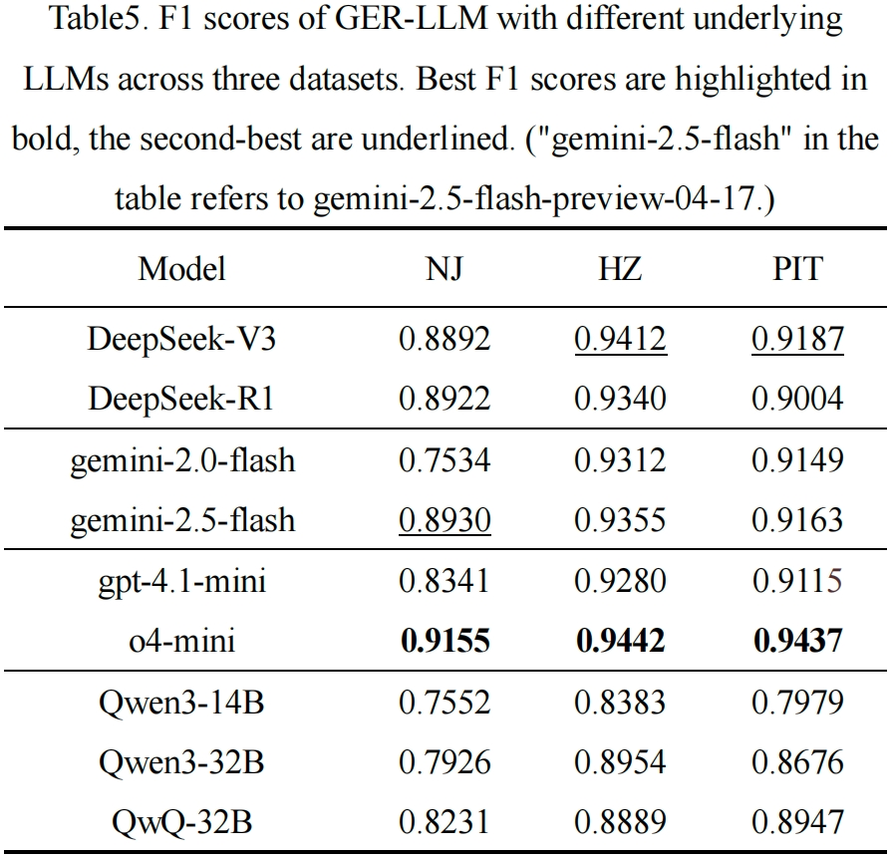
Ablation Studies
7

Slide 8



Conclusion
Contributions:
the first framework to integrate LLMs into GER
AOI-aware spatial blocking and group-wise LLM matching with conflict resolution
SOTA performance on three real-world datasets with significant efficiency gains
Future Work:
City-scale evaluation
Smaller or more resource-efficient LLMs
GitHub:
https://github.com/luck-seu/GER-LLM
8

Slide 9

感谢各位老师和同学！
请大家提出宝贵意见！

