Slide 1
Climate Refugees: Stateless By Degrees
July 10, 2019
“Saving Hopes” Team
Be Proactive and Save Lives
"Politicians Discussing Global Warming” by artist Isaac Cordal

Slide 2
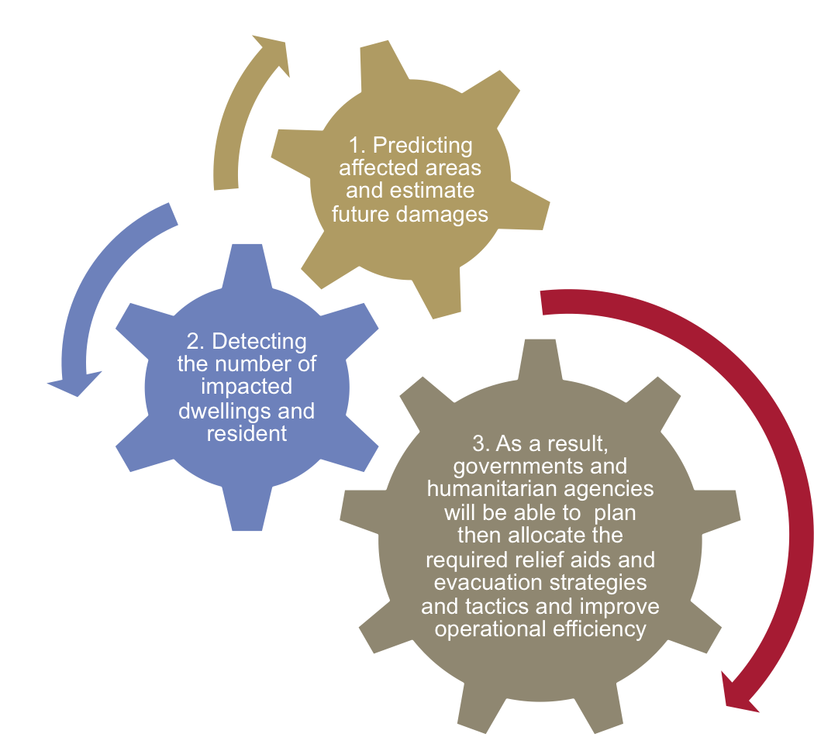
Business Model – Stop Waiting, Start Anticipating
The Frequency of natural disasters is on the rise because of the global warming.
Our solution aims at:

Slide 3
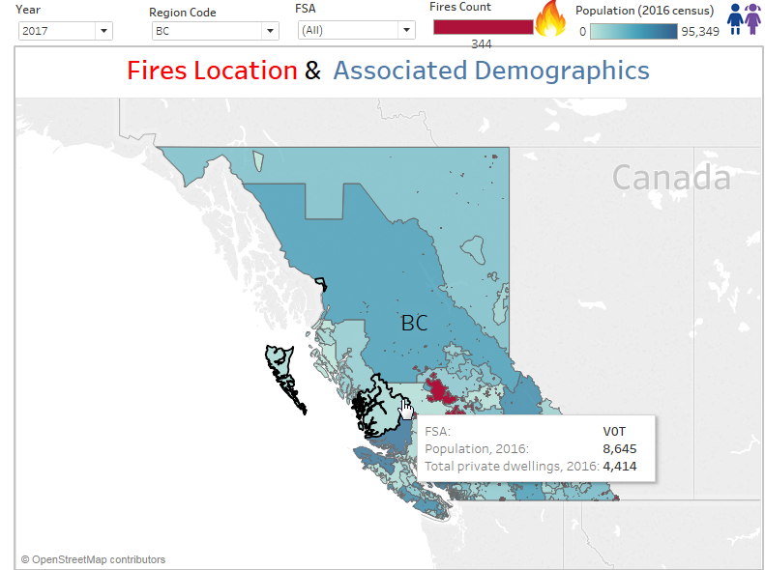
Business Model
1. Prediction & Detection (1/2)
2
3
By using interactive maps, stakeholders can simply enter the
year and the region on interactive maps that will show the count of fires, demographical information and areas of fires saturation once they hover over any area as a result as shown in step 4. Finding the amount of impacted residents and dwellings is simple and fast. Other layers of weather variables will be added to the future fully fledged solution
1
4

Slide 4
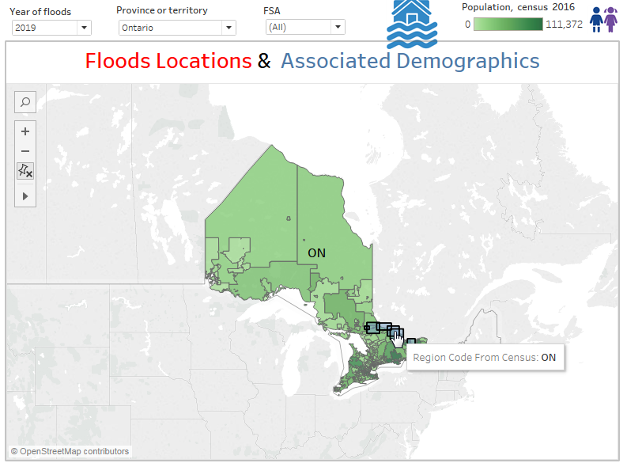
Business Model
1. Prediction &
Detection (2/2)
2
3
Our interactive maps can also show floods per geolocation so impacted areas (dwellings, infrastructure and mainly residents) can also be visually revealed, The governmental agencies and other humanitarian organizations can rely on this visual to address any natural hazardous situations, plan then allocate relief resources. Other layers of weather variables will be added in the future fully fledged solution
Reservation: Flood data was not available for us for security reasons, so we used a public data that was available online for demo purposes.
1
4

Slide 5
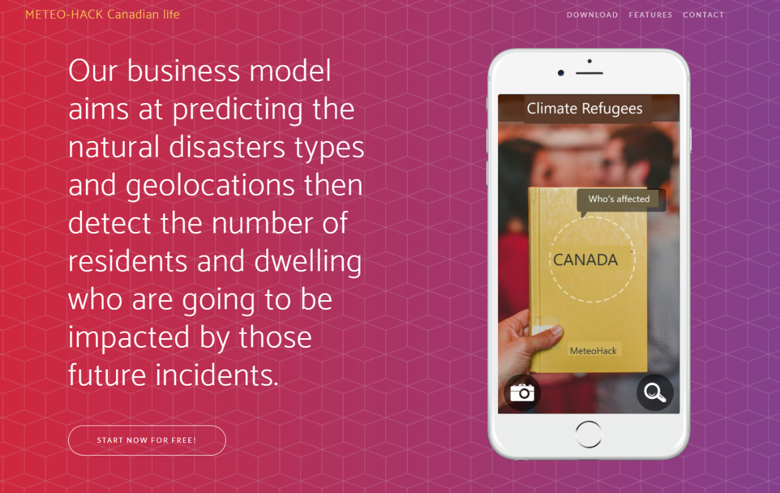
Delivery mode
Mobile App
When disasters happen, people rely heavily on their cell phone to receive/exchange information. Our App designed to be indispensable to both citizens and governments in hard times. Push messages and emergency aids will be available and interactive.

Slide 6
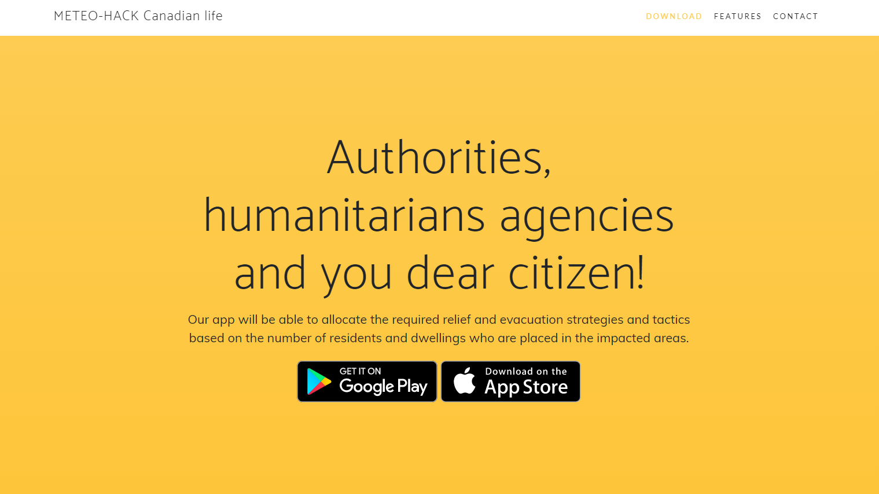
Business Model
Towards operational excellence when it’s most needed.

Slide 7
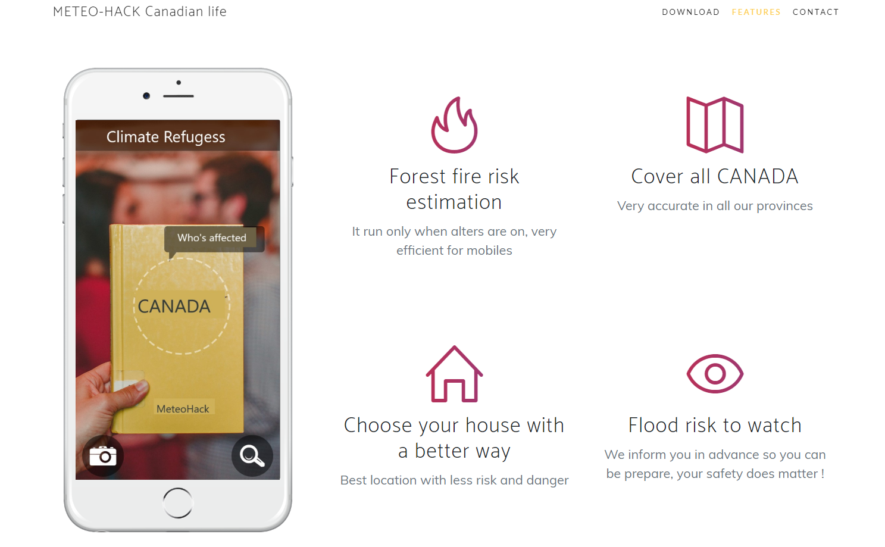
Delivery mode
Mobile App

Slide 8
Future Applications – From Local to Global
“An analysis of more than 7,000 disasters over the
past two decades, in which 1.35 million people
died, showed 90 percent of those deaths occurred
in low and middle-income countries. Ban called it
“a damning indictment of inequality ... High-income
countries suffer huge economic losses in
disasters, but people in low-income countries pay
with their lives...”
Source:
https://mises.org/wire/why-natural-disasters-are-worse-poor-countries
How can we scale the use of Environment Canada data to reach out to those across the globe who need our help and to aid our government to do a better job by proving insight.

Slide 9
1- Increase awareness and engagement
– How long before ‘you’ become a Climate Refugee?
In order to develop such an idea, certain parameters need to be trained using a sophisticated AI algorithms need to be trained. Parameters that can be used for such a platform are:
  Location approximation from watersides/forests
  Average water level rise over the years
  Average escalation in weather heat
  Amount of snow fall/Count of fires
  Speed of snow melting in relation to average rising of temperature
  Dwelling construction date, material and type.
  Municipality infrastructure and record of maintenance and history of natural disasters affecting the area
Reservation: In order to have a working platform we need much more time
and resources which we didn’t have in such a short time. Therefore we’r
only suggesting ideas.
To spread awareness about the seriousness of global warming and its impact, Canada needs to “personalize the experience”.
Predictive maps where people can enter their zip code and know when in the future they will lose their homes to climate change can serve a strong wakeup call.

Slide 10
2- Canada to allocate and prepare for its next wave of ‘Climate Change Refugees’ ahead of time
In December 2010, Parties to the UN Framework Convention on Climate Change (including Canada) adopted the Cancún agreements, which promote “measures to enhance understanding, coordination and cooperation with regard to climate change induced displacement, migration and planned relocation.”
Environment Canada with the help with international organization of similar mandate can develop a predictive model that help anticipate the future wave of refugees. Such a model will:
  Save lives by taking swiftly measures
  Understand the demographical, educational, financial and cultural values of affected societies and plan a head of time to place strategies and human resources to accommodate the impacted regions.
  Help Canada be better prepared when it comes to budget placement.
  Logistical excellency
Canada doesn’t support open-boarder policy. Choosing a vetting immigrants/refugees is a time consuming and an expensive process. The Canadian government has been frequently criticized for being too fast or too slow when it comes to accommodating refugees.

Slide 11
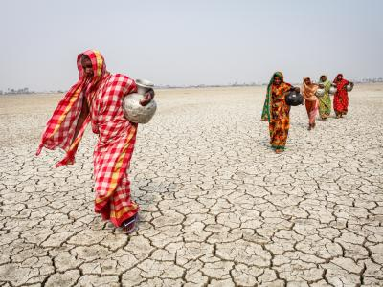

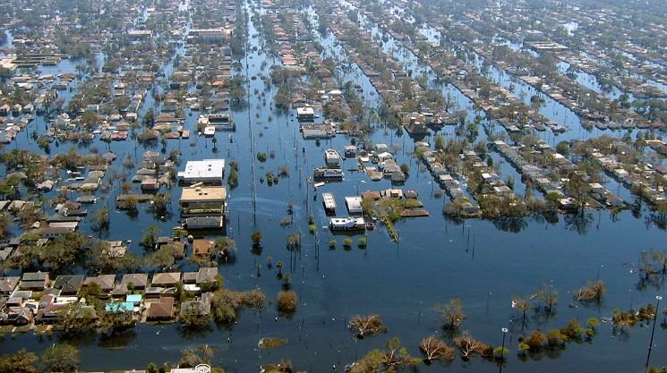
3- Canada to inspire UN organizations to improve processes
The solution and its application can be scaled out to an international level. The UN faces lot of challenges when it comes to addressing natural disasters and allocate much needed financial resources. The climate induced people displacement is rising every year.

Slide 12
Resources
Flood Data
http://geo.weather.gc.ca/geomet?service=WMS&version=1.3.0&request=GetCapabilities&LAYERS=HOTSPOTS
https://open.canada.ca/data/en/dataset/b1afd8d2-6e14-4ec4-9a09-652221a6cb71
https://webservices.maps.canada.ca/arcgis/rest/services/NRCan/EGS_Flood_Product_CurrentYear_en/MapServer/1
Fire Data
http://cwfis.cfs.nrcan.gc.ca/datamart/download/nfdbpoly?token=5839494ebfe00fd18ee7dd2ad9dfa8f3
2016 Census Data
https://www12.statcan.gc.ca/census-recensement/2016/dp-pd/hlt-fst/pd-pl/Table.cfm?Lang=Eng&T=1201&S=22&O=A

Slide 13
Thank you for giving us the opportunity to shape a better planet.
We couldn’t have asked for a better reward!

