Slide 1

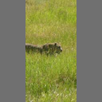

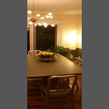


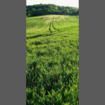

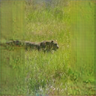
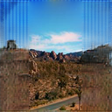
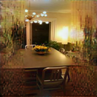


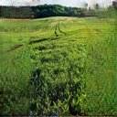

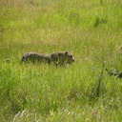

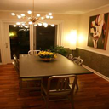



Input
Input
Output
GT
Notes:
Outpainting results

Slide 2




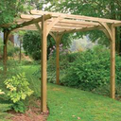
City
Places365

Slide 3

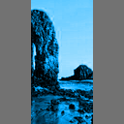

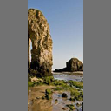
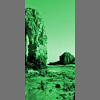
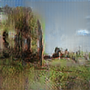
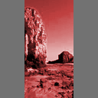


$$×$$
G
D
$$p∈(0,1)$$

Slide 4
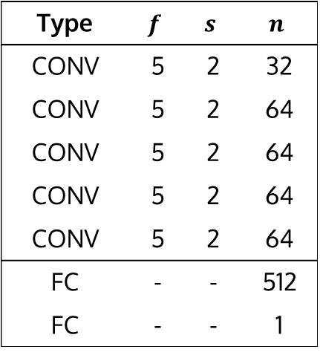
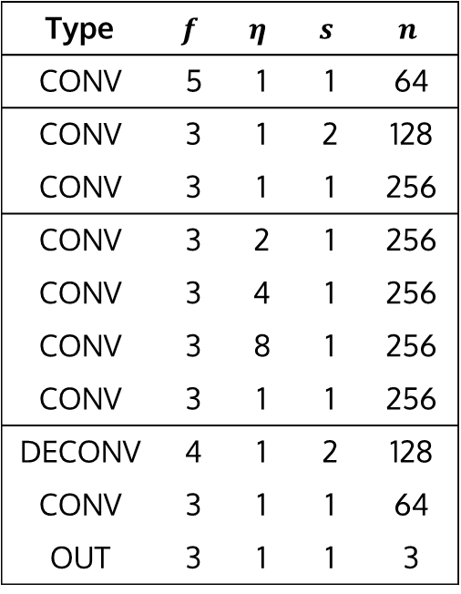
Type | $$f$$ | $$η$$ | $$s$$ | $$n$$
CONV | 5 | 1 | 1 | 64
CONV | 3 | 1 | 2 | 128
CONV | 3 | 1 | 1 | 256
CONV | 3 | 2 | 1 | 256
CONV | 3 | 4 | 1 | 256
CONV | 3 | 8 | 1 | 256
CONV | 3 | 1 | 1 | 256
DECONV | 4 | 1 | 2 | 128
CONV | 3 | 1 | 1 | 64
OUT | 3 | 1 | 1 | 3
Type | $$f$$ | $$s$$ | $$n$$
CONV | 5 | 2 | 32
CONV | 5 | 2 | 64
CONV | 5 | 2 | 64
CONV | 5 | 2 | 64
CONV | 5 | 2 | 64
FC | - | - | 512
FC | - | - | 1

Slide 5






[1,1,2]
[1,2,4]
[2,4,8]
Increasing dilation
GAN + MSE

Slide 6

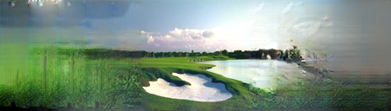



Slide 7
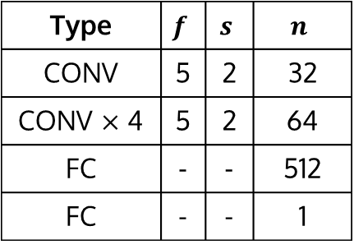
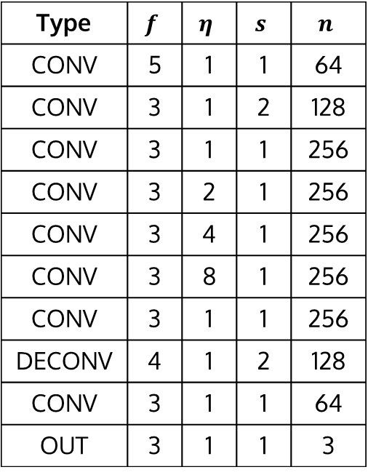
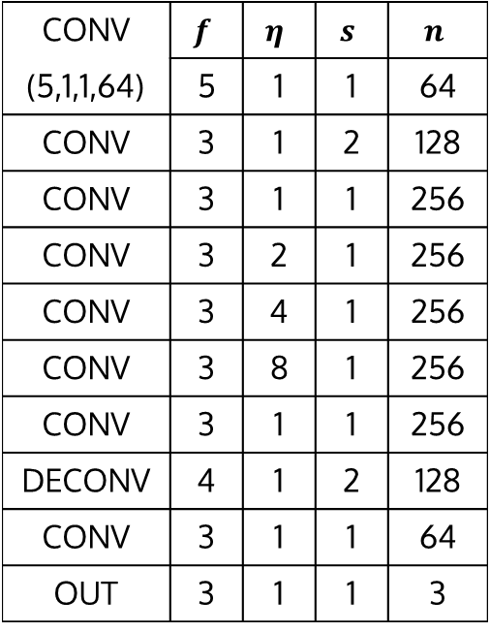
Type | $$f$$ | $$η$$ | $$s$$ | $$n$$
CONV | 5 | 1 | 1 | 64
CONV | 3 | 1 | 2 | 128
CONV | 3 | 1 | 1 | 256
CONV | 3 | 2 | 1 | 256
CONV | 3 | 4 | 1 | 256
CONV | 3 | 8 | 1 | 256
CONV | 3 | 1 | 1 | 256
DECONV | 4 | 1 | 2 | 128
CONV | 3 | 1 | 1 | 64
OUT | 3 | 1 | 1 | 3
Type | $$f$$ | $$s$$ | $$n$$
CONV | 5 | 2 | 32
CONV $×$ 4 | 5 | 2 | 64
FC | - | - | 512
FC | - | - | 1
CONV | $$f$$ | $$η$$ | $$s$$ | $$n$$
(5,1,1,64) | 5 | 1 | 1 | 64
CONV | 3 | 1 | 2 | 128
CONV | 3 | 1 | 1 | 256
CONV | 3 | 2 | 1 | 256
CONV | 3 | 4 | 1 | 256
CONV | 3 | 8 | 1 | 256
CONV | 3 | 1 | 1 | 256
DECONV | 4 | 1 | 2 | 128
CONV | 3 | 1 | 1 | 64
OUT | 3 | 1 | 1 | 3

Slide 8
