Slide 1
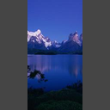
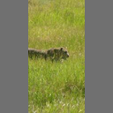
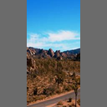
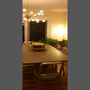
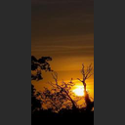
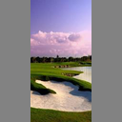
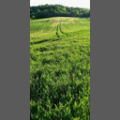
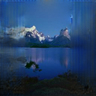
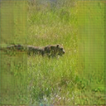
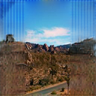
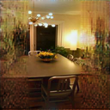
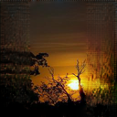
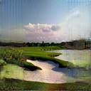
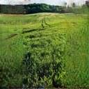

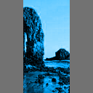
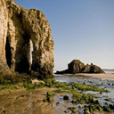
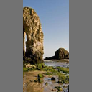
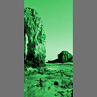
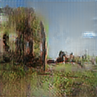
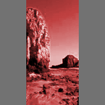
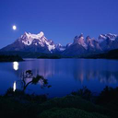
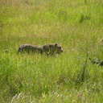
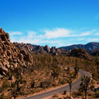
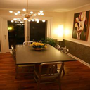
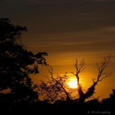
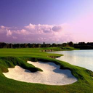
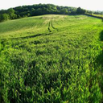
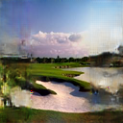
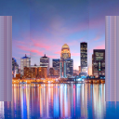
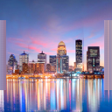

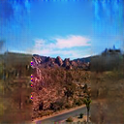
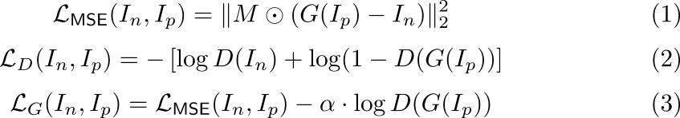

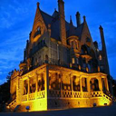
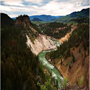
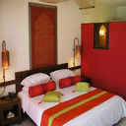
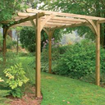
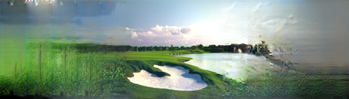
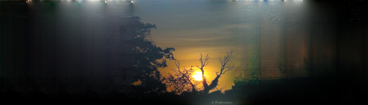
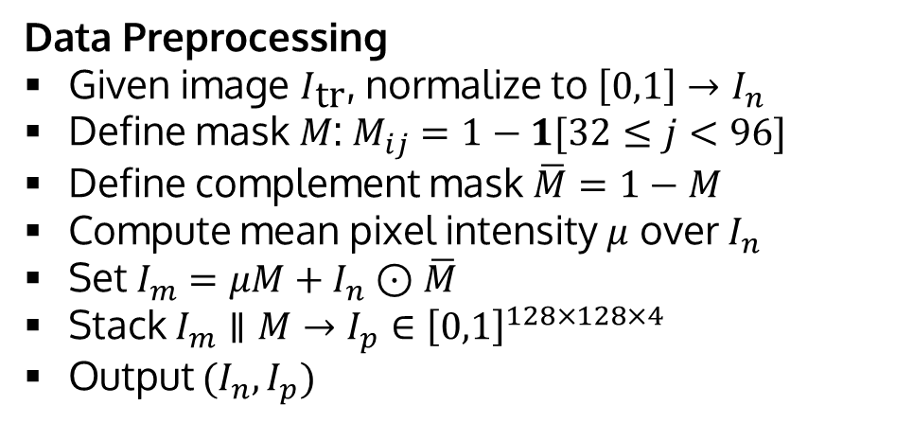

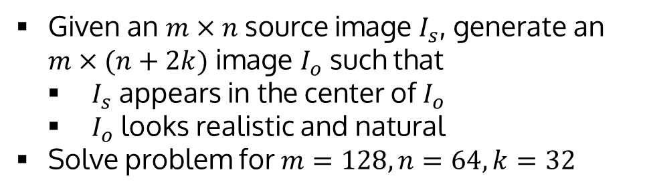

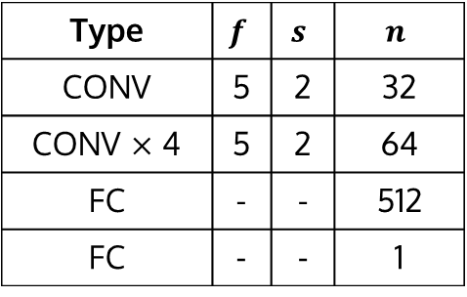

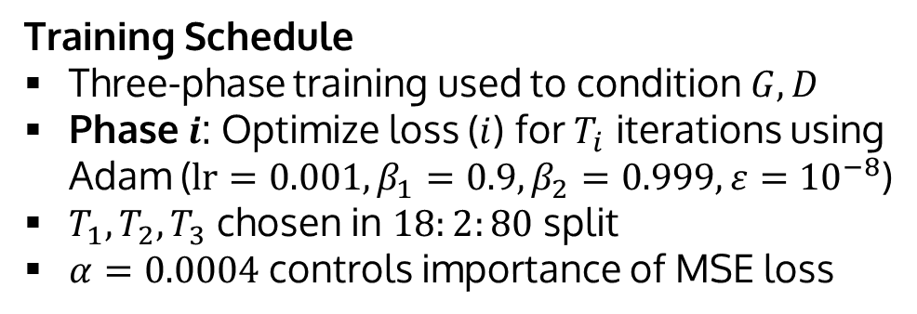



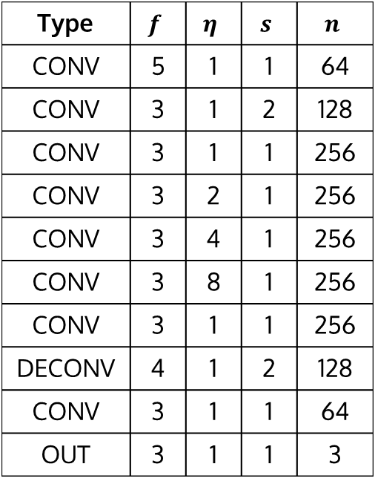
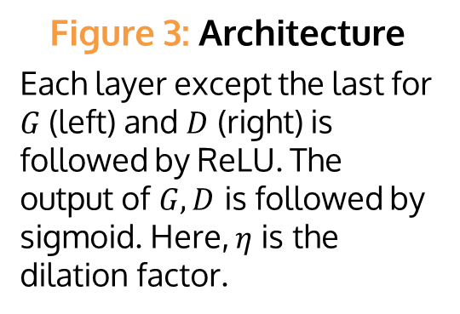
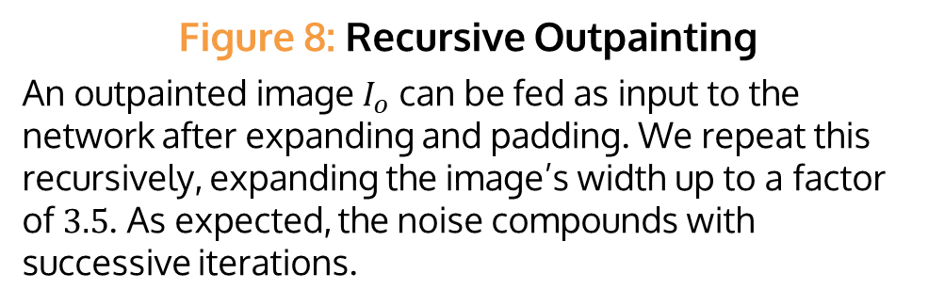

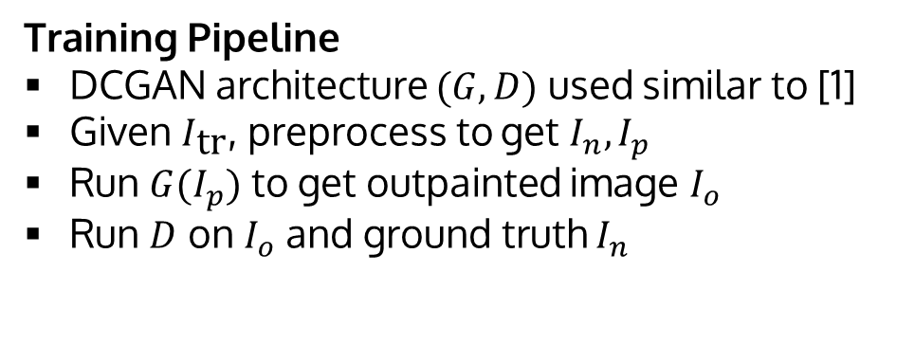
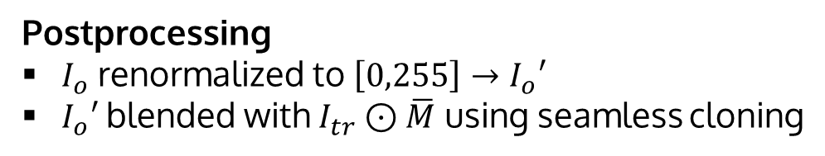


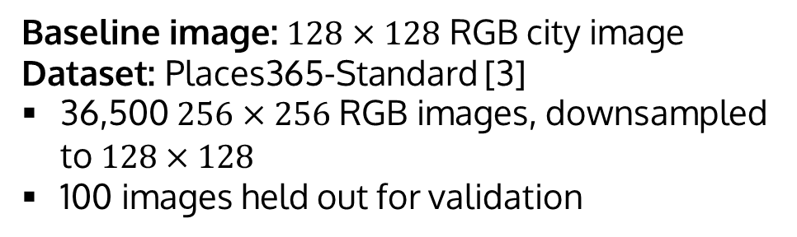
Painting Outside the Box: Image Outpainting with GANs
Mark Sabini (msabini), Gili Rusak (gili)
CS 230 (Deep Learning), Stanford University
Introduction
Methods
Results
Image inpainting is a widely-studied computer vision problem, which involves restoring missing portions within an image
Current state-of-the-art methods for inpainting involve GANs [1] and CNNs [2]
We aim to extend [1]’s method for outpainting, which extrapolates beyond image boundaries
Images can then be arbitrarily expanded by recursive outpainting
Training Pipeline
DCGAN architecture $(G,D)$ used similar to [1]
Given $I_{\text{tr}}$, preprocess to get $I_{n},I_{p}$
Run $G(I_{p})$ to get outpainted image $I_{o}$
Run $D$ on $I_{o}$ and ground truth $I_{n}$
Input
Figure 4: Outpainting
Outpainting results for sample of held-out images in validation set, shown alongside original ground truth. Model was trained for 100 epochs (equivalent to 227,500) iterations), using a batch size of 16.
Output
$$×$$
G
D
$$I_{n}$$
$$I_{m}$$
$$I_{p}$$
$$I_{o}$$
$$p∈(0,1)$$
GT
Problem Statement
$$M$$
No LD
LD
Given an $m×n$ source image $I_{s}$, generate an $m×(n+2k)$ image $I_{o}$ such that
$I_{s}$ appears in the center of $I_{o}$
$I_{o}$ looks realistic and natural
Solve problem for $m=128, n=64,k=32$
Figure 2: Training Pipeline
Increasing dilation
Training Schedule
Three-phase training used to condition $G,D$
Phase $i$: Optimize loss ($i$) for $T_{i}$ iterations using Adam ($\text{lr}=0.001, β_{1}=0.9, β_{2}=0.999, ε={10}^{−8}$)
$T_{1}, T_{2},T_{3}$ chosen in $18:2:80$ split
$α=0.0004$ controls importance of MSE loss
Data
[1,1,2]
[1,2,4]
[2,4,8]
Baseline image: $128×128$ RGB city image
Dataset: Places365-Standard [3]
36,500 $256×256$ RGB images, downsampled to $128×128$
100 images held out for validation
RMSE = 39.68
RMSE = 38.43
$η$ for layers 4, 5, 6 in $G$
Figure 5: MSE Loss for Places365
Training and dev MSE loss on Places365. Phases are illustrated by varying background colors. In Phase 3, the MSE loss increases slightly as we optimize the joint loss (3).
Figure 6: Local Discriminators
Training with local discriminators (LD) reduced vertical banding and improved color fidelity, but increased artifacts and training time.
Figure 7: Effect of Dilation
The network was trained to overfit on the city image. With insufficient dilation, the network fails to outpaint due to limited receptive field.
Postprocessing
$I_{o}$ renormalized to $\left[0,255\right]→I_{o}′$
$I_{o}′$ blended with $I_{tr}⊙\overline{M}$ using seamless cloning
City
Places365
Model
GT
Outpainted 5$×$
Conclusions
Figure 1: City Image and Places365 Samples
Type | $$f$$ | $$η$$ | $$s$$ | $$n$$
CONV | 5 | 1 | 1 | 64
CONV | 3 | 1 | 2 | 128
CONV | 3 | 1 | 1 | 256
CONV | 3 | 2 | 1 | 256
CONV | 3 | 4 | 1 | 256
CONV | 3 | 8 | 1 | 256
CONV | 3 | 1 | 1 | 256
DECONV | 4 | 1 | 2 | 128
CONV | 3 | 1 | 1 | 64
OUT | 3 | 1 | 1 | 3
Type | $$f$$ | $$s$$ | $$n$$
CONV | 5 | 2 | 32
CONV $×$ 4 | 5 | 2 | 64
FC | - | - | 512
FC | - | - | 1
Image outpainting successfully realized
Three-phase training aids in stabilizing training
Dilated convolutions crucial for sufficient neuron receptive field for outpainting
Recursive outpainting possible, although error and noise compound
Data Preprocessing
Given image $I_{\text{tr}}$, normalize to $\left[0,1\right]→I_{n}$
Define mask $M$: $M_{ij}=1−1[32≤j<96]$
Define complement mask $\overline{M}=1−M$
Compute mean pixel intensity $μ$ over $I_{n}$
Set $I_{m}=μM+I_{n}⊙\overline{M}$
Stack $I_{m}∥M→I_{p}∈{\left[0,1\right]}^{128×128×4}$
Output $(I_{n}, I_{p})$
Figure 3: Architecture
Each layer except the last for $G$ (left) and $D$ (right) is followed by ReLU. The output of $G,D$ is followed by sigmoid. Here, $η$ is the dilation factor.
Figure 8: Recursive Outpainting
An outpainted image $I_{o}$ can be fed as input to the network after expanding and padding. We repeat this recursively, expanding the image’s width up to a factor of $3.5$. As expected, the noise compounds with successive iterations.
Future Work
Explore sequence models for video outpainting
Incorporate perceptual and style loss
Experiment with partial convolutions [2]

