Slide 1
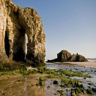

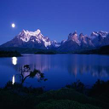
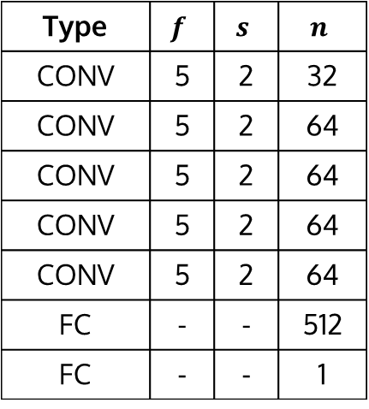
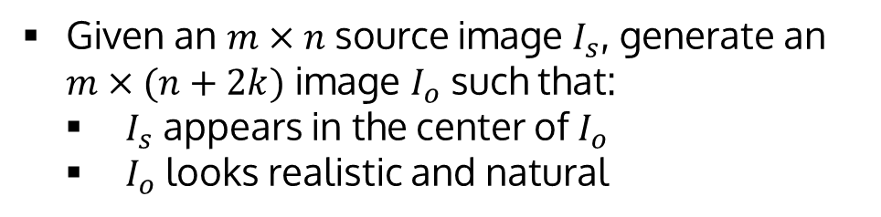
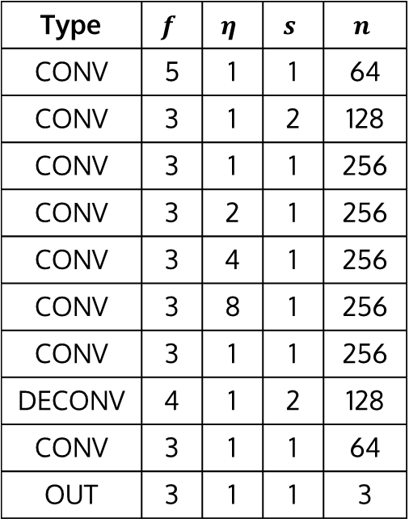
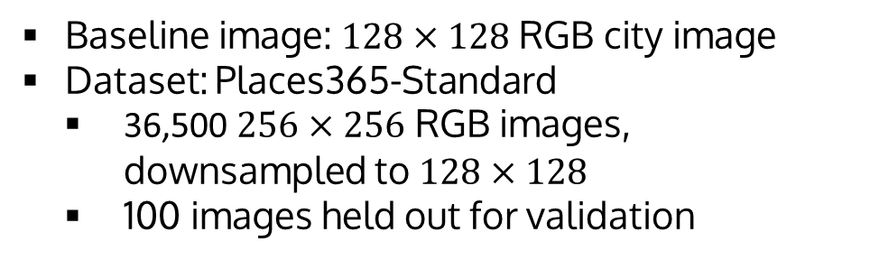
Painting Outside the Box: Image Outpainting with GANs
Mark Sabini (msabini), Gili Rusak (gili)
CS 230 (Deep Learning), Stanford University
References
Introduction
Methods
Results
PLACEHOLDER: I/O
Acknowledgements
[HOOK]
Much research conducted on inpainting, which restores missing portions within image
Current state-of-the-art methods for inpainting involve GANs [Iizuka] and CNNs [Liu]
We aim to extend [Iizuka]’s method for outpainting, which extrapolates beyond image boundaries
[Adversarial Training, Pipeline]
[Some sentences]
[Encoder/decoder network]
PIPELINE
“We learn the generative model using adversarial training”
OUTPAINTING RESULTS
Problem Statement
Given an $m×n$ source image $I_{s}$, generate an $m×(n+2k)$ image $I_{o}$ such that:
$I_{s}$ appears in the center of $I_{o}$
$I_{o}$ looks realistic and natural
[Three Phase Training]
[Some sentences]
[Three loss equations]
[Describe why we do this]
Test permutation invariance assumption by attempting to build a better model based on raw images
LOSS PLOT
QUANTITATIVE RESULTS
EXTRA (Maybe multiple outpainting)
Data
Baseline image: $128×128$ RGB city image
Dataset: Places365-Standard
36,500 $256×256$ RGB images, downsampled to $128×128$
100 images held out for validation
[Postprocessing]
[Keep it short]
Loss plot
Conclusions
Models
[Some words regarding this thingy]
Error analysis?
SAMPLES OF IMAGES
[Some words regarding this thingy]
Type | $$f$$ | $$η$$ | $$s$$ | $$n$$
CONV | 5 | 1 | 1 | 64
CONV | 3 | 1 | 2 | 128
CONV | 3 | 1 | 1 | 256
CONV | 3 | 2 | 1 | 256
CONV | 3 | 4 | 1 | 256
CONV | 3 | 8 | 1 | 256
CONV | 3 | 1 | 1 | 256
DECONV | 4 | 1 | 2 | 128
CONV | 3 | 1 | 1 | 64
OUT | 3 | 1 | 1 | 3
Type | $$f$$ | $$s$$ | $$n$$
CONV | 5 | 2 | 32
CONV | 5 | 2 | 64
CONV | 5 | 2 | 64
CONV | 5 | 2 | 64
CONV | 5 | 2 | 64
FC | - | - | 512
FC | - | - | 1
HYPERPARAMETER TUNING (Dilated conv, maybe no T1, changing alpha
City + Places2 samples
MODEL TABLE
Future Work
PREPROCESSING
[Some words regarding this thingy]

Slide 2
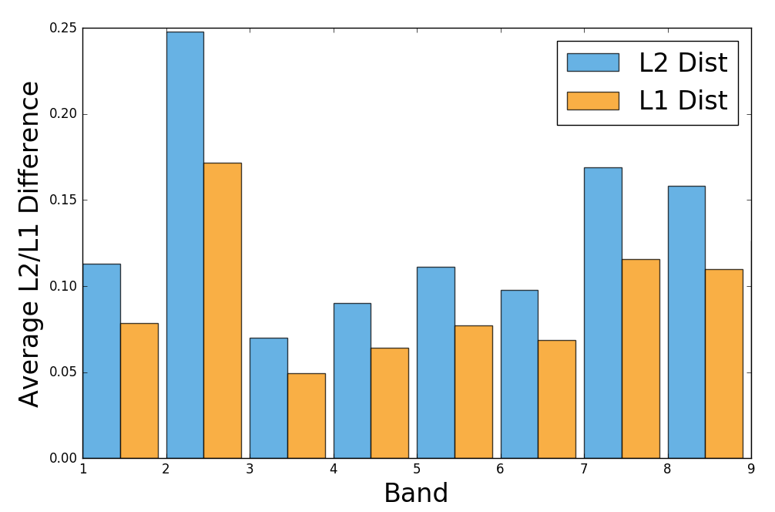
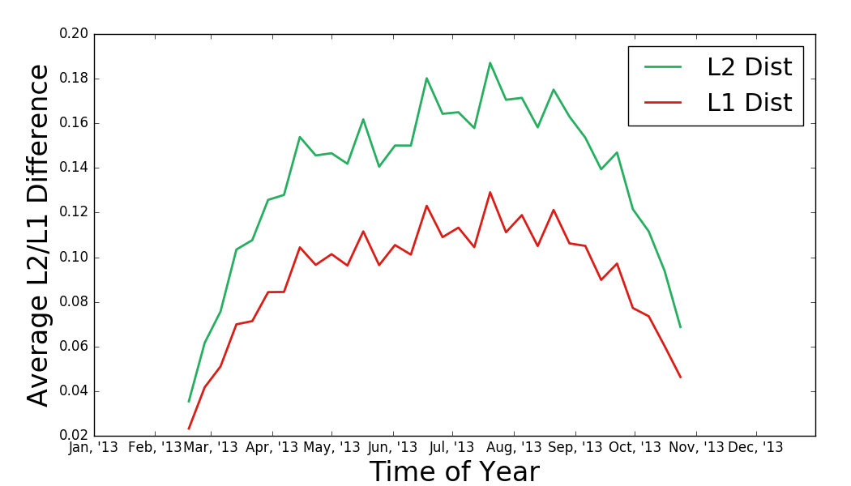
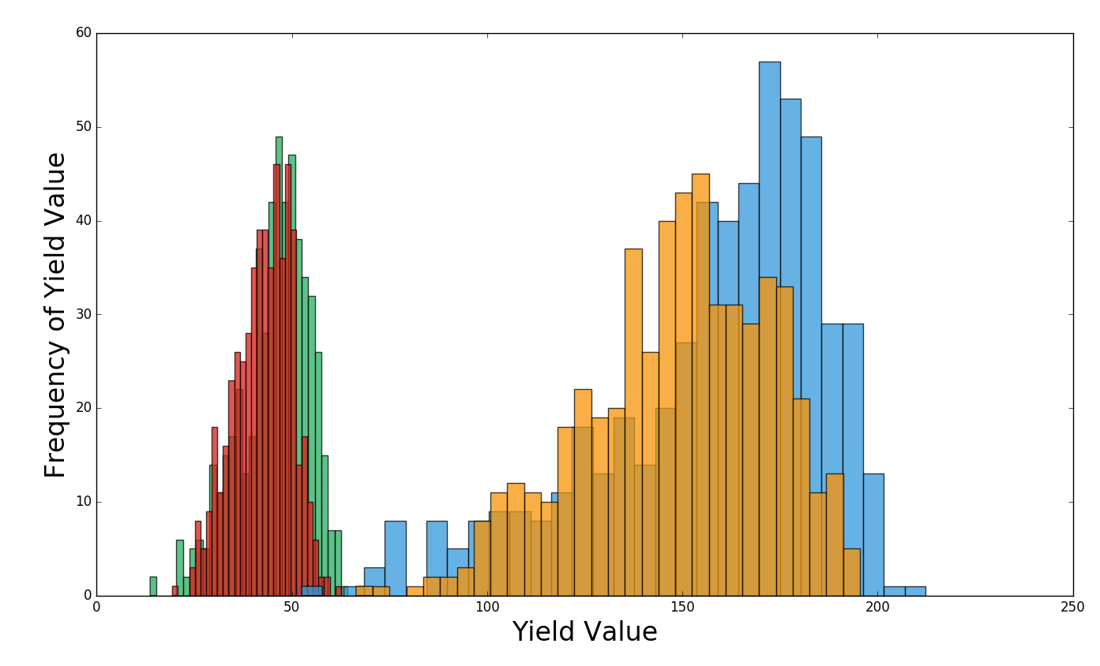
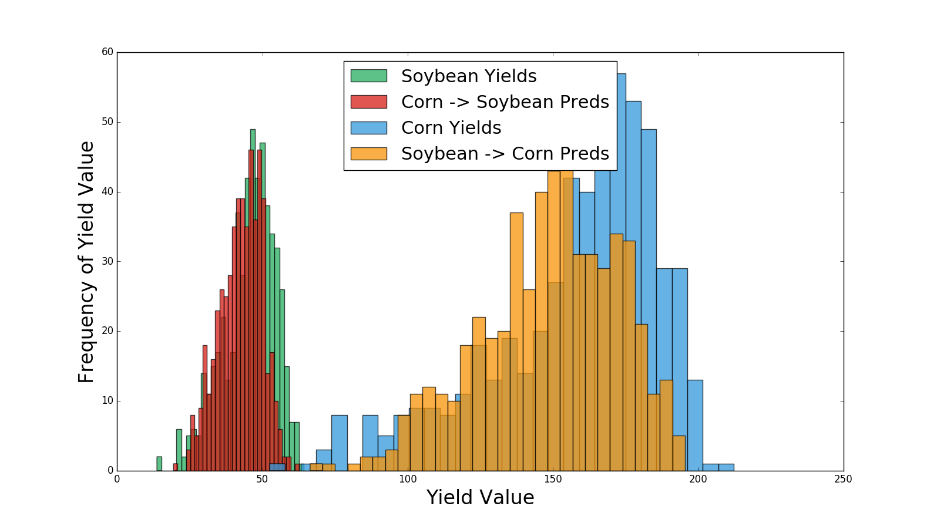

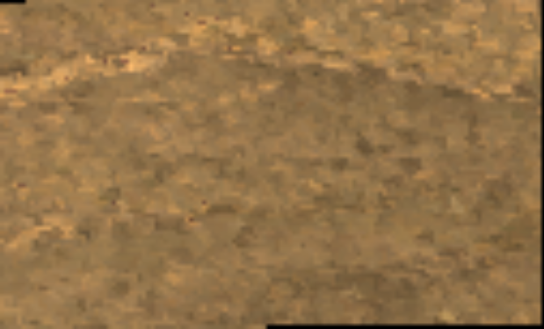
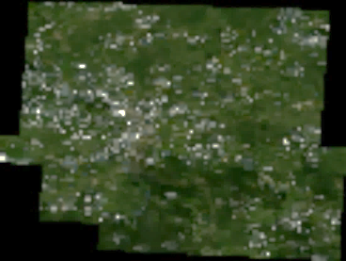
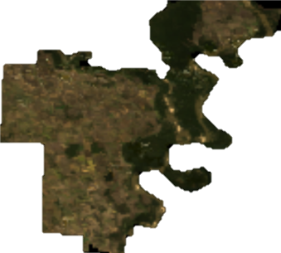
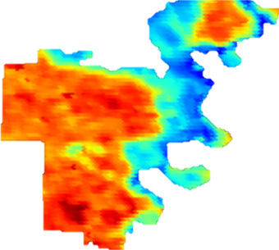
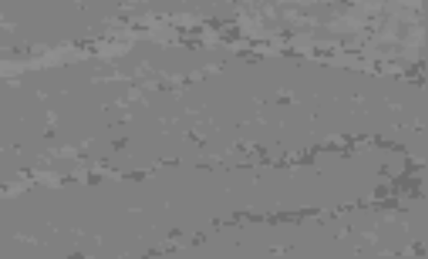

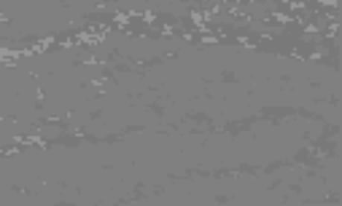
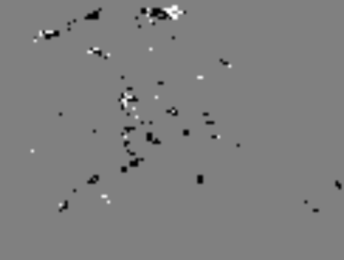

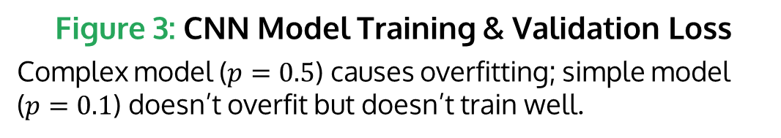
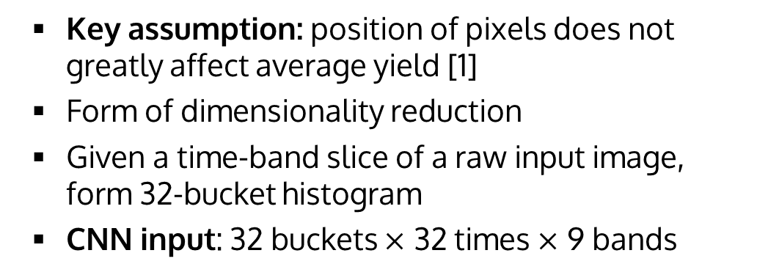
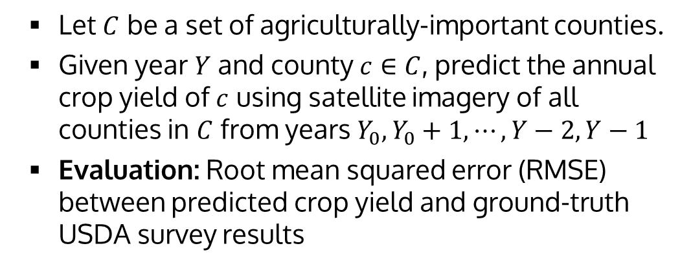
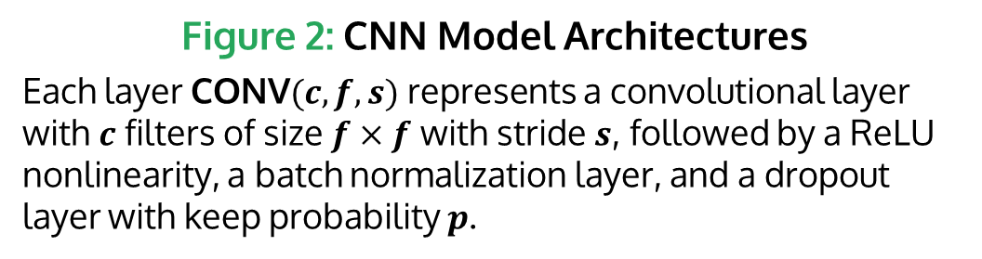
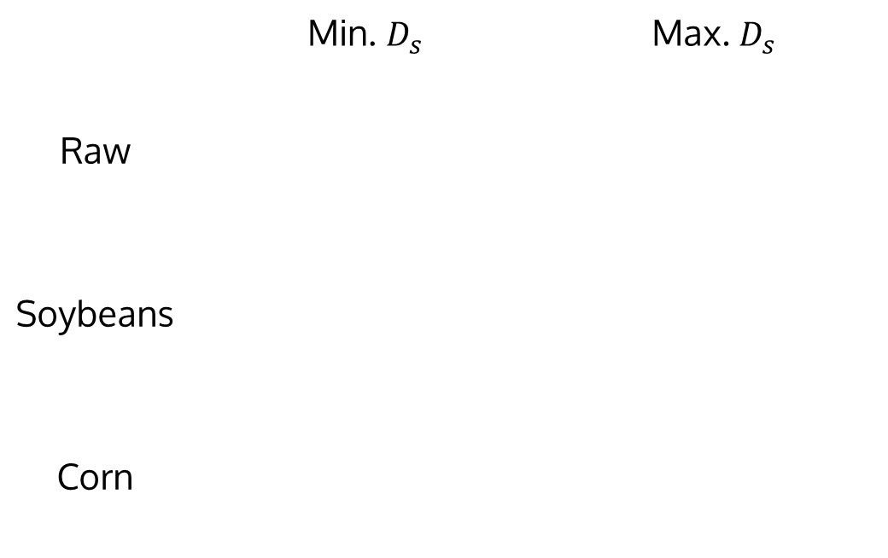
Painting Outside the Box: Image Outpainting with GANs
Mark Sabini (msabini), Gili Rusak (gili)
CS 230 (Deep Learning), Stanford University
Introduction
Permutation Invariance
Results
Crop yield prediction at local levels important for preventing food shortages
Crop yield was predicted using crude and expensive censuses
Remote-sensing data and technologies such as Convolutional Neural Networks (CNNs) make localized predictions possible
You et. al. attempted soybean yield prediction using CNNs and remote-sensing data [1]
We aim to investigate effectiveness of You et. al.’s model and improve their results.
Key assumption: position of pixels does not greatly affect average yield [1]
Form of dimensionality reduction
Given a time-band slice of a raw input image, form 32-bucket histogram
CNN input: 32 buckets $×$ 32 times $×$ 9 bands
Methods
Training the Model
Train on 2003-2012, validate on 2013
Training loss:
Validation error:
Problem Statement
Figure 3: CNN Model Training & Validation Loss
Complex model ($p=0.5$) causes overfitting; simple model ($p=0.1$) doesn’t overfit but doesn’t train well.
Figure 4: CNN Model Minimum RMSE
Validation set RMSE of various architectures over the course of training.
Let $C$ be a set of agriculturally-important counties.
Given year $Y$ and county $c∈C$, predict the annual crop yield of $c$ using satellite imagery of all counties in $C$ from years $Y_{0},Y_{0}+1,⋯,Y−2,Y−1$
Evaluation: Root mean squared error (RMSE) between predicted crop yield and ground-truth USDA survey results
 | Ref. | Deep1 | Deep2 | Deep3 | Deep4
CONV(128, 3, 1) | 1 | 1 | 1 | 2 | 2
CONV(128, 3, 2) | 1 | 1 | 1 | 1 | 1
CONV(256, 3, 1) | 1 | 1 | 2 | 2 | 2
CONV(256, 3, 2) | 1 | 1 | 1 | 1 | 1
CONV(512, 3, 1) | 2 | 3 | 3 | 3 | 3
CONV(512, 3, 2) | 1 | 1 | 1 | 1 | 1
CONV(1024, 3, 1) | 0 | 0 | 0 | 0 | 1
FC(2048) | 1 | 1 | 1 | 1 | 1
Datasets
Figure 5: Relative Importance of Bands
Average distances between saliency maps computed for each band; the first two bands are key for crop discrimination
Figure 6: Relative Importance of Times
Average distances between saliency maps for each time slice; photos from May through Sept. are key for crop discrimination
Figure 7: Dists. of Original Yields vs. Rescaled Predicted Yields
Actual dists. of crop yields compared with pred. yield dists. computed by rescaling predictions for one crop to predictions for the other crop
Raw Data: MODIS satellite imagery [2]
Surface Reflectance 8-Day L3 Global 500m (Bands 1-7)
Land Surface Temperature & Emissivity 8-Day L3 Global 1km (Bands 1 & 5)
Land Cover Type Yearly L3 Global 500m (Band 1)
Time span: 2003-2013, sampled 46 times per year, of which 32 occur during the growing season
Ground Truth: USDA NASS Survey Data - Crop yields for soybean and corn [3]
Figure 2: CNN Model Architectures
Each layer $\text{CONV}(c, f, s)$ represents a convolutional layer with $c$ filters of size $f×f$ with stride $s$, followed by a ReLU nonlinearity, a batch normalization layer, and a dropout layer with keep probability $p$.
 | Min. $D_{s}$ | Max. $D_{s}$
Raw
Soybeans
Corn
Conclusions
Saliency Map Visualization
Image $i$ for crop $c$:
Saliency map for $W_{ci}$:
Normalized map for $W_{ci}$:
$L_{2}$ diff. between crops 1, 2:
$L_{1}$ diff. between crops 1, 2:
Differing Crops
Rescale crop 1 pred. to crop 2 pred.:
The model determines difference between corn and soybean farms, at least to some extent
There is still signal to extract from the data since deeper models perform better
Figure 1: Desha County, AR (Left: RGB, Right: Temp.)
Future Work
Test permutation invariance assumption by attempting to build a better model based on raw images
Figure 8: Most Similar & Dissimilar Saliency Maps
Brighter pixels positively impact prediction accuracy, darker pixels negatively impact prediction accuracy

Slide 3
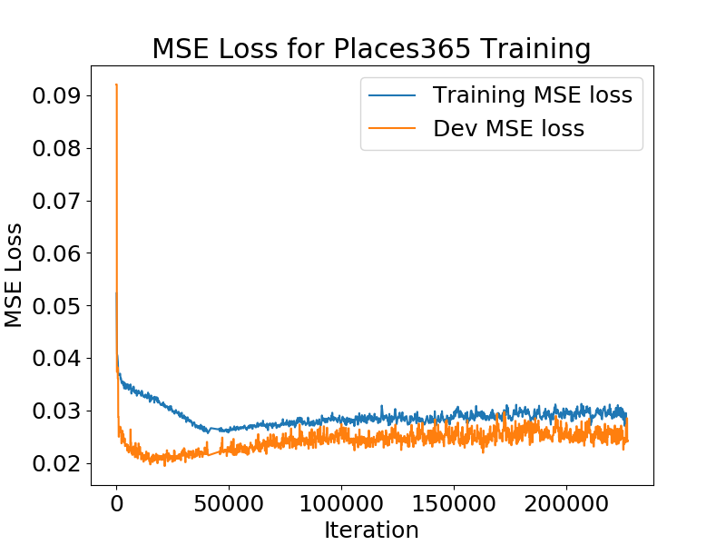
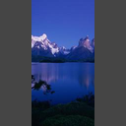
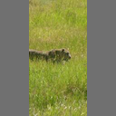
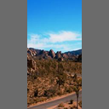
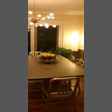
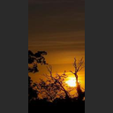
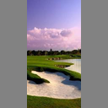
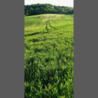
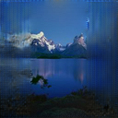
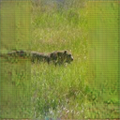
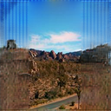
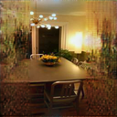
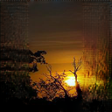
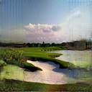
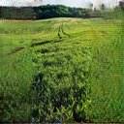
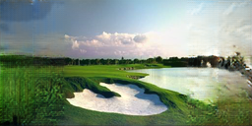

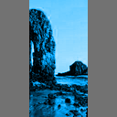
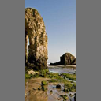
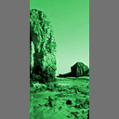
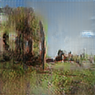
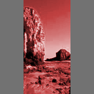
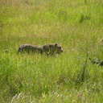
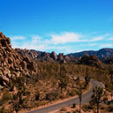
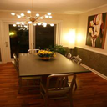
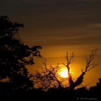
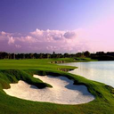
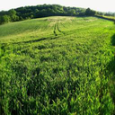






























Painting Outside the Box: Image Outpainting with GANs
“We learn the generative model using adversarial training”
Mark Sabini (msabini), Gili Rusak (gili)
CS 230 (Deep Learning), Stanford University
References
Introduction
Methods
Results
Image inpainting is a widely-studied computer vision problem, which involves restoring missing portions within image
Current state-of-the-art methods for inpainting involve GANs [Iizuka] and CNNs [Liu]
We aim to extend [Iizuka]’s method for outpainting, which extrapolates beyond image boundaries
Images can be arbitrarily expanded by recursive outpainting
Training Pipeline
DCGAN architecture $(G,D)$ used similar to [?]
Given $I_{\text{tr}}$, preprocess to get $I_{n},I_{p}$
Run $G(I_{p})$ to get outpainted image $I_{o}$
Run $D$ on $I_{o}$ and ground truth $I_{n}$
Acknowledgements
Input
Figure 4: Outpainting
Outpainting results for sample of held-out images in validation set, shown alongside original ground truth. Model was trained for 100 epochs (equivalent to 227,500) iterations), using a batch size of 16.
Output
$$×$$
G
D
PLACEHOLDER: I/O
$$I_{n}$$
$$I_{m}$$
$$I_{p}$$
$$I_{o}$$
$$p∈(0,1)$$
GT
Problem Statement
$$M$$
Given an $m×n$ source image $I_{s}$, generate an $m×(n+2k)$ image $I_{o}$ such that:
$I_{s}$ appears in the center of $I_{o}$
$I_{o}$ looks realistic and natural
Solve problem for $m=128, n=64,k=32$
Figure 2: Training Pipeline
Increasing dilation
Training Schedule
Three phase training used to condition $G,D$
Phase $i$: Optimize loss ($i$) for $T_{i}$ iterations using Adam ($\text{lr}=0.001, β_{1}=0.9, β_{2}=0.999, ε={10}^{−8}$)
$T_{1}, T_{2},T_{3}$ chosen in $18:2:80$ split
$α=0.0004$ controls importance of MSE loss
QUANTITATIVE RESULTS
Test permutation invariance assumption by attempting to build a better model based on raw images
Data
[1,1,2]
[1,2,4]
[2,4,8]
Baseline image: $128×128$ RGB city image
Dataset: Places365-Standard
36,500 $256×256$ RGB images, downsampled to $128×128$
100 images held out for validation
$η$ for layers 4, 5, 6 in $G$
Figure 5: MSE Loss for Places365 Training
Training and dev MSE loss during training on Places365. Phases 1, 2, and 3 are illustrated by varying background colors.
Figure 7: Effect of Dilated Convolutions
The network was trained to overfit on the city image. With insufficient dilation, the network fails to outpaint due to limited receptive field.
Loss plot
Postprocessing
$I_{o}$ renormalized to $\left[0,255\right]→I_{o}′$
$I_{o}′$ blended with $I_{tr}⊙\overline{M}$ using seamless cloning
SAMPLES OF IMAGES
City
Places365
GT
Outpainted 5$×$
Conclusions
Error analysis?
Model
Type | $$f$$ | $$η$$ | $$s$$ | $$n$$
CONV | 5 | 1 | 1 | 64
CONV | 3 | 1 | 2 | 128
CONV | 3 | 1 | 1 | 256
CONV | 3 | 2 | 1 | 256
CONV | 3 | 4 | 1 | 256
CONV | 3 | 8 | 1 | 256
CONV | 3 | 1 | 1 | 256
DECONV | 4 | 1 | 2 | 128
CONV | 3 | 1 | 1 | 64
OUT | 3 | 1 | 1 | 3
Type | $$f$$ | $$s$$ | $$n$$
CONV | 5 | 2 | 32
CONV $×$ 4 | 5 | 2 | 64
FC | - | - | 512
FC | - | - | 1
Image outpainting successfully realized
Three-phase training aids in stabilizing training
Dilated convolutions crucial for sufficient neuron receptive field for outpainting
Recursive outpainting possible, although error and noise compound
Figure 1: City Image and Places365 Samples
Data Preprocessing
Given image $I_{\text{tr}}$, normalize to $\left[0,1\right]→I_{n}$
Define mask $M$: $M_{ij}=1−1[32≤j<96]$
Define complement mask $\overline{M}=1−M$
Compute mean pixel intensity $μ$ over $I_{n}$
Set $I_{m}=μM+I_{n}⊙\overline{M}$
Stack $I_{m}∥M→I_{p}∈{\left[0,1\right]}^{128×128×4}$
Output $(I_{n}, I_{p})$
City + Places2 samples
EXTRA (Maybe multiple outpainting)
Figure 3: Architecture
Each layer except the last for $G$ (left) and $D$ (right) is followed by ReLU. The output of $G,D$ is followed by sigmoid. Here, $η$ is the dilation factor.
Figure 8: Recursive Outpainting
An outpainted image $I_{o}$ can be fed as input to the network after expanding and padding. We repeat this recursively, expanding the image’s width up to a factor of $3.5$. As expected, the noise compounds with successive iterations.
Future Work
PREPROCESSING
Explore sequence models for video outpainting
Incorporate perceptual and style loss
Experiment with partial convolutions [Liu]

Slide 4
Painting Outside the Box: Image Outpainting with GANs
“We learn the generative model using adversarial training”
Mark Sabini (msabini), Gili Rusak (gili)
CS 230 (Deep Learning), Stanford University
References
Introduction
Methods
Results
Image inpainting is a widely-studied computer vision problem, which involves restoring missing portions within image
Current state-of-the-art methods for inpainting involve GANs [Iizuka] and CNNs [Liu]
We aim to extend [Iizuka]’s method for outpainting, which extrapolates beyond image boundaries
Images can be arbitrarily expanded by recursive outpainting
Training Pipeline
DCGAN architecture $(G,D)$ used similar to [?]
Given $I_{\text{tr}}$, preprocess to get $I_{n},I_{p}$
Run $G(I_{p})$ to get outpainted image $I_{o}$
Run $D$ on $I_{o}$ and ground truth $I_{n}$
Acknowledgements
Input
Figure 4: Outpainting
Outpainting results for sample of held-out images in validation set, shown alongside original ground truth. Model was trained for 100 epochs (equivalent to 227,500) iterations), using a batch size of 16.
Output
$$×$$
G
D
PLACEHOLDER: I/O
$$I_{n}$$
$$I_{m}$$
$$I_{p}$$
$$I_{o}$$
$$p∈(0,1)$$
GT
Problem Statement
$$M$$
Given an $m×n$ source image $I_{s}$, generate an $m×(n+2k)$ image $I_{o}$ such that:
$I_{s}$ appears in the center of $I_{o}$
$I_{o}$ looks realistic and natural
Solve problem for $m=128, n=64,k=32$
Figure 2: Training Pipeline
Increasing dilation
Training Schedule
Three phase training used to condition $G,D$
Phase $i$: Optimize loss ($i$) for $T_{i}$ iterations using Adam ($\text{lr}=0.001, β_{1}=0.9, β_{2}=0.999, ε={10}^{−8}$)
$T_{1}, T_{2},T_{3}$ chosen in $18:2:80$ split
$α=0.0004$ controls importance of MSE loss
QUANTITATIVE RESULTS
Test permutation invariance assumption by attempting to build a better model based on raw images
Data
[1,1,2]
[1,2,4]
[2,4,8]
Baseline image: $128×128$ RGB city image
Dataset: Places365-Standard
36,500 $256×256$ RGB images, downsampled to $128×128$
100 images held out for validation
$η$ for layers 4, 5, 6 in $G$
Figure 5: MSE Loss for Places365 Training
Training and dev MSE loss during training on Places365. Phases 1, 2, and 3 are illustrated by varying background colors.
Figure 7: Effect of Dilated Convolutions
The network was trained to overfit on the city image. With insufficient dilation, the network fails to outpaint due to limited receptive field.
Loss plot
Postprocessing
$I_{o}$ renormalized to $\left[0,255\right]→I_{o}′$
$I_{o}′$ blended with $I_{tr}⊙\overline{M}$ using seamless cloning
SAMPLES OF IMAGES
City
Places365
GT
Outpainted 5$×$
Conclusions
Error analysis?
Model
Type | $$f$$ | $$η$$ | $$s$$ | $$n$$
CONV | 5 | 1 | 1 | 64
CONV | 3 | 1 | 2 | 128
CONV | 3 | 1 | 1 | 256
CONV | 3 | 2 | 1 | 256
CONV | 3 | 4 | 1 | 256
CONV | 3 | 8 | 1 | 256
CONV | 3 | 1 | 1 | 256
DECONV | 4 | 1 | 2 | 128
CONV | 3 | 1 | 1 | 64
OUT | 3 | 1 | 1 | 3
Type | $$f$$ | $$s$$ | $$n$$
CONV | 5 | 2 | 32
CONV $×$ 4 | 5 | 2 | 64
FC | - | - | 512
FC | - | - | 1
Image outpainting successfully realized
Three-phase training aids in stabilizing training
Dilated convolutions crucial for sufficient neuron receptive field for outpainting
Recursive outpainting possible, although error and noise compound
Figure 1: City Image and Places365 Samples
Data Preprocessing
Given image $I_{\text{tr}}$, normalize to $\left[0,1\right]→I_{n}$
Define mask $M$: $M_{ij}=1−1[32≤j<96]$
Define complement mask $\overline{M}=1−M$
Compute mean pixel intensity $μ$ over $I_{n}$
Set $I_{m}=μM+I_{n}⊙\overline{M}$
Stack $I_{m}∥M→I_{p}∈{\left[0,1\right]}^{128×128×4}$
Output $(I_{n}, I_{p})$
City + Places2 samples
EXTRA (Maybe multiple outpainting)
Figure 3: Architecture
Each layer except the last for $G$ (left) and $D$ (right) is followed by ReLU. The output of $G,D$ is followed by sigmoid. Here, $η$ is the dilation factor.
Figure 8: Recursive Outpainting
An outpainted image $I_{o}$ can be fed as input to the network after expanding and padding. We repeat this recursively, expanding the image’s width up to a factor of $3.5$. As expected, the noise compounds with successive iterations.
Future Work
PREPROCESSING
Explore sequence models for video outpainting
Incorporate perceptual and style loss
Experiment with partial convolutions [Liu]

Slide 5




Painting Outside the Box: Image Outpainting with GANs
“We learn the generative model using adversarial training”
Mark Sabini (msabini), Gili Rusak (gili)
CS 230 (Deep Learning), Stanford University
References
Introduction
Methods
Results
Image inpainting is a widely-studied computer vision problem, which involves restoring missing portions within image
Current state-of-the-art methods for inpainting involve GANs [Iizuka] and CNNs [Liu]
We aim to extend [Iizuka]’s method for outpainting, which extrapolates beyond image boundaries
Images can be arbitrarily expanded by recursive outpainting
Training Pipeline
DCGAN architecture $(G,D)$ used similar to [?]
Given $I_{\text{tr}}$, preprocess to get $I_{n},I_{p}$
Run $G(I_{p})$ to get outpainted image $I_{o}$
Run $D$ on $I_{o}$ and ground truth $I_{n}$
Acknowledgements
Input
Figure 4: Outpainting
Outpainting results for sample of held-out images in validation set, shown alongside original ground truth. Model was trained for 100 epochs (equivalent to 227,500) iterations), using a batch size of 16.
Output
$$×$$
G
D
PLACEHOLDER: I/O
$$I_{n}$$
$$I_{m}$$
$$I_{p}$$
$$I_{o}$$
$$p∈(0,1)$$
GT
Problem Statement
$$M$$
Given an $m×n$ source image $I_{s}$, generate an $m×(n+2k)$ image $I_{o}$ such that:
$I_{s}$ appears in the center of $I_{o}$
$I_{o}$ looks realistic and natural
Solve problem for $m=128, n=64,k=32$
Figure 2: Training Pipeline
Increasing dilation
Training Schedule
Three phase training used to condition $G,D$
Phase $i$: Optimize loss ($i$) for $T_{i}$ iterations using Adam ($\text{lr}=0.001, β_{1}=0.9, β_{2}=0.999, ε={10}^{−8}$)
$T_{1}, T_{2},T_{3}$ chosen in $18:2:80$ split
$α=0.0004$ controls importance of MSE loss
QUANTITATIVE RESULTS
Test permutation invariance assumption by attempting to build a better model based on raw images
Data
[1,1,2]
[1,2,4]
[2,4,8]
Baseline image: $128×128$ RGB city image
Dataset: Places365-Standard
36,500 $256×256$ RGB images, downsampled to $128×128$
100 images held out for validation
$η$ for layers 4, 5, 6 in $G$
Figure 5: MSE Loss for Places365
Training and dev MSE loss on Places365. Phases are illustrated by varying background colors. In Phase 3, the MSE loss increases slightly as we optimize the joint loss (3)
Figure 7: Effect of Dilation
The network was trained to overfit on the city image. With insufficient dilation, the network fails to outpaint due to limited receptive field.
Loss plot
Postprocessing
$I_{o}$ renormalized to $\left[0,255\right]→I_{o}′$
$I_{o}′$ blended with $I_{tr}⊙\overline{M}$ using seamless cloning
SAMPLES OF IMAGES
City
Places365
Error analysis?
Model
GT
Outpainted 5$×$
Conclusions
Figure 1: City Image and Places365 Samples
Type | $$f$$ | $$η$$ | $$s$$ | $$n$$
CONV | 5 | 1 | 1 | 64
CONV | 3 | 1 | 2 | 128
CONV | 3 | 1 | 1 | 256
CONV | 3 | 2 | 1 | 256
CONV | 3 | 4 | 1 | 256
CONV | 3 | 8 | 1 | 256
CONV | 3 | 1 | 1 | 256
DECONV | 4 | 1 | 2 | 128
CONV | 3 | 1 | 1 | 64
OUT | 3 | 1 | 1 | 3
Type | $$f$$ | $$s$$ | $$n$$
CONV | 5 | 2 | 32
CONV $×$ 4 | 5 | 2 | 64
FC | - | - | 512
FC | - | - | 1
Image outpainting successfully realized
Three-phase training aids in stabilizing training
Dilated convolutions crucial for sufficient neuron receptive field for outpainting
Recursive outpainting possible, although error and noise compound
Data Preprocessing
Given image $I_{\text{tr}}$, normalize to $\left[0,1\right]→I_{n}$
Define mask $M$: $M_{ij}=1−1[32≤j<96]$
Define complement mask $\overline{M}=1−M$
Compute mean pixel intensity $μ$ over $I_{n}$
Set $I_{m}=μM+I_{n}⊙\overline{M}$
Stack $I_{m}∥M→I_{p}∈{\left[0,1\right]}^{128×128×4}$
Output $(I_{n}, I_{p})$
City + Places2 samples
EXTRA (Maybe multiple outpainting)
Figure 3: Architecture
Each layer except the last for $G$ (left) and $D$ (right) is followed by ReLU. The output of $G,D$ is followed by sigmoid. Here, $η$ is the dilation factor.
Figure 8: Recursive Outpainting
An outpainted image $I_{o}$ can be fed as input to the network after expanding and padding. We repeat this recursively, expanding the image’s width up to a factor of $3.5$. As expected, the noise compounds with successive iterations.
Future Work
PREPROCESSING
Explore sequence models for video outpainting
Incorporate perceptual and style loss
Experiment with partial convolutions [Liu]

