Slide 1


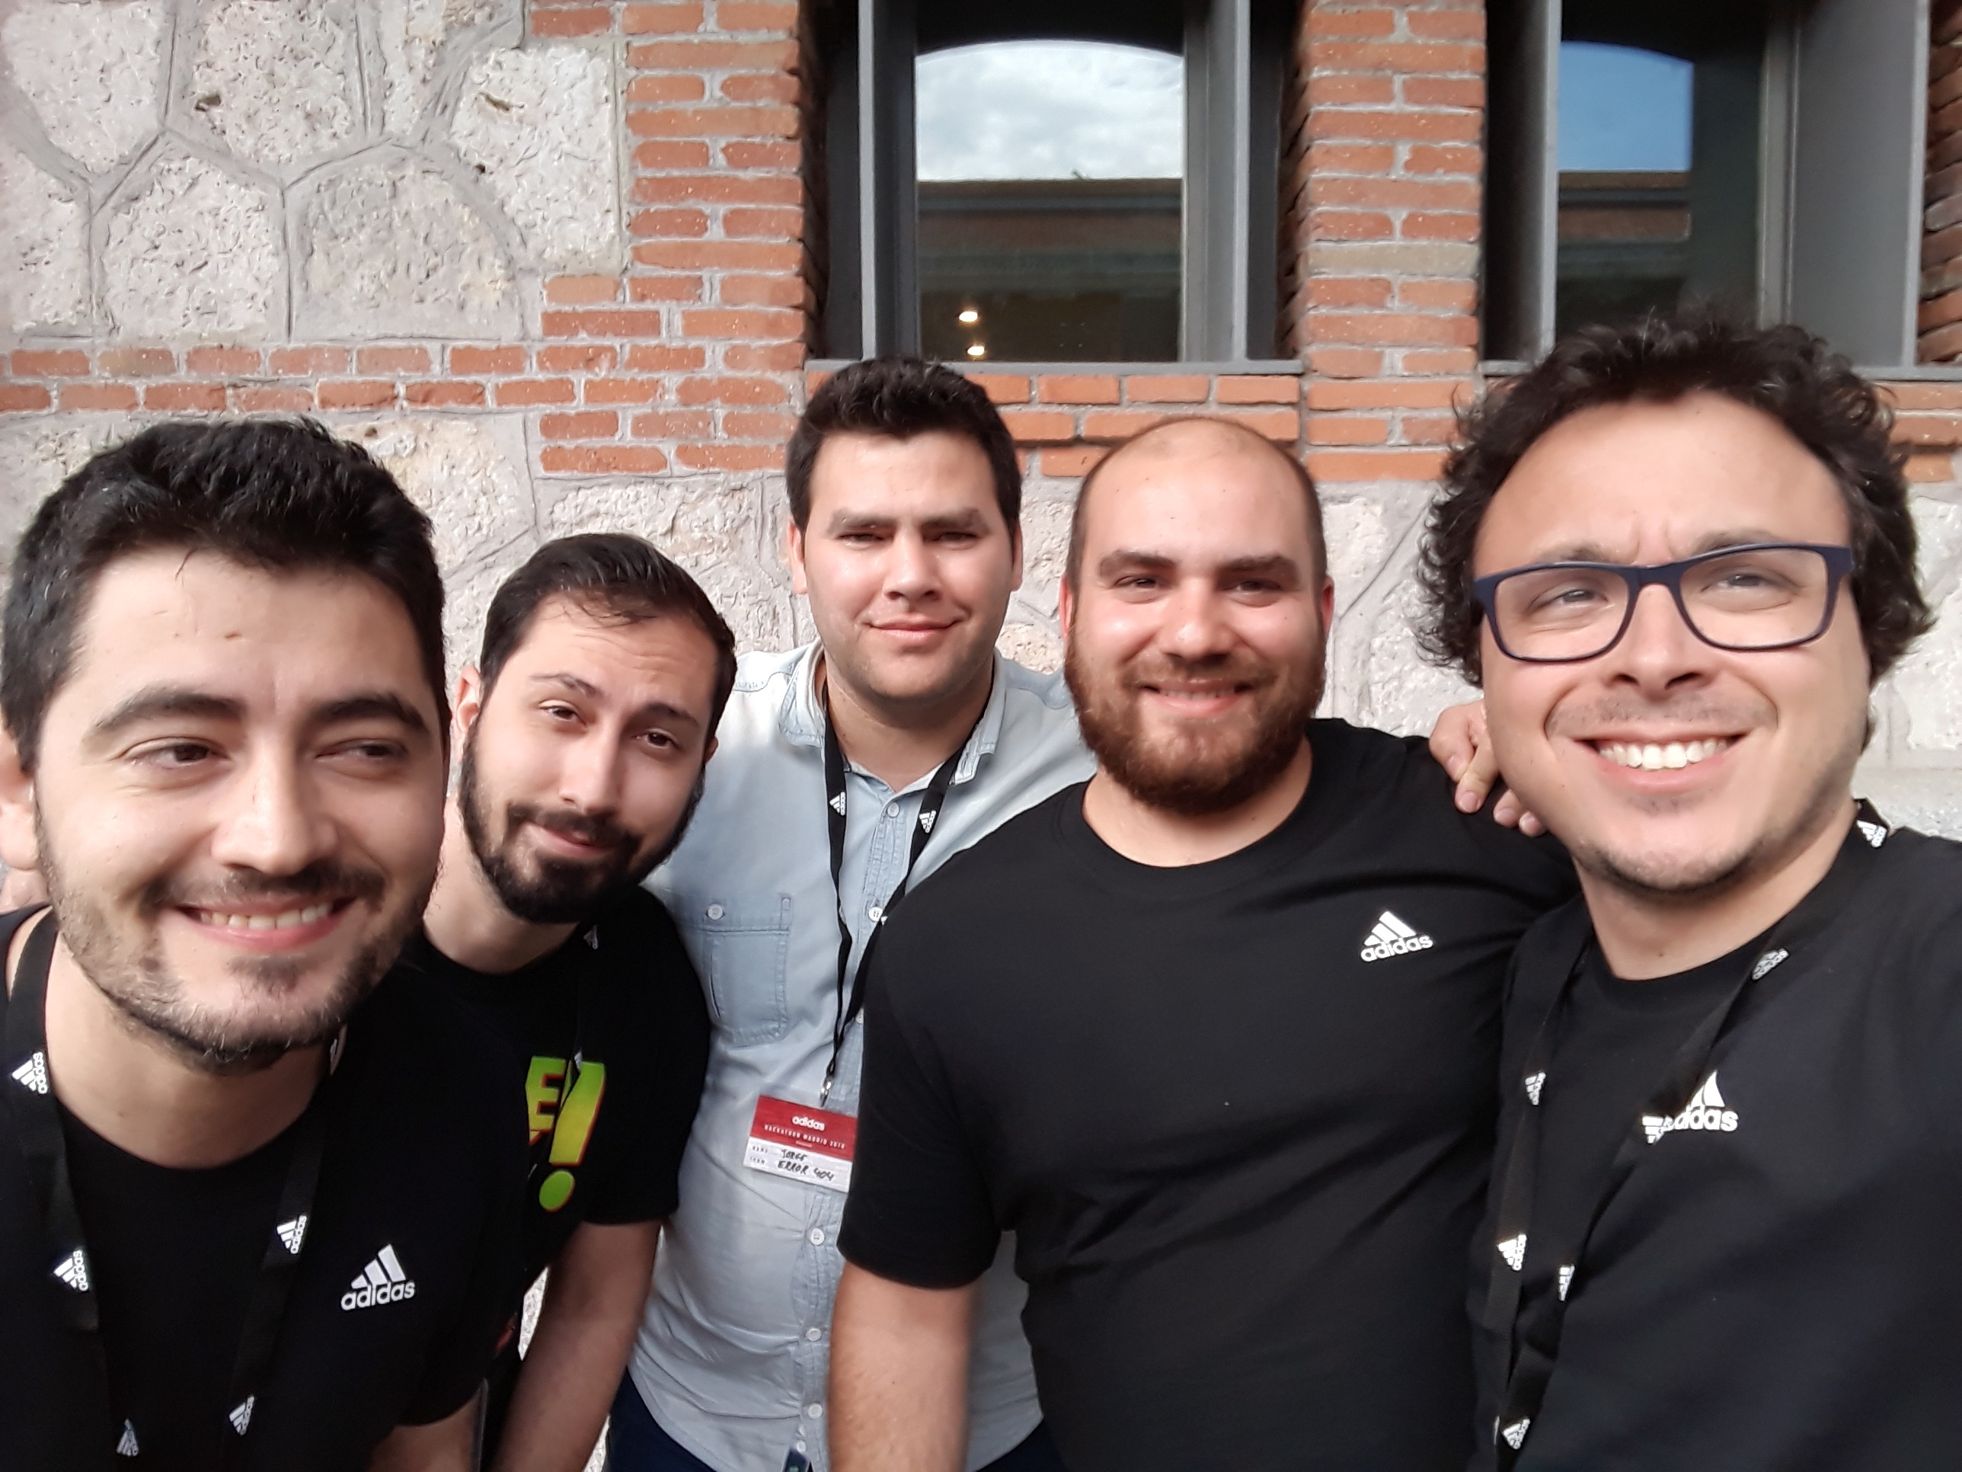


ERROR404
This is us!
Mariano Moreno
Jorge Rivero
Adriano Elorza
Fernando Ortega
Rolando González
IoT with Machine Learning
Machine Learning
TECHNOLOGIES
Big Data
IoT

Slide 2
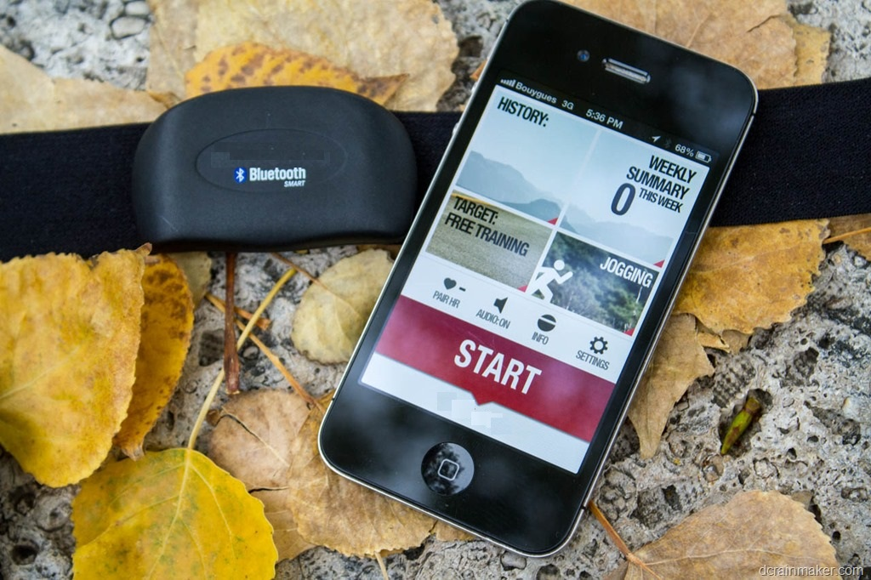
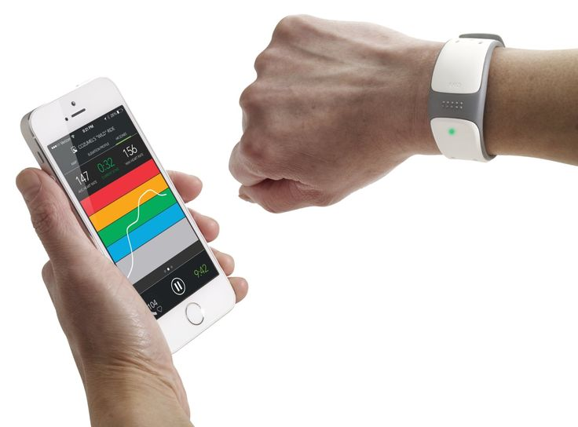
ERROR404
IoT with Machine Learning
Problem!
While playing sports…
We want to play.
But… What is the user doing?

Slide 3
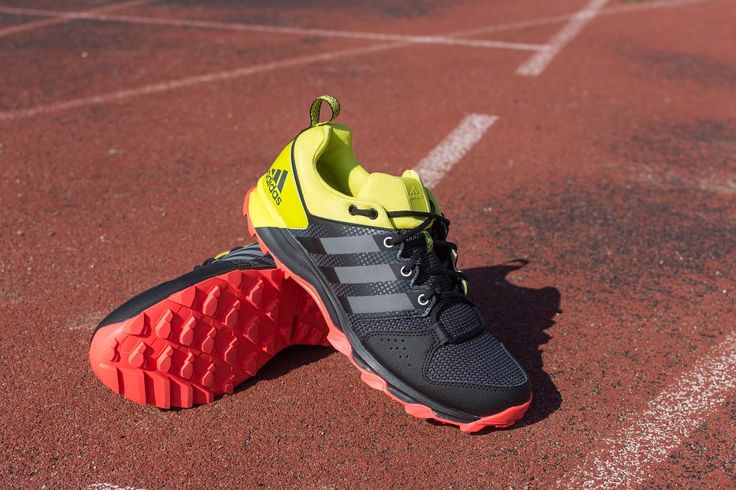
ssss
ERROR404
IoT with Machine Learning
Idea
Wear and forget!
Acelerometer
Sensors

Slide 4
ERROR404
IoT with Machine Learning
Architecture
Wearable
Mobile Phone
&
Web App
{ "JSONSHOE": [ { "id": "01", "timestamp": "yyyy-mm-dd 00:00:00", "sensor": "leftfeet", "axisx" : "9.8", "axisy" : "0.4", "axisz" : "-5.2" } ] }
API
It’s playing tennis!
Product Recomendations
Statistics
{
"JSONPHONE": [ { “[…]
"sensorData": [( "sensorType": "leftfeet", "latitude": "44.968046", "longitude" : "-94.420307", "axisx" : "9.8", "axisy" : "0.4", "axisz" : "-5.2" ), […]
ML

Slide 5
ERROR404
IoT with Machine Learning
ML
Data
Model
training/building
Training Set
Model Testing
Final
Model
OK
Results!
NOT OK
I mean tennis
Setting
ModelParameters

Slide 6
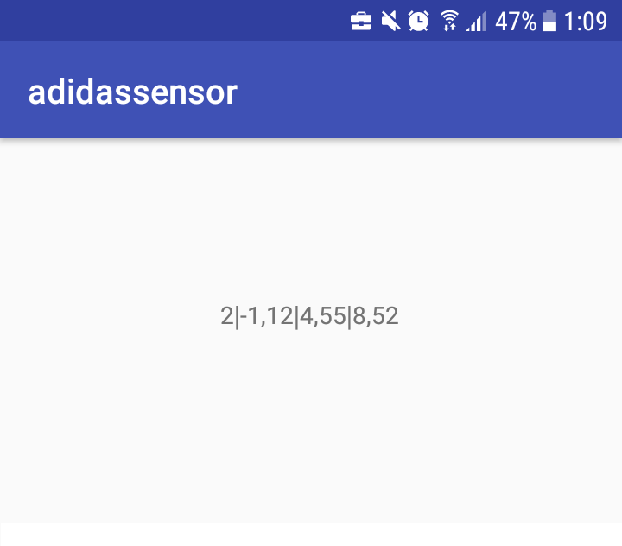
ERROR404
IoT with Machine Learning
Model
How we train…. the Model?
Wearable
ML Training
Android APP
TensorFlow, Keras, Python
{
"JSONPHONE": [ { “[…]
"sensorData": [( "sensorType": "leftfeet", "latitude": "44.968046", "longitude" : "-94.420307", "axisx" : "9.8", "axisy" : "0.4", "axisz" : "-5.2" ), […]

Slide 7

ERROR404
IoT with Machine Learning
Suggestions
www.adidas.es
Suggestions
Products
More use, wear out by use
Sales!
User Data
Products Data Base

Slide 8
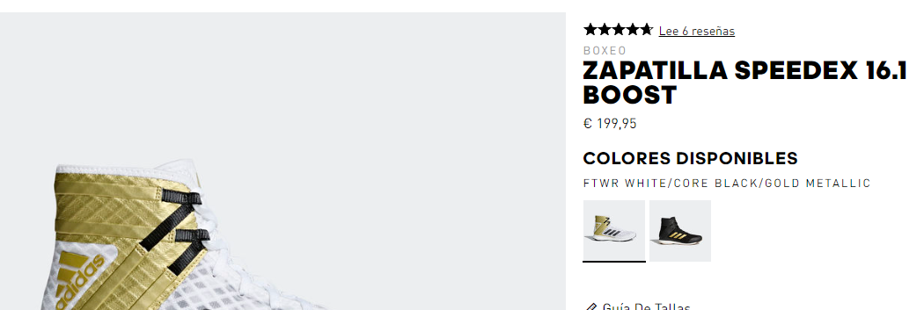
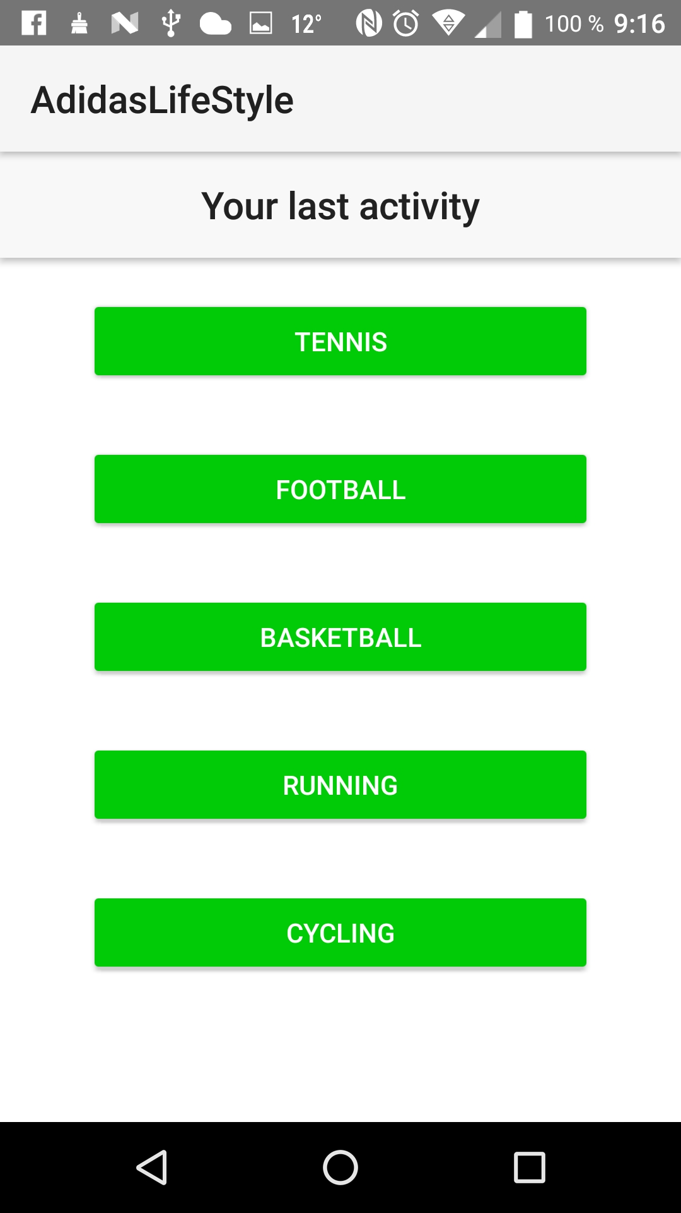
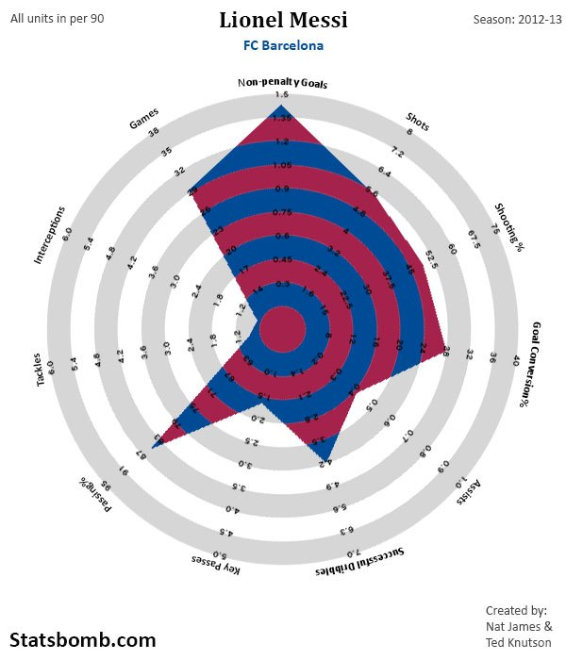
ERROR404
IoT with Machine Learning
Mobile Device
&
WebApp
Suggestions
Metrics

Slide 9

ERROR404
IoT with Machine Learning
Presentation finished
Any questions?

