Slide 1

Diego Gargallo Tarín
Ismael Lanchas
Araceli Manzano Chicano

Slide 2

General scheme
Calendar
- Timeseries forecasting
Mobile UI
Biometrics -
- Sentiment mining
Wearable
Camera
Social Networks
- “fitness buddies”
...
API REST
User’s activity forecasting
Training session prediction
Recommendation engine
Notification time based on user’s activity prediction
Propose new session
based on biometrics and last completed sessions
Show best rated sessions from similar users

Slide 3
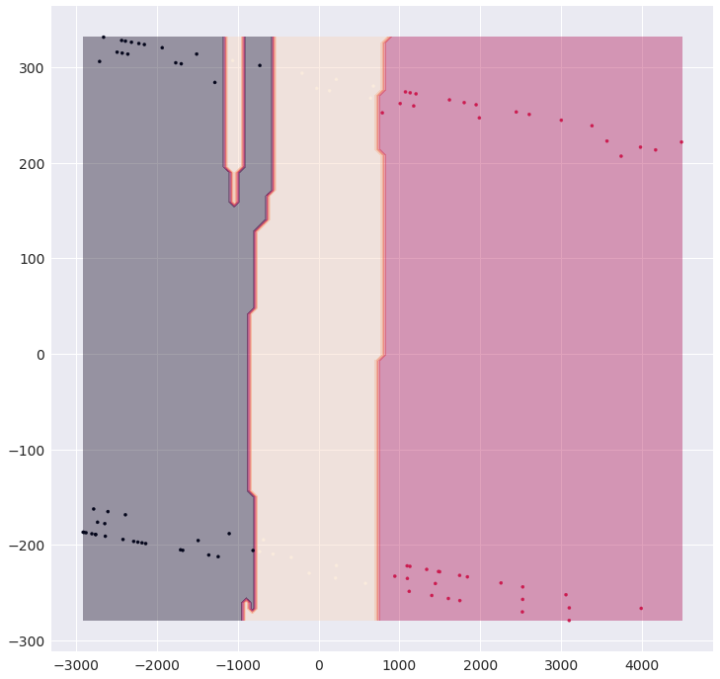
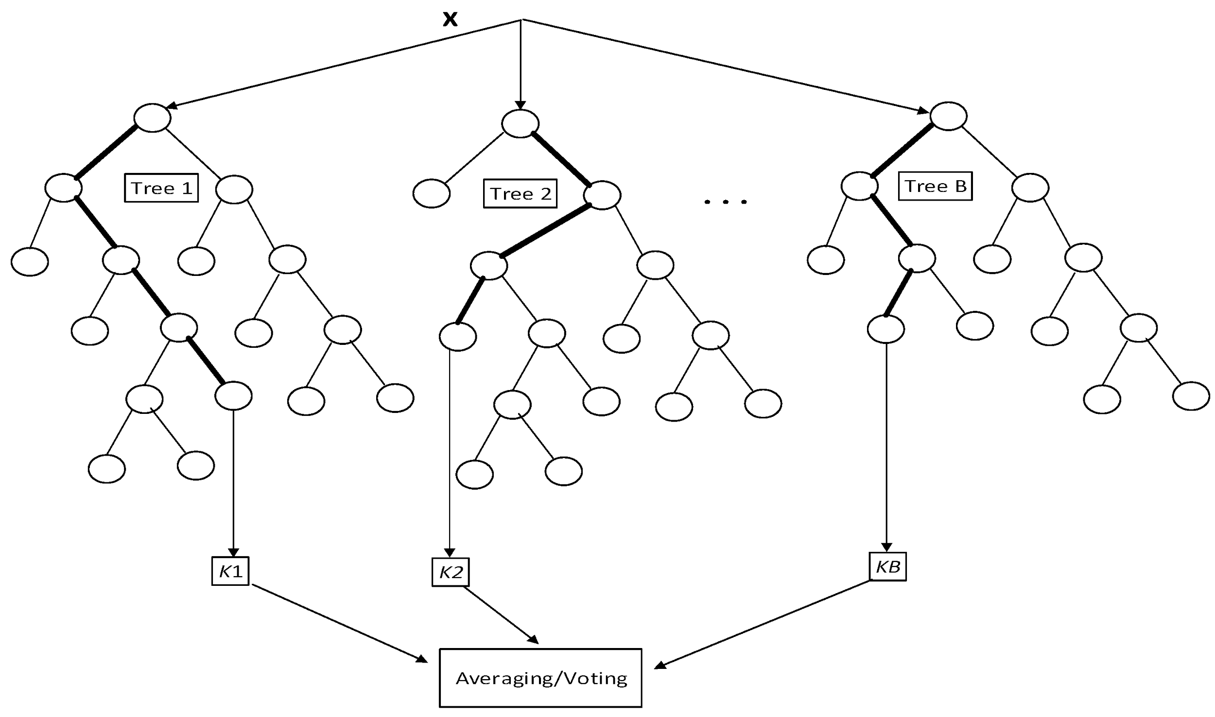
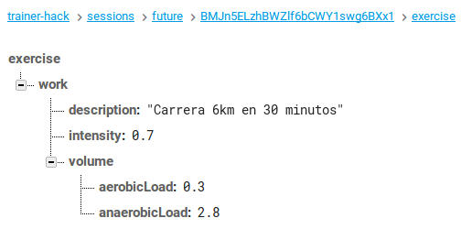
Random Forest Classifier
Classification model
Machine Learning Bagging (Random Forest Classifier) and Boosting (Adaboost/Gradient Boosting Classifier) model selection:
Hyperparameters tuning (mod
Cross-validation (overfitting)
Cross-testing (repetibility)
Input data
Training session prediction

Slide 4
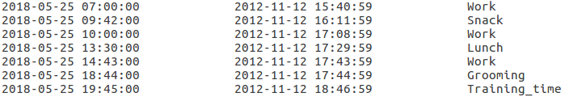

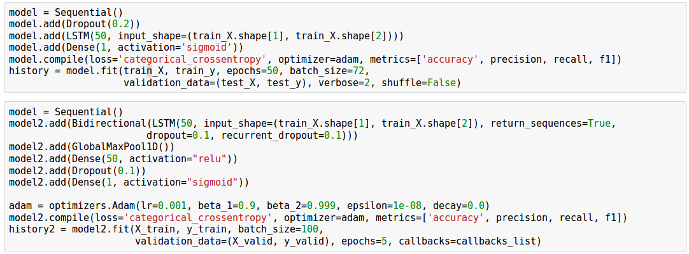
Future models implementation
User’s activity prediction through Timeseries Forecasting
Notification time
...
Personalized trAIner
COACH
ENGAGE
PLAN

Slide 5

Future models implementation
Best rated sessions from similar users, “fitness buddies”
Recommended sessions based on similar users preferences
Recommended users as best “fitness buddies” for a session
Collaborative filtering - ALS Matrix Factorization
This module integrates with the user’s social network, and ranks and recommends users or friends as “fitness buddies” to the user.
Fitness challenges, goal tracking and regularity in fitness activities are decision factors to decide relative ranking.
Enough data is needed for these future implementations.

Slide 6
Video-Demo of the
trAIner
Android App

