Slide 1
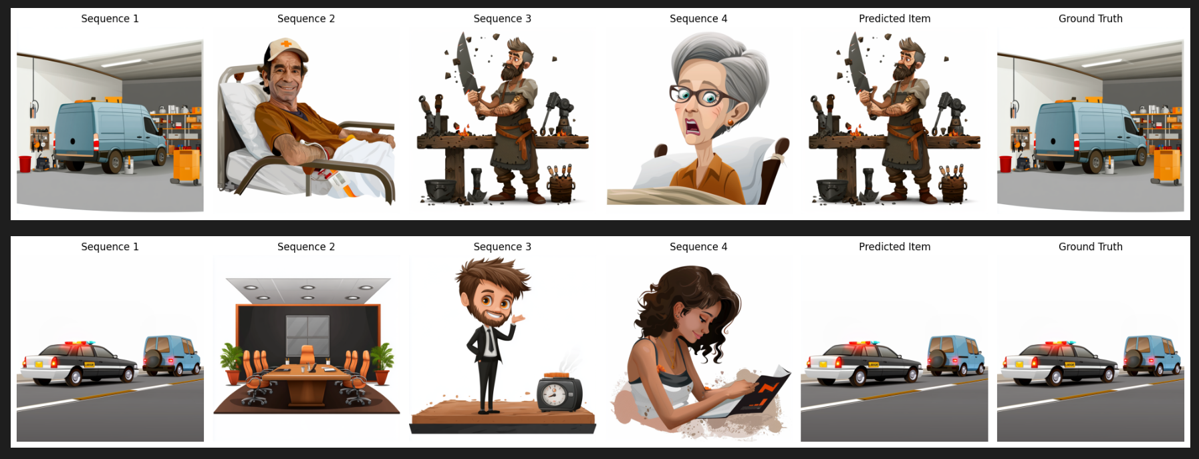
AIS411
Advancing Multimodal Idiomaticity Representation (AdMIRe)
Team: Ziad Moataz, Mohamed Hossam, Mohamed Ahmed, Michael Wagdy
Keywords
Multimodal learning, Image ranking, Sentence-to-image relevance
Idiomatic expressions, Visual-textual alignment, Similarity scoring
Visual storytelling, Sequential reasoning
Story-driven image selection, Contextual image ranking
Fine-Tuning
Sequence Images: Features of preceding images were aggregated using CLIP's image encoder.
Caption Processing: The sequence captions were combined and processed using CLIP's text encoder.
Candidate Prediction: Similarity scores between the combined embeddings and candidate images were computed. Cross-entropy loss was used to fine-tune the model.
Abstract
In our project, we explore two tasks that leverage state-of-the-art machine learning techniques for image-text alignment and ranking. Task A focuses on ranking images based on their semantic alignment with captions using BERT for textual embeddings and ResNet50 for image feature extraction. Task B extends this effort by fine-tuning the CLIP model to predict the next image in a sequence based on textual and visual context. The results from both tasks demonstrate the effectiveness of integrating pre-trained models and custom methodologies in tackling multi-modal ranking and prediction challenges.
Results
Task A
Mean Reciprocal Rank (MRR): 52.78%
Ranking Accuracy: 79.3%
These results indicate that the combined use of BERT and ResNet50 provides a robust approach for multi-modal ranking tasks.
Task B
Training Accuracy: Achieved 75.50% in the final epoch.
Qualitative Evaluation: The visualization function showed that the model effectively predicted the next image in most cases, aligning well with human evaluation.
Introduction
Understanding and aligning images with textual descriptions is a fundamental challenge in multi-modal machine learning. This research is divided into two interconnected tasks:
Task A aims to rank a set of images based on their relevance to a given caption. This task involves the use of BERT for generating contextual embeddings from captions and ResNet50 for extracting visual features from images. These embeddings are combined and compared to compute similarity scores, leading to an ordered ranking of images.
Task B addresses the prediction of the next image in a sequence, given preceding images and textual descriptions. For this task, the CLIP model, fine-tuned on the dataset, is used to integrate image and text features into a unified representation.
Both tasks contribute to advancements in image-text alignment and prediction, providing insights into the potential of state-of-the-art models for real-world applications.
Methodology
Task A: Ranking Image-Caption Pairs Based on Sentence Relevance
Text Embedding:
BERT, a transformer-based model, was used to extract contextual embeddings from captions. The final hidden state of the [CLS] token was taken as the representation of the entire caption.
Image Feature Extraction:
ResNet50, pre-trained on ImageNet, was used to extract visual embeddings from images. The output of the penultimate layer was used as the image representation.
Feature Alignment and Similarity Calculation:
The textual and visual embeddings were projected into a shared space using fully connected layers. Cosine similarity was then computed to rank image-caption pairs based on their alignment with the given sentence.
Evaluation Metrics
Mean Reciprocal Rank (MRR): Evaluates the rank of the first relevant image-caption pair.
Ranking Accuracy: Measures the percentage of pairs correctly ranked.
Task B: Predicting the Next Image in a Sequence
The CLIP model (Vision Transformer and Transformer-based text encoder) was fine-tuned to predict the next image in a sequence based on the context of preceding images and associated captions.
Conclusion And Future Work
This study highlights the potential of pre-trained models like BERT, ResNet50, and CLIP in addressing multi-modal ranking and prediction tasks. The integration of textual and visual embeddings significantly improves alignment and prediction accuracy. Future work will explore:
Fine-tuning BERT and ResNet50 jointly for better feature alignment.
Expanding the dataset to include more diverse image-text pairs.
Investigating transformer-based approaches like BLIP or Flamingo for enhanced performance.
By extending these methodologies, we aim to contribute further to the field of multi-modal machine learning.
References
[1] Markowski, M., Yearley, C., & Bower, H. (2022). Collaborative Learning in Practice (CLiP) in a London maternity ward-a qualitative pilot study. Midwifery, 111, 103360. https://doi.org/10.1016/j.midw.2022.103360
[2] He, W., Vieira, T. K., Garcia, M., Scarton, C., Idiart, M., & Villavicencio, A. (2024). Investigating Idiomaticity in Word Representations. Computational Linguistics, 1–48. https://doi.org/10.1162/coli_a_00546

