Slide 1

Bumblebee
TITLE PAGE
Problem Statement ID – SIH26084
Problem Statement Title – Real-Time Convective-Scale Nowcasting (0–6 h) of Severe Storms using Multi-Source Data Fusion
Theme – Disaster Management / Smart Automation
PS Category – Software
Team ID – 85508 (SIH26084_BUMBLEBEE)
Team Name – Bumblebee
Ministry / Agency – Ministry of Earth Sciences (MoES) & India Meteorological Department (IMD)

Slide 2
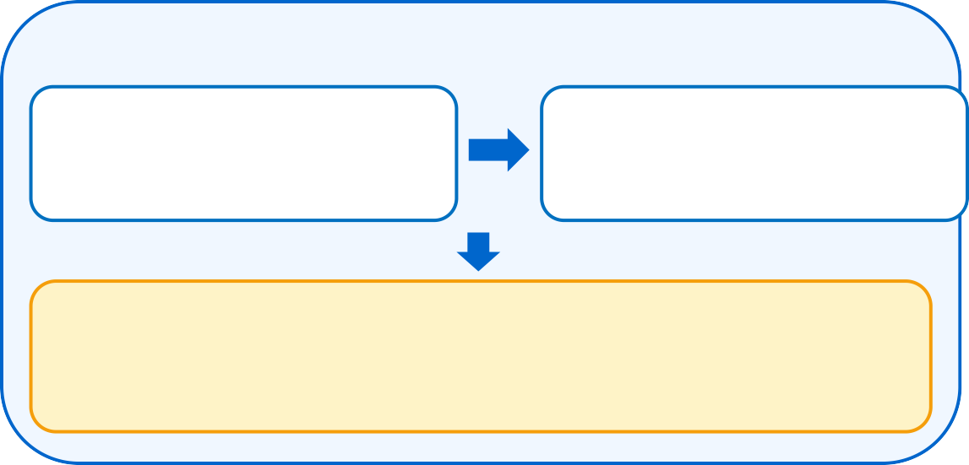

Bumblebee
IDEA TITLE
GIST : BUMBLEBLE fuses radar, INSAT-3DR & lightning data on a 2 km grid to nowcast severe storms 0–6 h ahead, with live arrival countdowns.
IDEA / SOLUTION
Multi-Source Data Fusion – DWR radar, INSAT-3DR IR/WV & lightning on one 2 km grid
Early Storm Detection – cloud-top cooling flags new storms before radar sees them
0–6 h Hazard Nowcast – lightning, hail, gust & cloudburst every 10 min
Live GIS Dashboard – arrival countdowns for 80+ cities, airports & farms
BUMBLEBLE NOWCAST FLOW
UNIQUENESS
Minute-precise countdowns to storm arrival for every city, airport & farm
Survives sensor outages – satellite + lightning fill radar gaps
Self-verifying: live CSI skill vs persistence every cycle
AI assistant + RAG (Gemini) answers from live data in EN / हिन्दी
Real data today: RainViewer radar, Open-Meteo & NASA IMERG
INGEST & FUSE
Real-Time Ingestion & Quality Control
2 km Multi-Source Fusion
radar mosaic · parallax fix · latency alignment
AI Detection & 0–6 h Nowcast
storm tracking · initiation · lightning jump · extrapolation
HAZARD ENGINE
PROBLEM RESOLUTION
Coarse, slow NWP grids → 2 km nowcast every 5–10 min
Storms forming in minutes are caught by satellite CI + lightning jumps
Radar gaps are filled by a satellite + lightning proxy
Vague district warnings replaced by minute-level ETAs per place
Lightning · Hail · Downburst · Cloudburst
ALL CLEAR
No threat in next 6 h
SEVERE THREAT
Countdown + alert issued
Live Demo
http://localhost:8000 · one-click Docker cloud deploy
Demo Modes
Realtime: live RainViewer radar · Simulated: Nor'wester storms
Try Ask AI: “Which cities are at risk?”

Slide 3















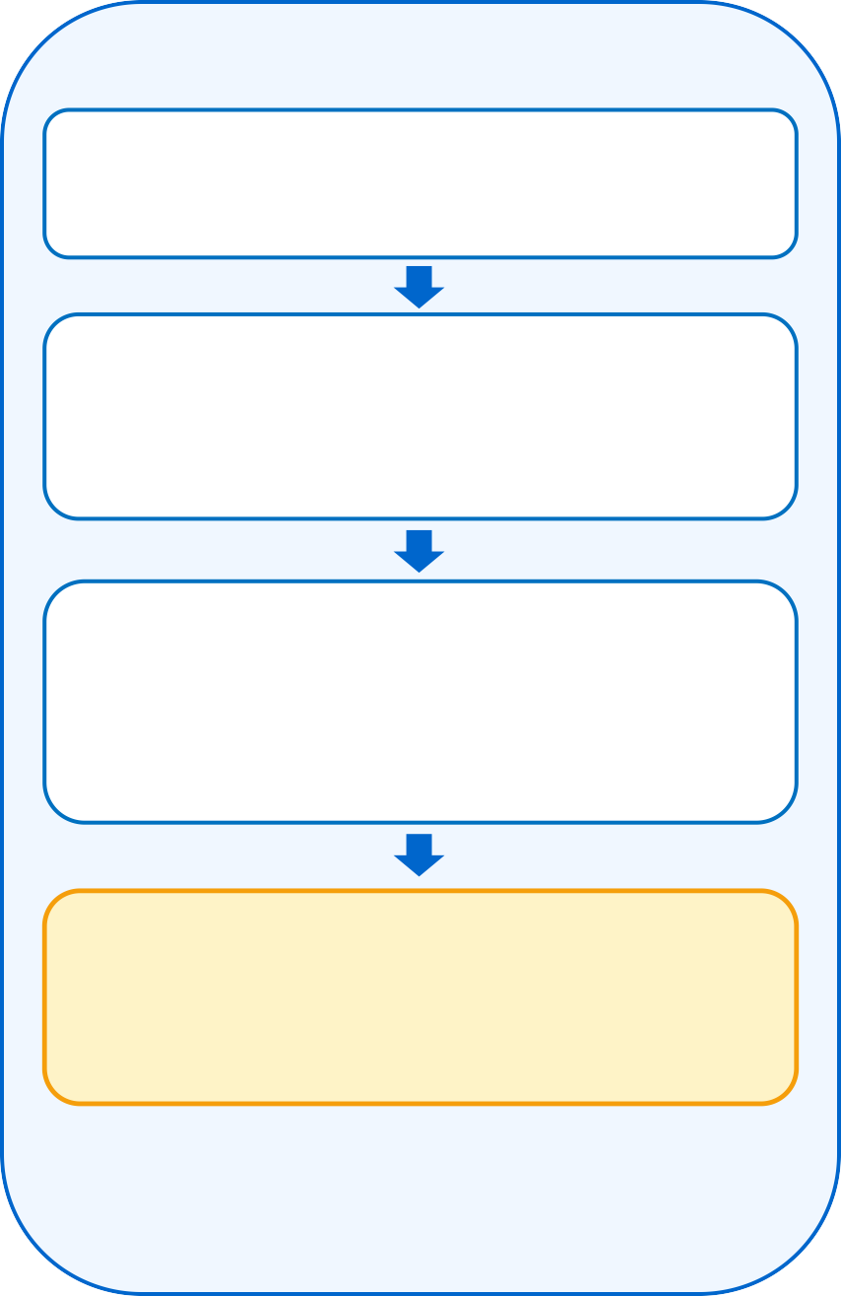
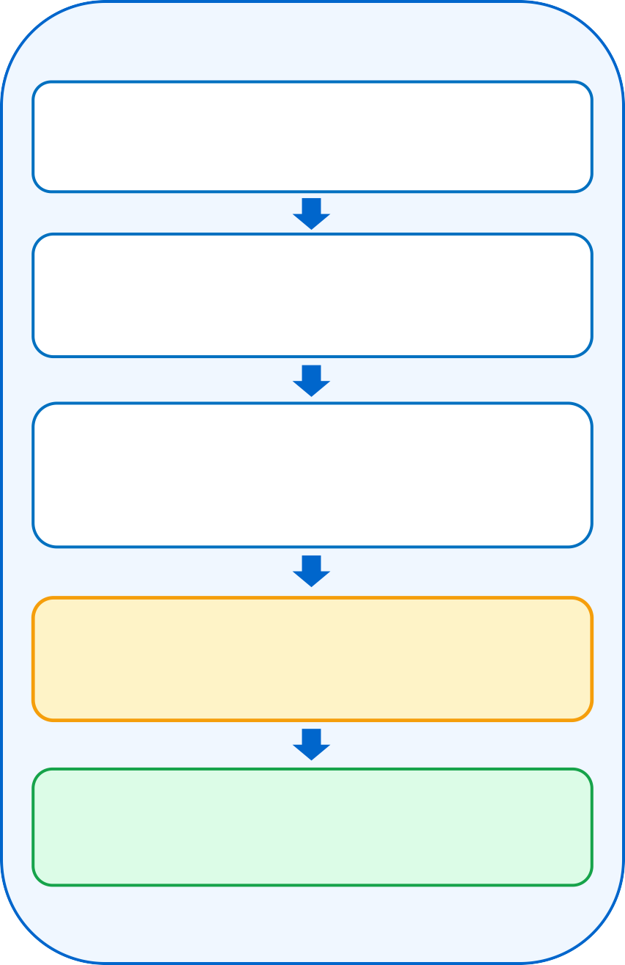














Bumblebee
TECHNICAL APPROACH
FLOW-CHART
TECH STACK
1 · Ingest & Fuse
2 · Detect & Nowcast
3 · Alert & Decide
Python 3
FastAPI
Multi-Source Ingestion
DWR radar · INSAT-3DR · lightning · RainViewer
Storm Motion
FFT phase correlation on radar + IR pairs
Arrival Countdowns
minute-level ETA for 80+ places
NumPy / SciPy
WebSocket
Quality Control
clutter & speckle filter · latency & feed health
Storm & CI Detection
40 dBZ cell tracking · CI · lightning jump
GIS Dashboard + AI
hazard maps · 0–6 h timeline · RAG assistant
Gemini 2.5 Flash
WebGL
2 km Data Fusion
radar mosaic · parallax fix · sat+lightning gap-fill
0–6 h Extrapolation
semi-Lagrangian · growth/decay · new cells
Threat ≥ Moderate?
Leaflet GIS
JavaScript
YES
RainViewer Radar
Open-Meteo
Fused Analysis Grid
reflectivity · cloud-top BT · flash density
Hazard Engine
VIL · Stewart gust · Z–R rain · probabilities
Warnings Issued
banner · browser alert · bulletin / CSV / GeoJSON
NASA GIBS
RAG Engine
Fused grid feeds the
2 · Detect & Nowcast →
Live Verification
CSI / POD / FAR vs persistence baseline
Forecast Improves
skill scored every cycle
ODIM_H5 / HDF5
Docker / Cloud

Slide 4





Bumblebee
FEASIBILITY AND VIABILITY
ANALYSIS OF FEASIBILITY
Economic
Near-zero data cost: free RainViewer, Open-Meteo & NASA feeds today
Funding: MoES / IMD, NDMA & state disaster-tech programmes
Low infrastructure: one CPU container — no GPU or supercomputer
Avoided losses → lives, crops, flights & power lines protected
Technical
Working prototype: full pipeline runs end-to-end today
~7 s per cycle for 37 lead times on a laptop CPU
Containerized (Docker) → free cloud deploy (HF Spaces)
IMD-ready: ODIM_H5 radar, INSAT HDF5 & lightning push API
Scalability
Region presets for East, NE, North, Central, West & South India
Modular pipeline → add radars, satellites & NWP blending
Open standards: ODIM, GeoJSON, REST & WebSocket APIs
Challenges & Risks | How We Overcome Them
No INSAT / lightning feed yet | Adapters built; MOSDAC & IMD/IITM data access
Radar gaps & outages | Satellite + lightning proxy with confidence score
Skill drops after 2–3 h | Widening probabilities; NWP blending on roadmap
AI overload & API keys | Gemini fallback chain → demo mode; keys server-side
False alarms & trust | Live verification; IMD warnings take precedence
KEY METRICS
2 km
grid resolution
(0.02° lat-lon)
0–6 h
lead time in
10-min steps
~7 s
full nowcast cycle
on a laptop CPU
80+
cities, airports
& farms monitored

Slide 5






Bumblebee
IMPACT AND BENEFITS
Social
Safety
Environmental
Economical
Technological
Alerts in English & हिन्दी for all
Early shelter from lightning & squalls
Climate-resilient cloudburst alerts
Protects crops, flights & power
AI data fusion + live GIS nowcasts
WHO BENEFITS
District & State Disaster Authorities
Targeted Warnings – ETA per city & block, not whole districts
Faster Response – teams deployed before the storm arrives
Airports & Aviation
Gust & Wind-Shear Alerts – live countdown for each airport
Safer Operations – plan holds & diversions in advance
Farmers & Rural Communities
Hail & Cloudburst Warnings – protect crops & livestock
Lightning Safety – shelter advice in the local language
NATIONAL IMPACT
Lives & Safety
Fewer Casualties – lightning & storms kill thousands yearly
Disaster Resilience – strengthens IMD & NDMA early warnings
Economic Growth
Crop Protection – timely hail & heavy-rain alerts cut losses
Aviation & Power – fewer diversions and line outages
Digital Leadership
Mission Mausam – supports India's weather-ready goals
Open Integration – GeoJSON, ODIM & REST plug into existing systems

Slide 6
Bumblebee
RESEARCH AND REFERENCES
RESEARCH BASE
Nowcasting & Storm Tracking
Radar Extrapolation – Germann & Zawadzki (2002), Mon. Wea. Rev.
pySTEPS Nowcasting – Pulkkinen et al. (2019), Geosci. Model Dev.
Cell Tracking – Dixon & Wiener (1993) TITAN, J. Atmos. Ocean. Tech.
Convection & Hazards
Convective Initiation – Mecikalski & Bedka (2006) SATCAST, MWR
Lightning Jump – Schultz et al. (2009), J. Appl. Meteor. Climatol.
Hazards & Data Standards
VIL Density Hail – Amburn & Wolf (1997), Weather & Forecasting
Downburst Gust – Stewart (1991) VIL + echo-top relation
Data Standards – EUMETNET ODIM_H5 radar; ISRO MOSDAC INSAT L1B
IMD Criteria – rainfall classes, squall & cloudburst (≥100 mm/h)
Proven Implementations
IMD DWR Network – operational district-level nowcasts
NOAA MRMS & UK Met Office – operational radar nowcasting systems
BENCHMARKING: OUR TECH VS REAL-WORLD SYSTEMS
Feature | Our Approach | Real-World Benchmark
Data Fusion | Radar + INSAT + lightning on a 2 km grid | NOAA MRMS multi-radar multi-sensor
Nowcast Engine | Semi-Lagrangian extrapolation + growth/decay | pySTEPS, UK Met Office STEPS
Storm Tracking | 40 dBZ cell tracking + lightning jump | NCAR TITAN, NOAA lightning-jump
Initiation Detection | IR cloud-top cooling-rate CI | SATCAST (GOES), EUMETSAT NWC SAF
Warning Delivery | City ETAs, GIS map, AI assistant, exports | IMD district nowcasts, Damini app

