Slide 1

Bumblebee
TITLE PAGE
Problem Statement ID – SIH26084
Problem Statement Title – Real-Time Convective-Scale Nowcasting (0–6 h) of Severe Storms using Multi-Source Data Fusion
Theme – Disaster Management / Smart Automation
PS Category – Software
Team ID – 85508 (SIH26084_BUMBLEBEE)
Team Name – Bumblebee
Ministry / Agency – Ministry of Earth Sciences (MoES) & India Meteorological Department (IMD)
Notes:
Good morning. We are Team Bumblebee, solving SIH26084: real-time nowcasting of severe convective storms. Our prototype is called BUMBLEBLE. In one line: it tells every city, airport and village exactly when a thunderstorm will hit them, up to six hours ahead, at 2 km detail.

Slide 2
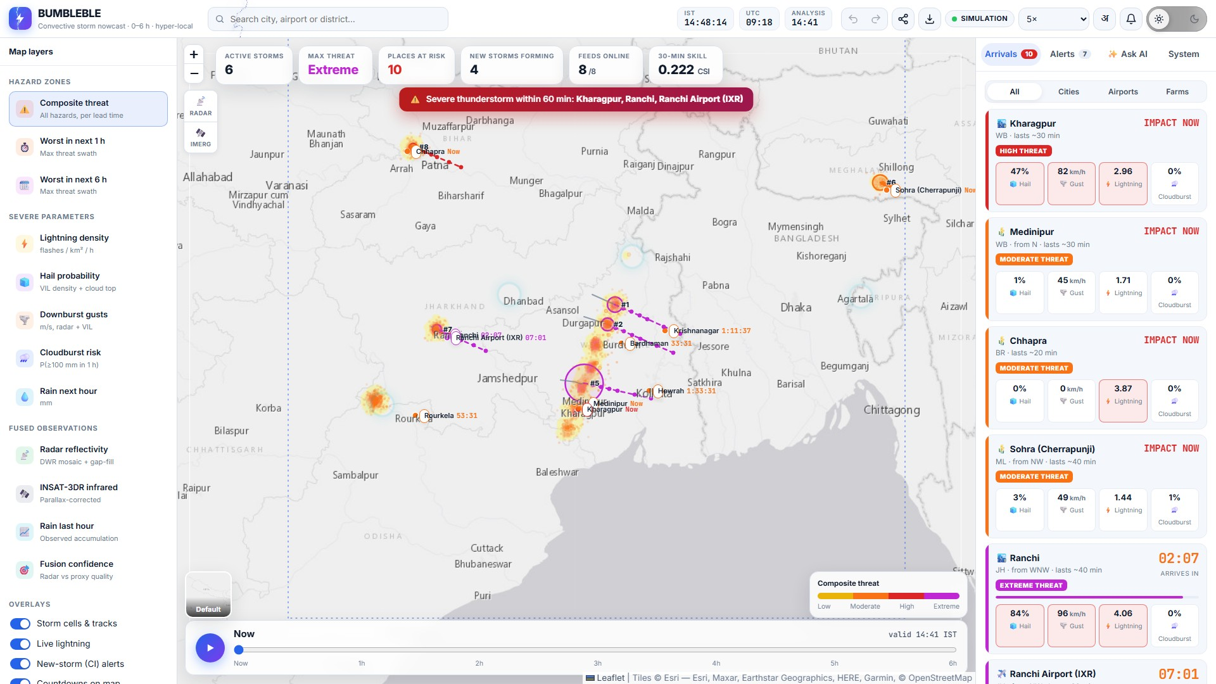
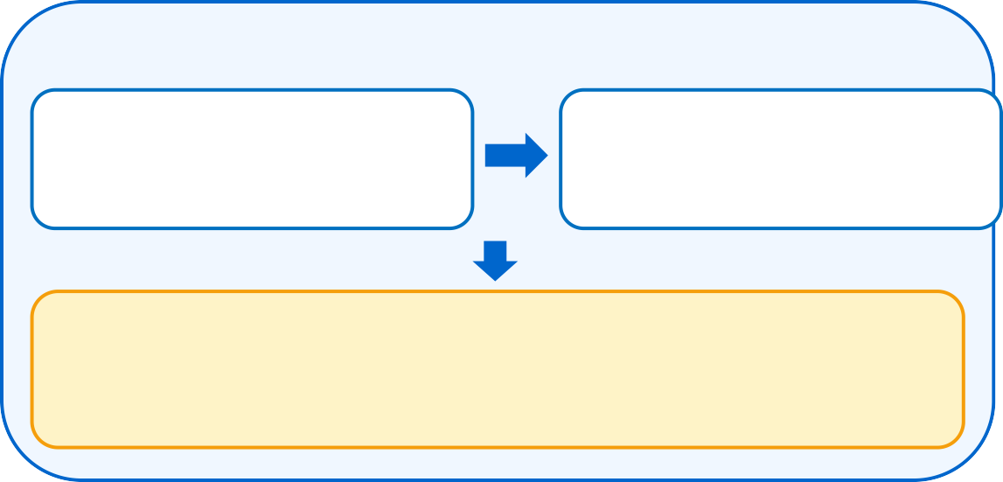

Bumblebee
IDEA TITLE
GIST : BUMBLEBLE fuses radar, INSAT-3DR & lightning data on a 2 km grid to nowcast severe storms 0–6 h ahead, with live arrival countdowns.
IDEA / SOLUTION
Multi-Source Data Fusion – DWR radar, INSAT-3DR IR/WV & lightning on one 2 km grid
Early Storm Detection – cloud-top cooling flags new storms before radar sees them
0–6 h Hazard Nowcast – lightning, hail, gust & cloudburst every 10 min
Live GIS Dashboard – arrival countdowns for 80+ cities, airports & farms
BUMBLEBLE NOWCAST FLOW
UNIQUENESS
Minute-level countdowns for 80+ places
Outage-proof: satellite + lightning fill radar gaps
Self-verifying: skill scored live vs baseline
AI + RAG assistant (Gemini) in EN / हिन्दी
INGEST & FUSE
Real-Time Ingestion & Quality Control
2 km Multi-Source Fusion
radar mosaic · parallax fix · latency alignment
AI Detection & 0–6 h Nowcast
storm tracking · initiation · lightning jump · extrapolation
LIVE PROTOTYPE
HAZARD ENGINE
PROBLEM RESOLUTION
Lightning: India's #1 natural-disaster killer → minute-level shelter alerts
Storms form in minutes – too fast for coarse NWP; we nowcast at 2 km
Radar gaps are filled by a satellite + lightning proxy
Vague district warnings replaced by minute-level ETAs per place
Lightning · Hail · Downburst · Cloudburst
ALL CLEAR
No threat in next 6 h
SEVERE THREAT
Countdown + alert issued
Live dashboard · simulated Nor'wester storm
Live Demo
http://localhost:8000 · one-click Docker cloud deploy
Prototype Status: Working
9/9 automated tests · 150-min storm benchmark
Realtime (live radar) + Simulated Nor'wester demo
Notes:
The problem: lightning is India's biggest natural-disaster killer, and pre-monsoon Nor'westers form in minutes, too fast and too small for weather models. BUMBLEBLE fuses Doppler radar, INSAT-3DR satellite and lightning data on one 2 km grid, spots storms forming before radar sees them, and forecasts four hazards: lightning, hail, downburst winds and cloudbursts. The screenshot is the working prototype: every place gets a live countdown. It keeps working when a radar fails, it scores its own accuracy live, and a Gemini assistant answers questions in English or Hindi.

Slide 3















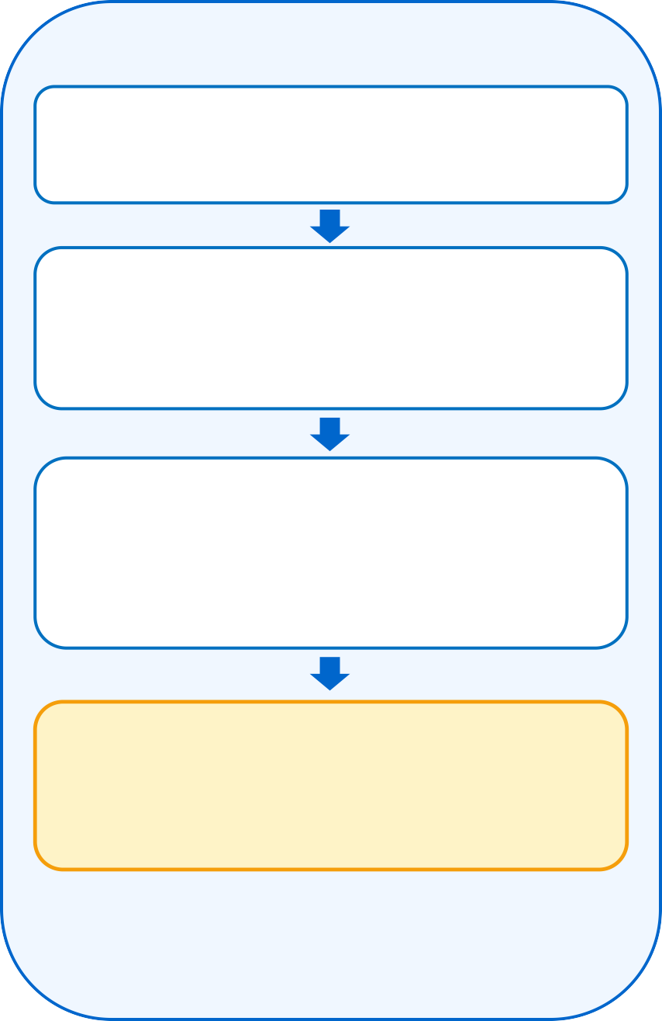
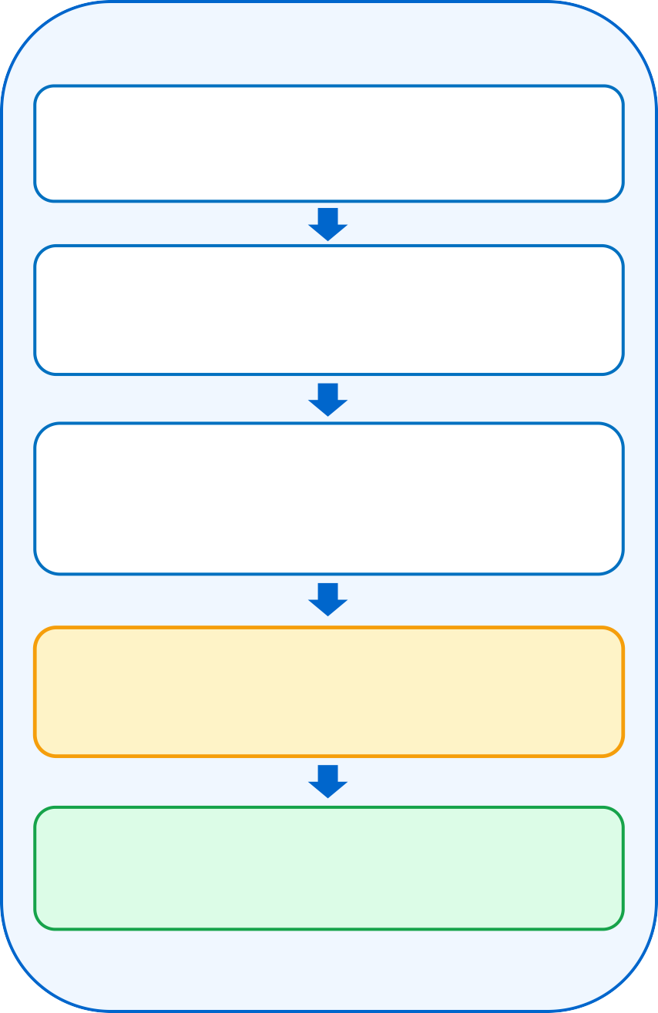














Bumblebee
TECHNICAL APPROACH
FLOW-CHART
TECH STACK
1 · Ingest & Fuse
2 · Detect & Nowcast
3 · Alert & Decide
Python 3
FastAPI
Multi-Source Ingestion
DWR radar · INSAT-3DR · lightning · RainViewer
Storm Motion
FFT phase correlation on radar + IR pairs
Arrival Countdowns
minute-level ETA for 80+ places
NumPy / SciPy
WebSocket
Quality Control
clutter & speckle filter · latency & feed health
Storm & CI Detection
40 dBZ cell tracking · CI · lightning jump
GIS Dashboard + AI
hazard maps · 0–6 h timeline · RAG assistant
Gemini 2.5 Flash
WebGL
2 km Data Fusion
radar mosaic · parallax fix · sat+lightning gap-fill
0–6 h Extrapolation
semi-Lagrangian · growth/decay · new cells
Threat ≥ Moderate?
Leaflet GIS
JavaScript
YES
RainViewer Radar
Open-Meteo
Fused Analysis Grid
reflectivity · cloud-top BT · flash density
Hazard Engine
VIL · Stewart gust · Z–R rain · probabilities
Warnings Issued
banner · browser alert · bulletin / CSV / GeoJSON
NASA GIBS
RAG Engine
Fused grid feeds the
2 · Detect & Nowcast →
Live Verification
CSI / POD / FAR vs persistence baseline
Forecast Improves
skill scored every cycle
ODIM_H5 / HDF5
Docker / Cloud
Notes:
Technically there are three stages. One: ingest and fuse. We quality-control each feed, correct satellite parallax, and build one fused grid. Two: detect and nowcast. We estimate storm motion by FFT phase correlation, track storm cells, detect convective initiation and lightning jumps, then extrapolate 0 to 6 hours with growth and decay. Hazard physics come from published relations: VIL for hail, Stewart's formula for gusts. Three: alert. Arrival countdowns, GIS maps, the AI assistant and exports. The stack is Python, FastAPI, NumPy, Leaflet and WebGL, packaged in one Docker container.

Slide 4





Bumblebee
FEASIBILITY AND VIABILITY
ANALYSIS OF FEASIBILITY
Economic
Near-zero data cost: free RainViewer, Open-Meteo & NASA feeds today
Funding: MoES / IMD, NDMA & state disaster-tech programmes
Low infrastructure: one CPU container — no GPU or supercomputer
Avoided losses → lives, crops, flights & power lines protected
Technical
Working prototype: 9/9 tests pass; runs on live radar
<15 s per cycle for all 37 lead times on a laptop CPU
Containerized (Docker) → free cloud deploy (HF Spaces)
IMD-ready: ODIM_H5 radar, INSAT HDF5 & lightning push API
Scalability
Region presets for East, NE, North, Central, West & South India
Modular pipeline → add radars, satellites & NWP blending
Open standards: ODIM, GeoJSON, REST & WebSocket APIs
Challenges & Risks | How We Overcome Them
No INSAT / lightning feed yet | Adapters built; MOSDAC & IMD/IITM data access
Radar gaps & outages | Satellite + lightning proxy with confidence score
Skill drops after 2–3 h | Widening probabilities; NWP blending on roadmap
AI overload & API keys | Gemini fallback chain → demo mode; keys server-side
False alarms & trust | Live verification; IMD warnings take precedence
KEY METRICS
* 150-min simulated Nor'wester benchmark, 24 verification samples
0.55
forecast skill (CSI)
at 30 min · 7× baseline*
86%
storm areas caught
at 30 min (POD)*
15 min
new storms flagged
before radar*
<15 s
full 0–6 h forecast
on a laptop CPU
Notes:
It is feasible today. Data cost is near zero: we already run on free live radar, and the IMD and INSAT adapters are built. It needs one CPU container: a full 0-to-6-hour forecast takes under 15 seconds on a laptop. In a 150-minute simulated Nor'wester, our 30-minute forecast scored a CSI of 0.55, seven times better than persistence, caught 86% of storm areas, and flagged new storms about 15 minutes before radar. The main risk is access to INSAT and lightning feeds, which we address through MOSDAC and IMD/IITM data access; meanwhile the system degrades gracefully.

Slide 5






Bumblebee
IMPACT AND BENEFITS
Social
Safety
Environmental
Economical
Technological
Alerts in English & हिन्दी for all
Early shelter from lightning & squalls
Climate-resilient cloudburst alerts
Protects crops, flights & power
AI data fusion + live GIS nowcasts
WHO BENEFITS
District & State Disaster Authorities
Targeted Warnings – ETA per city & block, not whole districts
Faster Response – teams deployed before the storm arrives
Airports & Aviation
Gust & Wind-Shear Alerts – live countdown for each airport
Safer Operations – plan holds & diversions in advance
Farmers & Rural Communities
Hail & Cloudburst Warnings – protect crops & livestock
Lightning Safety – shelter advice in the local language
NATIONAL IMPACT
Lives & Safety
Fewer Casualties – lightning & storms kill thousands yearly
Disaster Resilience – strengthens IMD & NDMA early warnings
Economic Growth
Crop Protection – timely hail & heavy-rain alerts cut losses
Aviation & Power – fewer diversions and line outages
Digital Leadership
Mission Mausam – supports India's weather-ready goals
Open Integration – GeoJSON, ODIM & REST plug into existing systems
Notes:
Impact: district authorities get block-level warnings instead of district-wide ones; airports get gust and wind-shear countdowns; farmers get hail and cloudburst warnings in their language. Nationally this saves lives from lightning, protects crops, flights and power lines, and supports Mission Mausam with open, plug-in standards.

Slide 6
Bumblebee
RESEARCH AND REFERENCES
RESEARCH BASE
Nowcasting & Storm Tracking
Radar Extrapolation – Germann & Zawadzki (2002), Mon. Wea. Rev.
pySTEPS Nowcasting – Pulkkinen et al. (2019), Geosci. Model Dev.
Cell Tracking – Dixon & Wiener (1993) TITAN, J. Atmos. Ocean. Tech.
Convection & Hazards
Convective Initiation – Mecikalski & Bedka (2006) SATCAST, MWR
Lightning Jump – Schultz et al. (2009), J. Appl. Meteor. Climatol.
Hazards & Data Standards
VIL Density Hail – Amburn & Wolf (1997), Weather & Forecasting
Downburst Gust – Stewart (1991) VIL + echo-top relation
Data Standards – EUMETNET ODIM_H5 radar; ISRO MOSDAC INSAT L1B
IMD Criteria – rainfall classes, squall & cloudburst (≥100 mm/h)
Proven Implementations
IMD DWR Network – operational district-level nowcasts
NOAA MRMS & UK Met Office – operational radar nowcasting systems
BENCHMARKING: OUR TECH VS REAL-WORLD SYSTEMS
Feature | Our Approach | Real-World Benchmark
Data Fusion | Radar + INSAT + lightning on a 2 km grid | NOAA MRMS multi-radar multi-sensor
Nowcast Engine | Semi-Lagrangian extrapolation + growth/decay | pySTEPS, UK Met Office STEPS
Storm Tracking | 40 dBZ cell tracking + lightning jump | NCAR TITAN, NOAA lightning-jump
Initiation Detection | IR cloud-top cooling-rate CI | SATCAST (GOES), EUMETSAT NWC SAF
Warning Delivery | City ETAs, GIS map, AI assistant, exports | IMD district nowcasts, Damini app
Notes:
Our methods are grounded in published research: radar extrapolation, pySTEPS, TITAN cell tracking, SATCAST convective initiation, the lightning-jump algorithm, VIL-density hail and Stewart gusts. And we benchmark ourselves against operational systems like NOAA MRMS, UK Met Office STEPS, EUMETSAT and IMD's own nowcasts.

Slide 7
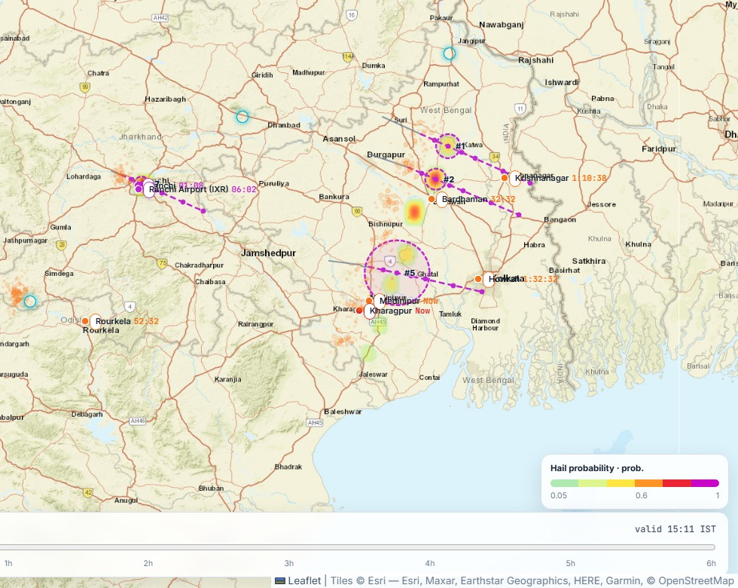
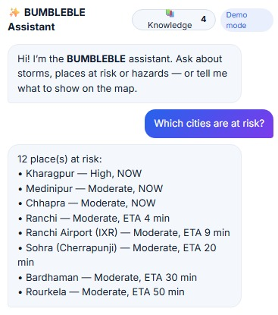
Bumblebee
WORKING PROTOTYPE
LIVE DASHBOARD · SIMULATED NOR'WESTER
FORECAST · AI ASSISTANT · PROOF
Hail probability · +30 min forecast
AI assistant · live answer
9/9
automated tests pass
37
forecast steps, 0–6 h
80+
places with countdowns
Storm tracking – 6 storm cells with 0–2 h forecast tracks
Live countdowns – e.g. Ranchi 02:07, Ranchi Airport 07:01
Severe banner – Extreme-threat cards with hail, gust & lightning
0–6 h timeline – scrub or animate every 10-min forecast
Verified skill – CSI 0.55 at 30 min, 7× persistence*
Early warning – new storms flagged ~15 min before radar*
Real data – live RainViewer radar frames every 10 min
Deploy anywhere – one Docker container · free cloud hosting
* 150-min simulated Nor'wester benchmark
Notes:
This is not a concept, it is running. Left: the live dashboard during a simulated Nor'wester: tracked storms, countdowns and a severe-weather banner. Right: the 30-minute hail forecast and the AI assistant answering from live data. Everything is tested, runs on real radar today, and deploys as one container. Thank you. We'd love to show you the live demo.

