Slide 1

Bumblebee
TITLE PAGE
Problem Statement ID – SIH26188 (SIH26288)
Problem Statement Title – AI-Based Fake Identity & Document Screening System
Theme – Security & Surveillance / Smart Automation
PS Category – Software
Team ID – 85508 (SIH26188_BUMBLEBEE)
Team Name – Bumblebee
Ministry / Agency – Ministry of Home Affairs & Bureau of Immigration

Slide 2
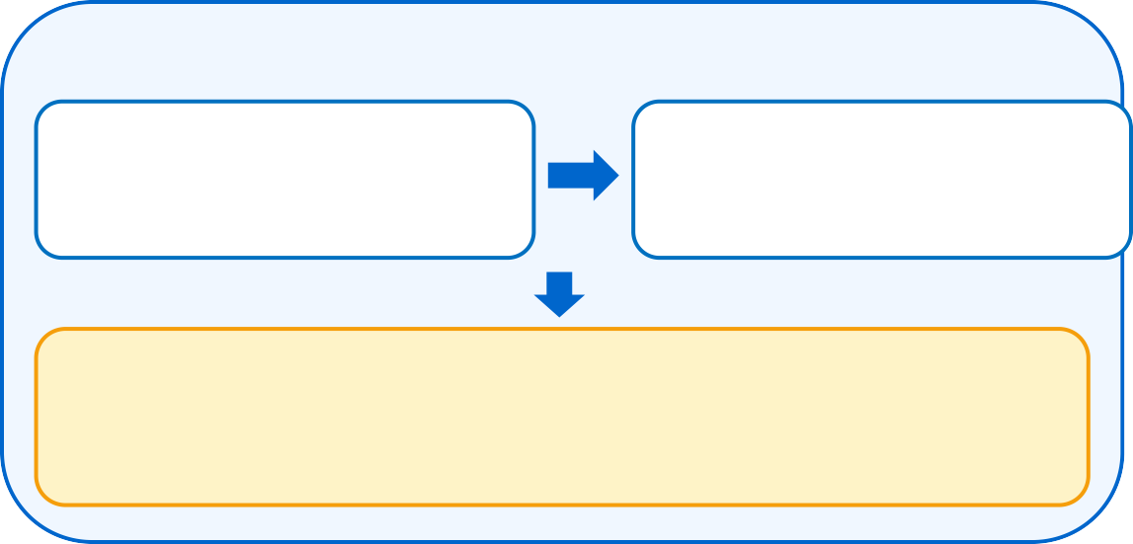

Bumblebee
IDEA TITLE
GIST : AI border-screening workstation that fuses multi-spectral forensics, OCR/MRZ checks and face biometrics to stop forged travel documents in real time.
IDEA / SOLUTION
Multi-Spectral AI Forensics – UV 365nm, IR ink & ELA analysis
Multimodal OCR + MRZ – ICAO 7-3-1 checksum on 10 fields
1:1 Face Match – FaceNet 128-d with 3D passive liveness
Explainable Verdict – XAI boxes + SHA-256 audit ledger
BUMBLEBEE SCREENING FLOW
UNIQUENESS
Reads the "Digital DNA" of passports, visas & IDs
Simulates UV/IR physics – no costly scanner hardware
Zero-Trust privacy: biometrics processed in-memory, never stored
Auto-failover (Gemini → heuristics) keeps screening running
Credit-optimized RAG: <140 tokens per scan
DOCUMENT GATE
Document Intake & Sanity Check
Multimodal OCR · MRZ 7-3-1
10 structured fields
Multi-Spectral Forensics & ICAO Checksum
UV 365nm · IR ink · ELA · Modulo 7-3-1
BIOMETRIC GATE
PROBLEM RESOLUTION
Manual checks take ~300s → cleared in <1.8s
Microscopic tampering (photo swaps, font shifts) is caught
Spoofs via screens, prints & masks are blocked
Officer fatigue replaced by evidence-backed decisions
CCTV Cam-04 → FaceNet 128-d + 3D Liveness
AUTHENTIC
e-Gate opens
FORGED / IMPOSTER
Alert dispatched
Live Demo
https://sih26188sampleeee.vercel.app/
Officer Login
ID: alkesh (or hardik / kshama) · Passcode: 8604058608
Role: Authorized Border Intelligence Officer

Slide 3















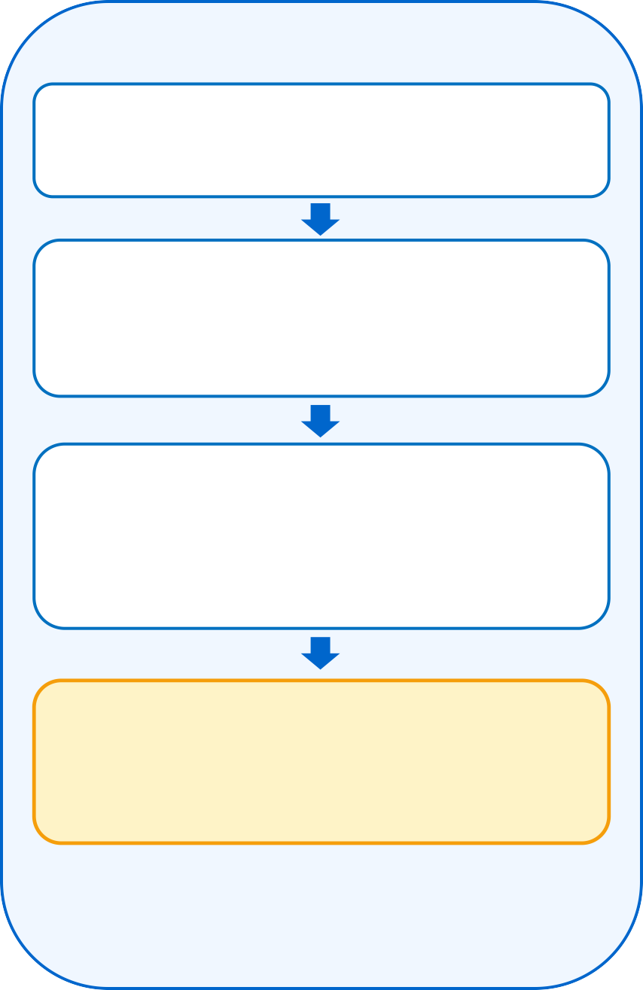
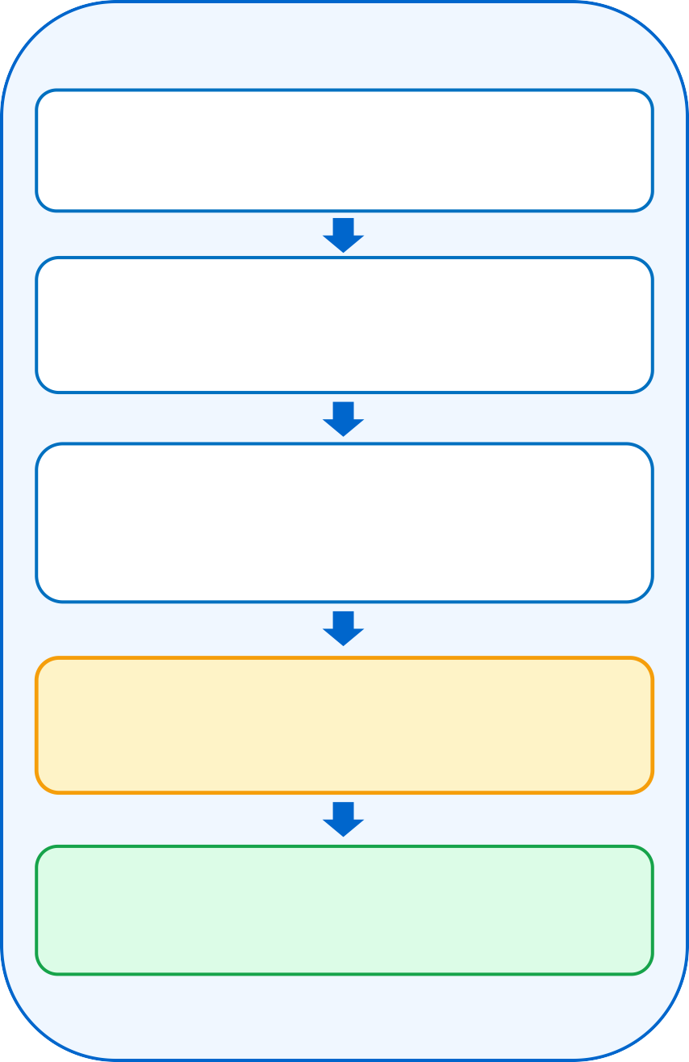
Bumblebee
TECHNICAL APPROACH
FLOW-CHART
TECH STACK
1 · Document Forensics
2 · Biometrics & Ledger
3 · Officer Review & Learning
React 18
TypeScript
Upload Travel Document
Passport / Visa / WebRTC Cam-04
FaceNet 128-d Face Match
Live CCTV Cam-04 vs document portrait
Flagged Document Queued
Sent for officer inspection
Python 3
OpenCV
OCR & MRZ 7-3-1
10 fields · ICAO Doc 9303 checksums
3D Passive Liveness
Blocks screens, prints & silicone masks
Officer Forensics Workstation
UV / IR / ELA views + AI bounding boxes
Gemini Flash
FaceNet 3D
AI Forensics Scan
UV fibres · IR ink · ELA · font kerning
Cryptographic Integrity
SHA-256 hash + Modulo-7 validation
Authentic?
Tailwind CSS
Vite / Vercel
YES
SHA-256
ICAO Doc 9303
Result: Verified / Flagged
XAI rationale + Bayesian risk score
Result: Passenger Verified
Cosine match >85% · zero vector storage
Ground-Truth Baseline
Expands RAG vector cache
Lucide React
RAG Engine
Flagged documents route to
3 · Officer Review →
Immutable Audit Trail
SHA-256 legal chain of custody
Model Improves
Continuous few-shot tuning
WebRTC Cam
Docker / K8s

Slide 4





Bumblebee
FEASIBILITY AND VIABILITY
ANALYSIS OF FEASIBILITY
Economic
B2G revenue: kiosk licences, e-Gate SaaS & integrations
Funding: CSR & digitization grants (MHA, Bureau of Immigration)
Zero capex: runs on existing border PCs & scanners
Low marginal cost → national-scale public savings
Technical
Proven stack: Gemini Flash, OpenCV, FaceNet, ICAO 9303
Live prototype already deployed on Vercel Edge
Containerized (Docker/K8s) → portable & resilient
e-Gate ready: REST APIs + WebRTC video streams
Scalability
Demand across airports, seaports & land borders
Modular 7-stage pipeline → phased national rollout
Compliance-ready: BoI, MHA, ICAO & DPDP Act
Challenges & Risks | How We Overcome Them
Offline border outposts | Heuristic fallback engine + local caching
Adoption & integration | Plug-and-play REST API / SDK + bulk scanner ingestion
AI accuracy & deepfakes | UV/IR physics simulation + 3D passive liveness
Insider threats & fraud | Immutable SHA-256 ledger + dual-officer sign-off
Passenger data privacy | In-memory matching, zero storage (DPDP / GDPR)
KEY METRICS
<1.8s
per verification
(vs 300s manual)
60–70%
manpower & admin
savings
<₹0.05
cost per
passenger
100K+
daily screenings,
<5% infra overhead

Slide 5






Bumblebee
IMPACT AND BENEFITS
Social
Security
Environmental
Economical
Technological
Public trust in border governance
Stops trafficking & fake identities
Paperless dossiers, no idle queues
Saves crores lost to document fraud
Multimodal AI + SHA-256 ledger
WHO BENEFITS
Immigration Bureau & MHA
Clearance Throughput – 300% boost at automated e-Gates
Reduced Workload – officers review only AI-flagged documents
Border Control Officers
Instant Authenticity – real-time Modulo-7 & multi-spectral checks
Cognitive Relief – XAI rationale removes guesswork
International Travellers
Frictionless Transit – no waiting queues at e-Gates
Biometric Privacy – in-memory matching, zero storage
NATIONAL IMPACT
Trust & Enforcement
Border Integrity – blocks forged & synthetic identities
Global Enforcement – links border data to Interpol & MHA watchlists
Economic Growth
Cost Efficiency – lower verification cost per traveller
Tourism & Commerce – faster transit boosts trade & business travel
Digital Leadership
Global Standards – India as a pioneer in ICAO 9303 AI screening
Tech Adoption – drives multimodal AI & biometric innovation

Slide 6
Bumblebee
RESEARCH AND REFERENCES
RESEARCH BASE
AI Forensics & OCR
Deep Learning – CNNs (Springer 2020) + Vision Transformers
Error Level Analysis – Krawetz (2007), JPEG quantization
Multimodal Vision – Google Gemini Flash technical report
Biometrics & Identity
Facial Embeddings – Schroff et al. (2015) FaceNet, IEEE CVPR
Presentation Attack – ISO/IEC 30107 liveness framework
Security Standards
ICAO Doc 9303 – MRTDs & Modulo-7 check digits
ISO/IEC 19794-5 – facial image interchange format
NIST FIPS 180-4 – SHA-256 hashing; TLS 1.3 transport
DPDP Act 2023 & GDPR – zero-persistence biometrics
Proven Implementations
DigiLocker – India's credential verification benchmark
Estonia e-Gates & Singapore Changi – automated border clearance
BENCHMARKING: OUR TECH VS REAL-WORLD SYSTEMS
Feature | Our Research Base | Real-World Benchmark
Document Forensics | CNNs, ViT anomaly detection, ELA, UV/IR | Frontex & Interpol forensic audits
OCR & MRZ Standards | Multimodal Vision + ICAO 9303 checksums | DigiLocker OCR pipelines, e-Passports
Biometric Identity | FaceNet 128-d + 3D liveness | Singapore Changi, US CBP e-Gates
Security Protocols | AES-256, TLS 1.3, SHA-256 ledger | Govt. standards (India + EU e-Gov)
Digital Audit Trail | SHA-256 evidentiary chain | Estonia e-Gov KSI Blockchain

