Slide 1




ImmoEliza
Data Analysis
BeCode - Data Science and AI Bootcamp
Presenters: Aleksander Szostakowski, Celina Bolanos,
Miriam Stoehr
22 November, 2024
Notes:
Topics to Present:
- Introduction of Dataset & Data Cleaning (Step 1) --> Alek
* How did we handle duplicates, missing
values, errors, blank spaces etc.
* Description of Dataset
- Data Analysis (Step 2) --> Miriam
* Qualitative and quantitative variables
and how we transformed them
* Correlation between other variables
* Correlation between variables and price
* Variables with greatest and least impact
on price
* Most important variables and which we
would delete (Miriam?)
* Details on correlations between price and most important variables:
* Mean price by living area (Miriam)
* Mean price by bedroom number (Miriam?)
* Mean prices by provinces and geographical distribution (Alek)
- Data Interpretation --> All ?
* Outliers (?)
* Number of properties according to their
surface using a histogram (?)
* Questions on most and least expensive
municipalities (Celina?)
* Bonus questions (?)

Slide 2


Introduction of Dataset
We startet with raw_data.csv, a product of web scrapping.
26 147 rows, 17 columns
'zip_code', 'commune', 'province', 'type_of_property', 'subtype_of_property', 'price', 'building_condition', 'facade_number', 'living_area', 'equipped_kitchen', 'bedroom_nr', 'swimming_pool', 'furnished', 'open_fire', 'terrace', 'garden', 'plot_surface'

Slide 3
Step 1: Data Cleaning and Preprocessing

Slide 4
Data Cleaning & Preprocessing
Duplicates have been delt with during scraping phase (immoweb id)
Dropped 36 rows with missing price and 5 with living_area equals 0
Missing 9362 entries for facade_number filled based on median value of appropriate subtype_of_property
Kitchen data cleaned and normalized: not installed, installed, equipped
Building condition had 6690 values missing, without sure way to fill it we introduced ‘no info’, ‘to restore’, ‘to renovate’, ‘good’

Slide 5
Property subtype
36 different subtypes of properties in initial dataset
first step: eliminate ‘units’, e.g. apartment unit -> apartment
second step: create 5 large categories
1 (Luxury Properties): 'mansion', 'castle', 'exceptional property', 'villa'
2 (Houses): 'house', 'bungalow', 'town house', 'manor house', 'duplex', 'triplex'
3 (Apartments): 'apartment', 'flat studio', 'penthouse', 'ground floor', 'loft', 'kot'
4 (Rural): 'country cottage', 'farmhouse', 'chalet'
5 (Other): 'other property', 'mixed use building', 'service flat', 'apartment block'

Slide 6
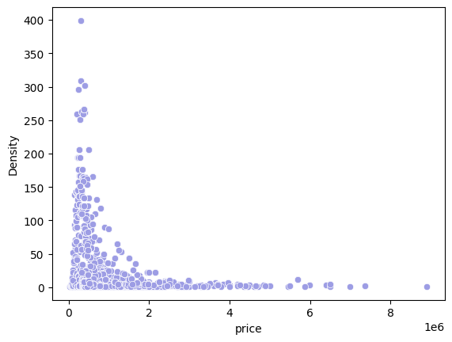
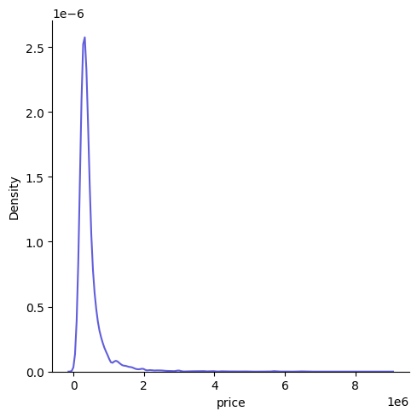
Outliers
There’s a very clear maximum of value density
around 500,000 Euro. Almost no price values over 2,000,000 Euro.

Slide 7
Step 2: Data Analysis

Slide 8

Encoding of Qualitative Features
6 Quantitative and 11 Qualitative Features
Binary Encoding:
Label Encoding:
Based on Categories Ranked by Average Price
Type of Property
Swimming Pool
Furnished
Equipped Kitchen
Open Fire
Terrace
Province
Subtype of Property
Building Condition
Notes:
- Some of the features here mentioned as qualitative such as furnished, open fire, etc. were encoded as binary while scraping with 1 for yes and 0 for no
- Terrace is mentioned as qualitative feature, since we decided to encode it binary as for many properties we had to information that there was a terrace but no indication of the surface area

Slide 9
How Are the Features Correlated to Each Other?

Slide 10
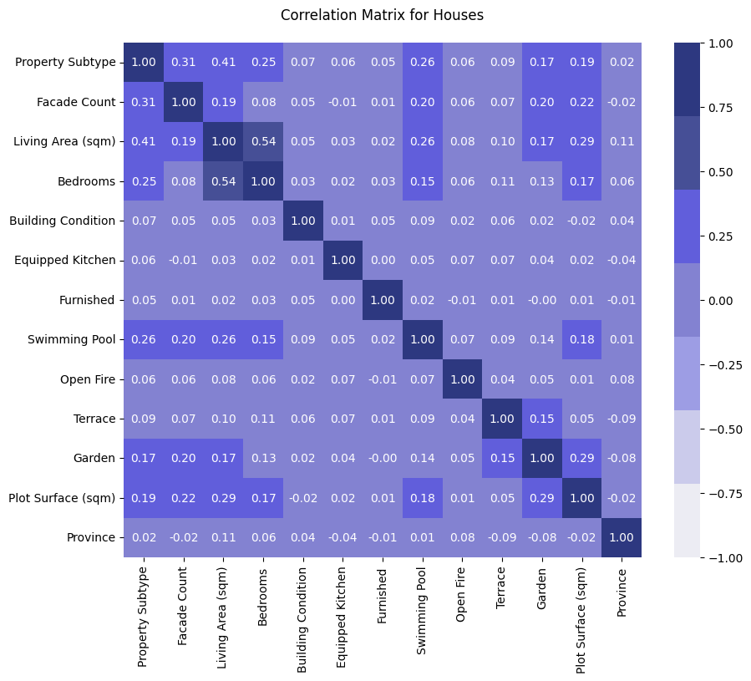
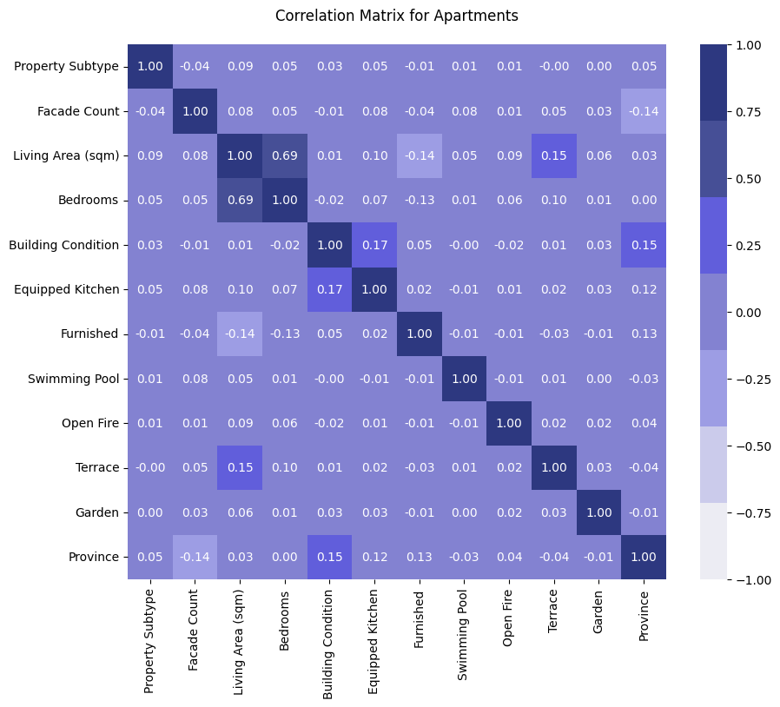

Notes:
* Separation between Houses and Apartments since both types have quite different features
Houses:
* Property subtype + facade count & Swimming pool
* Living area & Property subtype, bedroos, swimming pool and plot surface
* Plot Surface & Garden
-> Logical correlations
Apartments:
* Overall much weaker correlations than for houses
* Higher correlation between living are and bedrooms than houses (for houses at some point rooms get bigger rather than more)
* Negative correlation between living area and furnished -> smaller apartments slightly more likely to be furnished
* Equipped kitchen and building condition -> e.g. renovated apartments
-> Overall confirms our assumptions

Slide 11
What is the Correlation Between the Price and Other Features?

Slide 12
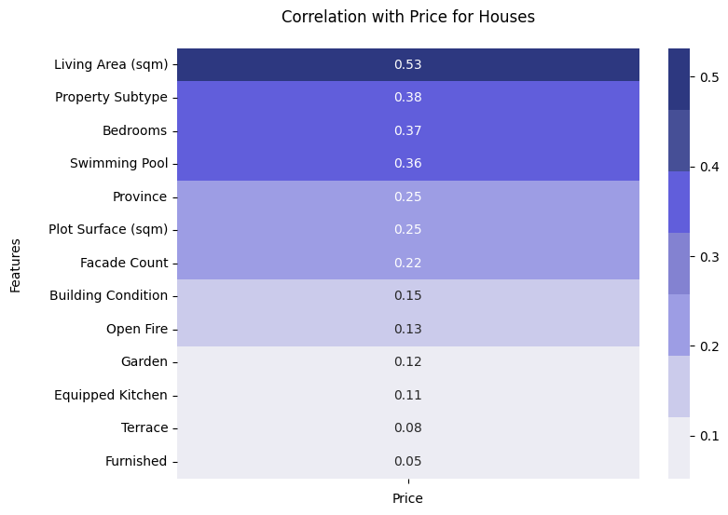
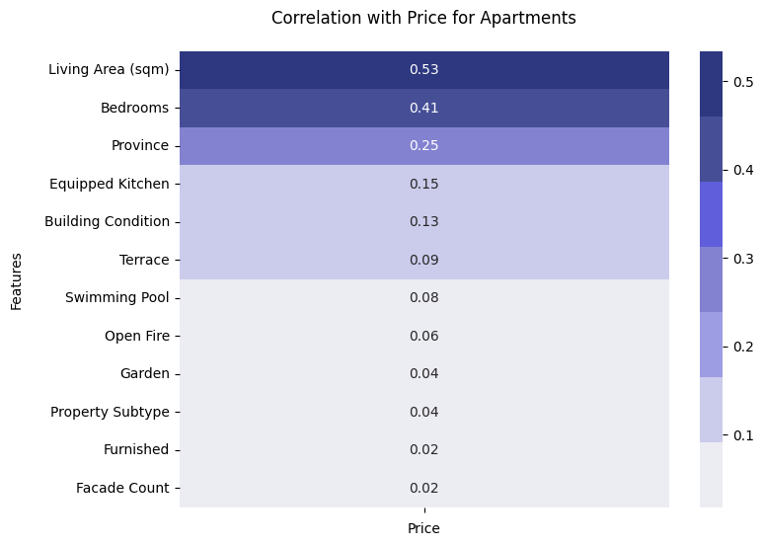

Notes:
Houses:
- Living area (the bigger the more expensive)
- Property subtype (since we ordered the subtypes by mean price)
- Number of bedrooms (aligns with living area)
- Swimming Pool (which is correlated to living area)
- Province -> locality
Apartments:
- Living area (same as houses)
- Bedrooms (same)
- Province (same correlatio index, but higher in rank)
- Features like equipped kitchen and building condition
Logically weaker correlations:
- Swimming pool, open fire, garden since as we saw, overall weak correlations for apartments
Interesting/ surprising:
- Subtype of property have a much bigger impact on the price for houses than for apartments, probably since the luxury and extraordinary properties such as castles, manors, villas, etc. which have a high weight on price are more prevalent among houses than apartments

Slide 13
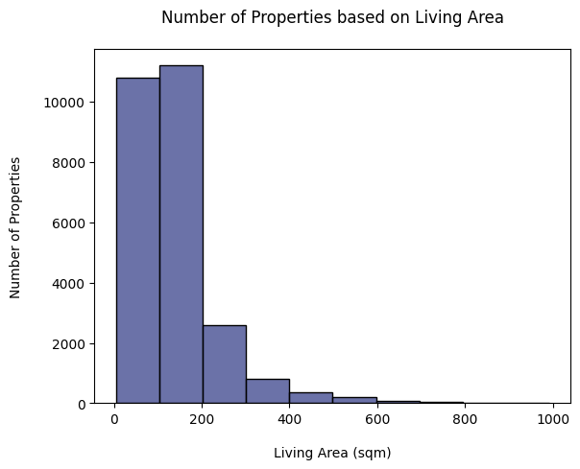

Distribution Based on Living Space
Notes:
* Shows a concentration of data points up to 200 sqm
* This is confirmed when looking at the scatter plot

Slide 14
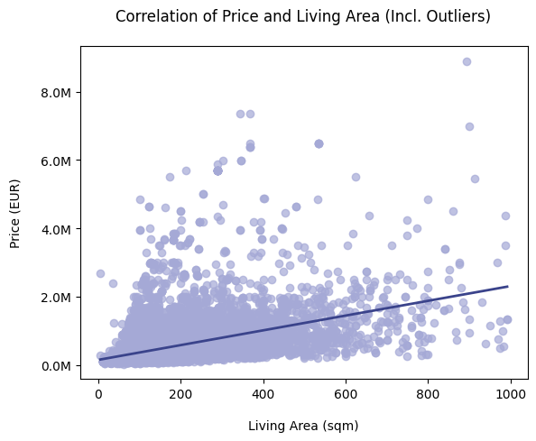
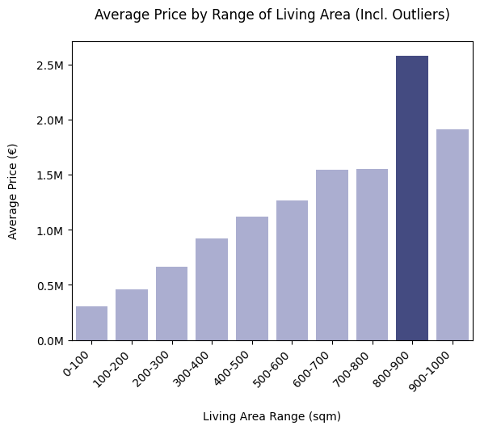
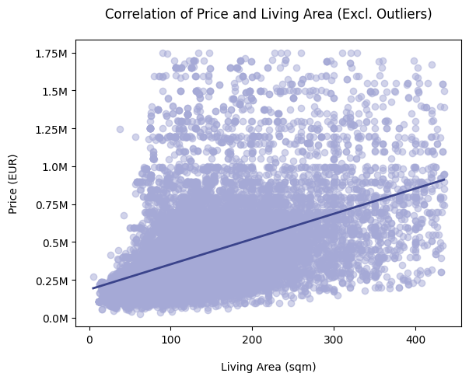
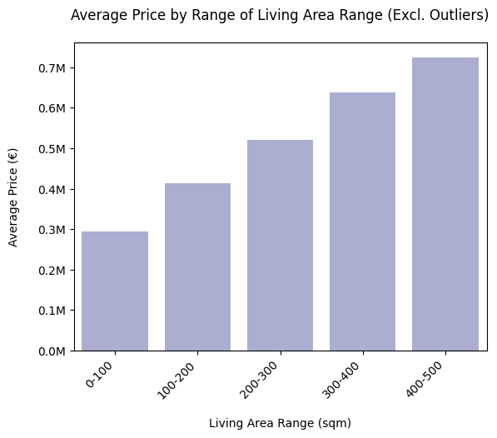
Notes:
* Both, kinds of plots show similar trend with and without outliers, with steadily increasing price per increasing living area.
* Comparison with and without outliers show sharp cut in dataset & since the data points calculated as outliers represent for the most part valid properties, we decided to include them.
* Only excluded data points: Properties below 12 sqm as the price and other features show that these data points are errors.
* Impact of the outliers most visible in bar plot showing the distribution of the average price per range of living area, where they lead to the range from 800-900 sqm to be the most expensive.

Slide 15
Step 3: Data Interpretation

Slide 16
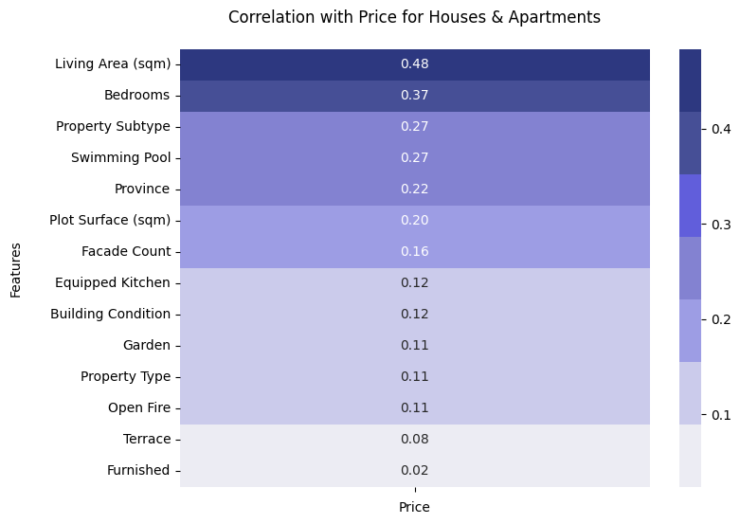
Most & Least Important Features
Most Important Features
Living Area
Property Subtype
Locality
Swimming Pool
Plot Surface
Least Important Features
Furnished
Number of Facades
Terrace Surface
Open Fire
Notes:
- Living Area for both types most important for price
- Property Subtypes : less important for apartments, but for houses it has a big impact
- Not Bedrooms since connected with living area, as seen
- Locality as very important for apartments as well as for houses
- Plot surface and Swimming Pool particularly for houses

Slide 17
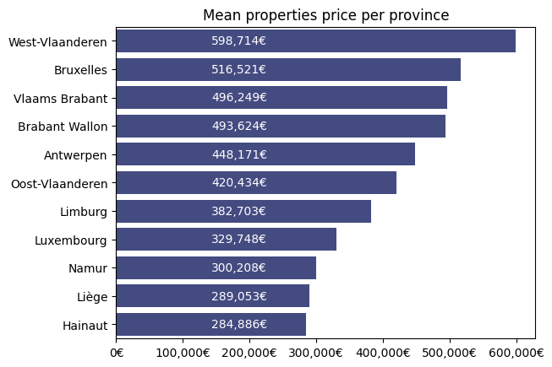
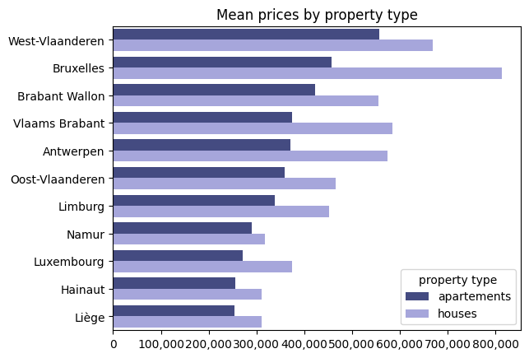
Mean property prices in different Belgian provinces

Slide 18
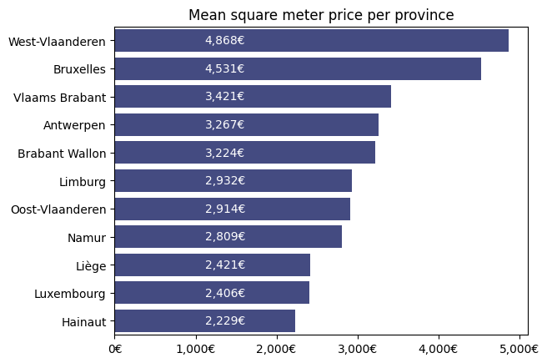
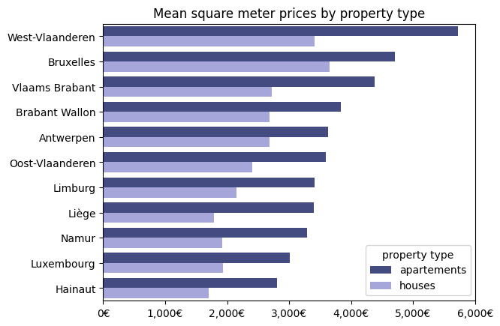
Mean sqm prices in different Belgian provinces

Slide 19
Most and least expensive municipalities
in Belgium
Analysis criteria:
Average price
Median price
Price per square meter
Communes with at least 20 observations

Slide 20
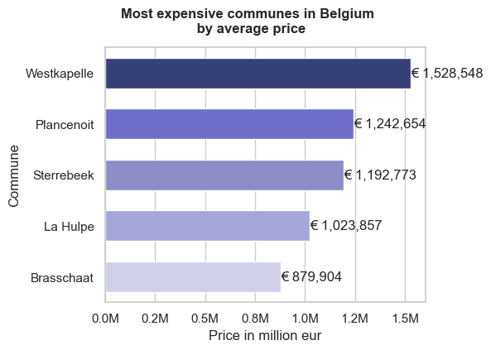
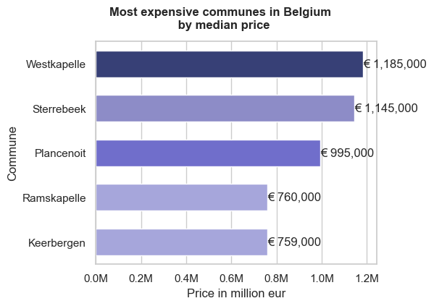
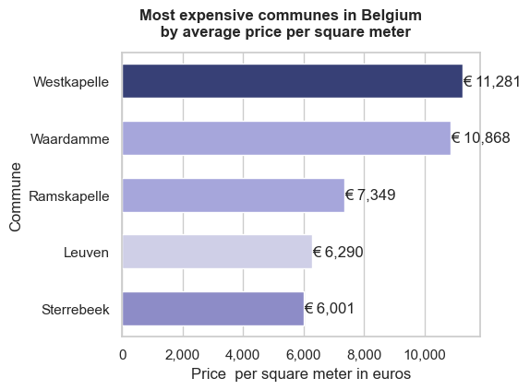
Most expensive municipalities in Belgium
Westkapelle

Slide 21
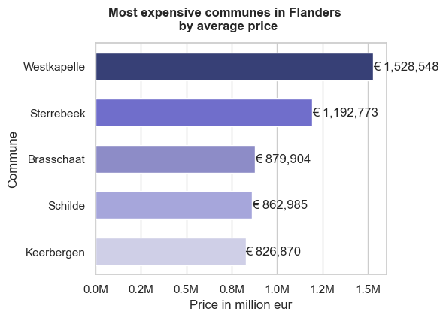
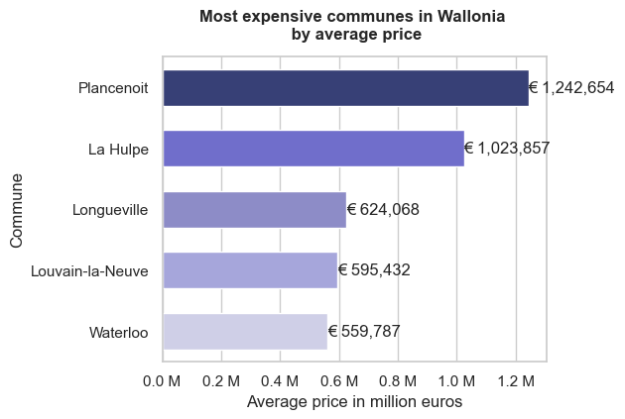
Most expensive municipalities by average price

Slide 22
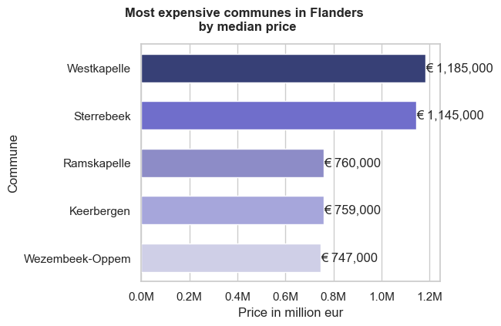
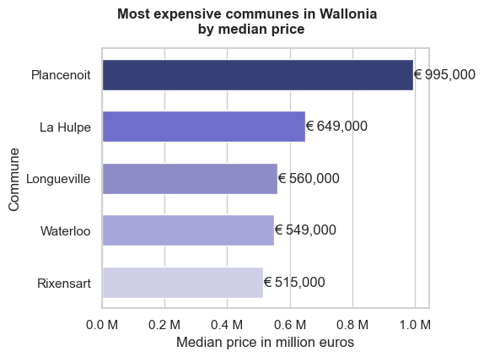
Most expensive municipalities by median price

Slide 23
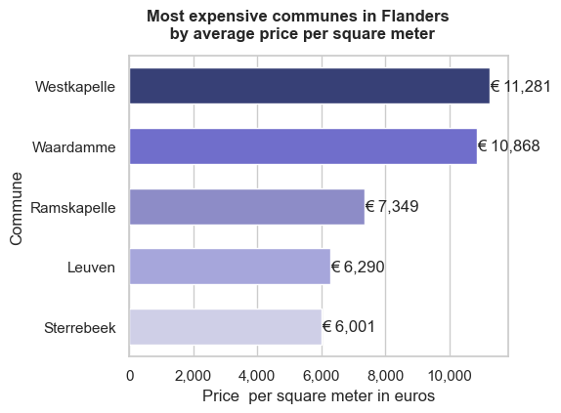
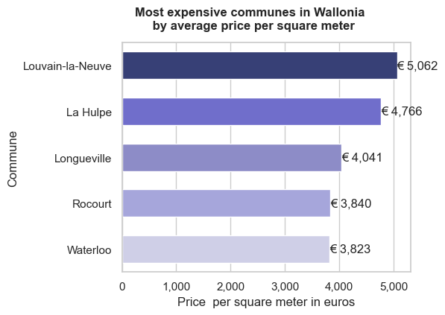
Most expensive municipalities by price per sqm.

Slide 24
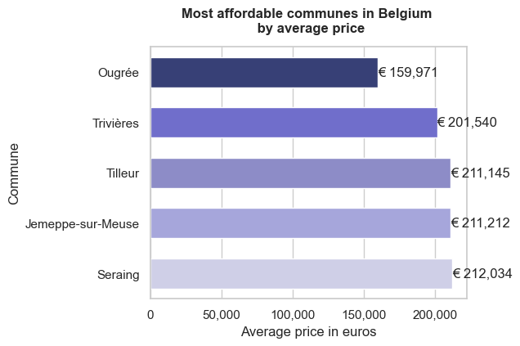
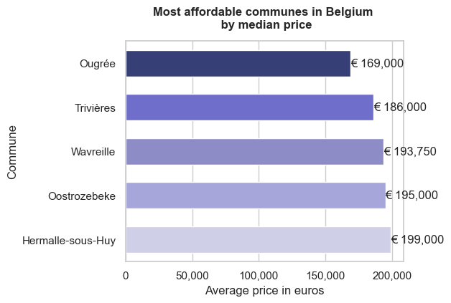
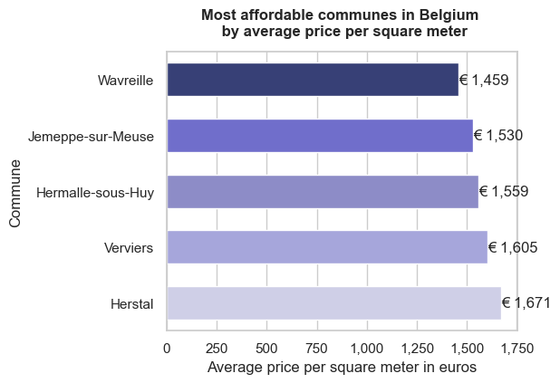
Most affordable municipalities in Belgium
Ougree

Slide 25
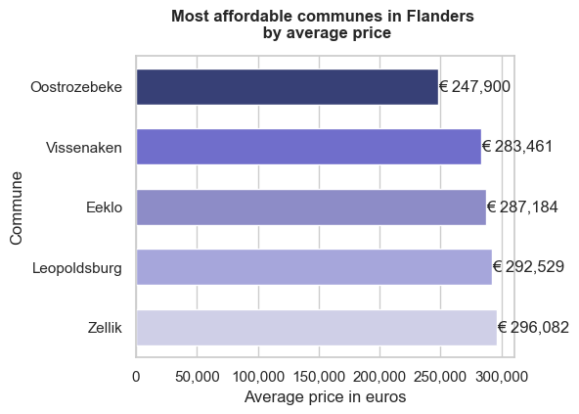
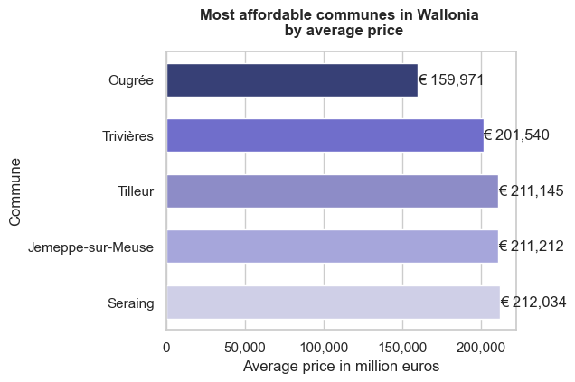
Most affordable municipalities by average price

Slide 26
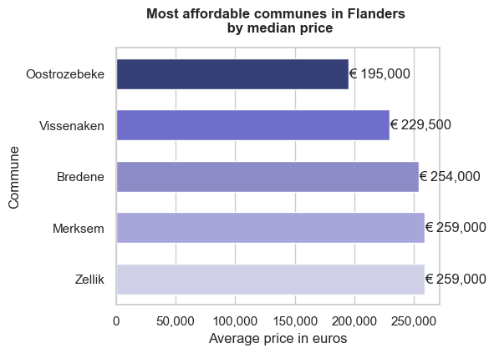
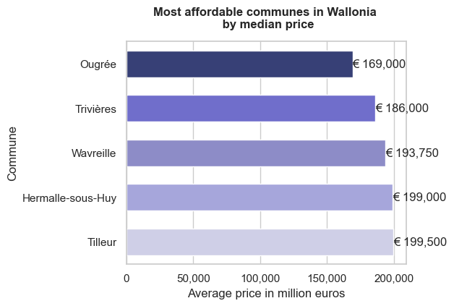
Most affordable municipalities by median price

Slide 27
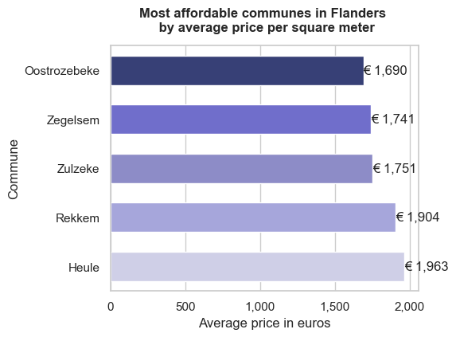
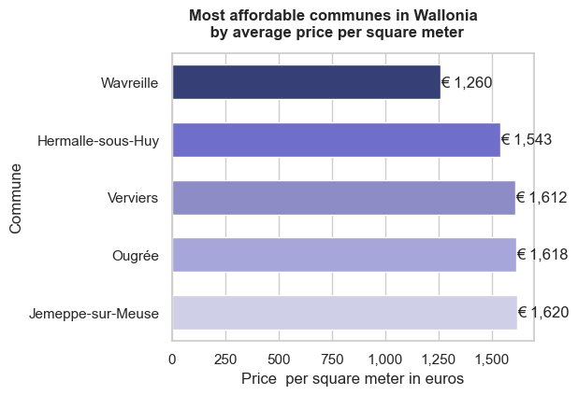
Most affordable municipalities by price per sqm

Slide 28

Thank You

