Slide 1
THE TRI-CARBOXYLIC ACID (TCA) CYCLE
The TCA cycle is also called Citric Acid Cycle or Krebs’s Cycle.
It is called the Krebs cycle in honour of Sir Hans Krebs, the scientist who first formulated the cyclic nature of its reactions.
It is also called the citric acid cycle because citrate was one of the first compounds known to participate.
The most common name for this pathway is the tricarboxylic acid or TCA cycle, denotes the involvement of the tricarboxylates citrate and isocitrate.

Slide 2
Significance of TCA cycle
The citric acid cycle is the final common pathway for the oxidation of carbohydrates, lipids, and protein because glucose, fatty acids, and most amino acids are metabolized to acetyl-CoA or intermediates of the cycle.
It also has a central role in gluconeogenesis, lipogenesis, and interconversion of amino acids.
Many of these processes occur in most tissues, but the liver is the only tissue in which all occur to a significant extent.

Slide 3
Catabolic and anabolic functions of TCA cycle
The TCA cycle is an integral part of the process by which much of the free energy liberated during the oxidation of fuels is made available. The energy is in the form of reducing equivalents NADH and FADH, and triphosphates GTP and ATP.
It provides CO₂ used for gluconeogenesis, fatty acid synthesis, urea synthesis and nucleotide synthesis.
It provides precursors for gluconeogenesis (all intermediates), amino acid synthesis (non-essential amino acids), haeme synthesis (succinyl CoA), and fatty acid synthesis (citrate).
It regulates other metabolic pathways – citrate inhibits phosphofructokinase-1.

Slide 4
Enzymatic conversion of Pyruvate to acetyl CoA
The fate of pyruvate produced during glycolysis and oxidation of other biofuels depends on the amount of energy in the tissues.
If tissues have adequate energy pyruvate is oxidized through gluconeonegenesis to generate glucose which can be converted glycogen for storage.
However, when the energy is low pyruvate is preferentially oxidized to CO₂ and H₂O in the TCA cycle, with generation of 15 molecules ATP per pyruvate.
The enzymatic activities of the TCA cycle (and of oxidative phosphorylation) are located in the mitochondrion.
When transported into the mitochondrion, pyruvate encounters two principal metabolizing enzymes: pyruvate carboxylase (a gluconeogenic enzyme) and pyruvate dehydrogenase (PDH), the first enzyme of the PDH complex.
The activities of these two enzymes depend on the acylation state state of Coenzyme A (CoA).

Slide 5
CONT’
With adequate or high tissue energy CoA is acylated to become acetyl-CoA. Acetyl-CoA is able to activate pyruvate carboxylase which in turn directs pyruvate towards gluconeogenesis.
When tissue energy is low pyruvate dehydrogenase (PDH) complex comes into play. Under low tissue energy CoA is not acylated hence the gluconeogenetic activity of pyruvate carboxylase is inhibited.
Pyruvate is therefore preferentially metabolized via the PDH complex and the enzymes of the TCA cycle to CO₂ and H₂O.
The PDH complex is made up of 3 enzymes designated as E1, E₂ and E_{3.}
Apart from CoA, the PDH complex also requires nicotinamide adenine dinucleotide (NAD), flavin adenine dinucleotide (FAD) and thiamine pyrophosphate (TPP) as coenzymes to function.

Slide 6
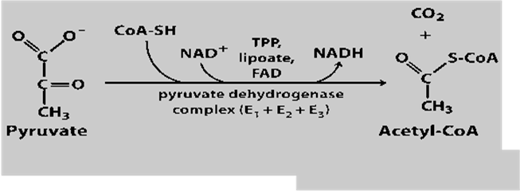
CONT’
In the presence of CoA, NAD, FAD and TPP pyruvate is converted to acetyl CoA with release CO₂.
The acetyl CoA formed enters the TCA cycle as a substrate for energy generation.
This reaction is illustrated in the reaction here below.

Slide 7
CONT’
The reactions of the PDH complex serve to interconnect the metabolic pathways of glycolysis, gluconeogenesis and fatty acid synthesis to the TCA cycle.
As a consequence, the activity of the PDH complex must be highly regulated to maintain homeostasis.

Slide 8
Reactions of the TCA cycle
With the conversion of pyruvate to acetyl-CoA, the carbon derived from glucose reaches a central pathway of energy metabolism.
Degradation of all foodstuﬀs (carbohydrates, amino acids, and fat) proceeds through this stage. The next step toward complete oxidation is the TCA cycle.
There are 8 enzymatic reactions in the TCA cycle that result in the oxidation of biofuels to water (H₂O) and carbondioxide (CO₂).
The Figure 6 illustrates the enzymatic reactions of the TCA cycle.

Slide 9
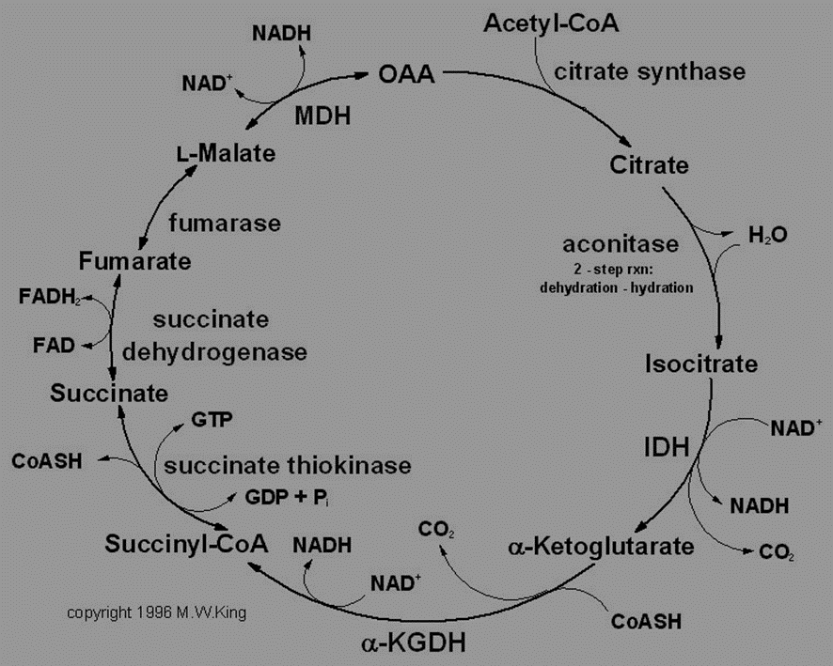
TCA cycle

Slide 10
CONT’
Acetyl CoA serves as a common point of convergence for the major pathways of fuel oxidation. This leads us to the following question.
Other sources of acetyl CoA besides pyruvate oxidation. Some of these sources are
i)Direct generation from the β-oxidation of fatty acids,
ii)Direct degradation of the ketone bodies β-hydroxybutyrate and acetoacetate,
iii)Formation from acetate, which can arise from the diet or from ethanol oxidation,
As reminder, glucose and other carbohydrates enter glycolysis, a pathway common to all cells, and are oxidized to pyruvate.
The amino acids alanine and serine are also converted to pyruvate.

Slide 11
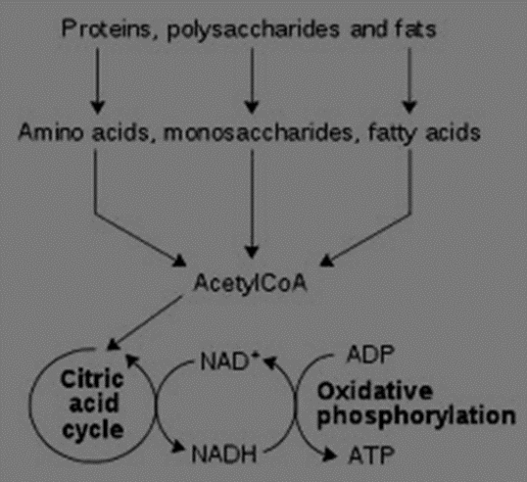
CONT’
Pyruvate is oxidized to acetyl CoA by the pyruvate dehydrogenase complex.
A number of amino acids, such as leucine and isoleucine, are also oxidized to acetyl CoA. Thus, the final oxidation of acetyl CoA to CO₂ in the TCA cycle is the last step in all major pathways of fuel oxidation.

Slide 12

Enzymatic reactions of the TCA cycle in sequence
1st Reaction: Condensation of Acetyl COA with Oxaloacetate to form Citrate
This is the first reaction of the TCA cycle.
It is catalysed by the enzyme citrate synthase which condenses acetyl CoA with oxaloacetate (OAA) to yield citrate and coenzyme A (CoASH).
A molecule of H₂O is required for the condensation reaction.
Considerable free energy is lost as heat due to hydrolysis of thioester bond, this drives the reaction forward.
Under standard conditions this reaction is irreversible.
H₂O CoASH
Acetyl-CoA + Oxaloacetate Citrate

Slide 13


2nd Reaction: Isomerization of Citrate to Isocitrate by Aconitase
The citrate produced in reaction 1 is a poor candidate for oxidation because it contains a tertiary alcohol, which could be oxidized only by breaking a carbon–carbon bond.
This problem is solved by isomerization of citrate a (tertiary alcohol) to isocitrate (a secondary alcohol).
The enzyme catalyzing the isomerization is called aconitase. Citrate isomerization to isocitrate by aconitase is a two-step process.
The aconitase reaction converts citrate to cis - aconitate and then to isocitrate.
H₂O H₂O
Citrate cis-Aconitase Isocitrate

Slide 14
CONT’
The convertion of citrate to cis-Aconitase results in loss of H₂O, while conversion of cis-Aconitase to isocitrate requires a molecule of H₂O.
3rd Reaction: Oxidative decarboxylation of isocitrate by isocitrate dehydrogenase
This is an irreversible reaction and is the first oxidative reaction of the TCA cycle.
In this reaction the isocitrate is decarboxylated to α-ketoglutarate by isocitrate dehydrogenase (IDH) and CO₂ is released.
The IDH of the TCA cycle, which is located only in the mitochondrial matrix, uses NAD⁺ as a cofactor.
Before carboxylation, isocitrate is first oxidized whereby 2 electrons (2e⁻) and a hydrogen ion/proton (H⁺) are given to charged nicotinamide adenosine dinucleotide (NAD⁺), reducing it to NADH + H⁺.

Slide 15

CONT’
NAD⁺ NADH+H
Isocitrate ketoglutarate + CO₂

Slide 16
4th RXN: Oxidative decarboxylation of α- ketoglutarate by α - KGDH complex
In this reaction α-ketoglutarate undergoes oxidative decarboxylation in a reaction catalyzed by a multi-enzyme complex, the α-ketoglutarate dehydrogenase complex.
This enzyme complex is similar to the pyruvate dehydrogenase complex and requires the same co-factors as the pyruvate dehydrogenase complex (thiamine diphosphate, lipoate, NAD⁺, FAD, and CoA).
The reaction results in the formation of a thiester product succinyl-CoA and the respective reducing agents from the co-factors.
The principal reducing agent produced is NADH. Succinyl-CoA and NADH products are energy-rich species that are important sources of metabolic energy in subsequent cellular processes.
The equilibrium of this reaction is so much in favour of succinyl-CoA formation that it must be considered to be physiologically unidirectional.

Slide 17
CONT’
NAD⁺ NADH
α-Ketoglutarate Succinyl-CoA + CO₂

Slide 18
CONT’
Arsenite inhibits α-Ketoglutarate dehydrogenese complex blocking the TCA cycle.
In the presence of arsenite, α-ketoglutarate accumulates in the tissues.
Arsenite is also an inhibitor of pyruvate dehydrogenase complex that we discussed earlier on in this section.
5th Reaction: Conversion of succinyl CoA into succinate by succinate thiokinase (succinyl CoA synthetase)
The succinyl-CoA produced in reaction 4 is a high-energy intermediate and is utilized in this 5th reaction of the TCA cycle to drive the phosphorylation of guanosine diphosphate (GDP) to guanosine triphosphate (GTP).
The reaction is catalyzed by succinyl-CoA synthetase, sometimes called succinate thiokinase.

Slide 19

CONT’
This reaction catalyzed by succinyl-CoA synthetase provides another example of a substrate-level phosphorylation in which a substrate, rather than an electron transport chain or proton gradient, provides the energy for phosphorylation.
It is the only such reaction in the TCA cycle.
The GTP produced participates in mitochondrial protein synthesis pathways or is converted into ATP.
GDP +pi GTP
Succinyl-CoA Succinate

Slide 20
6th Reaction: Oxidation of Succinate to Fumarate by Succinate Dehydrogenase
During this stage succinate is oxidized to fumarate by the action succinate dehydrogenase.
Single electrons are transferred from the two adjacent methylene groups of succinate to co-factor FAD which is bound to succinate dehydrogenase, thereby forming the double bond of fumarate.
From the reduced enzyme-bound FADH₂, the electrons are passed into the electron transport chain.
FAD FADH₂

Slide 21
7th Reaction: Hydration of Fumarate by Fumarase
In this reaction, fumarase (also called fumarate hydratase) catalyzes the addition of water across the double bond of fumarate, yielding malate, a hydroxyl (–OH) group and a proton (H⁺) from water are added across the double bond of fumarate.

Slide 22
8th Reaction: Oxidation of Malate by Malate Dehydrogenase
In the last reaction of the TCA cycle, the alcohol group of malate is oxidized to a keto group through the donation of electrons to NAD⁺.
The catalyzing enzyme is malate dehydrogenase and the products are oxaloacetate and NADH₂
NAD NADH₂
Malate Oxaloacetate

Slide 23
Bioenergetics of TCA cycle
The overall stoichiometry equation of the TCA cycle is:
Acetyl-CoA + 3NAD⁺ + FAD + GDP + P_{i} + 2H₂O ——> 2CO₂ + 3NADH + FADH₂ + GTP + 2H⁺ + CoASH
The equation shows that overally, 1 molecule of acetyl CoA was invested plus 3NAD⁺, 1FA D⁺, 1 GDP, 1 high-energy phosphate (P_{i}) and 2 molecules of H₂O.
As a return on that investment 2CO₂ molecules were lost, while 3 NADH₂, 1 FADH₂ and 1 GTP were harvested as storage forms of energy.
In addition 2 H⁺ and coenzyme A were produced for recycling.
Given that 1 NADH₂ has an equivalent of 3 moles of ATP, 1 FADH₂ has 2 moles of ATP and GTP has 1 of mole ATP

Slide 24
Table 1: Amount of energy in the form of ATP is generated in TCA.

Slide 25
CONT’
Therefore it can be summarized that as a result of oxidations in the TCA cycle, three molecules of NADH and one of FADH₂ are produced for each molecule of acetyl-CoA catabolized in one turn of the cycle.
These reducing equivalents are transferred to the respiratory chain where reoxidation of each NADH results in formation of approximately 3 ATP, and of FADH₂, approximately 2 ATP.
In addition, 1 ATP (or GTP) is formed by substrate-level phosphorylation catalyzed by succinate thiokinase.

Slide 26
Regulation of the TCA cycle
The TCA cycle is regulated through various mechanisms which include:
Regulation of acetyl CoA entry at the citrate synthase stage
Allosteric regulation of enzyme isocitrate dehydrogenase
Regulation of enzyme α-ketoglutarate dehydrogenase
Regulation of TCA Cycle Intermediates
Regulation of acetyl CoA entry into the TCA cycle
This occurs at the first stage of TCA cycle.
The enzyme involved is citrate synthase and it is subject to feedback regulation.
This first step of TCA must be regulated so that precursors flow into alternative pathways if product is not needed.
Citrate synthase, which is the first enzyme of the TCA cycle, is a simple enzyme that has no allosteric regulators.

Slide 27
CONT’
Its rate of reaction is controlled principally by the concentration of oxaloacetate, its substrate, and by the concentration of its product citrate.
Situations of increased oxaloacetate and decreased citrate levels will stimulate citrate synthase and vice vasa.
In addition, in the liver, the NADH/NAD⁺ ratio helps to determine whether acetyl CoA enters the TCA cycle or goes into other alternative pathways.
High ratio is inhibitory while a low ratio is stimulatory.

Slide 28
b) Allosteric regulation of enzyme isocitrate dehydrogenase
This regulation occurs at the third stage of TCA cycle.
This is a rate-limiting (slowest) step in TCA. Isocitrate dehydrogenase is allosterically activated by ADP and inhibited by NADH.
Thus, at the concentration of isocitrate found in the mitochondrial matrix, a small change in the concentration of ADP can produce a large change in the rate of the isocitrate dehydrogenase reaction.
Small changes in the concentration of the product NADH and of the co-substrate NAD⁺ also affect the rate of the enzyme more than they would a non-allosteric enzyme.
During muscle contraction, increased Ca²⁺ concentrations activate isocitrate dehydrogenase.

Slide 29
CONT’
This effect of Ca²⁺ is also the same for enzymes and α-ketoglutarate dehydrogenase and pyruvate dehydrogenase.
c) Regulation of enzyme α-ketoglutarate dehydrogenase
The α-ketoglutarate dehydrogenase complex, although not an allosteric enzyme, is product-inhibited by NADH and succinyl CoA and may also be inhibited by GTP.
Thus, both α-ketoglutarate dehydrogenase and isocitrate dehydrogenase respond directly to changes in the relative levels of ADP and hence the rate at which NADH is oxidized by electron transport.
Both of these enzymes are also activated by Ca²⁺ generated during muscle contraction when ATP is being rapidly hydrolyzed.

Slide 30
d) Regulation of TCA cycle intermediates
Regulation of the TCA cycle serves two functions: it ensures that NADH is generated fast enough to maintain ATP homeostasis, and it regulates the concentration of TCA cycle intermediates.
For example, in the liver, a decreased rate of isocitrate dehydrogenase increases citrate concentration, which stimulates citrate efflux to the cytosol.
A number of regulatory interactions in the TCA cycle, in addition to those mentioned earlier, control the levels of TCA intermediates and their flux into pathways that adjoin the TCA cycle.

Slide 31
The role of vitamins in TCA cycle
Vitamins, mainly of the B-group play important roles in TCA cycle. Four of the B vitamins that are essential in the TCA cycle and hence energy-yielding metabolism are:
Riboflavin in the form of flavin adenine dinucleotide (FAD), it is a co-factor for succinate dehydrogenase.
Niacin in the form the form of adenine dinucleotide is the electron acceptor for isocitrate dehydrogenase, α-ketoglutarate dehydrogenase, and malate dehydrogenase.
Thiamine (Vitamin B1) as thiamine diphosphate is the co-enzyme for decarboxylation in the α-ketoglutarate dehydrogenase reaction.
Pantothenic acid is a part of coenzyme A, the co-factor attached to "active" carboxylic acid residues such as acetyl-CoA and succinyl-CoA.

