Slide 1

From theory to practice:
exploring FreeRTOS with QEMU
Computer Architectures and Operating Systems course
Alessandro Genova, Alessandro Torrisi, Giorgia Moscato,
Simone Sambataro, Emanuele Cornaggia
Academic year: 2023-2024

Slide 2
4
3
OVERVIEW
2
1

Slide 3

Creation of a step-by step guide that explains how to start using FreeRTOS on QEMU and to enable everyone to replicate the work we have done.
4
3
OVIERVIEW
2
1

Slide 4
Implemention of pratical examples:
Creation of a step-by step guide that explains how to start using FreeRTOS on QEMU and to enable everyone to replicate the work we have done.
4
UART command line
LEDs Animation
Memory WatchDog
Communication between tasks
3
OVIERVIEW
2
1
SEMAPHORE
NOTIFICATION

Slide 5
Implemention of pratical examples:
Implemention of new features:
Creation of a step-by step guide that explains how to start using FreeRTOS on QEMU and to enable everyone to replicate the work we have done.
4
Scheduling algorithm:
Non-preemptive: Shortest Job First and Longest Job First
Preemptive: Early Deadline First
Memory management algorithm:
Worst-fit
Best-fit
UART command line
LEDs Animation
Memory WatchDog
Communication between tasks
3
OVIERVIEW
2
1
SEMAPHORE
NOTIFICATION

Slide 6
Implemention of pratical examples:
Implemention of new features:
Evaluation of performance for the implemented features
Creation of a step-by step guide that explains how to start using FreeRTOS on QEMU and to enable everyone to replicate the work we have done.
4
Scheduling algorithm:
Non-preemptive: Shortest Job First and Longest Job First
Preemptive: Early Deadline First
Memory management algorithm:
Worst-fit
Best-fit
UART command line
LEDs Animation
Memory WatchDog
Communication between tasks
3
OVIERVIEW
2
Worst Fit and Best Fit
EDF and Round Robin
1
SEMAPHORE
NOTIFICATION

Slide 7
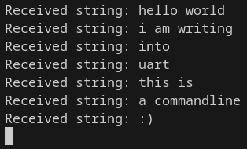
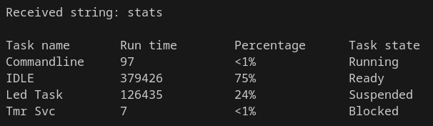
UART command line
CPU Usage Statistics
Polling method
Interrupt method
Tickless IDLE
Less power consumption
Percentage of usage
Task State
Debug with stats flag
Hardware timer

Slide 8
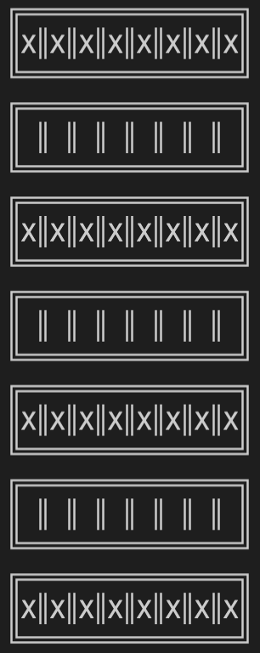
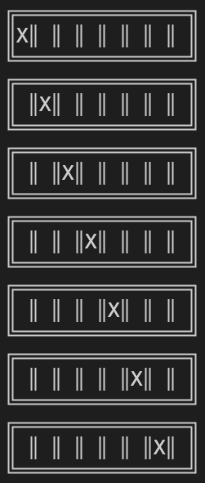
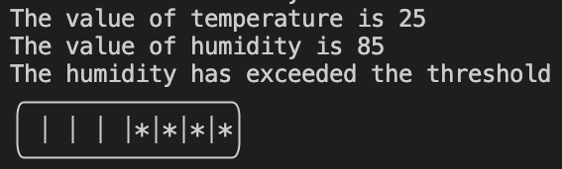
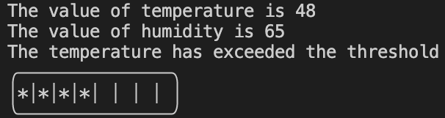
Led Animation
Knight Rider Effect
Constant Blink Effect
Notifications in FreeRTOS
Lightweight inter-task communication
Simulation of two sensors: temperature and humidity
Two threshold values
If respective value is exceeded, half of leds light on

Slide 9
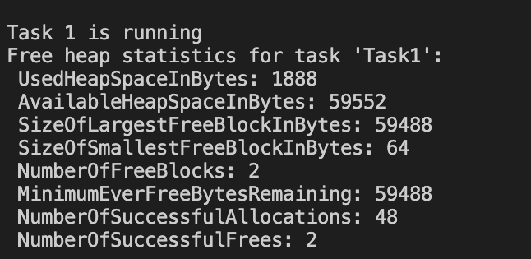
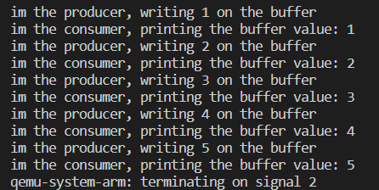
Memory WatchDog
Memory event-handler
Check if thresholds exceeds
If memory allocated by the task is too high -> terminates
Semaphore Example
Producer and Consumer Task
Synchronization between two tasks

Slide 10
Non preemptive Scheduling Algorithms
Shortest Job First
Longest Job First
While FreeRTOS uses as base non preemptive algorithm First Come First Served.
 | FIRST COME FIRST SERVED (FCFS) | SHORTEST JOB FIRST (SJF) | LONGEST JOB FIRST (LJF)
Average Waiting Time(unit) | 324 | 173 | 389
Average Turnaround Time(unit) | 382 | 218 | 468

Slide 11
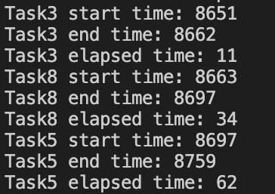
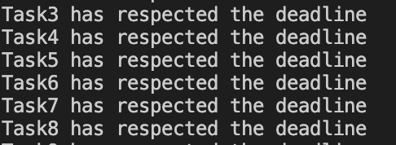
Preemptive Scheduling Algorithm - EDF
Dynamic priority based on deadlines
First execute task with the earliest deadline
Check of missed deadlines
Context switching based on deadline

Slide 12
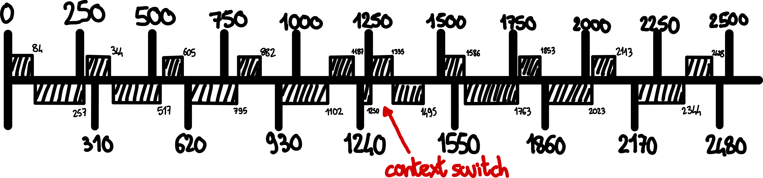
Evaluation of EDF
 | Round Robin | EDF
Percentage of respected deadlines | 30% | 88%
Comparison with Round Robin
 | C | T
Task 1 | 95 | 250
Task 2 | 180 | 310
Gantt Diagram for two periodic tasks

Slide 13
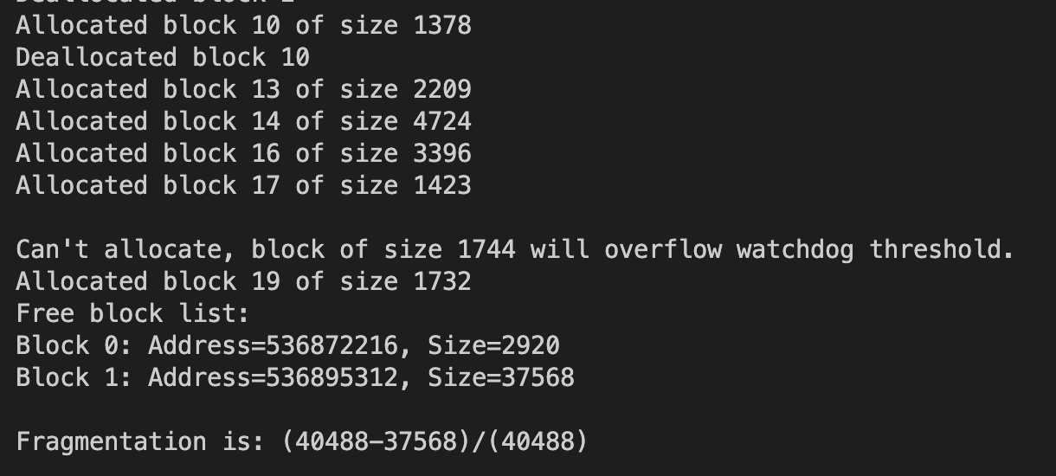
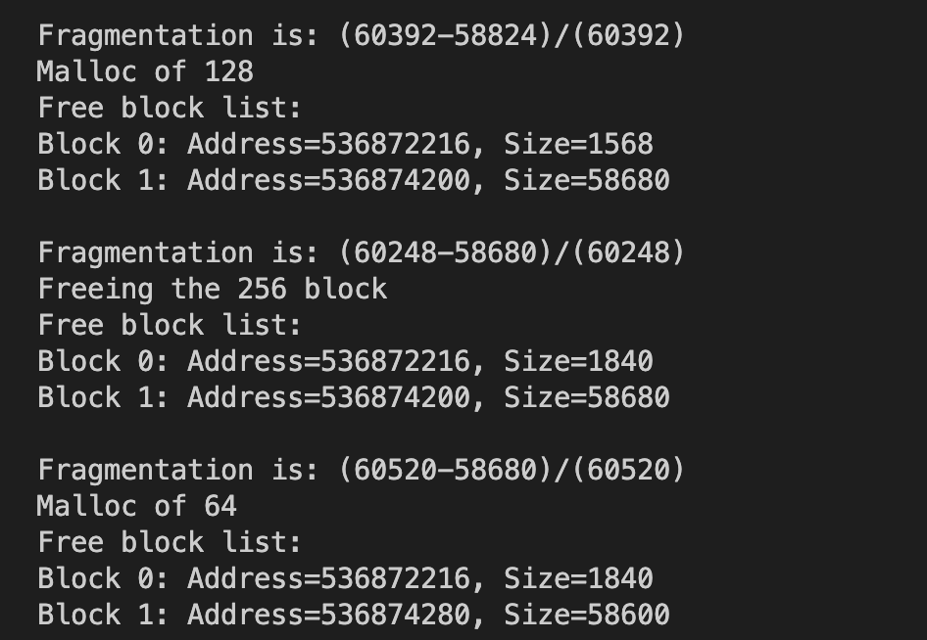
Memory Management Algorithm
Best-Fit
Worst-Fit
Blocks with random size
Blocks with fixed size

Slide 14
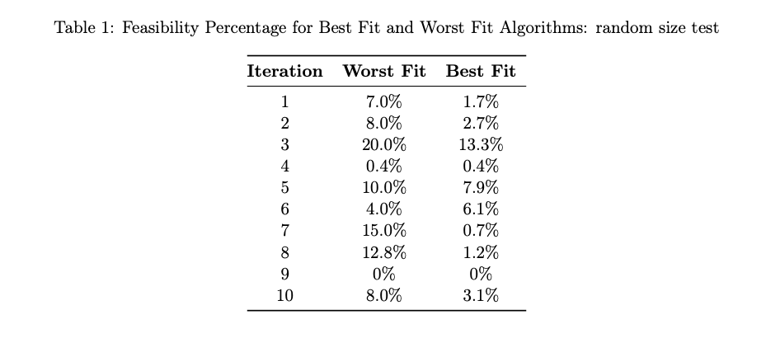
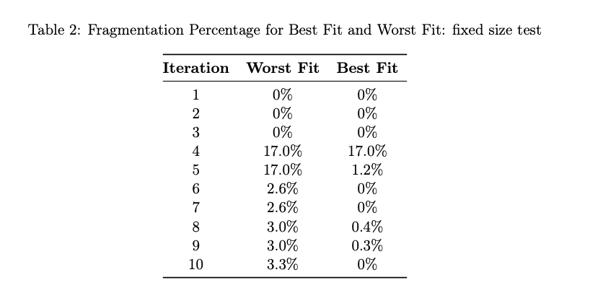
Memory Management Algorithm
Evaluation of performance in two different cases
For the Best Fit we have an average fragmentation of 3% while for the Worst Fit we have a average fragmentation of 9% (table 1)
For the Best Fit we have an average fragmentation of 2% while for the Worst Fit we have a average fragmentation of 5% (table 2)

Slide 15
THANK YOU FOR YOUR ATTENTION!

