Slide 1
EduBlocks & Minecraft
Hide a Diamond, Find a Diamond

Slide 2

Overview
In this lesson, we will use the basic principles of
coding to solve a problem in Minecraft. We will then extend
this to use physical computing to enhance our program.
We shall be using a program called EduBlocks which is a visual block based programming tool that looks like Scratch to make learning Python easier.
Today we shall be using the Raspberry Pi’s to do our Python Programming/

Slide 3

Lesson Objectives
All: Use EduBlocks to build a program in Python
Use the Minecraft Python library
Most: Run a EduBlocks program in Minecraft
Solve a problem using code
Some: Use EduBlocks to send instruction to
external components
Understand how to connect a LED

Slide 4

Key Vocabulary
Sequencing – providing step by step instructions to the computer in order
Variables – the process of storing data
Selection – making a decision on what happens next based on a condition
Repetition – the process of running a program a certain number of times or until a condition is met
EduBlocks – a visual coding language based in Python
Library – a collection of precompiled routines that a program can use
Raspberry Pi – a computer
Physical Computing – adding external elements to a computer program
LED – light emitting diode

Slide 5



What are we doing today?
Using Minecraft Pi Edition
Different from Minecraft on the PC or Xbox.
We can code it with Python or EduBlocks
It can do much more than normal Minecraft through the power of code.
Using EduBlocks
A Visual block based programming tool
Python code on the blocks
Looks like scratch
Interfaces with Minecraft

Slide 6

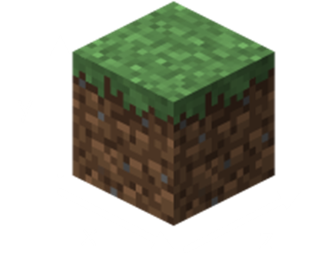

Minecraft
Minecraft is a 3D game and works off x, y, z coordinates which
can be addressed in EduBlocks & Python.
We use the MCPI Python Library (Or API) to interface with
Minecraft through EduBlocks.

Slide 7

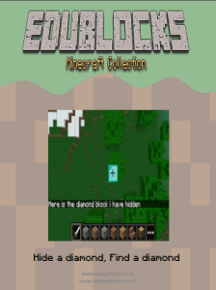
Task 1
Follow pages 1-5 of the booklet
Make sure that you follow all the steps carefully and read the brown explanation boxes so that you understand the code.
EXTENSION:
Speedy coder? Try some of these tasks:
Change the type of block that is hidden
Reduce the amount of time where the player is shown the location of the block
Personalise the messages displayed to the player

Slide 8
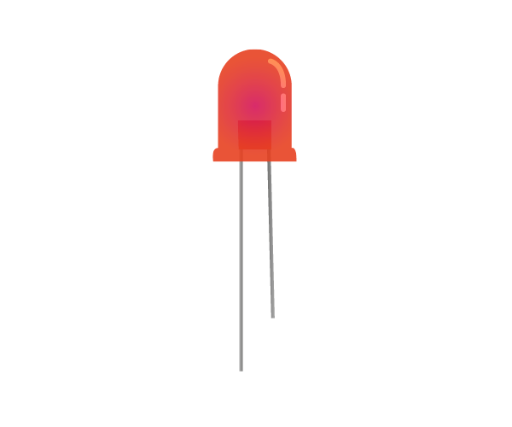
Lets get Physical!
Physical Computing is where we connect components to the GPIO pins and interact with them. In this lesson we shall be connecting up an LED.

Slide 9
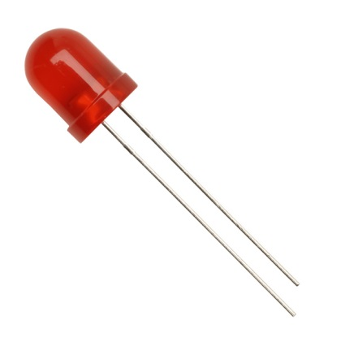
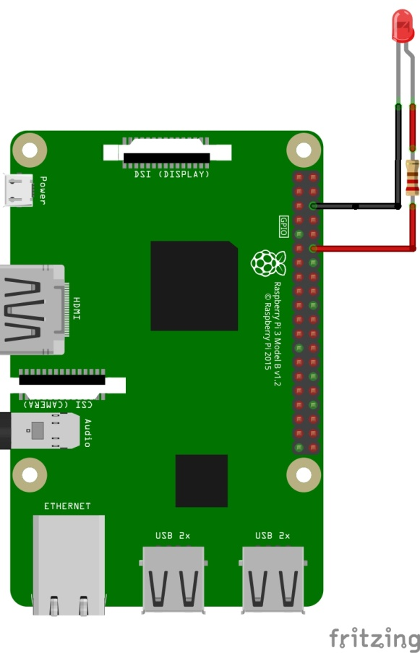
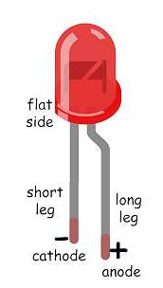
Lets get Physical!
LED: Real
Long Leg Positive +
Short Led Negative -
Complete the circuit as
per the diagram.
LED: Diagram
Bent Leg Positive +
Straight Leg Negative -

Slide 10
Task 2
Follow pages 6-10 of the booklet
Make sure that you follow all the steps carefully and read the brown explanation boxes so that you understand the code.
EXTENSION:
Speedy coder? Try some of these tasks:
Change the location of the block (remember to change the coordinates in all relevant places
Make the lights flash faster or slower
Make the lights flash faster the closer the player gets

Slide 11

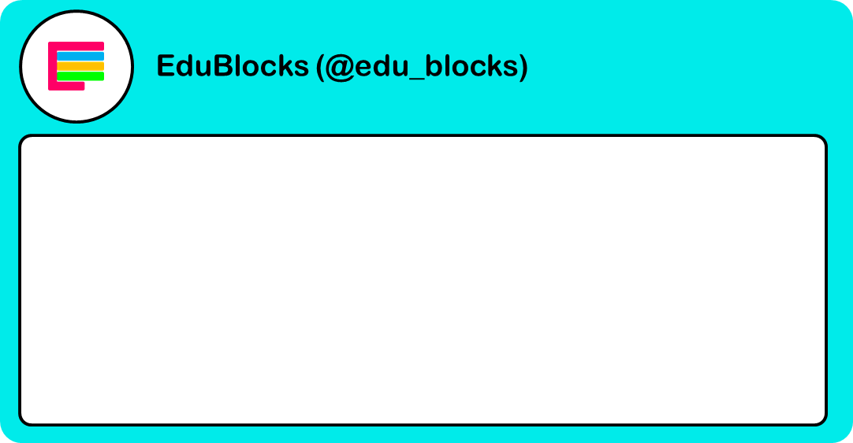
Reflect on the lesson
Fill in a 140 character tweet to sum up what you have learnt in this lesson.

Slide 12
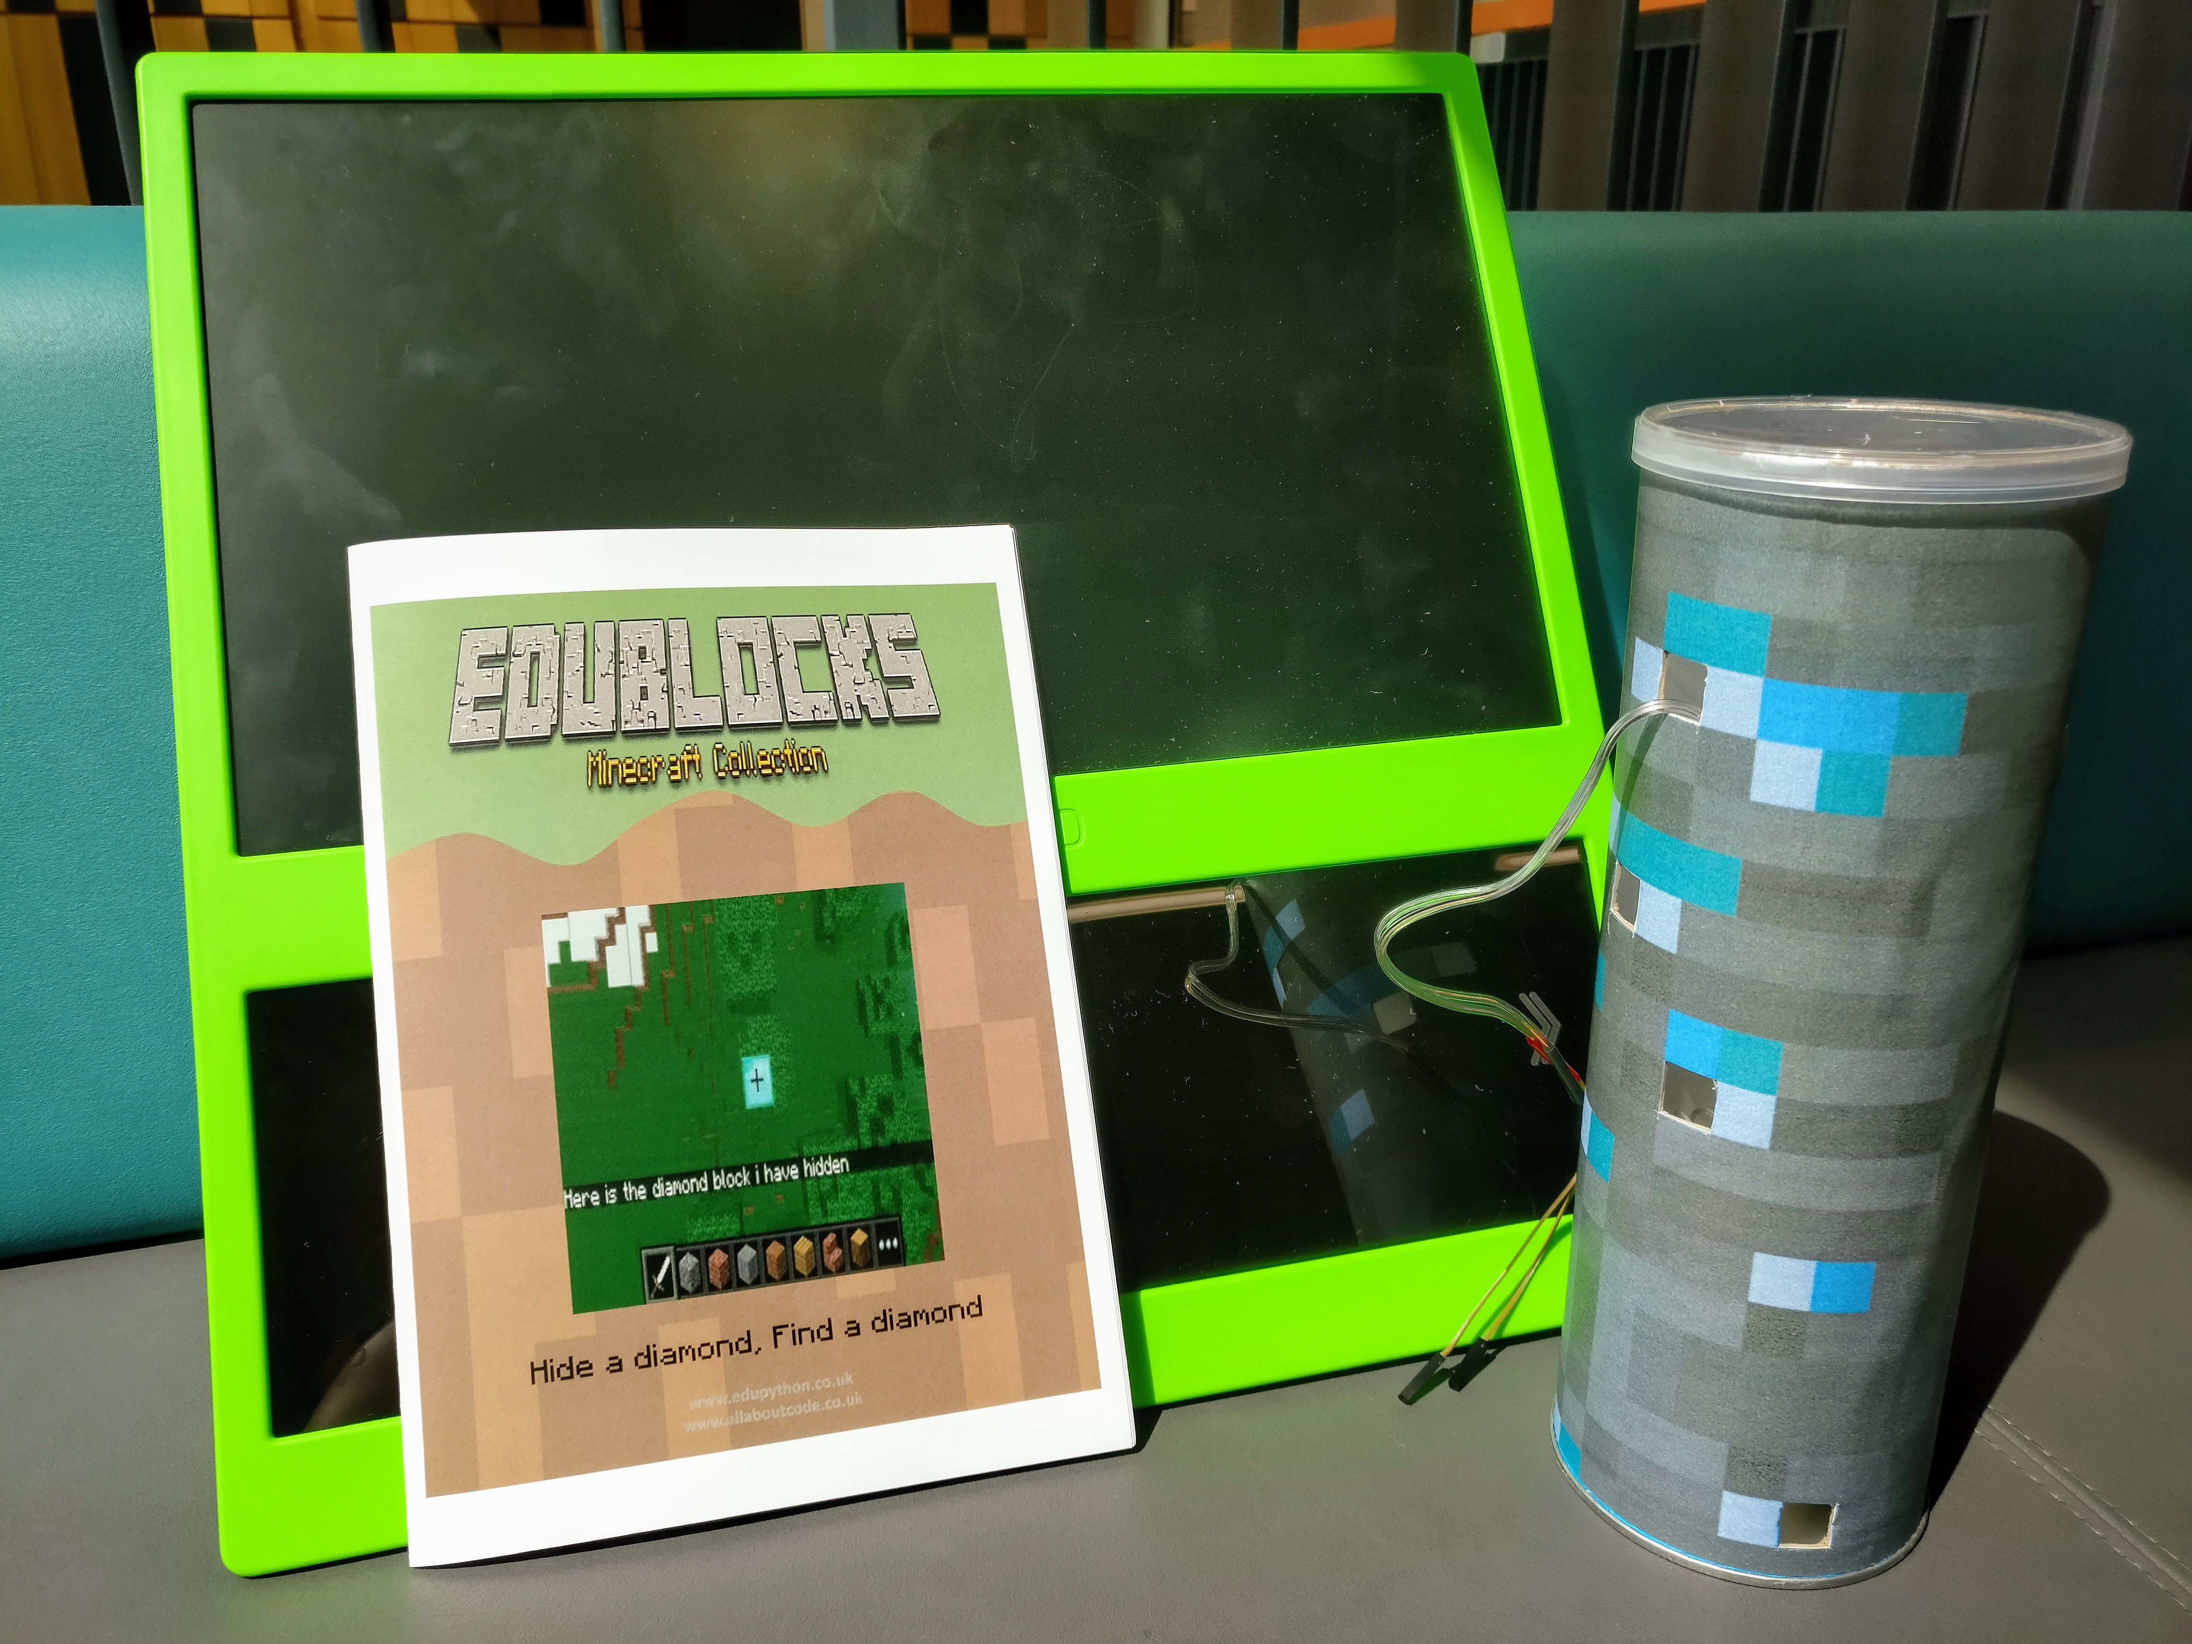
Next Steps
Next time we could create a recycled case for our lights a bit light the Pringles Tube example. You could also re use some fairy lights.

