Slide 1
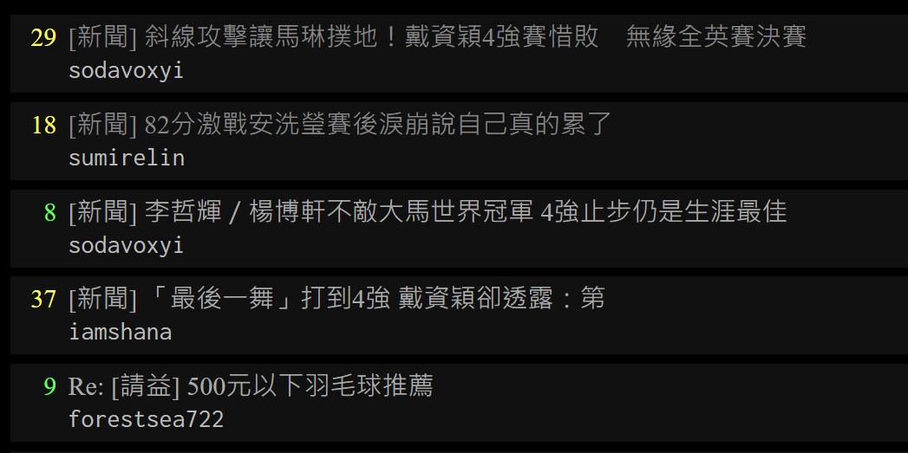
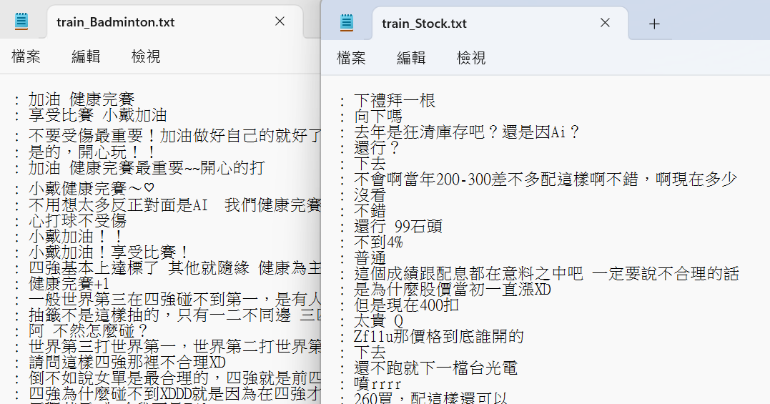
AI Capstone: Project 1 report
110550068 王振倫
In this report, I will start with a data description, followed by an introduction to the experiments and analyses of three models, then final discussion.
1.1 Data description
PTT is a popular online forum among Taiwanese internet users, primarily utilized for discussing current events. Known for its real-time nature, PTT allows users to post comments at any time. Therefore, the objective of this project is to train a classification model to predict the forum in
which a comment appears, with
a focus on forums such as
Badminton and Stock.
1.2 Data collection
To collect data, I utilize a web scraper to extract comments from PTT. Each comment is treated as a single data and is stored as a string. Additionally, I control the size of the dataset by the total number of pages when downloading.
To ensure the accuracy of the experiment, I will divide the dataset into training sets and testing sets to avoid the testing results being influenced by the training data. Further preprocessing tasks will be managed within each respective model.
Figure 1. PTT website
Figure 2. Comments scraped from PTT

Slide 2
2. Algorithms & Experiments Analysis
2.1 kNN model
kNN (k-Nearest Neighbors) is a supervised learning model. It uses cosine distance to find the k nearest neighbors in the feature space in order to predict the target and identify the forum to which the target belongs.
2.1.1 Details of preprocessing:
1. Remove punctuation and retain only Chinese characters.
2. Calculate the feature vectors of sentences when reading files.
3. Perform cross-validation using 5 folds.
2.1.2 Compare different amount of training data
Q: How are the results affected by the amount of training data?
A: I tried to control the number of lines of data when reading the files to understand the relationship between the amount of data and the performance of the model. Each experiment uses 1000 lines of comments from the Badminton forum and 1000 from the Stock forum to test the model. Here are the results:
Badminton /Stock | Accuracy | Precision | Recall | F1-score | AUROC
15/15 | 0.53 | 0.54 | 0.43 | 0.48 | 0.59
200/200 | 0.64 | 0.65 | 0.59 | 0.62 | 0.70
1000/1000 | 0.73 | 0.73 | 0.74 | 0.73 | 0.79
2000/2000 | 0.77 | 0.75 | 0.79 | 0.77 | 0.84
Table 1. Different amount of training data in kNN
From the results, it can be observed that as the amount of the data increases, the metrics such as accuracy, precision, recall, F1-score, and AUROC improved. The results are reasonable because when the model is fed with more data, it is more likely to gain the information present in the test data, thereby increasing the prediction accuracy.

Slide 3
2.1.3 Compare different composition of training data
Q: How are the results affected by the composition of training data?
A: I tried to control the number of data from Badminton forum to understand the relationship between the composition of data and the performance of the model. Each experiment uses 1000 lines of comments from the Badminton forum and 1000 from the Stock forum to test the model. Here are the results:
Badminton/ Stock | Accuracy | Precision | Recall | F1-score | AUROC
10/990 | 0.53 | 1.00 | 0.06 | 0.11 | 0.55
100/900 | 0.55 | 0.93 | 0.09 | 0.17 | 0.62
300/700 | 0.63 | 0.81 | 0.35 | 0.48 | 0.71
500/500 | 0.67 | 0.67 | 0.67 | 0.67 | 0.72
Table 2. Different composition of training data in kNN
From the results, it can be observed that as the data composition becomes more balanced, the accuracy gradually improves.
It's worth noting that accuracy is not the only metric we need to focus on. When the distribution is highly imbalanced, the model tends to predict the target with the larger quantity. For example, in the experiment where the composition is 10/990, precision is 1.00, but recall is only 0.06. It’s because the model tends to predict “Stock” far more than predict “Badminton.
2.1.4 Over sampling to solve the imbalance of training data
When faced with highly imbalanced training data, we can use oversampling to handle the data imbalance. Here, I duplicated the data with the rare data, resulting in the following outcomes.

Slide 4
Original/ Over-sampling | Accuracy | Precision | Recall | F1-score | AUROC
500/700 | 0.68/0.67 | 0.74/0.68 | 0.55/0.62 | 0.63/0.65 | 0.73/0.72
500/1000 | 0.68/0.67 | 0.81/0.68 | 0.46/0.66 | 0.59/0.67 | 0.74/0.74
500/1500 | 0.66/0.66 | 0.85/0.68 | 0.39/0.61 | 0.53/0.64 | 0.74/0.74
500/2000 | 0.65/0.67 | 0.91/0.71 | 0.33/0.58 | 0.48/0.64 | 0.74/0.73
Table 3. Over sampling in kNN
The experimental results indicate that the accuracy remains similar across the four data compositions even if the over sampling is used. However, there are significant differences in precision and recall values. This is because in imbalanced compositions, the model tends to predict the more frequently occurring target. Thus, by using oversampling, this bias can be reduced, preventing the model from only predicting the same outcome.
2.1.5 Random deletion to implement data augmentation
Random deletion involves removing words from the training data with a certain probability. After random deletion, the model can learn how to handle incomplete data, thereby improving its generalization ability. Here are the results.
Deletion rate | Accuracy | Precision | Recall | F1-score | AUROC
Original | 0.73 | 0.73 | 0.73 | 0.73 | 0.80
10% | 0.73 | 0.74 | 0.72 | 0.73 | 0.80
30% | 0.73 | 0.73 | 0.74 | 0.73 | 0.80
50% | 0.73 | 0.73 | 0.73 | 0.73 | 0.80
Table 4. Random deletion in kNN
Although the results show similar performance on the test data, the model's prediction ability for unfamiliar data may be enhanced.

Slide 5
2.2 SVM
SVM (Support vector machine) is also a type of supervised learning model, aiming to find a hyperplane to separate different data.
2.2.1 Details of processing:
First, I labeled all the data and performed feature extraction. It tokenizes the comments using Jieba and converts them into
TF-IDF features. Finally, the model is trained and its predictive capability is evaluated with the test data.
2.2.2 Compare different amount of training data
Like in the previous sections, I want to test how different amounts of dataset affect the predictive capability of the model. Here are the results:
Badminton/ Stock | Accuracy | Precision | Recall | F1-score | AUROC
15/15 | 0.51 | 0.44 | 0.27 | 0.33 | 0.48
200/200 | 0.64 | 0.62 | 0.56 | 0.59 | 0.63
1000/1000 | 0.75 | 0.74 | 0.68 | 0.71 | 0.74
2000/2000 | 0.80 | 0.76 | 0.83 | 0.80 | 0.81
Table 5. Different amount of training data in SVM
It can be observed that as the amount increases, the model learns more classification capabilities, leading to improved predictive ability.
2.2.3 Compare different composition of training data
To examine the impact of different compositions of training data on the model, I conducted several tests. Here are the results:

Slide 6
Badminton/Stock | Accuracy | Precision | Recall | F1-score | AUROC
10/990 | 0.56 | 1.00 | 0.04 | 0.09 | 0.52
100/900 | 0.57 | 0.93 | 0.08 | 0.15 | 0.53
300/700 | 0.65 | 0.82 | 0.32 | 0.49 | 0.63
500/500 | 0.71 | 0.66 | 0.75 | 0.70 | 0.71
Table 6. Different composition of training data in SVM
It can be observed that as the data composition becomes more balanced, the accuracy gradually improves. Also, precision and recall tend to become closer, preventing the model from predicting only one side.
2.2.4 Over sampling to solve the imbalance of training data
I did the similar tests. Here are the results:
Original/ Over-sampling | Accuracy | Precision | Recall | F1-score | AUROC
500/700 | 0.70/0.71 | 0.77/0.73 | 0.50/0.58 | 0.61/0.64 | 0.69/0.69
500/1000 | 0.70/0.71 | 0.83/0.79 | 0.43/0.49 | 0.57/0.61 | 0.68/0.69
500/1500 | 0.68/0.70 | 0.89/0.85 | 0.36/0.42 | 0.51/0.57 | 0.66/0.68
500/2000 | 0.67/0.69 | 0.91/0.89 | 0.31/0.39 | 0.47/0.53 | 0.64/0.67
Table 7. Over sampling in SVM
After oversampling, there is a slight improvement in the predictive performance of the model in each composition. It also reduces the gap between precision and recall, indicating that it reduces the tendency to predict the majority class.

Slide 7
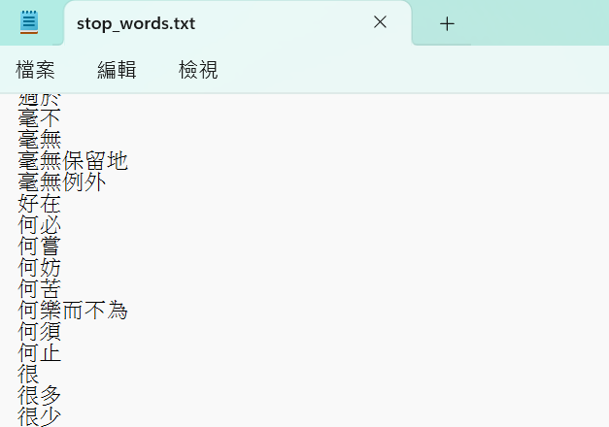
2.3 K-means cluster
K-means clustering is an unsupervised learning method used to group data into clusters. "K" represents that the data should be divided into K clusters. The objective is to assign each data point to the nearest cluster center, in a way that minimizes the distance between the data point and the center.
2.3.1 Details of processing:
I use CountVectorizer to calculate the frequency of each word appearing in the text, and then use TfidfTransformer to transform these words into TF-IDF vectors. Additionally, I utilize Chinese stop words to remove common vocabulary.
Figure 3. Stop_words in Chinese.
2.3.2 Compare different amount of training data
To know the impact of training data on the clustering, I used different amounts of training data and different numbers of clusters. Then use Silhouette Score to evaluate the model.
Silhouette Score considers the tightness within clusters and the separation between clusters. It ranges from -1 to 1, where a value closer to 1 indicates better clustering effectiveness.
Here are the results:

Slide 8
Badminton /Stock | 3 | 5 | 7 | 9 | 11
15/15 | 0.09 | 0.10 | 0.09 | 0.11 | 0.11
200/200 | 0.05 | 0.06 | 0.06 | 0.06 | 0.6
500/500 | 0.12 | 0.12 | 0.14 | 0.14 | 0.14
1000/1000 | 0.31 | 0.33 | 0.32 | 0.33 | 33
2000/2000 | 0.53 | 0.53 | 0.53 | 0.54 | 0.55
3000/3000 | 0.60 | 0.60 | 0.61 | 0.61 | 0.62
Table 8. Different amount of training data in K-means clustering
The results show that as the amount of data increases, the clustering performance of the model improves.
2.2.2 Compare different composition of training data
Like in the previous sections, I want to test how different amounts of dataset affect the clustering capability of the model. Here are the results.
Badminton/Stock | 3 | 5 | 7 | 9 | 11
100/2900 | 0.47 | 0.47 | 0.48 | 0.48 | 0.49
500/2500 | 0.46 | 0.47 | 0.47 | 0.49 | 0.49
1000/2000 | 0.44 | 0.46 | 0.46 | 0.46 | 0.47
1500/1500 | 0.44 | 0.44 | 0.45 | 0.46 | 0.46
Table 9. Different composition of training data in K-means clustering
Unlike other supervised learning models, the impact of training data with different compositions on clustering is not significant.
3. Further Discussion
Through the previous experiments, I have shown the influence of the amount of training data and the composition of training data on the model.

Slide 9
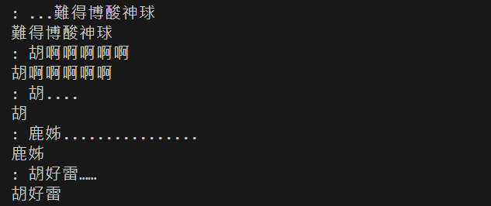
Additionally, I have explained how to perform feature extraction and oversampling. Therefore, I would like to conduct some experiments that are relevant to the dataset’s characteristics.
3.1 Real-time characteristics
As mentioned earlier, PTT is known for its real-time nature, so when test data and training data appear at different times, it may affect the predictive power of the model.
Because the training data all appeared before March 16th, I tried to use data from March 17th to conduct the test, and the results are as follows:
Original/ Latest test data | Accuracy | Precision | Recall | F1-score | AUROC
200/200 | 0.64/0.63 | 0.65/0.28 | 0.59/0.46 | 0.62/0.35 | 0.70/0.60
1000/1000 | 0.73/0.66 | 0.73/0.31 | 0.74/0.46 | 0.73/0.37 | 0.79/0.62
2000/2000 | 0.77/0.68 | 0.75/0.34 | 0.79/0.48 | 0.77/0.40 | 0.84/0.65
Table 10. Different amount of training data in K-means clustering
The table shows the original test data on the left and the latest test data on the right. It can be observed that when the test data is too new, it leads to a significant decrease in the predictive ability of the model. Therefore, when scraping the data in previous experiments, I have already randomized the dataset to avoid the influence of time factors on the model's predictive ability.
3.2 Chinese Extraction
When processing the data, to avoid handling unnecessary features, I used “extract chinese” to remove symbols. This experiment tests how the model‘s performance is affected if “extract chinese” is not used. This is an example where “：" and "..." in the sentence will be removed.
Figure 4. Sentences after Chinese Extraction

Slide 10
Then I perform an experiment to observe the impact when training model without Chinese extraction.
Here are the results:
Original/ Latest test data | Accuracy | Precision | Recall | F1-score | AUROC
200/200 | 0.64/0.58 | 0.65/0.55 | 0.59/0.95 | 0.62/0.70 | 0.70/0.66
1000/1000 | 0.73/0.69 | 0.73/0.67 | 0.74/0.73 | 0.73/0.70 | 0.79/0.77
2000/2000 | 0.77/0.72 | 0.75/0.73 | 0.79/0.69 | 0.77/0.71 | 0.84/0.79
Table 11. With/without Chinese extraction in kNN
The results indicate that without extracting Chinese characters, the accuracy of the model's predictions decreases. This demonstrates the importance of preprocessing the data.
3.3 The topicality of comments
In previous analyses, I chose relatively unrelated topics which are badminton and stock for examination. In this experiment, I aim to observe whether the predictive capability of the model is affected when comments under two related sports, badminton and baseball, are analyzed.
Original/ Latest test data | Accuracy | Precision | Recall | F1-score | AUROC
200/200 | 0.64/0.54 | 0.65/0.55 | 0.59/0.45 | 0.62/0.49 | 0.70/0.58
1000/1000 | 0.73/0.63 | 0.73/0.62 | 0.74/0.79 | 0.73/0.69 | 0.79/0.75
2000/2000 | 0.77/0.72 | 0.75/0.73 | 0.79/0.69 | 0.77/0.71 | 0.84/0.79
Table 12. Two sports forum in kNN
According to the results, it is obvious that the predictive capability of the model decreases when dealing with comments from two related sports, as the comment styles and content are similar.
4. Future experiments
If I want to gain a deeper understanding of the relationship between the model and the dataset, I would like to analyze those misclassified examples to enhance our understanding of the dataset and improve the predictive ability of the model.

