Slide 1
WHK Documentation
Yanxia Lu
Chair of Radio Frequency and Photonics Engineering

Slide 2
Outline

Slide 3
Main Tasks
Mathematical modeling of active silicon micro ring resonators (MRRs) with feedback control considering various nonlinear optical effects. Mathematische Modellierung aktiver Silizium-Mikroringresonatoren (MRRs) mit Rückkopplungssteuerung unter Berücksichtigung verschiedener nichtlinearer optischer Effekte.
Numerical simulation of the time and frequency response of the MRRs with feedback control using Python & MATLAB. Numerische Simulation des Zeit- und Frequenzverhaltens der MRRs mit Feedback-Steuerung unter Verwendung von Python & MATLAB.

Slide 4
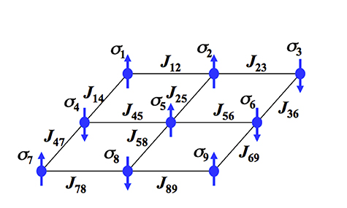
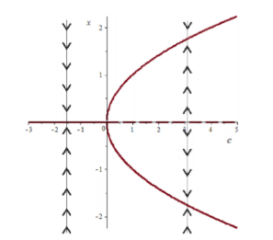
Week 1
Theory Background
Ising Model and Ising Machine
https://nbviewer.org/url/jakevdp.github.io/downloads/notebooks/CythonIsingModel.ipynb
https://matthewrocklin.com/blog/work/2015/02/28/Ising
Pitchfork Bifurcation
https://www.youtube.com/watch?v=Il75BOO94jY&t=2134s
Ising Model
https://social-innovation.hitachi/en-us/case_studies/new-computer-can-quickly-solve-combinatorial-optimization-problems/
Quench of an Ising system on a two-dimensional square lattice (500 × 500) with inverse temperature β = 10, starting from a random configuration.
https://en.wikipedia.org/wiki/Ising_model
McCann, Caitlin. "Bifurcation Analysis of Non-linear Differential Equations." The University of Liverpool (2013).

Slide 5
Literature Review
Realization of optical bistability through nonlinear optical resonator:
Ising Machines: Non-Von Neumann Computing with Nonlinear Optics - Alireza Marandi - 6/7/2019 (https://www.youtube.com/watch?v=V7BxJsLyubk&t=832s)
“Integrated Coherent Ising Machines Based on Self-Phase Modulation in Microring Resonators” (2020) Appendix A.
“A Review of Simulation Algorithms of Classical Ising Machines for Combinatorial Optimization” (2022)
“Ising Machines: Hardware Solvers for Combinatorial Optimization Problems” (2022)

Slide 6
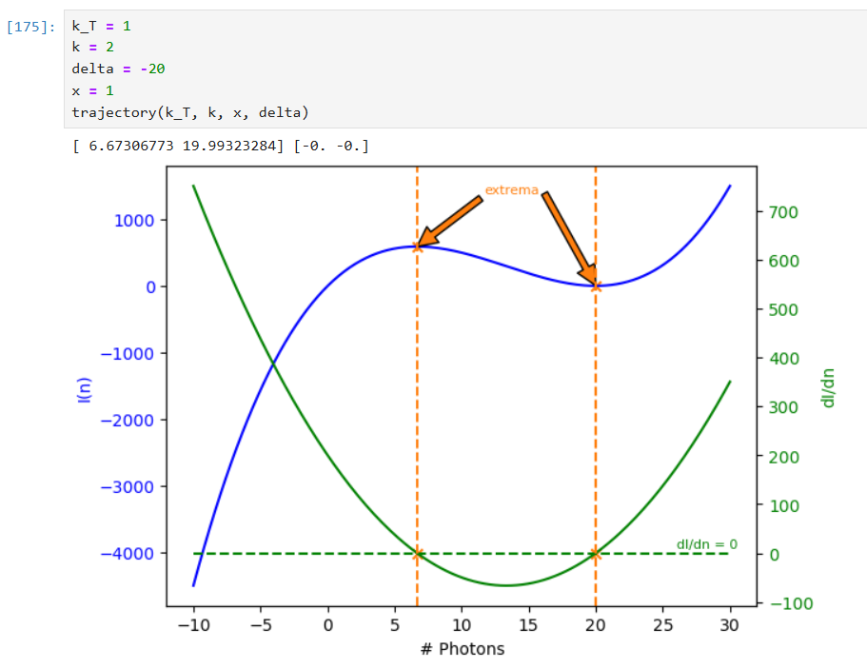
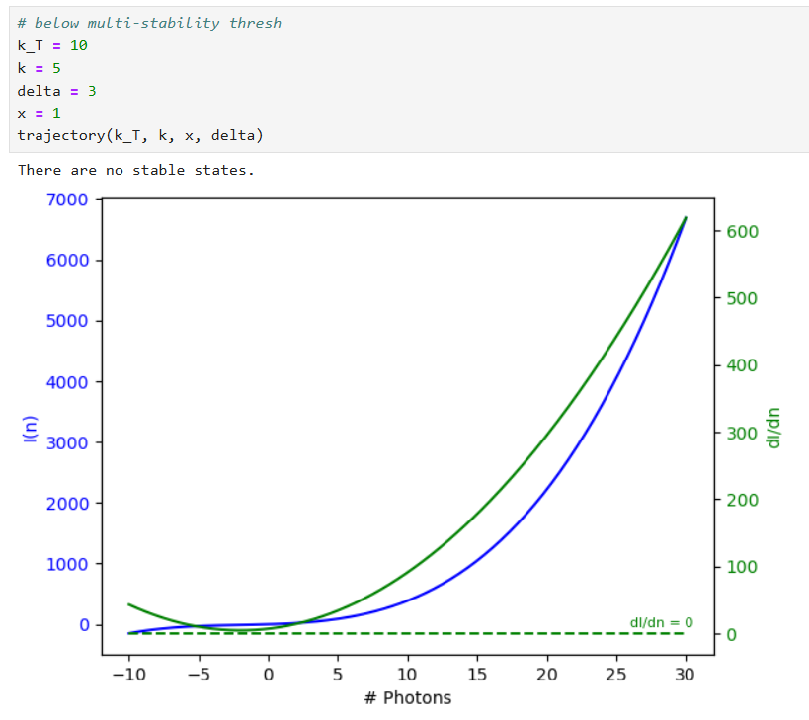
Simulation
Read through “Integrated Coherent Ising Machines Based on Self-Phase Modulation in Microring Resonators” (2020) Appendix A.
Plotted the characteristic function from Appendix A
$κI\left(n\right)=\left[k_{T}^{2}\text{/}4+{\left(Δ+χn\right)}^{2}\right]n$

Slide 7
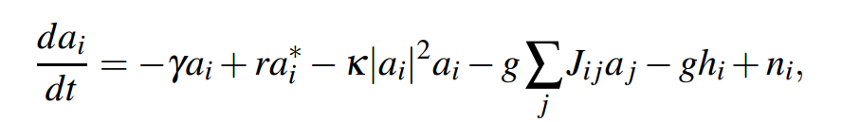
Week 2-3
Investigated an existing ising machine simulation algorithm to understand the numerical modelling of CIM, in order to prepare fundamental knowledge for future construction of quantitative model of ising machine with performance relevant parameters.
classical models of the CIM
CIMs with “error correction.”: chaotic amplitude control (CAC), amplitude-heterogeneity correction (AHC), and amplitude-heterogeneity correction with external field terms (AHC). The first two solvers do not have an external field, while the latter requires an external field ℎ.
Chen, F., Isakov, B., King, T., Leleu, T., McMahon, P., & Onodera, T. (2022). cim-optimizer: a simulator of the Coherent Ising Machine [Computer software].
https://github.com/mcmahon-lab/cim-optimizer
https://cim-optimizer.readthedocs.io/en/latest/problem_description.html

Slide 8
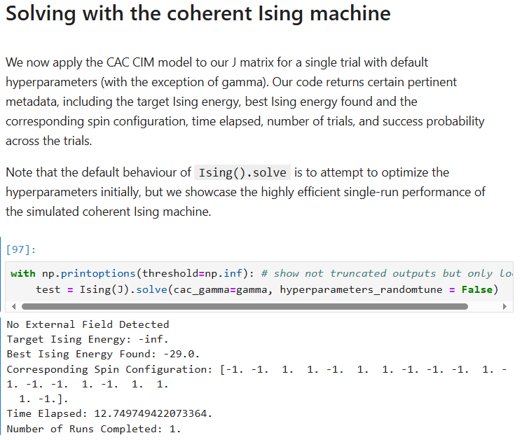
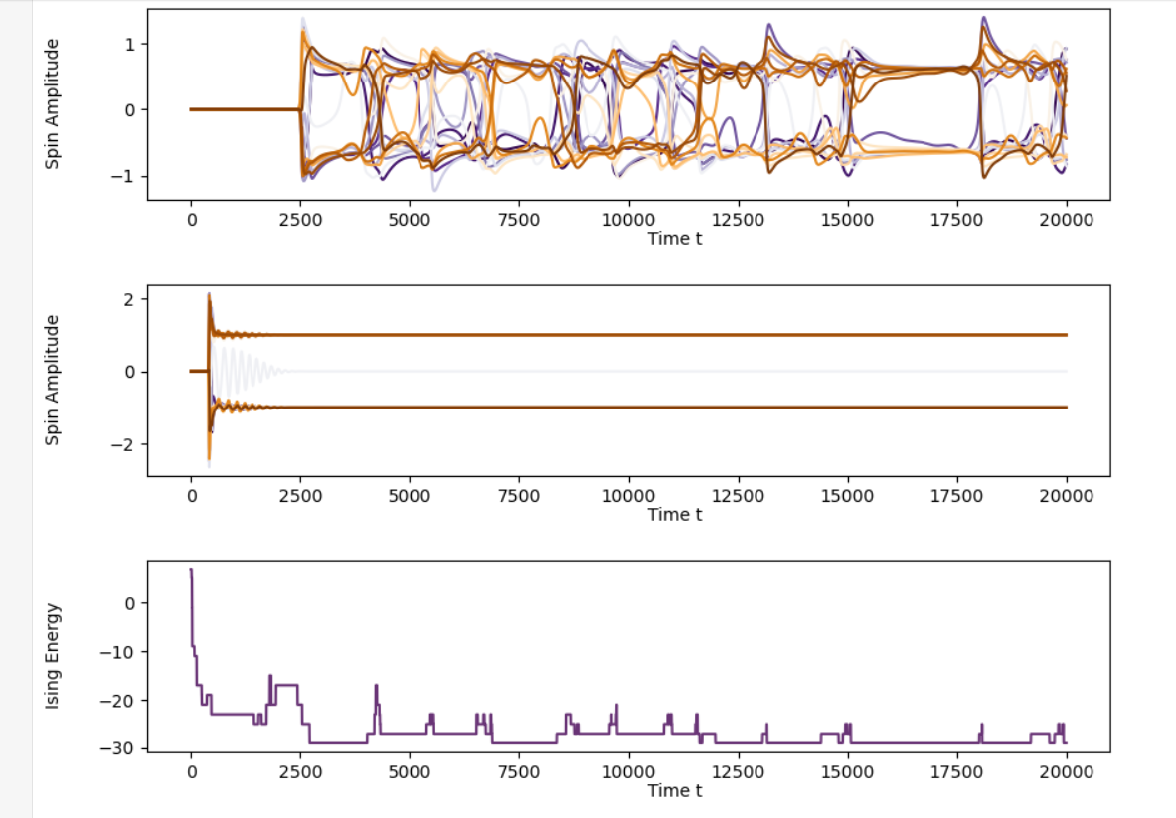
Locally installed the module and tried out different parameters to understand the model with Example 1: MAX-CUT with the CIM.

Slide 9
Found further possible model to investigate：
Monte Carlo simulation of the Ising model:
https://github.com/jfaraudo/Ising-model
Simulation of the experiment from paper:
Böhm, F., Verschaffelt, G. & Van der Sande, G. A poor man’s coherent Ising machine based on opto-electronic feedback systems for solving optimization problems. Nat Commun 10, 3538 (2019). https://doi.org/10.1038/s41467-019-11484-3
https://github.com/gautham-umasankar/Ising_model/tree/master

Slide 10
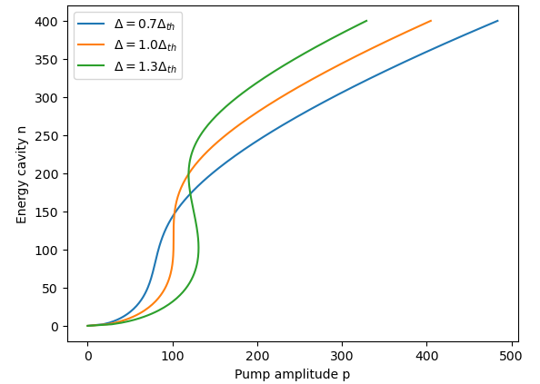
Week 4
Re-read Integrated Coherent Ising Machines Based on Self-Phase Modulation in Microring Resonators - Appendix A
To understand the pumping threshold to have multi-stability in a single nonlinear resonator
To understand single mode ordinary differential equation
Validated the relationship in Fig. 2 by plotting

Slide 11
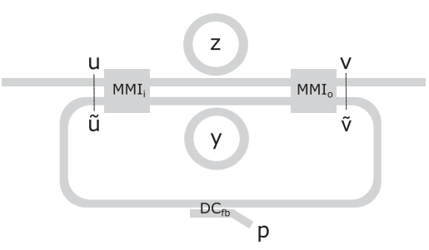
Week 5
Read through “Integrated Coherent Ising Machines Based on Self-Phase Modulation in Microring Resonators” - Appendix B
To understand the open-loop and closed-loop model with two ring resonators
Tezak, Nikolas, et al. "Integrated coherent Ising machines based on self-phase modulation in microring resonators." IEEE Journal of Selected Topics in Quantum Electronics 26.1 (2019): 1-15.

Slide 12
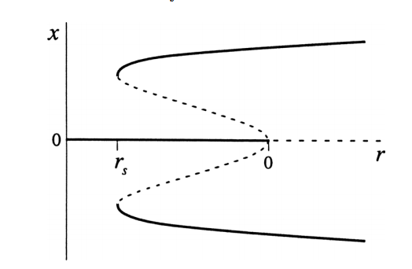
Week 6-9
Read over and over again “Integrated Coherent Ising Machines Based on Self-Phase Modulation in Microring Resonators” - Appendix B
Tried to plot Fig. 11 but faied to understand the meaning of x-axis in Fig.11. Read more about pitchfork bifurcation, especially about the stabilizing influence of higher-order terms in subcritical case.
Strogatz, S.H. (2015). Nonlinear Dynamics and Chaos: With Applications to Physics, Biology, Chemistry, and Engineering (2nd ed.). CRC Press.
https://doi.org/10.1201/9780429492563

Slide 13
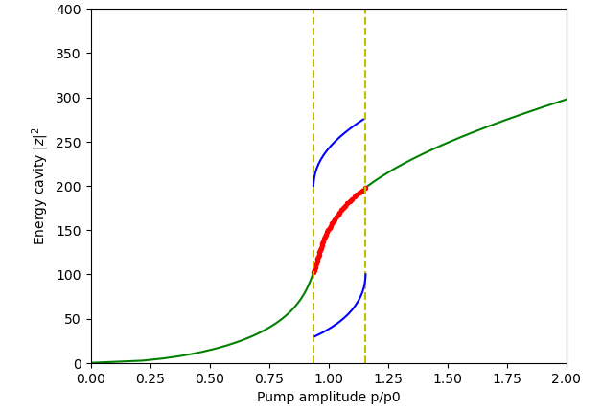
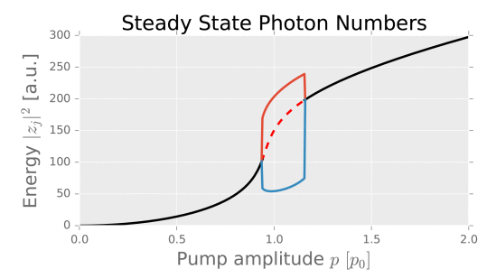
Had difficulty to plot exact the same graph and realized that I didn‘t fully understand how the tunable amplifier could achieve ideal symmetrically bistable spin in the subcritical working region.
As shown below, the left one is my plot, and the right one is Fig. 4 (right) from the paper "Integrated coherent Ising machines based on self-phase modulation in microring resonators."
Tezak, Nikolas, et al. "Integrated coherent Ising machines based on self-phase modulation in microring resonators." IEEE Journal of Selected Topics in Quantum Electronics 26.1 (2019): 1-15.

Slide 14
Week 10
Went back to literature to understand how CIM works
With sub-harmonic injection locking (SHIL), bistable states have a phase difference of 180°→ almost any nonlinear self-sustaining oscillators can be applied to realize Ising machine, with logic values encoded in their phases [1].
https://www.spiedigitallibrary.org/conference-proceedings-of-spie/11703/117030D/Integrated-coherent-Ising-machines-for-next-generation-optimization-accelerators/10.1117/12.2585839.full
Mapping of NP-hard problems to Ising problem, e.g. Max-cut
[1] Wang, Tianshi, and Jaijeet Roychowdhury. "Oscillator-based Ising machine." arXiv preprint arXiv:1709.08102 (2017).

Slide 15

Max-cut
The MAX-CUT problem on an undirected graph G = (V, E) with an edge weight function w : E → R is one of them, where V and E denote the sets of vertices and edges respectively. The goal of the MAX-CUT problem is to find a cut (S, V \ S) such that the sum of the weight of the edges with one endpoint in S and the other in V \ S is maximized over all possible cuts [8]. Let wjl = wlj be the edge weight if (j, l) ∈ E and wjl = 0 if (j, l) ∈/ E, and σj = +1 if the j-th vertex is in S and σj = −1 if not. The weight of a cut S is thus given by
Wjl→-Jjl, max-cut corresponds to the ground state of Ising problem.
Wang, Zhe, et al. "Coherent Ising machine based on degenerate optical parametric oscillators." Physical Review A 88.6 (2013): 063853.

Slide 16
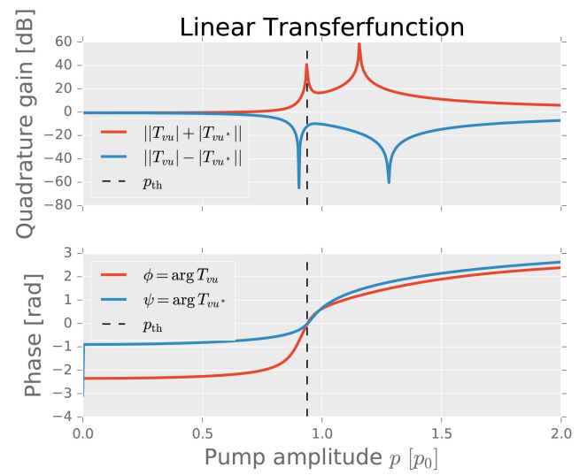
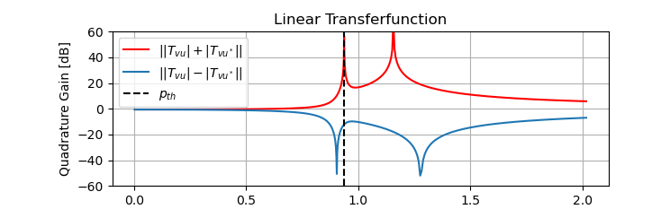
Week 11
Wrap up the first phase
Tried to understand linearity near threshold and the corresponding linear gain in “Integrated Coherent Ising Machines Based on Self-Phase Modulation in Microring Resonators” [1], along with the paper from the same author “A coherent perceptron for all-optical learning” [2].
Validated the linear transferfunction by plotting Fig.4 in [1] (left). Code available on https://github.com/AllInCoffee/Playground/tree/main
[1] Tezak, Nikolas, et al. "Integrated coherent Ising machines based on self-phase modulation in microring resonators." IEEE Journal of Selected Topics in Quantum Electronics 26.1 (2019): 1-15.
[2] Tezak, N., Mabuchi, H. A coherent perceptron for all-optical learning. EPJ Quantum Technol. 2, 10 (2015). https://doi.org/10.1140/epjqt/s40507-015-0023-3

Slide 17
Week 12
Summarize the first phase
Presentation

Slide 18
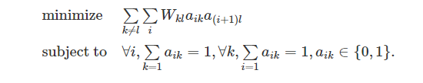
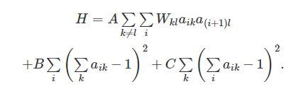
Week 13
TSP formulation

Slide 19
Week 14-15 Literature Review
Literature review on state-of-the-art Kerr Parametric Oscillator (KPO) based Ising machines
Objectives
To find a more accurate model for mapping into Ising problems
Add noise or thermal flucturation (error correction)
Increase order of nonlinearity in cost function
Add external magnetic field
To compute faster
Optimize the model for less computing complexity
Reduce bits required for coupling strength
To be more compact / to scale
Reduce power consumption
Reduce footprint

Slide 20
DOPO Based CIM
Advantage: Scaling
Disadvantage: bulky, amplitude homogeneity → error correction through optimization of model with external magnetic field and addition of noise
NTT Group
Simulating Ising spins in external magnetic fields with a network of degenerate optical parametric oscillators (2020) : model with external field
100,000-spin coherent Ising machine (2021): scaling with time multiplexing
Yamamoto Group
Effect of Coupling Discretization on Coherent-Ising-Machine-Implemented Hopfield Model(2023): reduce the number of bits of coupling strength
Yamamoto, NTT and Standford
Skew-Gaussian model of small-photon-number coherent Ising machines (2024): control of amplitude homogeneity, DOPOs + two third-order fluctuation products

Slide 21
Yamamoto, NTT and Standford
Mean-field coherent Ising machines with artificial Zeeman terms (2023): implementation of Zeeman terms (external magnetic field) within Mean-Field CIM (MF-CIM) models, improving performance of CIM with chaotic amplitude control in 2022 (Control of amplitude homogeneity in coherent ising machines with artificial zeeman terms (2022)).
Skew-Gaussian model of small-photon-number coherent Ising machines (2024): control of amplitude homogeneity, DOPOs + two third-order fluctuation products
Dynamic Anisotropic Smoothing for Noisy Derivative-Free Optimization (2024) : improve tunning of parameters in CIM with chaotic amplitude control ((Leleu et al., 2019) using DAS (dynamic anisotropic smoothing) algorithm, which is used for derivative-free optimization.

Slide 22
Opto-electronic Oscillator (OEO) Based Ising Machine
Advantages: fast, low cost, mitigating amplitude inhomogeneity, compact
Disadvantages: periodic transfer function due to the Mach-Zehnder interferometer is an approximation of CIM polynomial model
Applied Physics Research Group, Vrije Universiteit Brussel (VUB)
A poor man’s coherent Ising machine based on opto-electronic feedback systems for solving optimization problems (2019)
Hewlett Packard Labs (HP Labs), Belgium
Tunable coherent Ising machines with fifth-order nonlinearity (2024): a fifth-order nonlinearity to have more hyperparameters and a large noise regime to facilitate exploration
Integrated Coherent Ising Machines Based on Self-Phase Modulation in Microring Resonators (2019)
VUB + HP Labs
Order-of-magnitude differences in computational performance of analog Ising machines induced by the choice of nonlinearity (2021): higher order helps solve optimization problems
Compact and inexpensive photonic Ising machines based on optoelectronic oscillators (2021): comparison of OEO-based and DOPO-based Ising machines

Slide 23
Other Integrated Kerr Ising Machines
Columbia University + Cornell University
Demonstration of chip-based coupled degenerate optical parametric oscillators for realizing a nanophotonic spin-glass (2020)
Korea Advanced Institute of Science and Technology, KAIST + Daegu-Gyeongbuk Institute of Science and Technology, DGIST, Korea
Low Power Coherent Ising Machine Based on Mechanical Kerr Nonlinearity (2023)

Slide 24
Week 16: Free Carrier and Thermal
Literature reading
On the modeling of thermal and free carrier nonlinearities in silicon-on-insulator microring resonators
Thermo-Optic multistability and relaxation in silicon microring resonators with lateral diodes - Appendix B
Conditions for Parametric and Free-Carrier Oscillation in Silicon Ring Cavities - V
Measurement with Pump and probe technique, modelling with experimental modeling through fitting and finite-element model (FEM)
Refractive index variation due to
→ free carrier dispersion (FCD) → extra loss
→ the temperature variation (thermal-optic (TO))

Slide 25
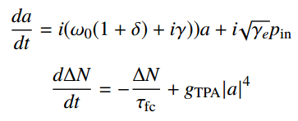
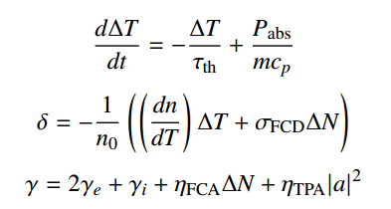

The Temporal Dynamics of SOI Microresonator Self-pulsing
The internal energy of MR:
The free carrier population:
The normalized resonance shift induced by ΔT and ΔN:
The rate of int. and ext. loss：
The differential temperature with the cladding ∆T:
When the temperature profile in the surroundings of the MR is
not spatially uniform.
Borghi, M., Bazzanella, D., Mancinelli, M. and Pavesi, L., 2021. On the modeling of thermal and free carrier nonlinearities in silicon-on-insulator microring resonators. Optics Express, 29(3), pp.4363-4377.

Slide 26
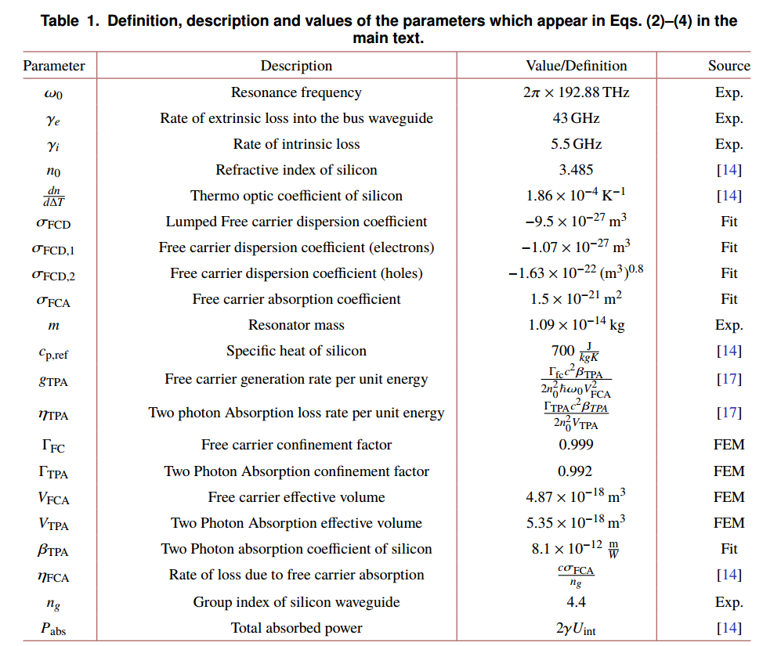
Borghi, M., Bazzanella, D., Mancinelli, M. and Pavesi, L., 2021. On the modeling of thermal and free carrier nonlinearities in silicon-on-insulator microring resonators. Optics Express, 29(3), pp.4363-4377.

Slide 27


TO Modelling in MR with Lateral PIN Junctions for Active Free Carrier Removal.
The coupling of FC dynamics and thermal optic effect (TOE):
active free-carrier removal increases TO nonlinearity caused by Joule heating
Logarithmic time dependence of temperature deflection:
a = 0.155, b = 16 ns and γ ≈ 0.577 (Euler-Mascheroni constant)
Gray, Dodd, et al. "Thermo-optic multistability and relaxation in silicon microring resonators with lateral diodes." Physical Review Applied 14.2 (2020): 024073.

Slide 28


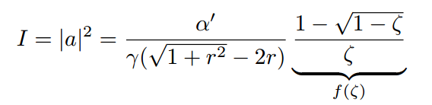

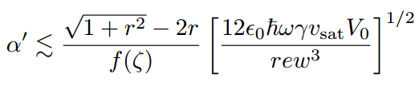
Free-carrier Oscillations (FCO)
Realization of FC amplification with wave length above and around 2.0 µm
Limit on Carrier Lifetime
Upper bound on the effective loss that arises from screening the free-carrier sweepout field
Generation rate
TPA:
Hamerly, Ryan, et al. "Conditions for parametric and free-carrier oscillation in silicon ring cavities." Journal of Lightwave Technology 36.19 (2018): 4671-4677.
Notes:
anomalous dispersion
Dispersion that occurs when the medium's index of refraction decreases as the frequency of the propagating light increases. For a given medium, some wavelength ranges may produce anomalous dispersion while others produce normal dispersion.
In physics, screening is the damping of electric fields caused by the presence of mobile charge carriers. It is an important part of the behavior of charge-carrying fluids, such as ionized gases (classical plasmas), electrolytes, and charge carriers in electronic conductors (semiconductors, metals).

Slide 29
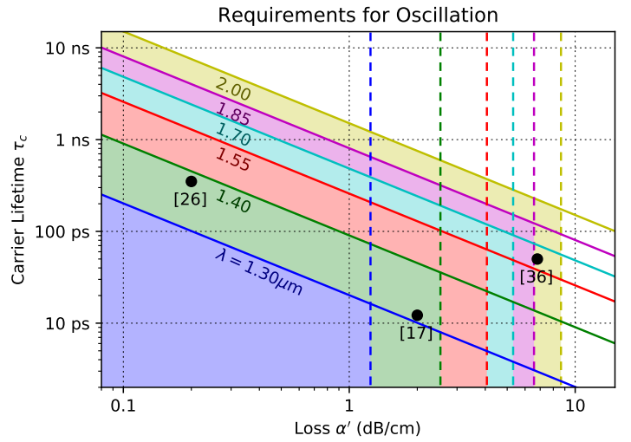
f(ζ) = 1, V0 = −15 V, w = λ/1.55
Hamerly, Ryan, et al. "Conditions for parametric and free-carrier oscillation in silicon ring cavities." Journal of Lightwave Technology 36.19 (2018): 4671-4677.

Slide 30
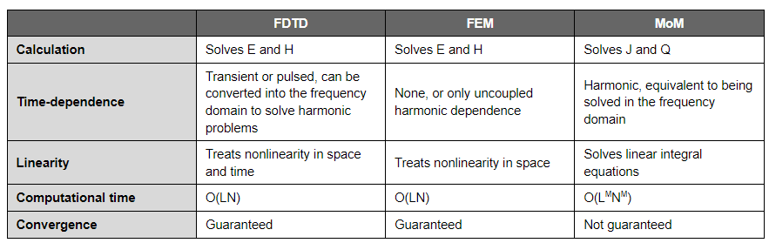
Week 17 Waveguide Field Solvers
Numerical schemes that are used to discretize electromagnetics problems and solve Maxwell’s equations in arbitrary geometries include: finite-difference time-domain (FDTD), finite element method (FEM), and method of moments (MoM).
https://resources.system-analysis.cadence.com/blog/msa2021-fdtd-vs-fem-vs-mom-what-are-they-and-how-are-they-different

Slide 31
Femwell
https://github.com/HelgeGehring/femwell/tree/main
Debug
#from femwell.mode_solver import ( #wrong
from femwell.mode_solver_inplane import (
calculate_coupling_coefficient,
compute_modes,
plot_mode,
)
#from femwell.mode_solver import solver_slepc
from femwell.solver import solver_eigen_slepc

Slide 32
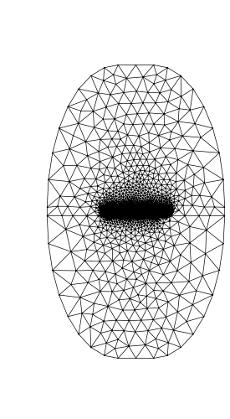
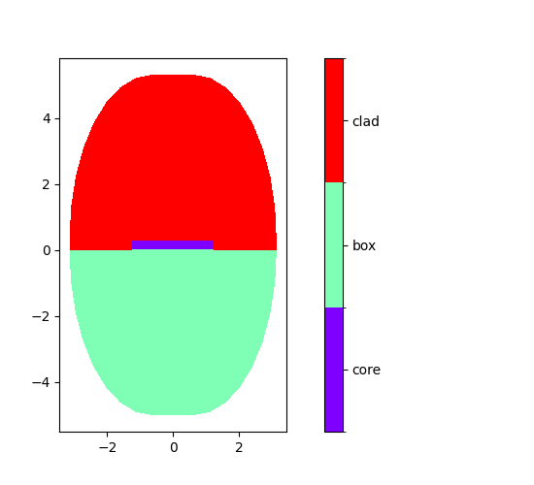
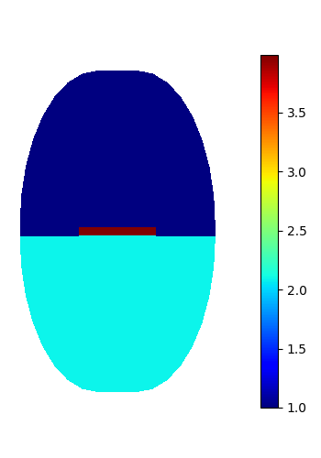
Femwell

Slide 33
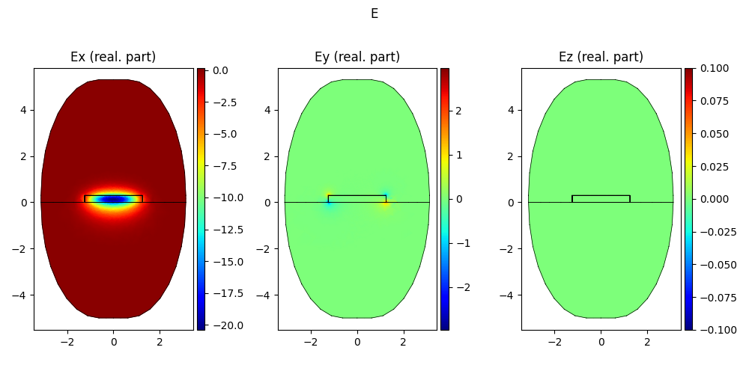
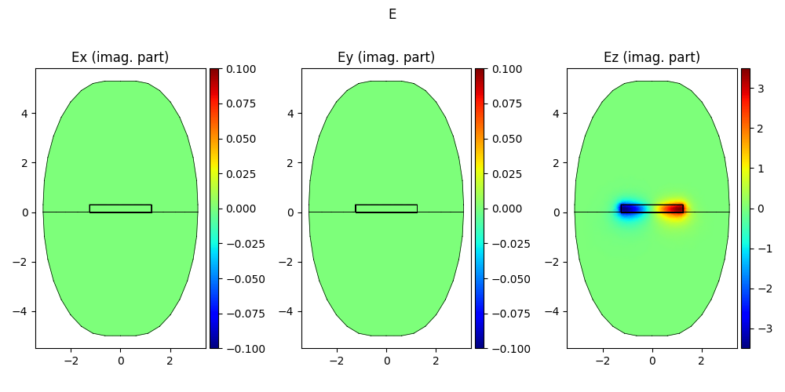
Femwell

Slide 34
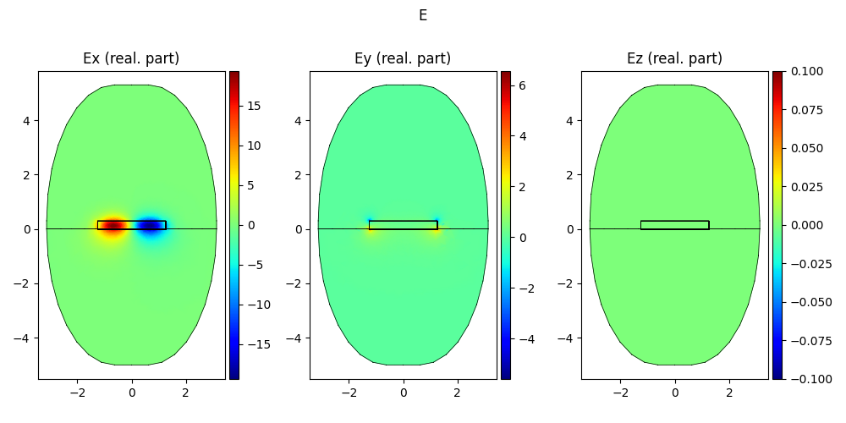
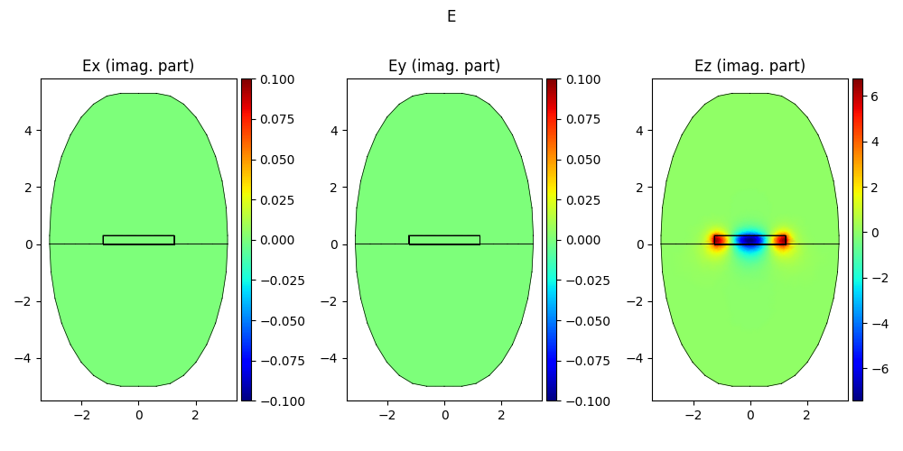
Femwell

Slide 35
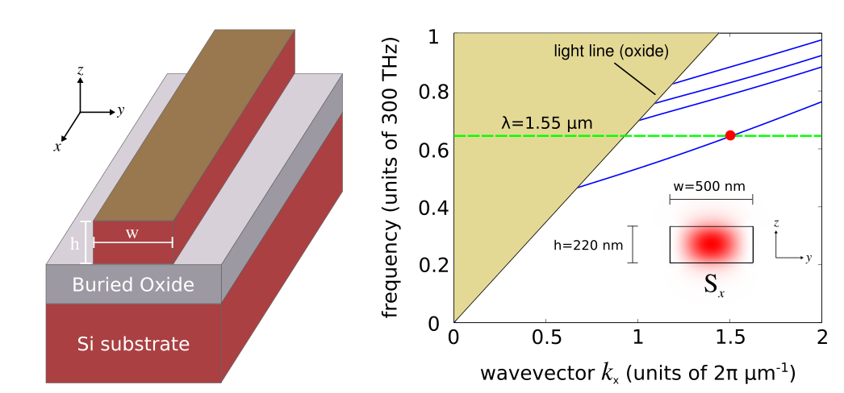
MEEP
Useful Links
http://www.mfertig.de/pages/photonics.html
https://meep.readthedocs.io/en/latest/Python_User_Interface/
http://www.simpetus.com/projects.html#mpb_waveguide
http://www.simpetus.com/projects.html#mpb_waveguide MPB Project #1 — Modes of Silicon on Insulator (SOI) Strip Waveguides

