Slide 1
CUT CLINIC • DIGITAL SERVICE IMPROVEMENT
Appointment
Management System
Implemented functionality, stakeholder problems, and how the solution improves the appointment process
Stakeholder: CUT Clinic | Users: CUT students and clinic staff
2026

Slide 2
01 | THE PROBLEM
The stakeholder’s critical problems
The system is designed around the current clinic workflow and the delays students experience.
Requests depend on email and phone
Only two staff receive requests
Students may miss updates
Students contact the clinic through Outlook/email or telephone. Requests can be difficult to track consistently.
When those staff members are unavailable, requests can wait longer before being reviewed.
Some students have limited mobile data and cannot check Outlook regularly to see whether the clinic has responded.
Impact on the clinic and students
● Delayed visibility: students may not know the status of a request promptly.
● Manual coordination: staff must manage communication and appointment details across separate channels.
● Need for a shared view: staff require a clearer way to see, review, schedule, and follow up requests.
CUT CLINIC APPOINTMENT MANAGEMENT SYSTEM | PROJECT PRESENTATION
2

Slide 3
02 | THE SOLUTION
The proposed solution
One connected workflow for student requests and clinic staff decisions.
Student mobile app
Clinic staff web portal
Shared Supabase backend
Students register/sign in, submit appointment requests, view appointment status and history, and cancel when needed.
Staff view requests in a dashboard, review them, approve/reject, assign appointment times, and manage scheduled appointments.
Authentication and shared data connect both applications so changes made by staff can appear in the student app.
The key change
Move from disconnected email/phone follow-up toward a shared, status-based appointment process with a dedicated interface for students and clinic staff.
CUT CLINIC APPOINTMENT MANAGEMENT SYSTEM | PROJECT PRESENTATION
3

Slide 4
03 | SYSTEM ARCHITECTURE
How the applications work together
High-level architecture of the implemented solution.
Flutter student app
Supabase
ASP.NET Core staff portal
Registration, login, requests, status and appointment history.
Authentication + PostgreSQL data
Shared appointments, students, documents metadata and notifications.
Staff login, dashboard, appointment handling and student details.
Data flow
1
Student submits
2
Staff reviews
3
Staff decides
4
Student sees update
Request is saved to shared data.
Request appears in the staff portal.
Approve/reject and assign a slot.
Status synchronises; email is sent for supported outcomes.
CUT CLINIC APPOINTMENT MANAGEMENT SYSTEM | PROJECT PRESENTATION
4

Slide 5
04 | FEATURES
Student-facing functionality
What students can do in the Flutter application.
Account access
Request an appointment
View appointment status
Register and sign in to use the appointment service.
Submit a request for clinic staff to review. Staff assign the date and time.
See updates from the shared backend rather than relying only on email follow-up.
Appointment history
Cancellation
Email updates
View past and current appointment information, including completed appointments.
Students can cancel an appointment when needed, subject to the implemented workflow.
Receive supported appointment outcome messages by email.
Important workflow decision: students submit a request; clinic staff control approval and appointment time assignment.
CUT CLINIC APPOINTMENT MANAGEMENT SYSTEM | PROJECT PRESENTATION
5

Slide 6
05 | FEATURES
Clinic staff portal functionality
The ASP.NET Core portal gives authorised clinic staff a central workspace.
Dashboard overview
Review requests
Scheduling controls
Summary cards show total requests, pending, scheduled, completed, rejected, cancelled, and today's appointments.
Open appointment requests and approve or reject them.
Assign appointment date/time and manage scheduled appointments.
Reschedule if needed
Student details
Email integration
Staff can reschedule an approved appointment if the clinician becomes unavailable.
View student profile information and appointment history, including completed visits.
Appointment emails are configured and have been confirmed to send in project testing.
Staff alerts: the in-app notification area is intended to alert staff to new appointment requests.
CUT CLINIC APPOINTMENT MANAGEMENT SYSTEM | PROJECT PRESENTATION
6

Slide 7
06 | WORKFLOW
Appointment lifecycle
The workflow makes the clinic's decision points explicit.
1
Request submitted
2
Pending review
3A
Approved + scheduled
Student sends request from Flutter.
Request is visible in staff portal.
Staff assigns date/time.
5
Manage appointment
4
Outcome communicated
3B
Rejected
Cancellation or staff rescheduling when appropriate.
Status appears in the apps; supported email is sent.
Staff declines request.
Business rule: one active appointment per student; the system also checks for past appointment times and duplicate date/time bookings.
CUT CLINIC APPOINTMENT MANAGEMENT SYSTEM | PROJECT PRESENTATION
7

Slide 8
07 | STAKEHOLDER VALUE
How the solution addresses stakeholder problems
The value is not just digitisation—it is a clearer process for students and staff.
Critical problem
Implemented response
Expected benefit
Requests rely on email/phone
Student app + staff portal share appointment data
One organised workflow instead of scattered follow-up
Only two staff receive emails
Requests are listed in a staff dashboard
Staff can see pending work in a central view
Students may not check Outlook daily
Status is available in the student app; supported email updates are sent
Less dependence on repeatedly checking inboxes
Scheduling is manually coordinated
Staff approve/reject and assign date/time; rescheduling is supported
Clearer decisions and fewer scheduling conflicts
These are intended operational improvements; actual reductions in delays should be measured during stakeholder testing.
CUT CLINIC APPOINTMENT MANAGEMENT SYSTEM | PROJECT PRESENTATION
8

Slide 9
08 | VALIDATION
Rules that improve reliability
Business rules help prevent avoidable appointment errors.
One active appointment
No past appointment slots
Avoid duplicate slots
A student should not hold multiple active appointments at the same time.
The system checks date/time so a new booking cannot be set in the past.
The appointment workflow checks for an existing booking at the same date/time.
Shared source of data
Staff authentication
Status visibility
Flutter and ASP.NET read/write through the same Supabase-backed data model.
Staff portal uses authenticated staff access and role-based protection.
Appointment statuses help staff and students understand the current state.
CUT CLINIC APPOINTMENT MANAGEMENT SYSTEM | PROJECT PRESENTATION
9

Slide 10
09 | TECHNICAL APPROACH
Technology choices and feasibility
The stack supports a student mobile interface and a staff web interface over shared data.
Flutter / Dart
ASP.NET Core / C#
Supabase / PostgreSQL
Cross-platform mobile app for students.
Provides a dedicated interface for submitting and checking appointment requests.
Web portal for clinic staff.
Supports authenticated access, dashboard views, appointment management, and email integration.
Shared backend, authentication, and structured appointment data.
Allows both apps to work from the same records.
Feasibility strengths
● Technical: the core mobile, web, database and email components are already working together.
● Operational: each user group has an interface aligned to its role.
● Maintainability: shared backend data reduces the need to maintain separate appointment lists.
CUT CLINIC APPOINTMENT MANAGEMENT SYSTEM | PROJECT PRESENTATION
10

Slide 11
10 | DELIVERY STATUS
Implemented now—and what remains
Be clear with the stakeholder about completed functionality versus future enhancements.
Implemented / demonstrated
Not to present as completed yet
• Flutter student app connected to Supabase
• ASP.NET Core staff login and dashboard
• Appointment request review and status updates
• Scheduling and staff rescheduling of approved appointments
• Student profile and appointment history
• Email notifications for supported appointment outcomes
• Cross-app data synchronisation
• Validation for active appointments and scheduling conflicts
• SMS delivery: paused; no full Twilio end-to-end test
• Registration-proof approval/rejection workflow: still to be implemented
• Production deployment and load testing: not confirmed
• Measured reduction in appointment delays: requires stakeholder evaluation
Recommended next validation: run a clinic-staff walkthrough and student scenario tests, then record feedback and evidence.
CUT CLINIC APPOINTMENT MANAGEMENT SYSTEM | PROJECT PRESENTATION
11

Slide 12
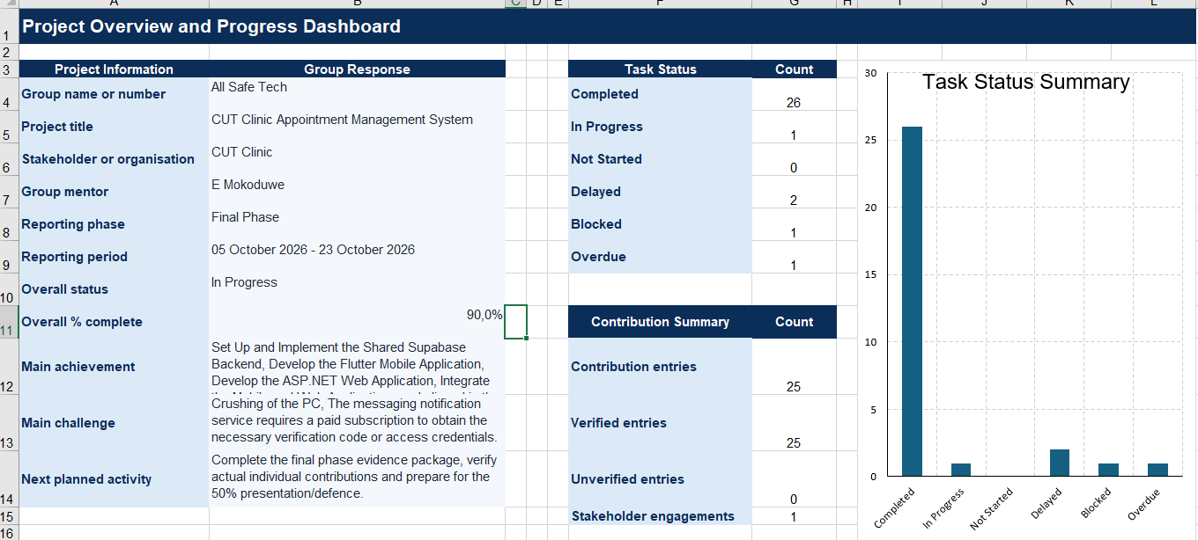
Project Tracker overview

Slide 13
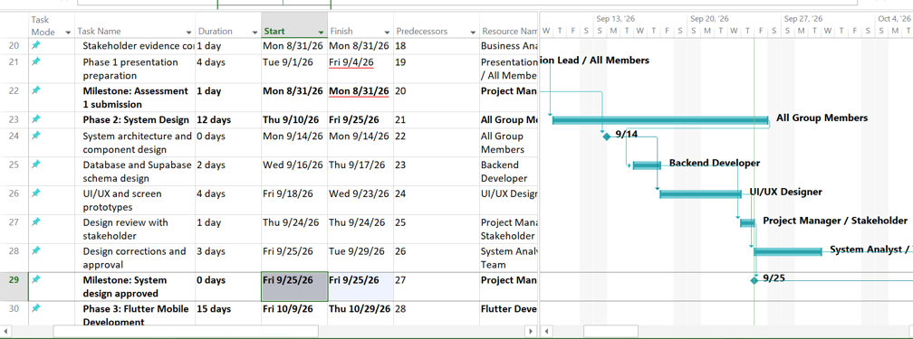
Microsoft Plan

Slide 14
Github

Slide 15
Supabase

Slide 16
11 | DEMONSTRATION
Suggested live demonstration
Use one realistic scenario to connect the features back to the stakeholder's problems.
Student submits a request
Staff sees the request
1
2
Show the request being created in Flutter.
Open the ASP.NET dashboard and point out pending requests.
Staff reviews and schedules
Student sees the change
3
4
Approve and assign a date/time, or demonstrate rejection.
Return to Flutter and show the updated status.
Show email evidence
Explain the benefit
5
6
Open the test inbox and show a supported appointment email.
Highlight less reliance on manual email checking and a central staff queue.
CUT CLINIC APPOINTMENT MANAGEMENT SYSTEM | PROJECT PRESENTATION
12

Slide 17
KEY TAKEAWAYS
A clearer appointment journey for students and clinic staff
CENTRALISED
Staff can see and manage requests in one portal.
CONNECTED
Flutter and ASP.NET use shared Supabase-backed data.
TRACEABLE
Appointment status, history and email outcomes are easier to follow.
STAKEHOLDER-FOCUSED
The design directly targets delays, fragmented communication and limited inbox access.
Questions and stakeholder feedback
CUT Clinic Appointment Management System • Flutter • ASP.NET Core • Supabase

