Slide 1
Searching and Sorting

Slide 2
Sequential Search
Assuming you have an array with elements such as:
3, -9, 12, 24, 56, 78, 10
How can you search the elements “56”?

Slide 3
Sequential Search (Cont’d)
We can look one by one (Let’s say from left to right)
If you decide to search one by one, then it’s called Sequential Search

Slide 4
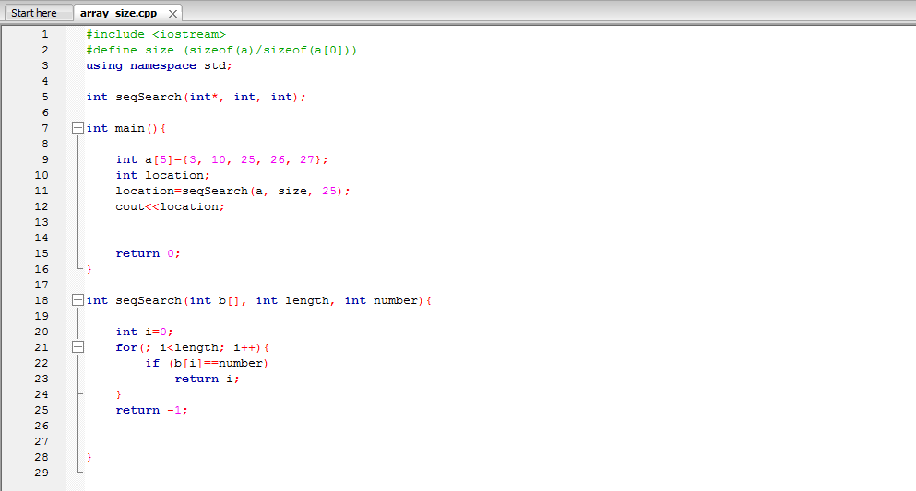
Sequential Search (Cont’d)

Slide 5
Sequential Search (Cont’d)
Advantage of sequential search:
The items do not have to be sorted in order to perform the search.
Disadvantage of sequential search:
It could be slow (Imagine you have thousands of items and the one you want to find happens to be at the last place)
In general, if you have n items, the worst case scenario is you need to perform n times in order to locate the item

Slide 6
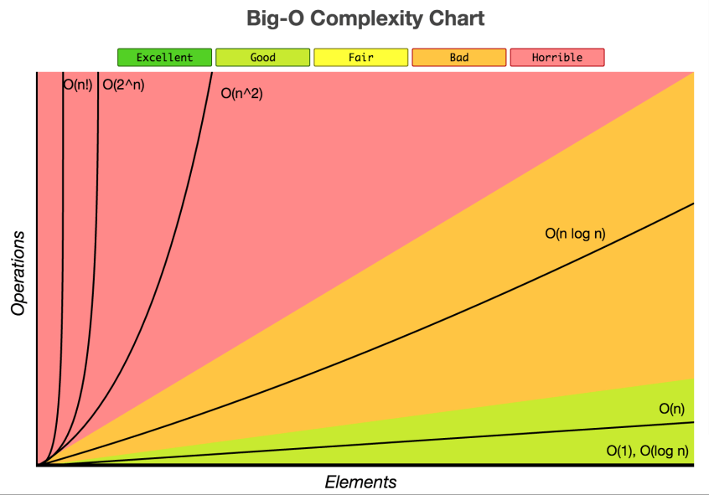
Big O notation (from http://www.jessicayung.com/big-o-notation-a-common-mistake-and-documentation/)

Slide 7
Binary Search
Suppose you go through the trouble sorting the item first. You could search for the item you want much more efficiently.
Suppose you have a list of the following:
16, 19, 22, 24, 27, 29, 37, 40, 43, 44, 47, 52, 56, 60, 64, 71
If you want to search for the element “47”, how many times you need to look for the element 47 with sequential search?

Slide 8
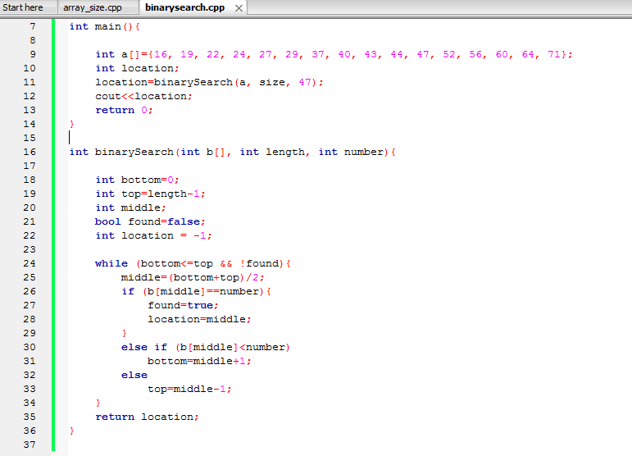
Binary Search (Cont’d)
Using Binary Search would be much faster

Slide 9
Binary Search
This is how the binary search goes:
16, 19, 22, 24, 27, 29, 37, 40, 43, 44, 47, 52, 56, 60, 64, 71
After first trial
43, 44, 47, 52, 56, 60, 64, 71
After second trial
43, 44, 47
After third trial
47 (it only takes 3 trials)

Slide 10
Binary Search (Cont’d)
Advantage:
Much faster than sequential search (Binary Search is O(log n) {base 2, not 10})
Disadvantage:
You have to sort the item first. If you have efficient way of sorting the items, it will be worth it because binary search is much more efficient.

