Slide 1
Communication and Advocacy
for Research Transparency
Slides: http://bit.ly/2uah49w

Slide 2
Overview
Today we will:
Become familiar with essential information and resources on research transparency.
Create compelling and targeted messages that engage their audiences.
Learn effective communication and advocacy strategies.
Create a personal advocacy plan with support and feedback.

Slide 3
Objectives
Introducing research transparency + advocacy.
Defining your advocacy issue + advocacy goal.
Identifying key decision-makers + influencers.
Identifying opponents + partners.
Selecting your advocacy objectives and activities.
Creating an advocacy plan.
Developing compelling messages.
Notes:
By the end of this series, you will be able to effectively communicate with different audiences is a way that will motivate them to care about the issues that matter to you.
We will be focussing on communication and advocacy to improve transparency, but the same rules apply to communication more generally.

Slide 4
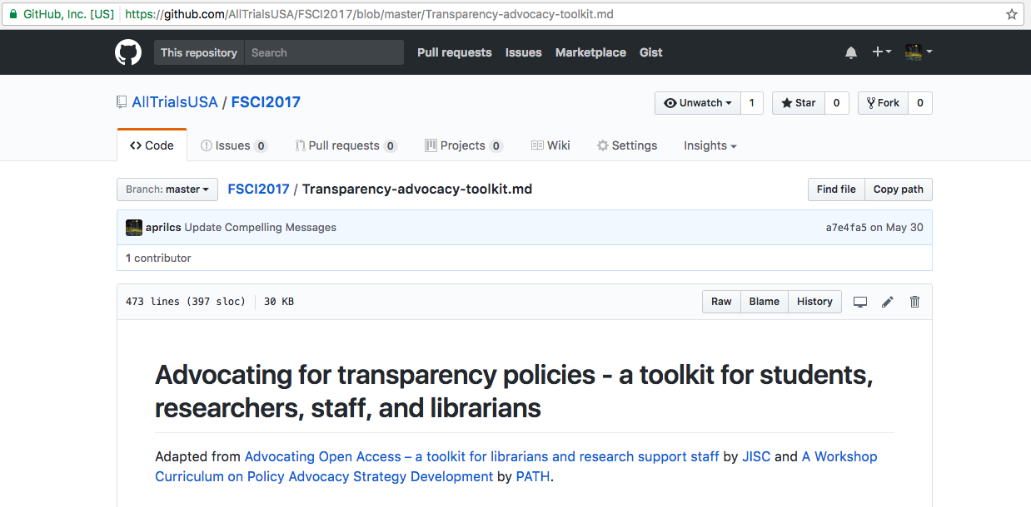
Further information

Slide 5
Code of Conduct
Welcoming & supportive environment for all people, regardless of background or identity.
All participants are expected to show respect and courtesy to others.
Read Code of Conduct here: https://docs.google.com/document/d/1M8n0L-ngd1dAt5bvh3GAsJ7krAcEw1OxF2Q6Of_1t_s/edit?usp=sharing
Notes:
Welcoming & supportive environment for all people, regardless of background or identity
All participants are expected to show respect and courtesy to others
If you have any concerns, or think someone is not following our Code of Conduct, please email me.
Read Code of Conduct here: https://docs.google.com/document/d/1M8n0L-ngd1dAt5bvh3GAsJ7krAcEw1OxF2Q6Of_1t_s/edit?usp=sharing

Slide 6
Schedule
1:30-1:40pm | The Story of “Why”
1:40-1:50pm | Research transparency: issues ripe for advocacy
1:50-2:20pm | Choose an advocacy issue.
2:20-2:50pm | Choose an advocacy goal.
2:50-3:00pm | Identify key decision-makers and influencers.
3:00-3:10pm | Create a power map (or 10-min break)
3:10-3:20pm | Plan for opposition and obstacles.
3:20-3:30pm | Assess your advocacy team and partners.
3:30-4:00pm | Create an advocacy plan.
4:00-4:25pm | Develop compelling messages.
4:25-4:30pm | Keep planning! Advocacy Toolkit and Train-the-trainer Workshops

Slide 7
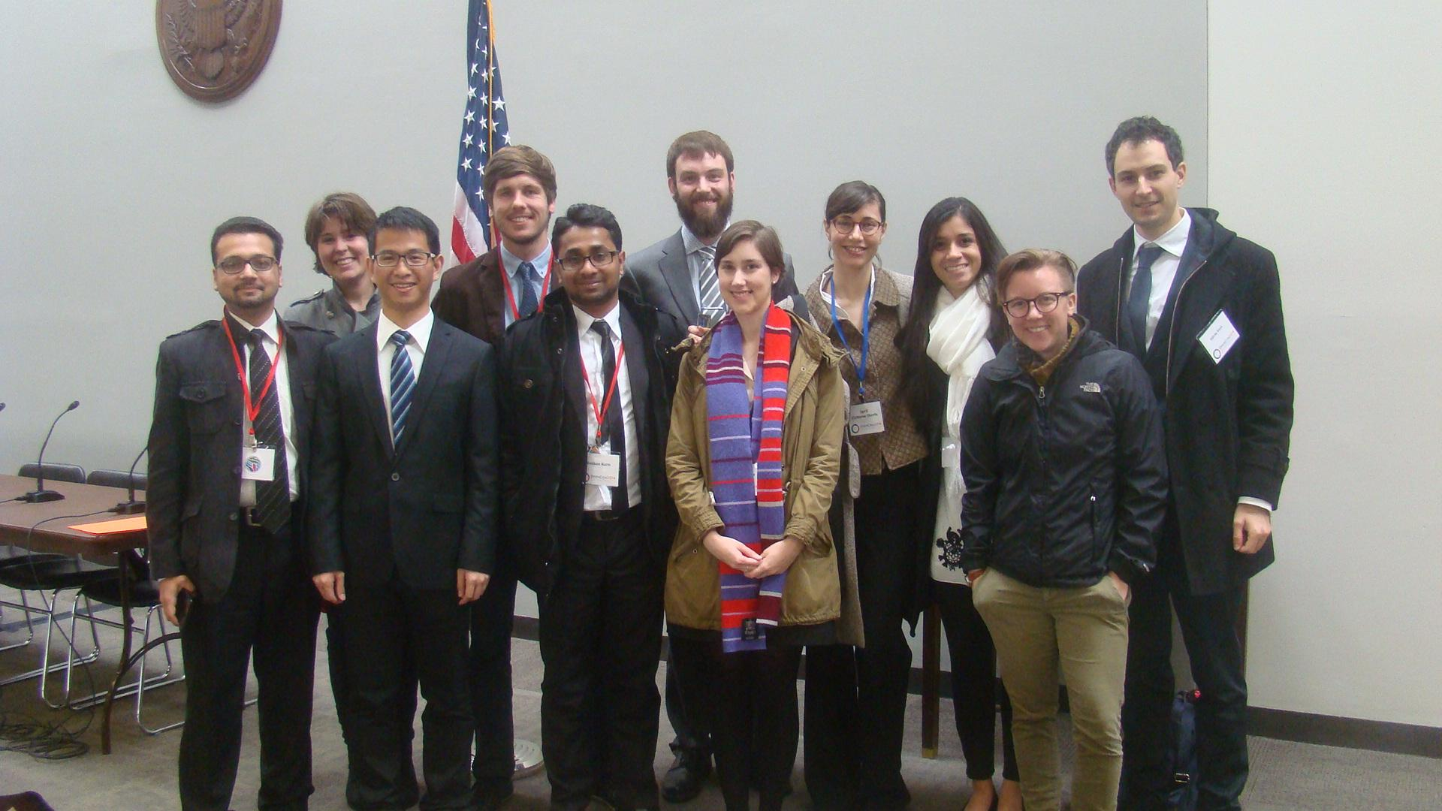
The Story of “Why”
Notes:
1:30-1:40pm
Start with the why: why do you care? Why are you talking to me? Source: Simon Sinek http://www.ted.com/talks/simon_sinek_how_great_leaders_inspire_action?language=en
Believe that scientific research is the best way for humans to create knowledge, and evidence built through good research is the best way for us to solve our biggest challenges, such as disease and poverty.
When I learned that there were some issues in research that were preventing important knowledge from getting to those who need it, I thought that I should see what I can do to help fix those issues.
I was fortunate enough to participate in a train-the-trainer workshop by Software Carpentry and then advocacy training from OpenCon. What these communities taught me is that ordinary people like me, shy people, people who have never advocated for anything before, and people who are not experts, can successfully advocate for issues they care about.
At OpenCon, the conference organizers scheduled meetings for us with lawmakers on Capitol Hill. I was scheduled to meet with a Senator and advocate for open access to scientific research. I was terrified, felt like an imposter, and was sure the Senator would ask me a question I didn’t know the answer to and I would ruin the whole meeting. We had a plan, however. The plan was to just tell the Senator why we care about access to research. So when the Senator asked why I was here, I said “I am a researcher, and it is important to me that I am always doing the best research I can. In order to do that, I need to have access to all previous research in my field.” The Senator smiled, nodded his head, and it was clear that our stories resonated with him. He asked if we had some literature his staff could review, and we gave him a folder of information, shook his hand, and left. I had survived, I didn’t ruin the meeting, and my story helped to motivate this Senator to learn more about my issue.
What I learned that day is that I didn’t need to memorize facts and theories to be an advocate for the things I cared about. I was capable, with only the essential information, to get people interested in the issue.
Telling the story of why you care about the issue allows you to express your values to your audience, values that can resonate with them, and can motivate them to care about your issue as well. The most effective way to communicate is not to share facts and plans with the people that can make change, but to tell them a story about why you care, and why they should too.
Learning how to tell my own Story of Why open research is important to me has allowed me to communicate and advocate, even though I was not an expert. And I know that there are others like me that are just a few practice conversations away from becoming effective advocates themselves - which is what this workshop aims to do.

Slide 8
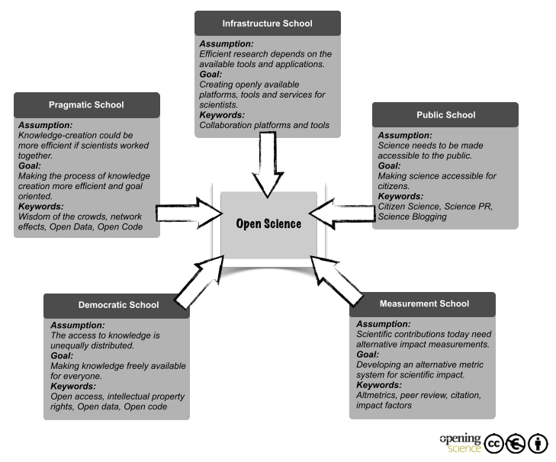
The Story of “Why”
Open Research!
Five Open Science schools of thought (Fecher and Friesike, 2014)
Notes:
1:30-1:40pm
As we discuss about research transparency, think about:
How does this issue relate to your experiences?
How does this issue relate to your values
What worries or hopes do you have?
How do you fit into this picture?
How does this issue impact your role / profession / identity?
As a rule, when first introducing your audiences to your advocacy issue and goal:
Start with the Why
Your goal is to talk about why you care, and why they should care
Highlight values that you and your audience share
Your conversation will be memorable if you present the “I have a dream” type speech rather than the “I have a plan” type speech
If they leave caring, they can search out more information. The reverse is not usually the case.

Slide 9
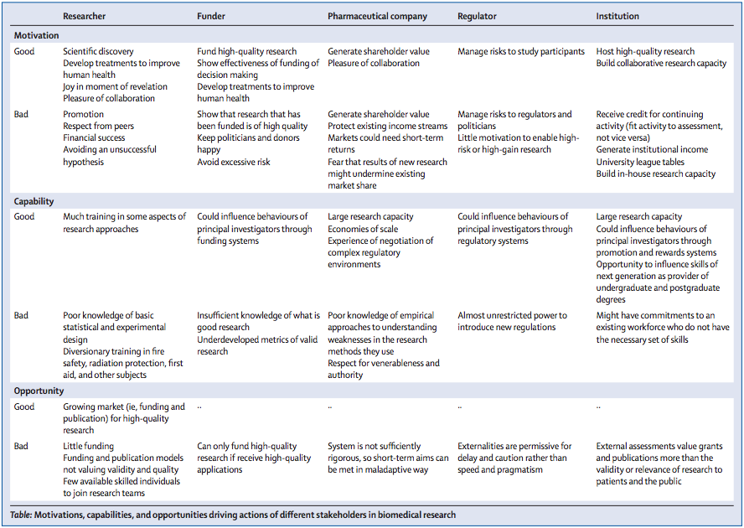
Notes:
1:30-1:40pm
Your story of Why is not enough though
We will quickly go through a strategy planning exercise
Part of this will be thinking about the key interests & motivations of influencers and decision makers
You need to be able to not only express your Why, but do some research to identify their why
What motivates them?
How does this issue and goal relate to their needs and wants?
What opportunity does your goal offer for them?

Slide 10

Research transparency: issues ripe for advocacy
Definition blitz!
Open Access
Open Data
Open Education
Open Innovation & Global Access
Clinical Trial Transparency
Notes:
1:40-1:50pm
Open Access
Free, immediate, online availability of research articles
Rights to use these articles fully in the digital environment
Open Data
Research data that can be freely used, reused and redistributed by anyone, subject at most to the requirement to attribute and sharealike.
Availability
Data should be made available in whole, and at no more than a reasonable reproduction cost.
Access
Data should be available for downloading on the open Internet in a form that is both convenient and modifiable.
Redistribution + reuse
Data must be provided in a format and under terms that permit full redistribution and full reuse of the data.
Open Education
Teaching, learning, and research resources
Open license
Permits their free use and repurposing by others
Open Science
Allows collaboration and contribution.
Research data, lab notes, and other research processes are freely available.
Under terms that enable reuse, redistribution.
Allows replication of research, data, and methods.
Open Innovation & Global Access
Allows collaboration for research and development of technologies.
Not only data and knowledge but products themselves are made accessible and affordable through various open approaches to technology transfer such as global access licensing and patent pools.
Clinical Trial Transparency
Public registration
Reporting of results
Protocol sharing
Statistical Analysis Plans

Slide 11
What is advocacy?
Policy advocacy is the deliberate process of informing and influencing decision-makers in support of policy change and policy implementation.
Policy change includes:
Elimination of a harmful policy.
Updating or amending an existing policy.
Developing a new policy.
Allocating or committing resources within a budget.
Policy implementation includes:
Enforcing a policy.
Disbursing allocated funds appropriately.
Demonstrating accountability for policy commitments and carrying out the provisions called for within policies.
Notes:
1:40-1:50pm
Policy advocacy is a deliberate process that requires planning and strategy. It is not effective if done haphazardly, unless you are lucky.
It aims to inform and influence decision-makers. Policy advocacy tries to influence those who have the formal power to make the change.
Policy advocacy seeks changes that are evidence-based. You should have program experience or data to prove the issue is important and the suggested solution will help.
The ultimate goal of policy advocacy is to achieve a desired policy change or ensure that an existing policy is implemented.
It is not enough to just educate policymakers. We want to convince them to take action.
Policy change and implementation can happen at any level. It can happen at an organizational or facility level if they are the institutional target of your advocacy efforts.

Slide 12
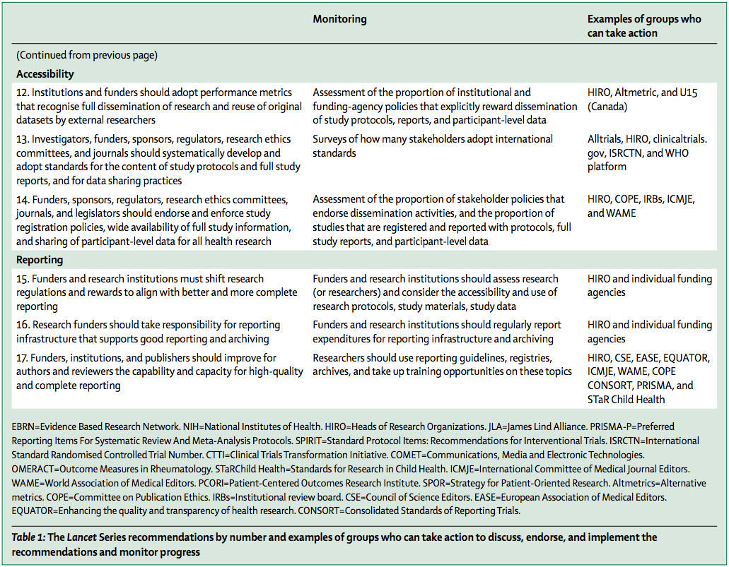
Notes:
1:40-1:50pm
Research transparency is ripe for advocacy
Complex and emerging area
Lots of parties and interests involved
Guidance and ideas available for you to start with

Slide 13
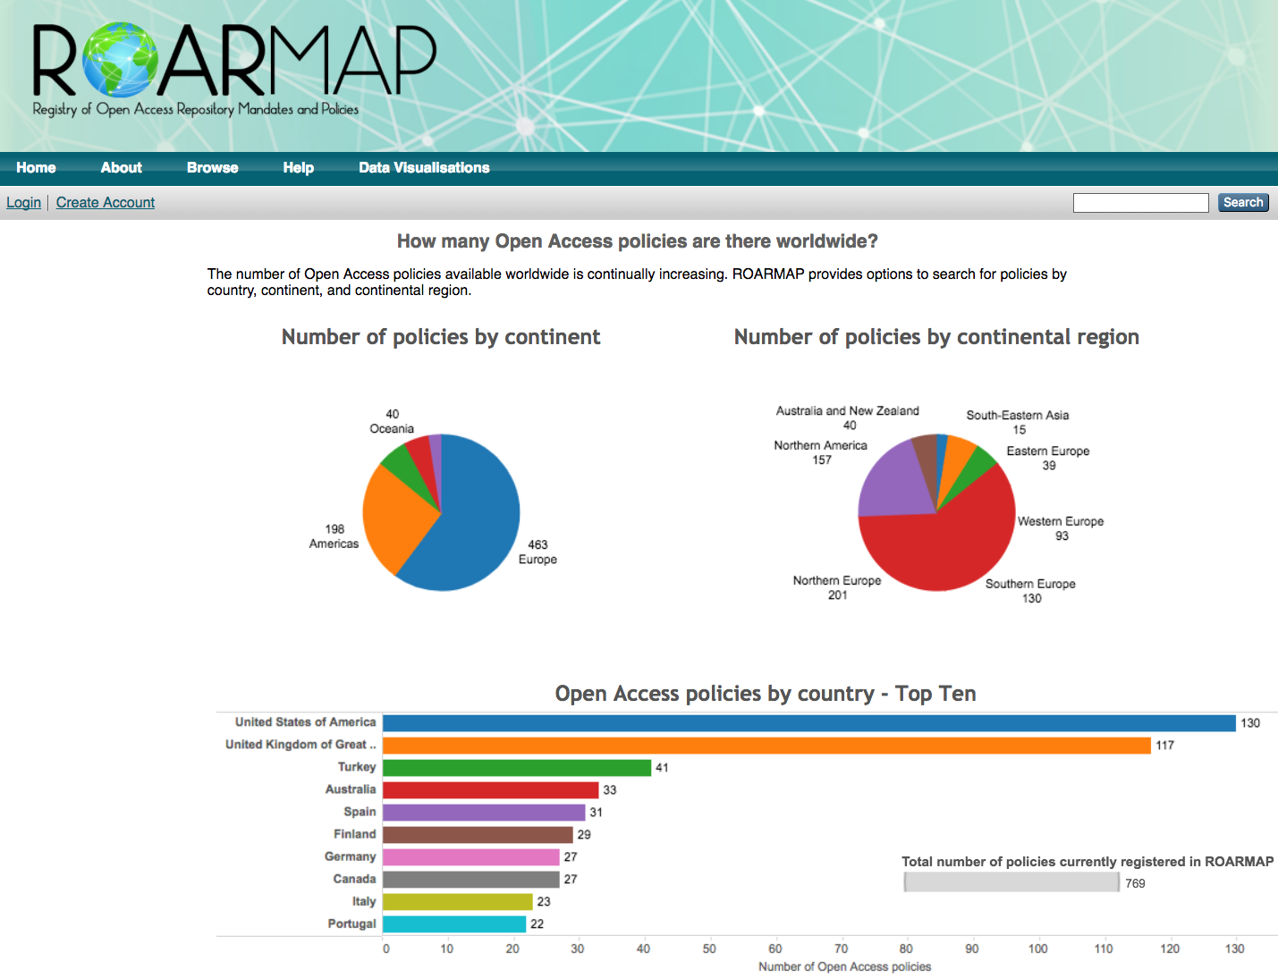
Open Access Policies
Registry of Open Access
Repository Mandates and
Policies (ROARMAP)
Registry of open access mandates and policies
universities, research institutions and research funders
http://roarmap.eprints.org
Notes:
1:40-1:50pm
Looking at other policies is useful
Sense of what others have done to solve issues

Slide 14
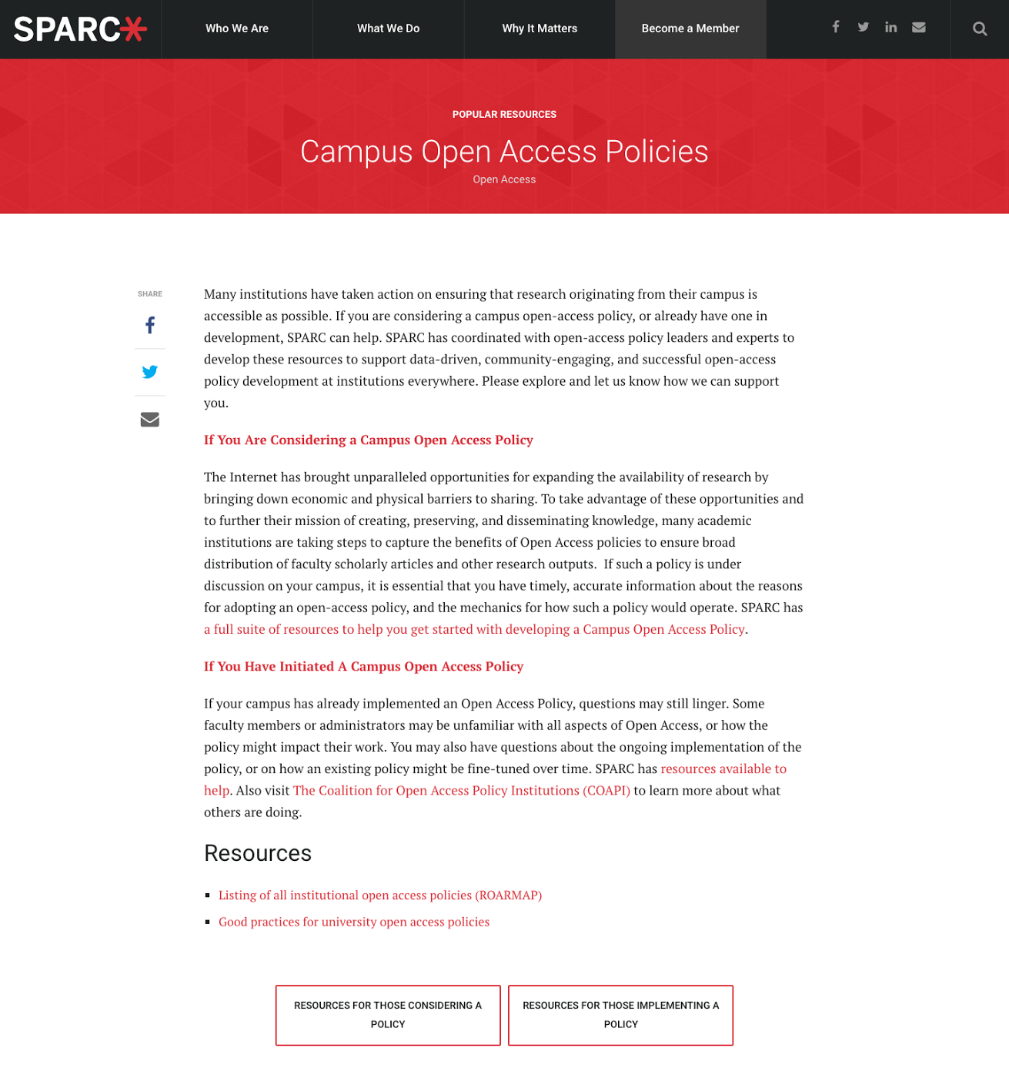
Open Access Policies
SPARC
Make Open the default for research and education
Supports advocacy + adoption of policies and practices that advance Open Access, Open Data, and Open Education
Includes resources to help develop + implement policies
https://sparcopen.org
Notes:
1:40-1:50pm
Many open resources from groups like SPARC
Here is information on developing and implementing open access policies

Slide 15
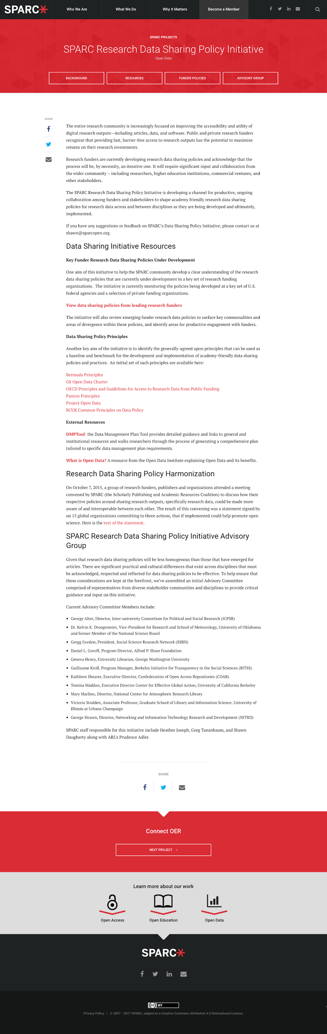
Open Data Policies
https://sparcopen.org/our-work/research-data-sharing-policy-initiative/
Notes:
1:40-1:50pm
Here are resources on open data policies

Slide 16
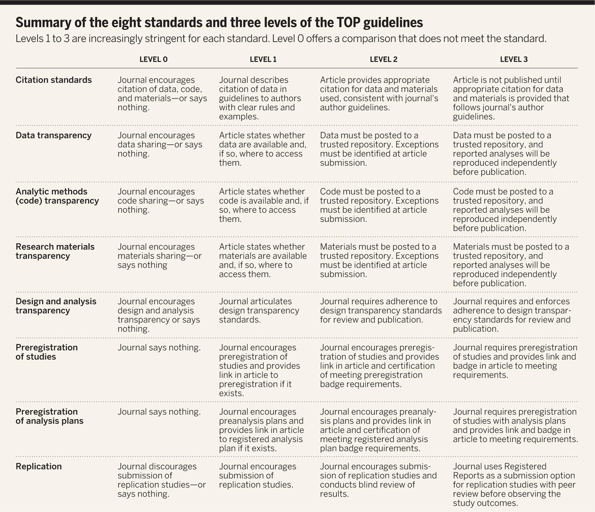
Transparency and Openness Promotion (TOP) Guidelines
Modular standards
Low barrier to entry
Discipline agnostic
http://cos.io/top
Notes:
1:40-1:50pm
When possible, find standards of policy development. Harmonizing your policy advocacy is best.
There are eight standards in the TOP guidelines; each moves scientific communication toward greater openness. These standards are modular, facilitating adoption in whole or in part. However, they also complement each other, in that commitment to one standard may facilitate adoption of others. Moreover, the guidelines are sensitive to barriers to openness by articulating, for example, a process for exceptions to sharing because of ethical issues, intellectual property concerns, or availability of necessary resources.
First, two standards reward researchers for the time and effort they have spent engaging in open practices.
Citation standards extend current article citation norms to data, code, and research materials. Regular and rigorous citation of these materials credit them as original intellectual contributions.
Replication standards recognize the value of replication for independent verification of research results and identify the conditions under which replication studies will be published in the journal. To progress, science needs both innovation and self-correction; replication offers opportunities for self-correction to more efficiently identify promising research directions
Second, four standards describe what openness means across the scientific process so that research can be reproduced and evaluated. Reproducibility increases confidence in results and also allows scholars to learn more about what results do and do not mean.
Design standards increase transparency about the research process and reduce vague or incomplete reporting of the methodology.
Research materials standards encourage the provision of all elements of that methodology.
Data sharing standards incentivize authors to make data available in trusted repositories such as Dataverse, Dryad, the Interuniversity Consortium for Political and Social Research (ICPSR), the Open Science Framework, or the Qualitative Data Repository.
Analytic methods standards do the same for the code comprising the statistical models or simulations conducted for the research. Many discipline-specific standards for disclosure exist, particularly for clinical trials and health research more generally (e.g., www.equator-network.org).
Finally, two standards address the values resulting from preregistration.
Standards for preregistration of studies facilitate the discovery of research, even unpublished research, by ensuring that the existence of the study is recorded in a public registry.
Preregistration of analysis plans certify the distinction between confirmatory and exploratory research, or what is also called hypothesis-testing versus hypothesis-generating research. Making transparent the distinction between confirmatory and exploratory methods can enhance reproducibility ( 3, 13, 14).

Slide 17
More resources on research transparency!
Publication bias: http://www.alltrials.net/news/the-economist-publication-bias/
Clinical research transparency: https://trialstracker.ebmdatalab.net
Access to publications: https://sparcopen.org/open-access/
Access to data: https://sparcopen.org/open-data/
Access to educational materials: https://sparcopen.org/open-education/
Access licensing: https://uaem.org/our-work/global-access-licensing-framework/
Notes:
1:40-1:50pm

Slide 18
Choose an advocacy issue.
Any issue you select for policy advocacy should have these five elements:
Don’t advocate for an issue with which you have no experience. It limits your credibility.
There needs to be proof that your issue is in fact a problem.
A change in policy or implementation of a policy should help to improve the problem.
It should be reasonably attainable in three to five years.
It should be suitably specific and clear.
Notes:
1:50-2:20pm total
1:50-1:53pm
Any issue you select for policy advocacy should have these five elements:
It should be an existing objective or natural outgrowth of your organization or program’s work. Don’t advocate for an issue with which your organization has no experience. It limits your credibility.
It should be based in evidence. There needs to be proof that your issue is in fact a problem.
A change in policy or implementation of a policy should help to improve the problem.
It should be reasonably attainable in three to five years. That is the average length of a policy advocacy strategy.
It should be suitably specific and clear. Broad health topics, such as HIV and AIDS, are too general.
Experienced advocates are likely to identify the absence of a policy or funding as the main problem. In this case, encourage them to back up and clarify the main problem they hope to solve through funding or policy.

Slide 19
Choose an advocacy issue.
What is the main problem you wish to address?
Write 2 sentences describing a problem you care about:
Patients are being enrolled in clinical trials at my university that do not share their results publicly.
Notes:
1:53-2:00pm
Ask a participant to state a main problem he/she would like to address through policy advocacy in two sentences or less. Write the problem in the top box.
A main problem is typically a challenge that impacts the people you serve or that impedes access to or delivery of effective care. Then we identify the root causes of the problem; these tend to become your issues for advocacy.
Experienced advocates are likely to identify the absence of a policy or funding as the main problem. In this case, encourage them to back up and clarify the main problem they hope to solve through funding or policy.

Slide 20
Choose an advocacy issue.
Assess + prioritize potential advocacy issues
 | Root cause #1 |  |  |  | Root cause #2 |  |  |  | Root cause #3
Identify 3 root causes that lead to your problem. |  |  |  |  |  |  |  |  | There are no career incentives for results sharing.
 | Yes |  | No |  | Yes |  | No |  | Yes |  | No
Can a policy change improve this root cause? |  |  |  |  |  |  |  |  | x
Do you have experience with this root cause? |  |  |  |  |  |  |  |  | x
Can a policy change happen in 3 years? |  |  |  |  |  |  |  |  | x
Notes:
2:00-2:10pm
A helpful way to make your issue suitably specific is to start with a very brief statement of the main problem you hope to address through policy advocacy.
A main problem is typically a challenge that impacts the people you serve or that impedes access to or delivery of effective care. Then we identify the root causes of the problem; these tend to become your issues for advocacy.
Ask the participant to next identify two to three root causes of the problem in two sentences or less.
Can a policy change or the implementation of an existing policy help improve the root cause?
Do you have experience with this root cause?
Do you have any evidence that this is a root cause?
Can the problem be reasonably (if not completely) addressed in three to five years?

Slide 21
Choose an advocacy issue.
Assess + prioritize potential advocacy issues
 | Root cause #1 |  |  |  | Root cause #2 |  |  |  | Root cause #3
Identify 3 root causes that lead to your problem. |  |  |  |  |  |  |  |  | There are no career incentives for results sharing.
Assess your root cause for: | Low | Med |  | High | Low | Med |  | High | Low | Med |  | High
Clarity |  |  |  |  |  |  |  |  |  | x
Specificity |  |  |  |  |  |  |  |  | x
Evidence-base |  |  |  |  |  |  |  |  |  |  |  | x
Partnership potential |  |  |  |  |  |  |  |  |  |  |  | x
Political will |  |  |  |  |  |  |  |  | x
Risk |  |  |  |  |  |  |  |  | x
Impact |  |  |  |  |  |  |  |  |  |  |  | x
Based on your assessment, pick a root cause to address through advocacy. This is your advocacy issue! |  |  |  |  |  |  |  |  | My advocacy issue is:
Notes:
2:10-2:20pm
Then answer the four questions for each root cause.
If you checked “yes” to all four questions, write the root cause in the box below labeled “Potential Issue for Advocacy.”
At this point, you may have several root causes that could be a good issue for advocacy; you’ll be able to compare and choose between root causes utilizing a different worksheet.
If you do not yet have at least two root causes that would be suitable for advocacy, flip to the other side of the worksheet and repeat this exercise.
Score issues (high, medium, or low) against the worksheet criteria:
Specificity and clarity of the issue.
Amount of evidence to prove the problem.
Potential for partnership to address issue.
Amount of political will to address issue.
Organization has unique experience and expertise to contribute to addressing the issue.
Availability of resources (time, money, and influence) to address the issue.
Risk to your organization to address the issue.
Likelihood the policy change or action will significantly impact the problem.
Feasibility of success in three to five years.

Slide 22
Choose an advocacy goal.
Identify 3 possible solutions to your advocacy issue.
Describe these solutions, how they would work, who needs to take action, and when.
Assess each solution.
Share your advocacy goal!
Notes:
2:20-2:50pm total

Slide 23
Choose an advocacy goal.
Brainstorm 3 possible solutions to your issue.
 | Solution #1 |  |  | Solution #2 |  |  | Solution #3
What: What is the big change you would like to see? |  |  |  |  |  |  | Prospective trials have their results shared publicly.
How: What is the action a decision-maker can take to improve your issue? |  |  |  |  |  |  | Require results sharing for all trials by faculty.
Who: What is the decision-making institution or individual with the power to take that action? |  |  |  |  |  |  | The faculty.
When: What time frame is best for your action to be a success? |  |  |  |  |  |  | By 2021.
Notes:
2:20-2:35pm
Four elements of a policy advocacy solution.
WHO: the decision-making institution with the power to take action on your advocacy issue.
WHAT: the change you would like to see relative to your advocacy issue.
HOW: the specific action a decision-making institution can take to accomplish the change.
WHEN: a time frame for the action to occur (often between six months and three to five years, depending on the particular advocacy effort).
It is time for participants to brainstorm the “what” of their policy advocacy goals.
Ask participants to think back to their advocacy issue and identify the big change they would like to see—what is the difference that will improve the lives of the people they serve or will improve access to or delivery of effective care?
Encourage participants to describe that change in one sentence and write it down in the “what” column.
Next ask participants to brainstorm the “how” of their goals—or what a decision-making institution can do to make the desired change happen.
Can the decision-maker develop, repeal, or amend a policy, form a budget line, organize dissemination of policies, hire more health care workers, or make specific purchases, etc.
 The more specific your “how” the better. For example, if you want a decision-making institution to develop, amend, or repeal a policy, specify the name of the policy. Similar to your advocacy issue, the more specific your goal the greater clarity it will bring to your overall advocacy strategy.
The “how” is an extremely critical component of your policy analysis. Too often, advocates approach decision-makers with problems they want addressed without recommendations as to how those problems can be effectively solved. Without a strong policy solution, your advocacy efforts can be easily undermined.
The “how” within a policy advocacy goal refers to a specific policy change or an accountability action that can be made by a decision-making institution. 
It is important to remember your advocacy goal should reflect what a decision-making institution can do to solve your advocacy issue. Remember, policy advocacy is working toward influencing someone else to take action. So your advocacy goal will not be an action you or your organization will take. 

Slide 24
Choose an advocacy goal.
Brainstorm 3 possible solutions to your issue.
 | Solution #1 |  |  | Solution #2 |  |  | Solution #3
Assess each solution for: | Low | Med | High | Low | Med | High | Low | Med | High
Clarity
Specificity
Evidence-base
Partnership potential
Political will
Risk
Impact
Based on your assessment, pick a goal & write an advocacy goal statement: ____________ will ____________ to ensure ____________ by ____________ . Who How What When The faculty will vote to require the reporting of clinical trial results by future trials by their faculty by 2021.
Notes:
2:35-2:50pm

Slide 25
Identifying influencers.
Brainstorm decision-makers.
Brainstorm their influencers.
Notes:
2:50-3:10pm total
Decision-makers: People with the formal power or authority to take the desired policy action and/or their key advisors or staff.
Executive leaders, such as Presidents and Vice Presidents
Ministers of Finance, Health, Education, and Gender and Women’s Affairs
Provosts and Deans
Division Heads
Chief Administrative Officers
Local Council Members
Key influencers: People or groups who can have a compelling force on the actions, opinions, or behavior of decision-makers. x Professional associations x Community action groups x Specific journalists x Civic leaders x NGOs x Business associations x Celebrities x A voting bloc x Research institutions x Academics x Coalitions

Slide 26
Identifying influencers.
Brainstorm decision-makers and influencers.
Category of decision-makers | Specific decision-makers | Category of influencers | Specific influencers
Notes:
2:50-3:00pm
Starting in the left column, list the different categories of decision-makers that are relevant for your advocacy strategy (e.g., parliamentarians, district health management team members). Depending on your focus, you may have multiple categories or only one category.
Then, write the specific names or titles of the most relevant individual decision-makers for that category.

Slide 27
Creating a power map.
Plot influence vs. position of your influencers.
OR take a break until 3:10pm!
Notes:
3:00-3:10pm
Prioritize your influencers and decision-makers with a power map.

Slide 28
Identifying influencers.
Plot the influence vs. position of your influencers as they relate to your advocacy goal.
High influence
High opposition & unaware
High support & awareness
Low influence
Notes:
3:00-3:10pm

Slide 29
Planning for opposition.
Identify opponents of your advocacy goal.
Describe reasons for their opposition.
Categorize their influence on your decision-makers.
Identify mitigation strategies for each.
Independent work: Analyze the obstacles (from Advocacy Toolkit).
Notes:
3:10-3:20pm
Explain that it is just as important to understand the actors or organizations that may resist or oppose your desired policy action, as it is your decision-makers.
This analysis will help you design activities to lessen the influence they might have with key decision-makers
Know the opposition and their motives. Work to understand who your opponents are and, more importantly, why they are against your issue or proposed policy solution. 
Identify their tactics and arguments. Get familiar with their main arguments and the approaches they use to promote those arguments. Then you can compile and present evidence that counters their arguments or claims. 
Assess the risks and benefits of confronting them. Directly countering your opponents can oftentimes be counterproductive. You will likely get better results with those who can be swayed more easily than with those who are deeply dedicated in their opposition. 
Mitigate their influence. When you anticipate and assess your opponents, you can design advocacy actions to lessen or counter their influence with your target decision-makers. 
Pick the right partnerships. It may help to partner with organizations or individuals who come from the same sector as your opponents and are uniquely trusted by your key decision-makers. Their presence can help to allay the authority of your opponents.

Slide 30
Identifying opponents + partners.
Brainstorm likely opposition and mitigation options.
Individuals or groups who oppose advocacy goal. | Reason for opposition. | Influence on decision-makers. |  |  | Ways to mitigate their influence.
 |  | Low | Med | High
Notes:
3:10-3:20pm
If your opponents have no influence, don’t worry about them.  In general, you don’t want to engage opponents who strongly object to your position. You want to know their arguments in order to counter what they are saying when you communicate with decision-makers. But you don’t want to counter them directly.
Brainstorm a brief list of potential opponents to that goal, note their reasons for opposition, their level of influence on key decision-makers, and some of their arguments or tactics. Finally, note any ideas for potential tactics to mitigate their influence.

Slide 31
Assessing team + partners.
You need a team.
Independent work:
Assess team capacity (from Advocacy Toolkit).
Choosing your partners.
Brainstorm individuals or groups who complement your team.
Identify strategic reasons for partnership.
List potential risks to partnership.
Brainstorm how you might collaborate. Be specific!
Reach out and build a community.
Lessons learned from the OpenCon community.
Notes:
3:20-3:30pm
While advocacy is almost always more successful when done in collaboration with others, you should not partner with anyone and everyone. In addition to benefits, partnerships can come with risks or downsides. Be selective about your partners. Any potential partner should have something helpful to add to the effort and should not weaken your impact.
Strategic reasons for partnering.
Adds to the number of organizations actively working on the issue.
Brings together new constituents demonstrating wide-scale and diverse support for the issue.
Demonstrates benefit to multiple sectors of importance. x Improves ability to reach and persuade a wider set of decision-makers and influencers.
Helps to mitigate the influence of the opposition.
Yields additional expertise, skills, and resources.
Helps fill an organization’s advocacy gaps.

Slide 32
Identifying opponents + partners.
Brainstorm advocacy partners.
Individuals or groups who complement your team. | Strategic reasons to partner. | Potential risks to partnership. | Ways you might collaborate.
 |  | .
Notes:
3:20-3:30pm
The best partners usually bring resources to the advocacy effort, especially ones that fill gaps that may exist for your organization.
Your ideal partner should also be in alignment with your advocacy goal. However, if you require them to agree on all aspects of your strategy, you may greatly reduce the number and quality of partners. Sometimes you need to “agree to disagree” on certain aspects of an advocacy strategy.
Strong partners usually bring few risks. Risks may impact your broader reputation or your potential to go off message.

Slide 33
Creating an advocacy plan.
Independent work: Define your advocacy mission, vision, strategy (from Advocacy Toolkit).
Defining SMART advocacy objectives.
Creating a logical framework for each objective.
Identify possible advocacy activities to achieve your objectives.
Independent work (from Advocacy Toolkit):
Prioritize advocacy activities
Identify advocacy activity resources
Create a work plan
Delegate advocacy tasks
Notes:
3:30-4:00pm total
Objective: Desired accomplishment or outcome that will contribute to the overall goal. A step toward your advocacy goal.

Slide 34
Create an advocacy plan.
Define 3 SMART advocacy objectives. Objectives are the specific actions and steps you want decision-makers or influencers to take in support of your advocacy goal.
Advocacy objective. | Specific? | Measureable? | Achievable? | Realistic? | Timeframe?
Within 12-months, a process to monitor results reporting of all faculty trials is designed and supported to create annual reports of compliance by the Office of Research. |  | .
Notes:
3:30-3:40pm
Objectives are the short- to medium-term steps toward your overall goal. They should not be harder to accomplish than the goal! 
Think of objectives as actions your decision-makers, influencers, or key stakeholders might take to demonstrate their commitment to change.
For example, your advocacy goal might be to pass a new piece of legislation in Parliament. Objectives toward that goal could include: a key Member of Parliament agrees to introduce the legislation; Parliament committee sponsors a hearing on the legislation.
Objectives are the actions you want someone else to take. The actions YOU will take will be your advocacy activities.
Three specific elements of an advocacy objective. Similar to your advocacy goal, your objectives should outline WHO, WHAT, and WHEN.
WHO: which specific decision-maker or key stakeholder you want to take action.
WHAT: what action the decision-maker should take.
WHEN: a time frame for the action to occur (often six months to three to five years depending on the particular advocacy effort).

Slide 35
Create an advocacy plan.
Begin with a logical framework.
Objective # 1 | Verifiable indicators. | Means of verification. | Critical assumptions.
Objective Process created to monitor prospective results reporting. | Policies can be better evaluated through monitoring. | Comparison of compliance information available before + after process.
Outcome Monitoring of all prospective trial results reporting by faculty. | All trials by faculty are accounted for in monitoring. | Audit or triangulation with external CT.gov. | That information on all trials is accessible.
Outputs Annual report of internal results reporting compliance. | Annual report created. | Confirm creation of report at the end-of-year. | Resources are available.
Activities Open Forums on faculty needs and process leadership. Organize design team to create process and report. | Number of forums held. Number of design team meetings & documentation. | Forum documentation. Process design documentation. | Faculty will wish to support a process of monitoring.
Notes:
3:40-4:00pm
The Logical Framework Approach (LFA) is a methodology mainly used for designing, monitoring, and evaluating international development projects.
The core of the Logical Framework is the "temporal logic model" that runs through the matrix. This takes the form of a series of connected propositions:
If these Activities are implemented, and these Assumptions hold, then these Outputs will be delivered.
If these Outputs are delivered, and these Assumptions hold, then this Purpose will be achieved.
If this Purpose is achieved, and these Assumptions hold, then this Goal will be achieved.

Slide 36
Developing compelling messages
Identify communication objectives.
Tailoring information to resonate and motivate your audience.
What is the issue, as it relates to the audience?
Why should your audience care about the issue?
Understand what motivates your audience.
Take their temperature.
Independent work (from Advocacy Toolkit):
Create an Audience Map
Create an Audience Profile
Always start with the “Why?”
What is the solution and its impact on the problem?
Notes:
4:00-4:25pm total

Slide 37
Create compelling messages.
Identify 3 communication objectives related to your activities and advocacy objectives.
Communication objective |  | Audience | Interests & motivation | Needs | Awareness | Support | Priority | Misconceptions
1
2
3
Notes:
4:00-4:05
What do you need to communicate exactly?
To whom?
What interests of theirs are relevant to the goal? Needs?
How aware are they already?
Do they support the goal?
Do they prioritize the goal?
Do they have misconceptions about the goal?

Slide 38
Create compelling messages.
For each objective and audience, frame and tailor information in a way that will resonate and motivate.
 | What is the problem? | Why should the audience care? | What is the solution? | What do you want this audience to do?
1
2
3
Notes:
4:05-4:15pm
Frame the problem with the audience and communication objective in mind
Frame the motivation with the audience and communication objective in mind
Frame the solution and ask

Slide 39
Developing compelling messages
Craft your pilot messages.
Identify channels and messengers.
Share your pilot messages!
Notes:
4:15-4:25pm
Qualities of a compelling message during the exercise.
Brief
Focused
Solution-oriented
Supported by evidence
Targets key interests of the decision-maker
Uses non-technical language
Optimistic and hopeful

Slide 40
Create compelling messages.
Consolidate into one key message per objective and audience. Identify a messenger with high expertise and high influence on your audience.
 | Message | Timing | Channel | Messenger
1
2
3
Notes:
4:15-4:25pm
Who delivers your message is just as important as what you choose to say. The right message delivered by the wrong messenger won’t be compelling. 
Messengers can be individuals, groups, or organizations. As with your message, your messenger may change depending on the decision-maker you are targeting and their key interests.
Messengers should be diverse. Have a number of messengers that represent a range of professional and personal backgrounds.
Messengers can represent a range of seniority. Recruit messengers that represent a level of seniority that matches somewhat with the level of decision-maker you are targeting. You won’t always need the president of your organization to carry your message; it’s a good idea to identify multiple messengers at varying levels of seniority.
Messengers should be effective public speakers. Your messengers should be able to speak in a way that is confident, simple, and easy for decision-makers to understand.
Messengers should support your advocacy goal. Your messengers should be people who already agree with you and won’t need convincing to deliver your message.
Brainstorm the types of individuals or organizations they might ask to serve as messengers for their issue. Flip chart their answers, making sure they include: x CEOs x Celebrities x Health professionals x Representatives of professional associations x Technical experts from your organization x Board members x Advocates x Scientists/researchers/academics x Head of a large coalition x Program beneficiaries x Patients x Journalists x Donors x Voters/constituents x Business leaders x Government employees x Politicians x Parents or spouses of people who have suffered from a particular issue

Slide 41
Evaluating success.
Think about how you can use your logical framework to track success and plan for midcourse adjustments.
Independent work: Define, measure, and evaluate success (from Advocacy Toolkit)
Notes:
4:25-4:30pm

Slide 42
For more information!
Notes:
4:25-4:30pm

Slide 43


Time for new interventions
Open, reusable curriculum
Communication
Advocacy
Strategies to improve transparency at their own institution
April Clyburne-Sherin, MS
AllTrials USA Campaign Manager
Sense About Science USA
Notes:
4:25-4:30pm

Slide 44
Get in touch
Email april@sensci.org to:
Organize an advocacy workshop!
To inquire about becoming an Ambassador
Follow our news
@AllTrialsUSA
senseaboutscienceusa/alltrials

