Slide 1
We Try To Code
Raj – 558191
Allabakshu - 801908

Slide 2
Xtra Ticket
The Idea of this app is to sell the tickets for a movie/show, if you booked earlier and you can’t able to go and you can sell the tickets without losing your money, it is helpful for any last minute plan.

Slide 3
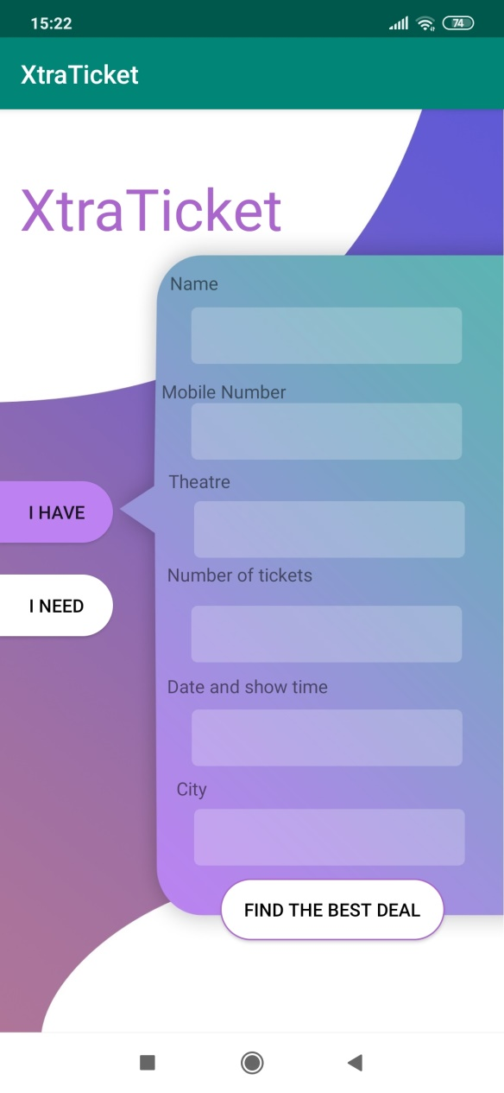
Screenshots
I have – Screen
where seller can tell us what they have

Slide 4
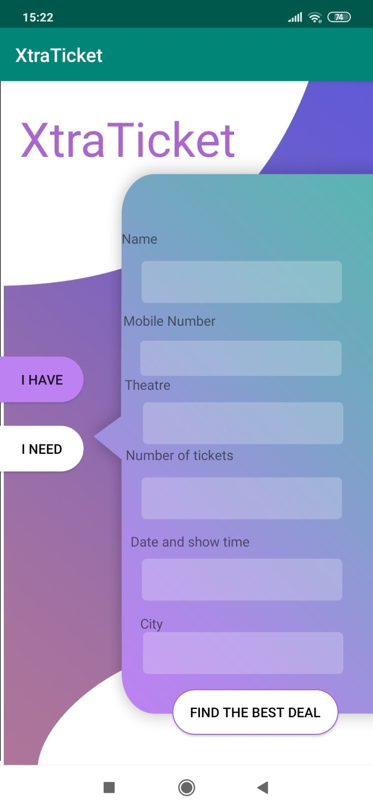
I Need – Screen
where buyers can tell us what they need

Slide 5

I Need – Screen

Slide 6
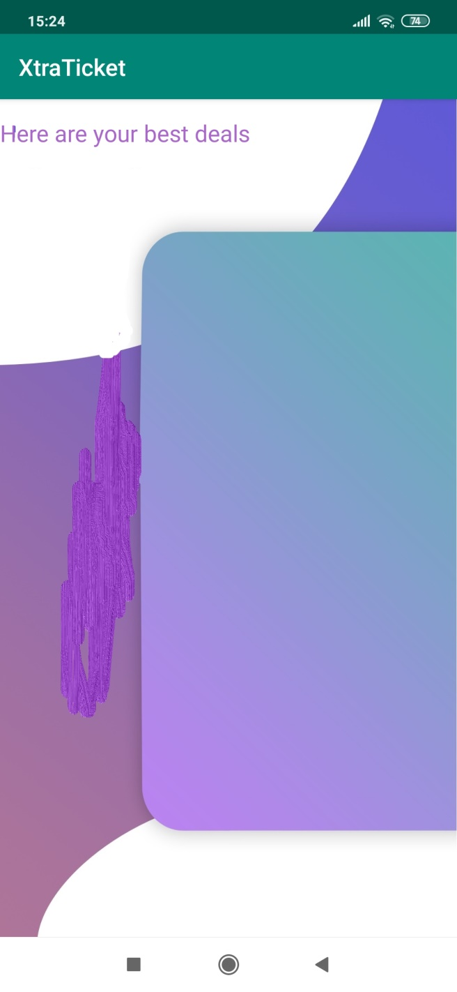
Best Deals will be displayed on the screen, where user can select by there wish

Slide 7
Advantages of XtraTicket
Any last Minute plans
Money Benefits

