Slide 1


01
Contexte générale du projet
DEARS: Distributed emergency alert & response system
02
Analyse et conception
PLAN
03
Realisation
Software Engineering
Presented by :
Supervised by :
04
Conclusion
Anass ALLABOUCH
Mr.Youssef EL HABOUZ
Année Universitaire : 2025/2026

Slide 2
01
General context
02
Analysis and conception
PLAN
03
Implementation
04
Conclusion

Slide 3







PROBLEM STATEMENT
PROBLÉMATIQUE
01
General context
PROBLÉMATIQUE

Slide 4



PROPOSED SOLUTIONS
PROBLEM STATEMENT
1. Distributed System Architecture 2. Central Dispatcher for Intelligent Routing
3. Remote Procedure Call (RPC) Communication
4. Web-Based Alert Submission Interface
5. Shared Relational Database
How can a distributed system be designed to allow citizens to report emergency situations in real time, while ensuring fast, reliable, and scalable communication between multiple emergency response services such as police, fire, and medical units?

Slide 5
PROPOSED SOLUTIONS
1. Distributed System Architecture 2. Central Dispatcher for Intelligent Routing
3. Remote Procedure Call (RPC) Communication
4. Web-Based Alert Submission Interface
5. Shared Relational Database

Slide 6
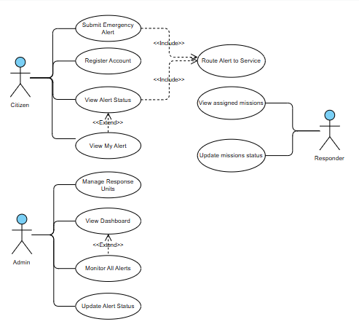
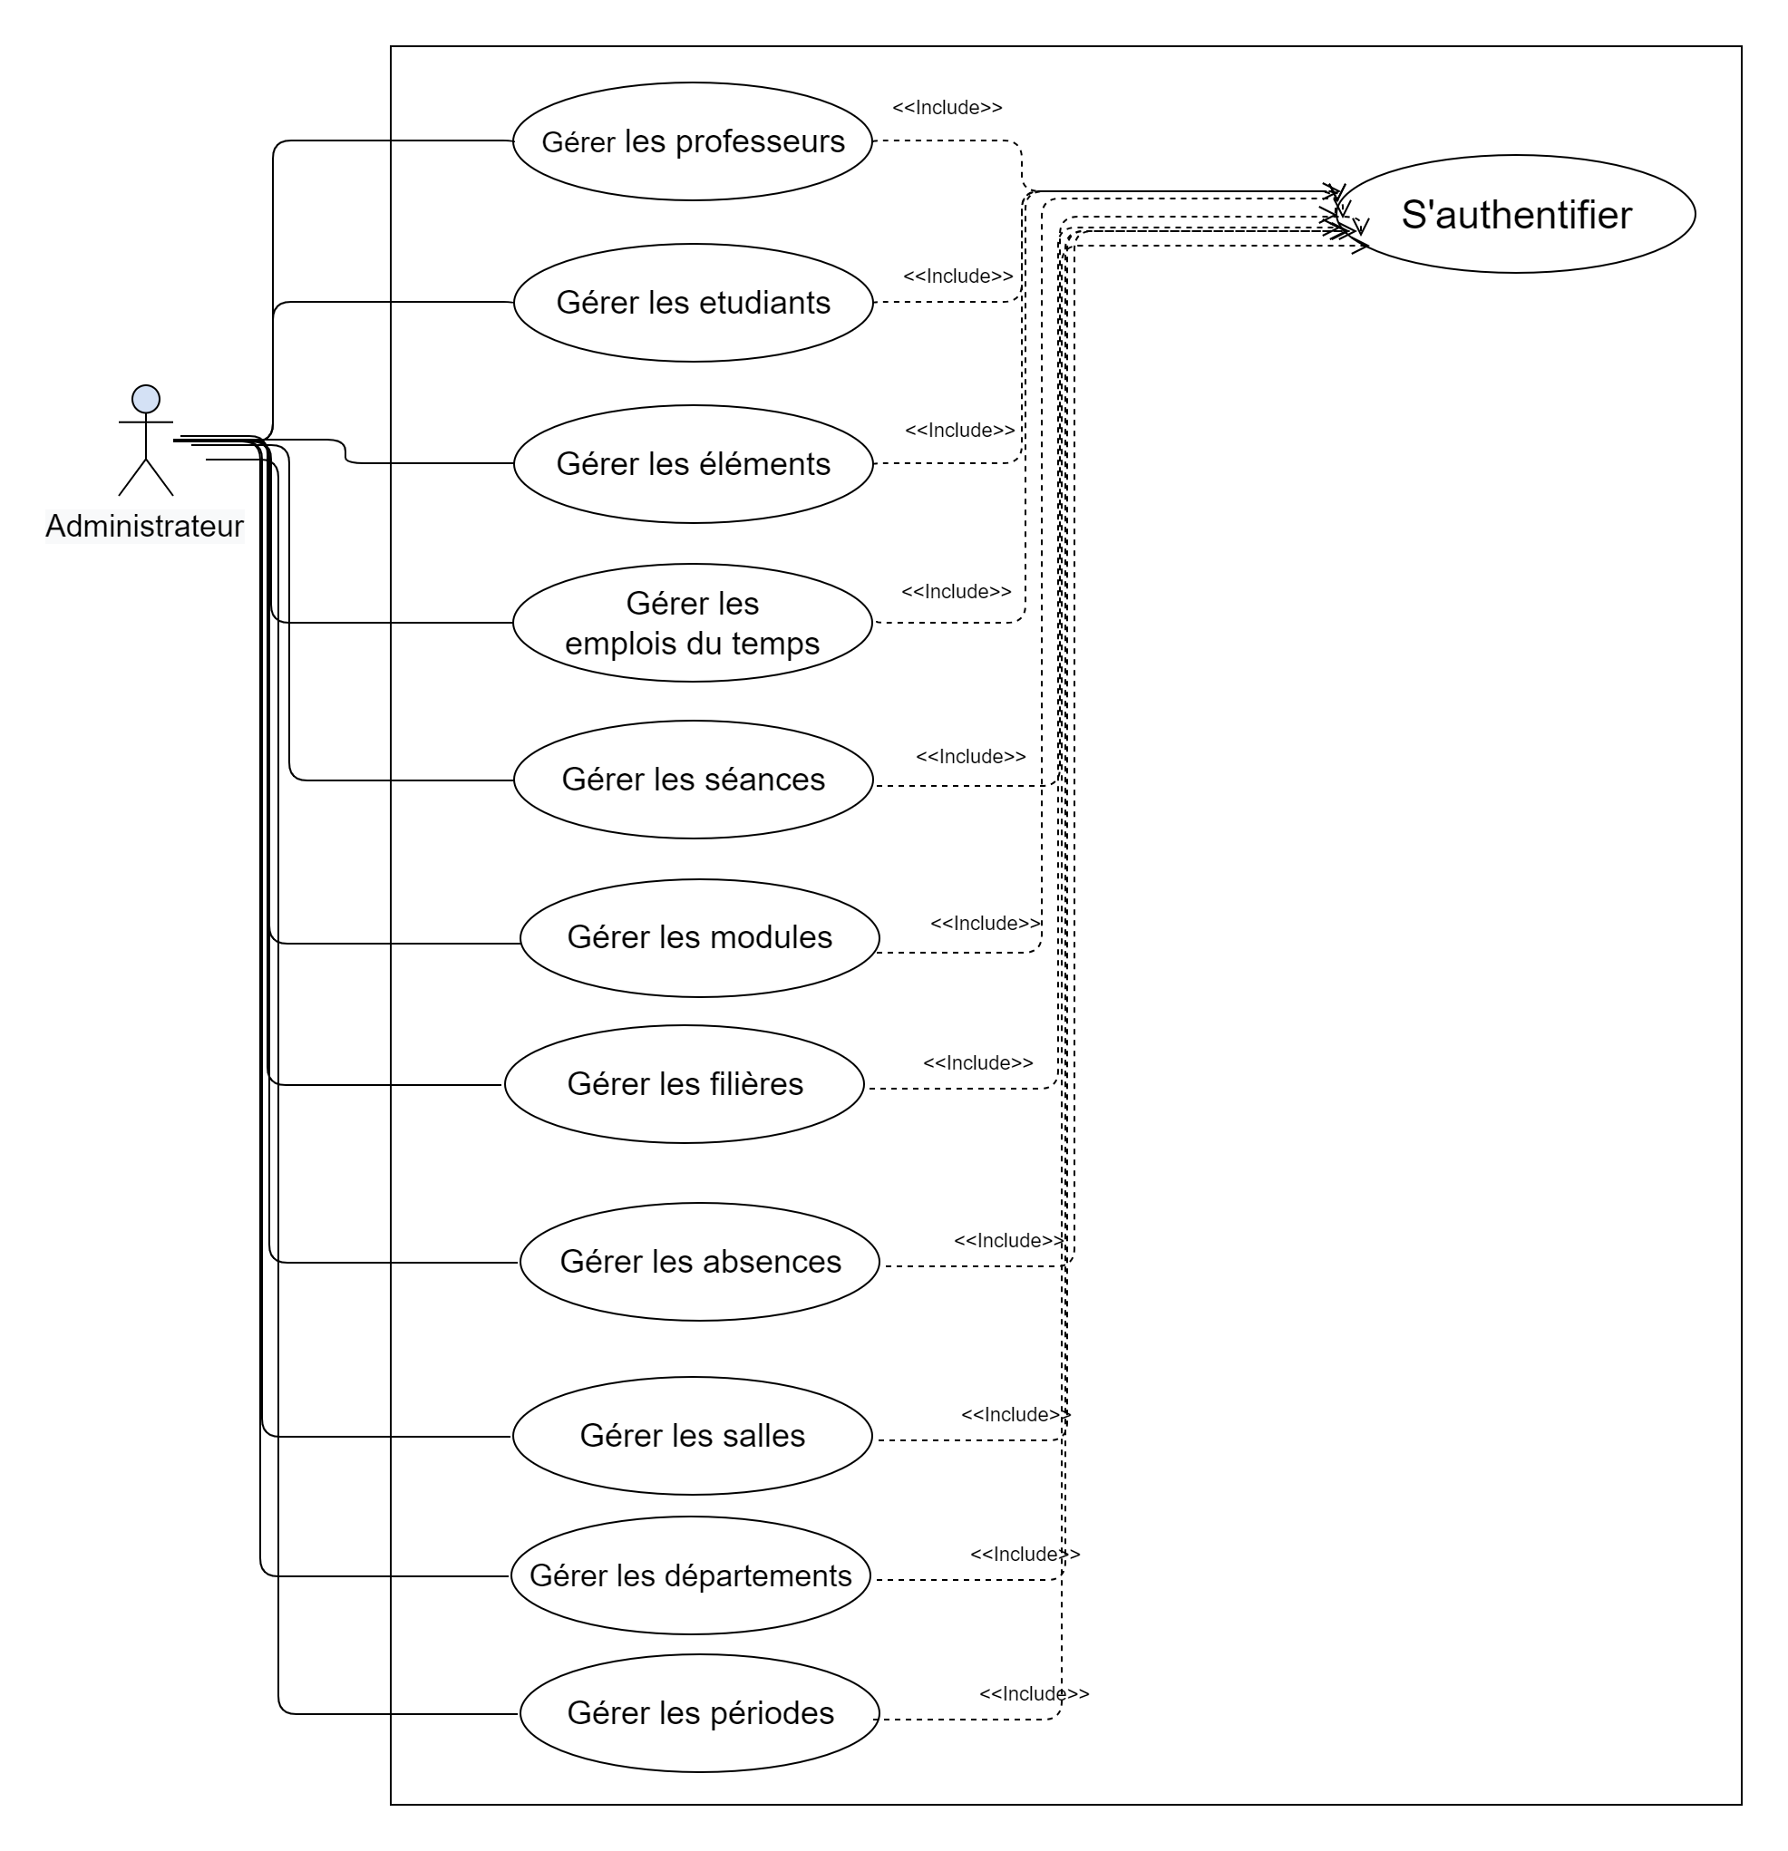


SOLUTIONS PROPOSÉES :
USE CASE DIAGRAM
01
General Context
02
Analysis and Conception
ÉTUDIANT

Slide 7
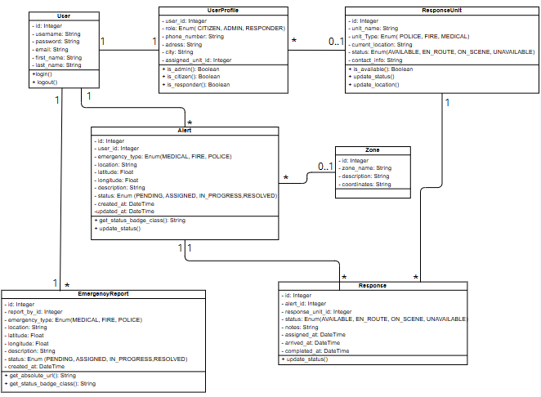
CLASS DIAGRAM
USE CASE DIAGRAM

Slide 8
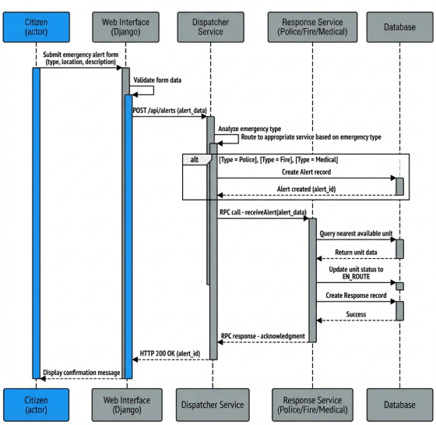
CLASS DIAGRAM

Slide 9
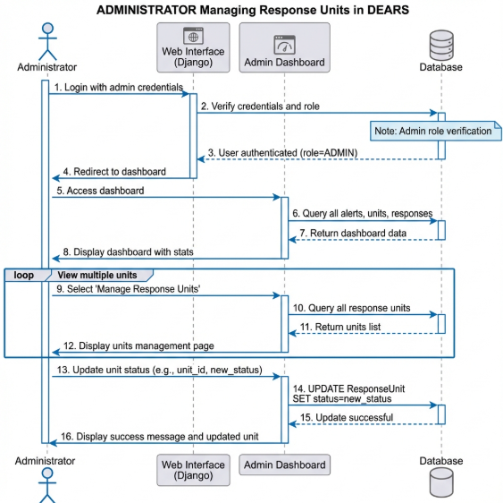
CLASS DIAGRAM
SEQUENCE DIAGRAM

Slide 10
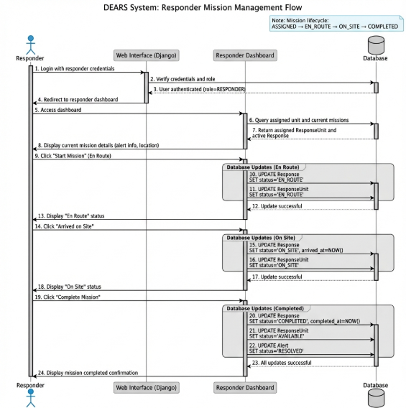
CLASS DIAGRAM
SEQUENCE DIAGRAM

Slide 11
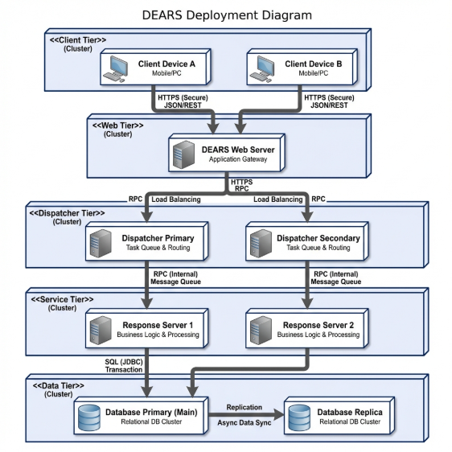
DEPLOYMENT DIAGRAM
CLASS DIAGRAM
SEQUENCE DIAGRAM

Slide 12
DEPLOYMENT DIAGRAM

Slide 13













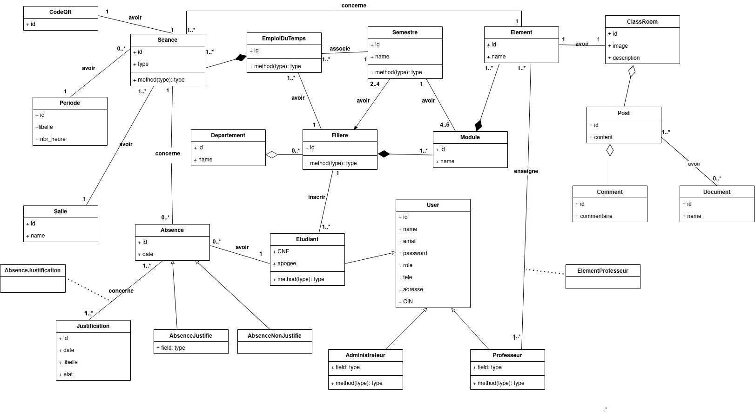
Diagramme de classe:
THE TOOLS USED
Les outils utilises
01
General Context
02
Analysis and conception
03
Implementation
RPyC

Slide 14
THE TOOLS USED
RPyC

Slide 15
Demonstration

Slide 16
Conclusion

