Slide 1
DATABASE SYSTEMS PROJECT
Disaster Relief
Volunteer Registry
Skills-based matching for emergency deployment
Abdulrahman Allam | Academic No: 152300093
Code: https://github.com/Allam-dev/dbproject

Slide 2
Project Overview
🗂️
🎯
🔧
Problem
Goal
Solution
Coordinate disaster relief volunteers by matching their skills to emergency event requirements in real time.
Build a normalized PostgreSQL database with a GUI to manage volunteers, skills, and disaster events.
ER model → Relational schema → DDL + sample data → Flutter desktop app connected to PostgreSQL.
Tech Stack: PostgreSQL • Flutter (Desktop) • SQL DDL • ER Modeling

Slide 3
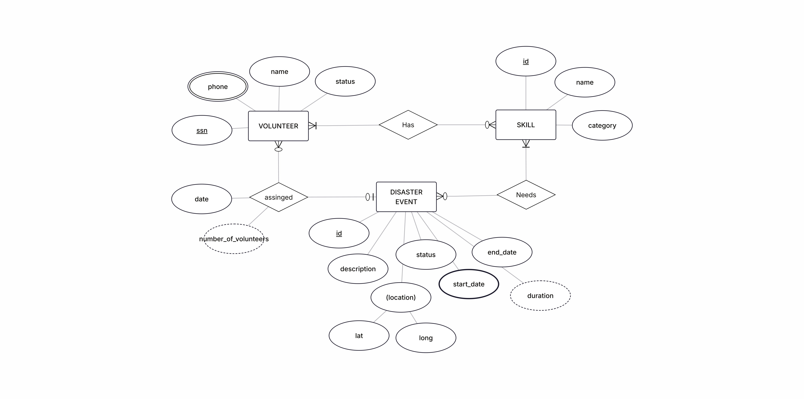
Entity-Relationship Diagram
3 Entities · 3 Relationships · Multivalued & Derived Attributes

Slide 4
ERD — Entities & Relationships
VOLUNTEER
DISASTER EVENT
PK: SSN · Attributes: name, status · Multivalued: phone · Derived: number_of_volunteers
PK: id · Attributes: description, status, start_date, end_date · Composite: location (lat, long) · Derived: duration
SKILL
Has (VOLUNTEER ↔ SKILL)
PK: id · Attributes: name, category
M:N — A volunteer can have many skills; a skill can belong to many volunteers
Needs (EVENT ↔ SKILL)
Assigned (VOLUNTEER ↔ EVENT)
M:N — An event can require many skills; a skill can be needed by many events
1:N — A volunteer is assigned to at most one active event; an event has many volunteers

Slide 5
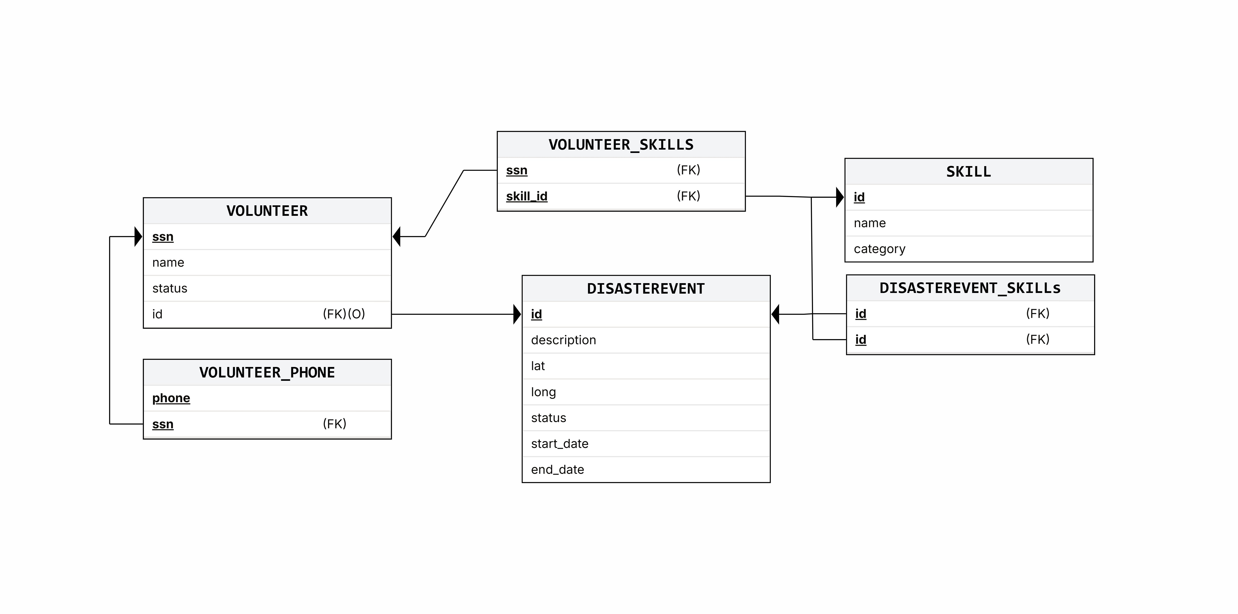
Relational Schema
6 tables · Foreign key constraints · ON DELETE CASCADE & SET NULL policies

Slide 6
Schema — Table Summary
Table | Primary Key | Foreign Key(s) | Notes
SKILL | id (SERIAL) | — | Stores skill name & category
DISASTEREVENT | id (SERIAL) | — | Stores event details, location, dates, status
VOLUNTEER | ssn (VARCHAR) | id → DISASTEREVENT | Optional FK for current assignment
VOLUNTEER_PHONE | (phone, ssn) | ssn → VOLUNTEER | Multivalued phone attribute
VOLUNTEER_SKILLS | (ssn, skill_id) | ssn, skill_id | M:N junction table
DISASTEREVENT_SKILLS | (event_id, skill_id) | event_id, skill_id | M:N junction table

Slide 7
DDL — Key Definitions
VOLUNTEER Table
VOLUNTEER_SKILLS Junction
CREATE TABLE VOLUNTEER (
ssn VARCHAR(20) PRIMARY KEY,
name VARCHAR(100) NOT NULL,
status VARCHAR(50) DEFAULT 'available',
id INT REFERENCES DISASTEREVENT(id)
ON DELETE SET NULL
);
CREATE TABLE VOLUNTEER_SKILLS (
ssn VARCHAR(20)
REFERENCES VOLUNTEER(ssn)
ON DELETE CASCADE,
skill_id INT
REFERENCES SKILL(id)
ON DELETE CASCADE,
PRIMARY KEY (ssn, skill_id)
);
Design Decisions
SSN as PK: Natural, globally unique identifier for volunteers avoids surrogate key overhead
ON DELETE CASCADE: Junction tables auto-clean when a volunteer or skill is deleted
ON DELETE SET NULL: Volunteer's event assignment becomes NULL when an event is deleted — preserves volunteer record
SERIAL PKs: Auto-incrementing IDs for SKILL and DISASTEREVENT for simplicity and performance

Slide 8
Sample Data
Volunteers
Skills
SSN | Name | Status
123-45-6789 | Ahmed Hassan | Deployed
987-65-4321 | Sara Mohamed | Available
111-22-3333 | Omar Khalil | Available
Name | Category
Nursing | Medical
CDL License | Transport
First Aid | Medical
Search & Rescue | Emergency
Arabic | Language
Disaster Events
Description | Status | Start Date | Required Skills
Flood in Alexandria | Active | Jan 10, 2025 | Nursing, CDL License
Earthquake response | Resolved | Nov 1, 2024 | Search & Rescue

Slide 9
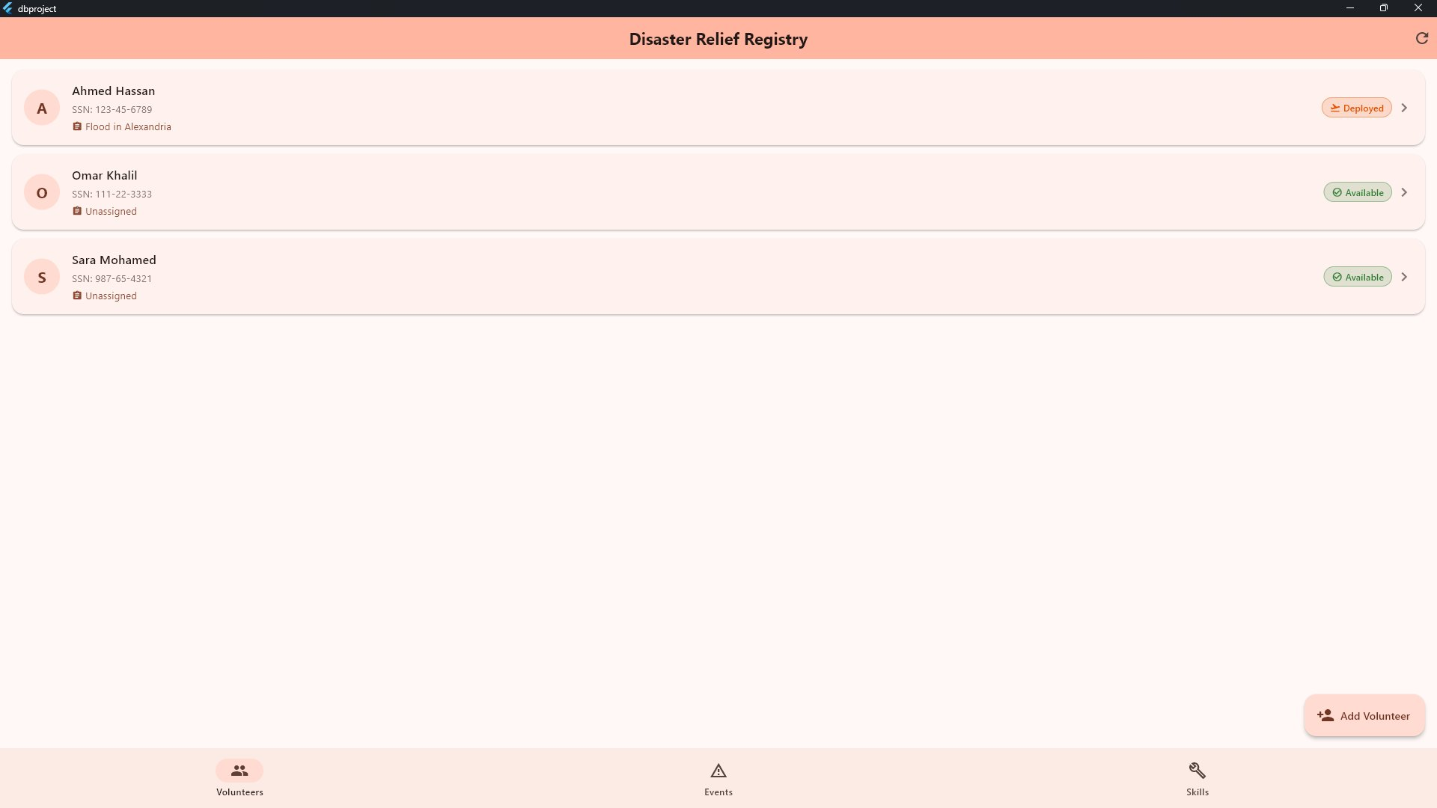
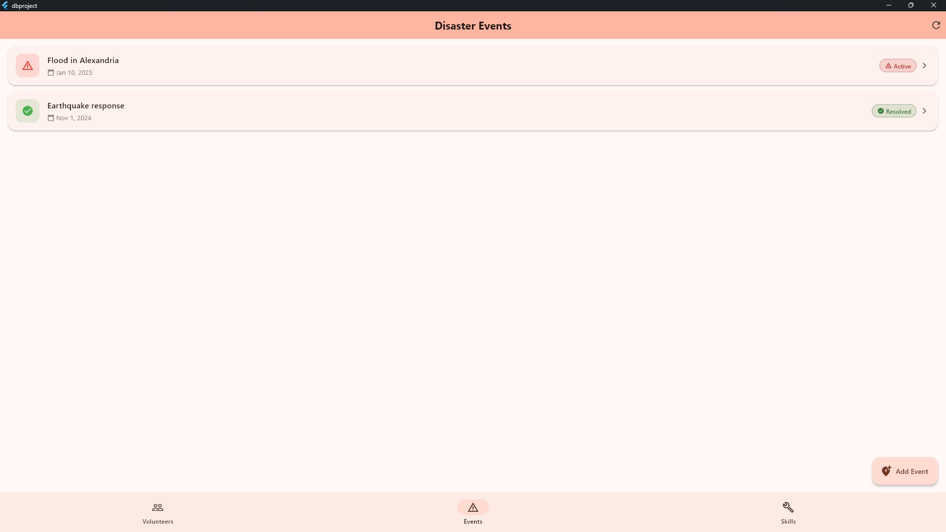
Application GUI — Volunteers & Events
Volunteer Registry
Disaster Events
Built with Flutter · Connected to PostgreSQL · Bottom navigation: Volunteers | Events | Skills

Slide 10
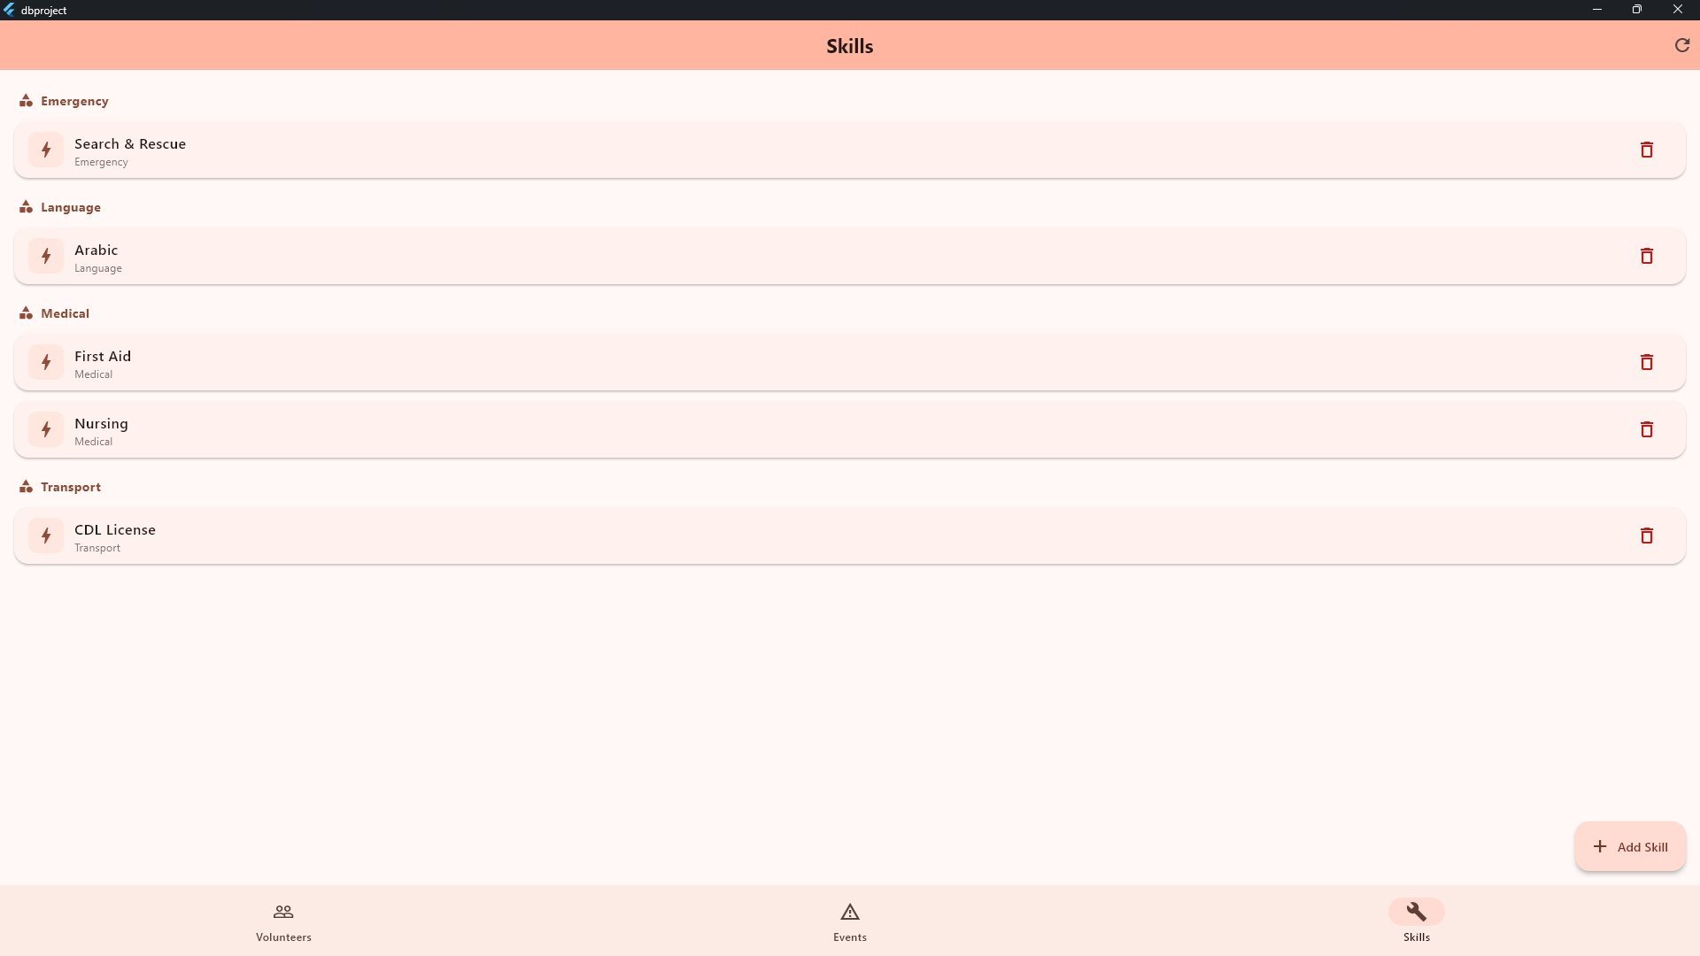
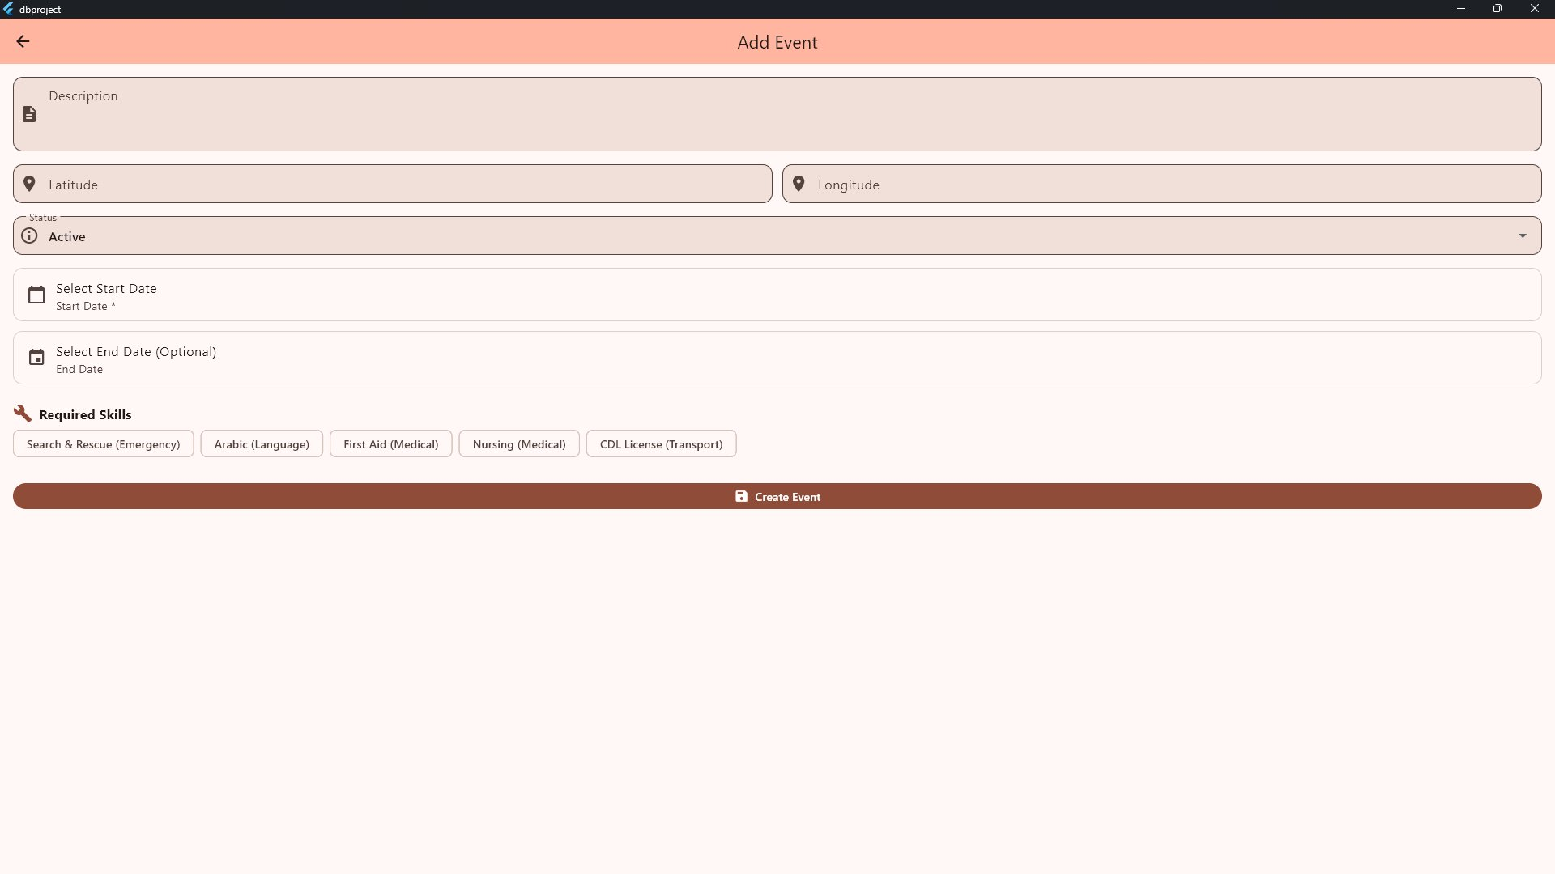
Application GUI — Skills & Add Event
Skills (grouped by category)
Add Event Form
Skills displayed by category · Event form with skill chip selection · Add Skill modal

Slide 11
Summary & Deliverables
What We Built
ER Diagram
Relational Schema
📐
📋
3 entities, 3 relationships, derived & multivalued attrs
6 normalized tables with FK constraints
PostgreSQL DDL
Flutter GUI
🗄️
💻
Full CREATE TABLE statements + sample data
Desktop app: Volunteers, Events, Skills screens
Abdulrahman Allam · 152300093

