Slide 1

FINAL PROJECT
Hotel Booking Data Analysis
Uncovering patterns, trends, and actionable insights from real-world hotel reservation data — powered by Python, SQL, and Power BI.

Slide 2


OVERVIEW
Project Overview
This project analyzes a comprehensive hotel booking dataset to understand guest behavior, reservation patterns, and operational performance — delivering insights that drive smarter business decisions.
Analyze
Visualize
Recommend
Reservation trends and guest demographics
Interactive dashboards in Power BI
Data-driven strategies for hotel operators

Slide 3
DATASET
Dataset Description
The dataset contains real-world hotel reservation records spanning multiple properties, seasons, and guest segments — ideal for end-to-end analytical exploration.
32K
2
Booking Records
Hotel Types
Total reservations analyzed across properties
Resort and city hotel categories
18
37%
Data Columns
Avg. Cancellation
Features including lead time, ADR, and stays
Overall cancellation rate across bookings

Slide 4


DATA ENGINEERING
Data Cleaning with Python
Raw data required systematic preprocessing to ensure analytical accuracy. Python and pandas were used to handle inconsistencies, missing values, and outliers before analysis.
Duplicate Removal
Missing Value Handling
Type Conversion
Outlier Detection
Eliminated redundant booking entries
Standardized dates and numeric fields
Flagged extreme ADR and stay values
Imputed or flagged null fields

Slide 5
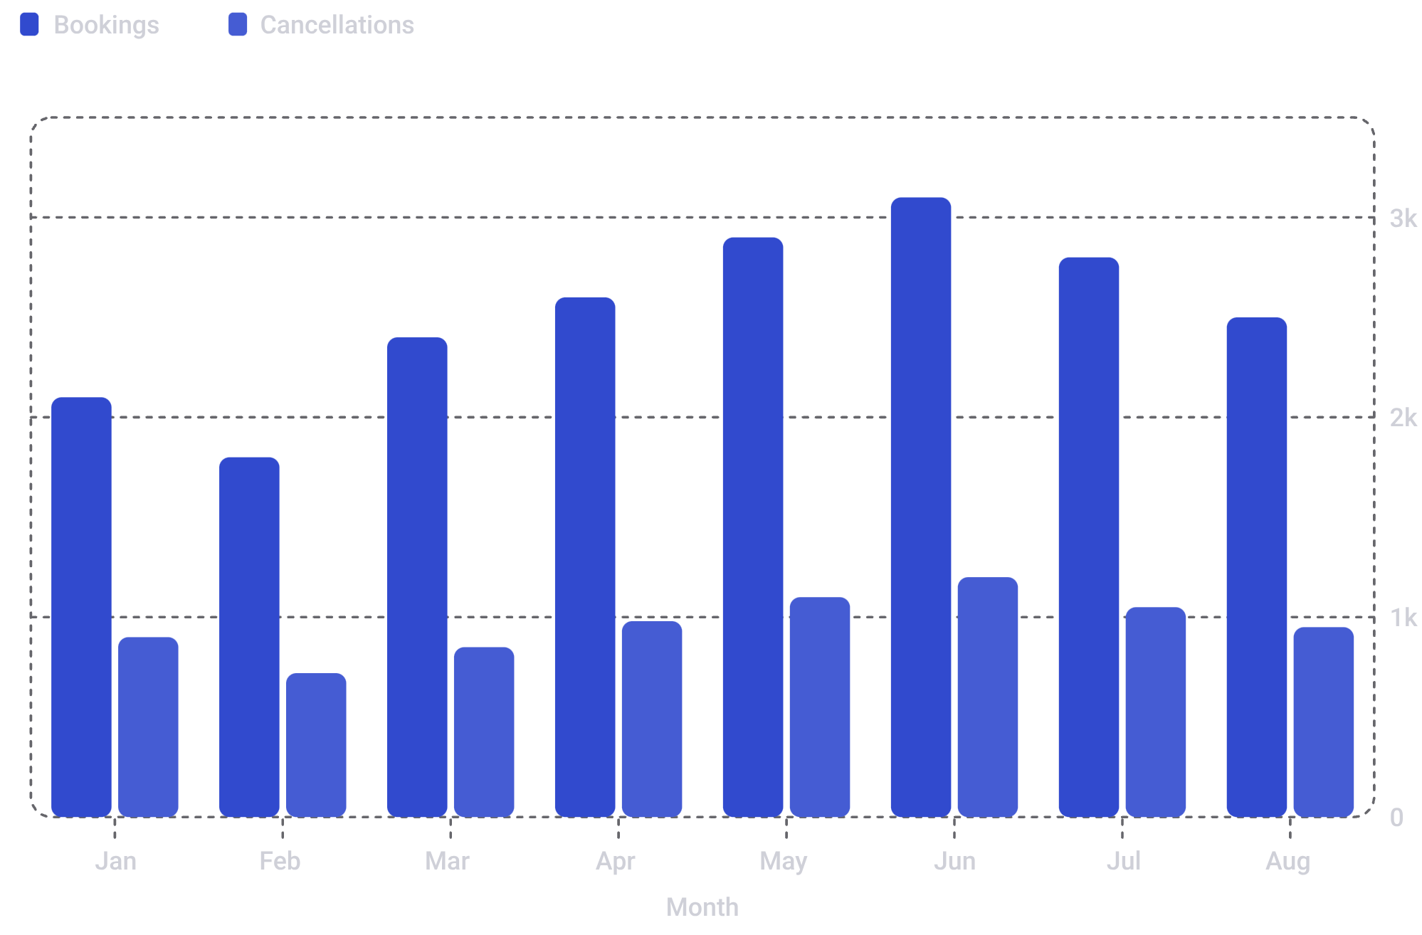
ANALYSIS
Exploratory Data Analysis
What the Data Reveals
Peak season: June sees the highest booking volume
Cancellation trend: Cancellations rise proportionally with bookings
Lead time: Average 30–45 days before arrival
ADR: Average Daily Rate varies significantly by hotel type

Slide 6

SQL ANALYSIS
SQL Analysis
SQL queries were used to segment data, compute aggregates, and answer targeted business questions directly from the database.
Segmentation
Aggregation
Filtering
Grouped by market segment, customer type, and distribution channel
Computed ADR, stay duration, and cancellation rates by property
Isolated high-value guests and repeat booking patterns

Slide 7
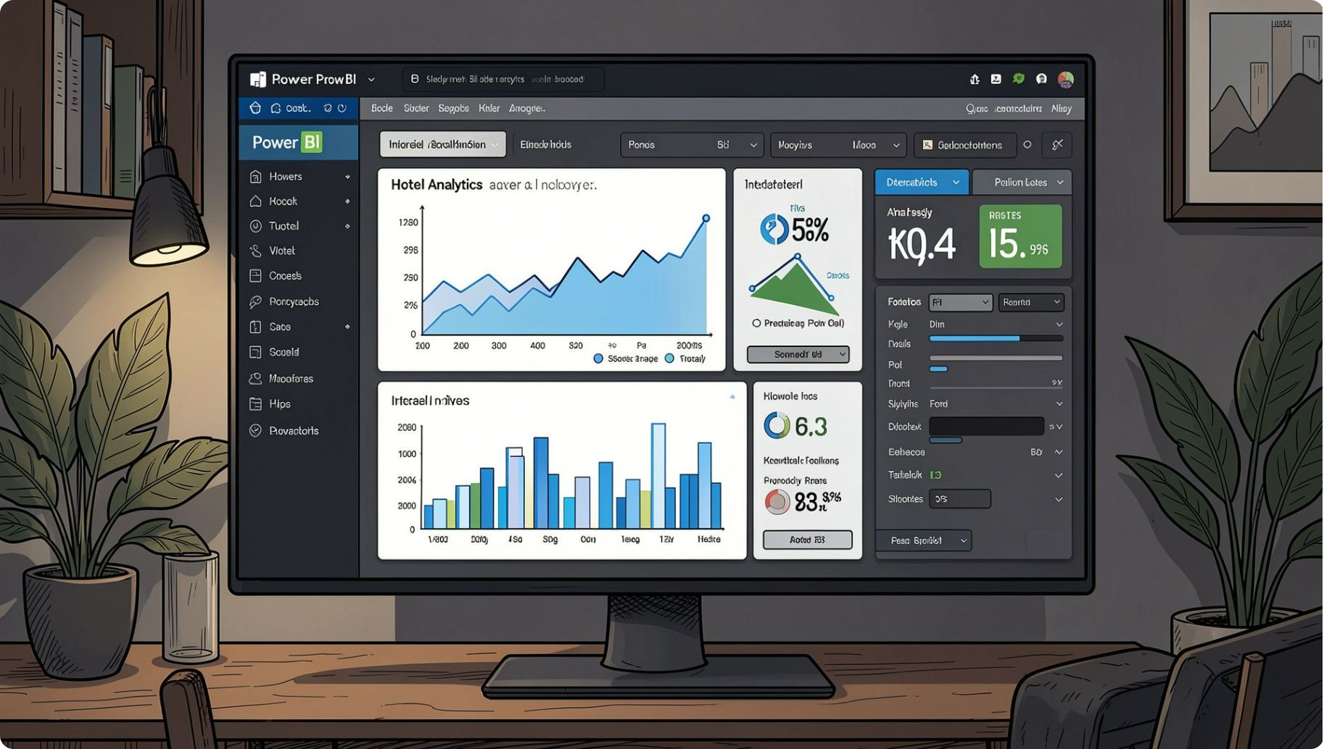



VISUALIZATION
Power BI Dashboard
An interactive Power BI dashboard was built to surface key metrics at a glance — enabling stakeholders to explore data dynamically without technical expertise.
KPI Cards
Interactive Filters
Geographic View
Total bookings, ADR, occupancy, and cancellation rate
Slice by hotel, month, market segment, and guest type
Guest origin countries and booking distribution

Slide 8


INSIGHTS
Key Insights
1
Summer Dominance
June–August accounts for over 35% of annual bookings, with peak ADR in July.
2
Cancellation Risk
Bookings made 60+ days in advance have a 50% higher cancellation rate than last-minute stays.
3
Segment Value
Corporate and loyal guests show the lowest cancellation rates and highest ADR contribution.
4
Channel Efficiency
Direct bookings yield higher ADR and lower cancellations versus OTA channels.

Slide 9

STRATEGY
Business Recommendations
1
Incentivize Direct Bookings
Offer loyalty perks and best-rate guarantees to shift demand from OTAs to direct channels.
2
Dynamic Cancellation Policies
Apply stricter non-refundable terms for long lead-time bookings to reduce revenue leakage.
3
Targeted Corporate Packages
Develop tailored packages for corporate and repeat guests — the highest-value segments.
4
Pre-Arrival Engagement
Deploy automated reminders and deposit requests 30 days before arrival to reduce no-shows.

Slide 10


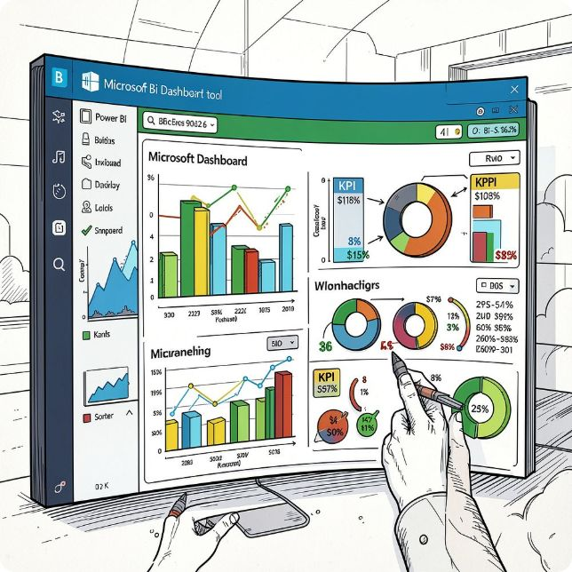
TECH STACK
Technologies Used
Python
SQL
Power BI
Pandas, NumPy, and Matplotlib for data cleaning, transformation, and exploratory analysis.
PostgreSQL for structured querying, segmentation, aggregation, and business question answering.
Interactive dashboards, KPI cards, and dynamic filters for stakeholder-facing reporting.
Conclusion
This project demonstrates how a modern analytics stack — Python, SQL, and Power BI — transforms raw hotel booking data into strategic business intelligence. From data cleaning to dashboard delivery, every step was designed to produce actionable, decision-ready insights for hotel operators and hospitality executives.

