Slide 1
Career Recommendation System
Presented by: Allan Saud
Supervised by: Pawan Niroula
Orchid International College
Tribhuvan University
Date: April 2025

Slide 2
Introduction
This project helps to recommend personalized career paths for students using their academic scores (Math, Science, etc.) and behavioral data (study hours, extracurriculars).
Working Process:
Data Input: Student scores and activities are collected.
Machine Learning:
Random Forest model (97% accuracy) predicts careers.
Analyzes key features like math_score and weekly_self_study_hours.
LLM Enhancement:
Mistral-7B generates detailed career descriptions (skills, responsibilities).
User-Friendly Output:
Django web app displays recommendations and insights.

Slide 3
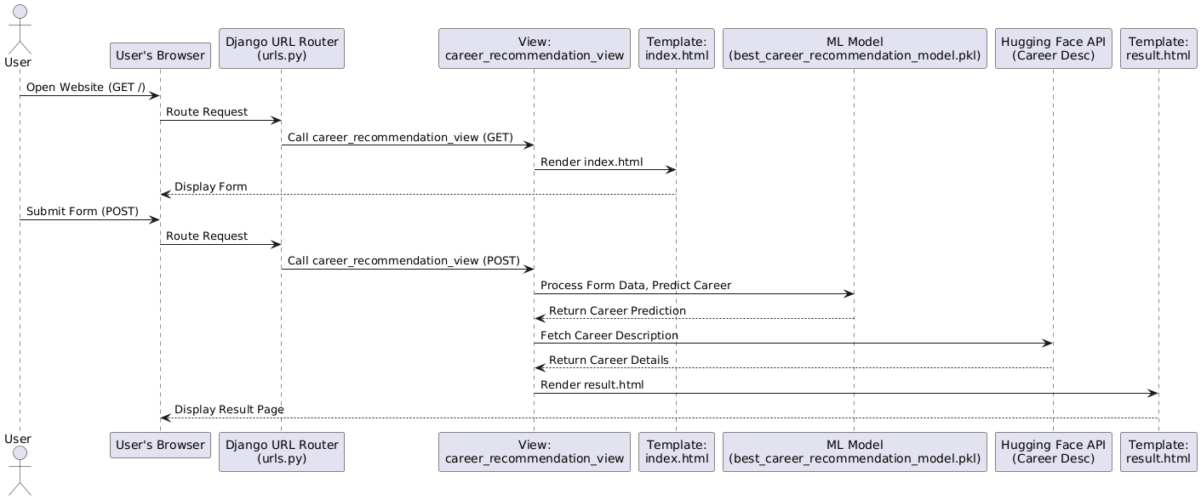
System Architecture

Slide 4
Data Pipeline:
Input: student-scores.csv → Preprocessing →Feature Engineering.
ML Core:
Random Forest model training/evaluation → Saved as .joblib.
LLM Integration:
Mistral-7B generates career descriptions (skills, responsibilities).
Django UI:
User inputs → Model prediction → Displays career + description.

Slide 5
Data Preprocessing & EDA
Steps:
Filled missing values (median/mean).
Encoded categorical variables (LabelEncoder).
Scaled features (StandardScaler).
Insights from EDA:
Heatmap: Strong correlation between Physics-Chemistry-Biology.
Box Plot: Doctors study 40+ hrs/week; Game Developers study less.

Slide 6
Feature Importance
Identify Key Influencers:
Determine which factors (e.g., math_score, weekly_self_study_hours) most impact career predictions.
Optimize the Model:
Focus on relevant features, improving accuracy and reducing noise (e.g., ignoring gender or email).
Explain Recommendations:
Show students why a career was suggested (e.g., "Engineering was recommended due to high math scores").

Slide 7
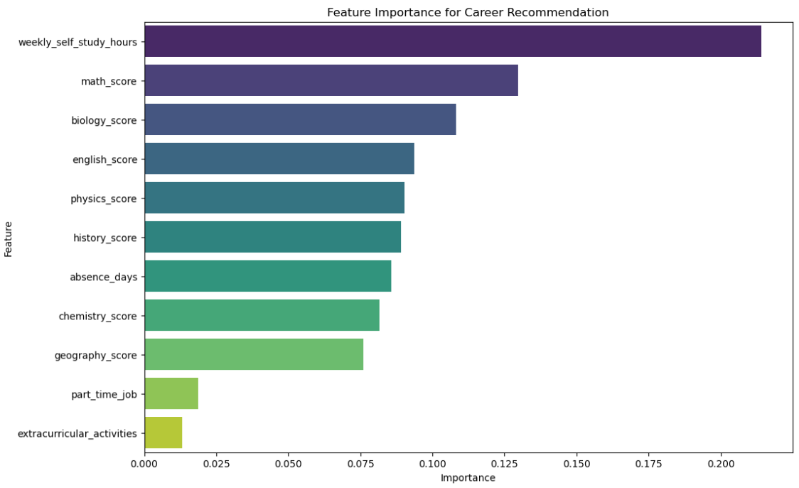
Visualization of feature Importance

Slide 8
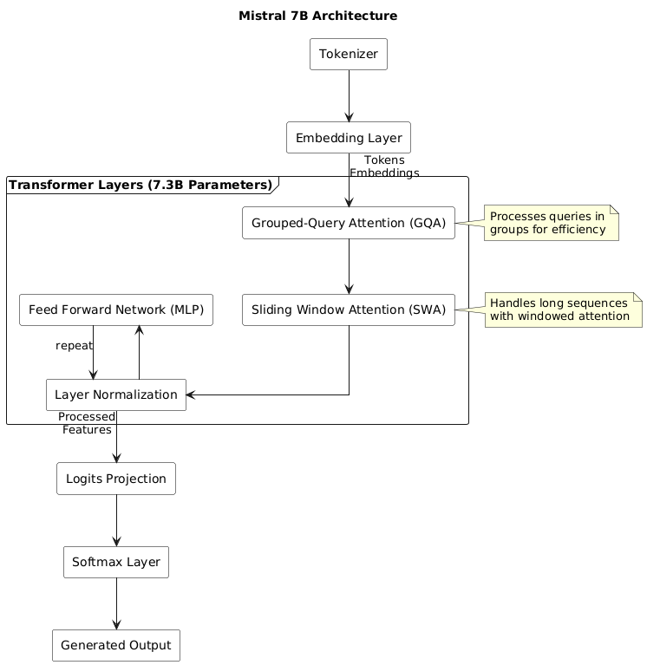
LLM: Mistral-7B Working Process

Slide 9
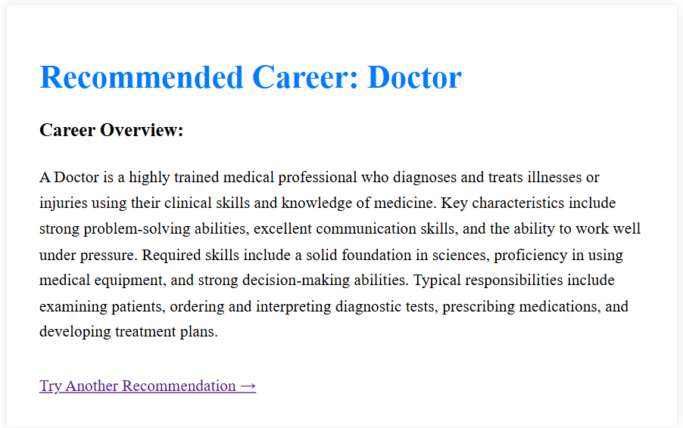
Career Descriptions with Mistral-7B
1.ML model recommends career (e.g., "Doctor").
Mistral-7B generates description:
Key skills (diagnosis, communication).
Responsibilities (patient care, treatment plans). Example Output:
"A Doctor diagnoses illnesses using clinical skills. Requires strong science knowledge and empathy."

