Slide 1

The Glasgow Admission Prediction Score
Allan Cameron
Consultant Physician, Glasgow Royal Infirmary

Slide 2
Outline
The need for an admission prediction score
What is GAPS?
GAPS versus human judgment and Amb Score
GAPS as a predictor of adverse outcomes
The role of GAPS in ambulatory care

Slide 3
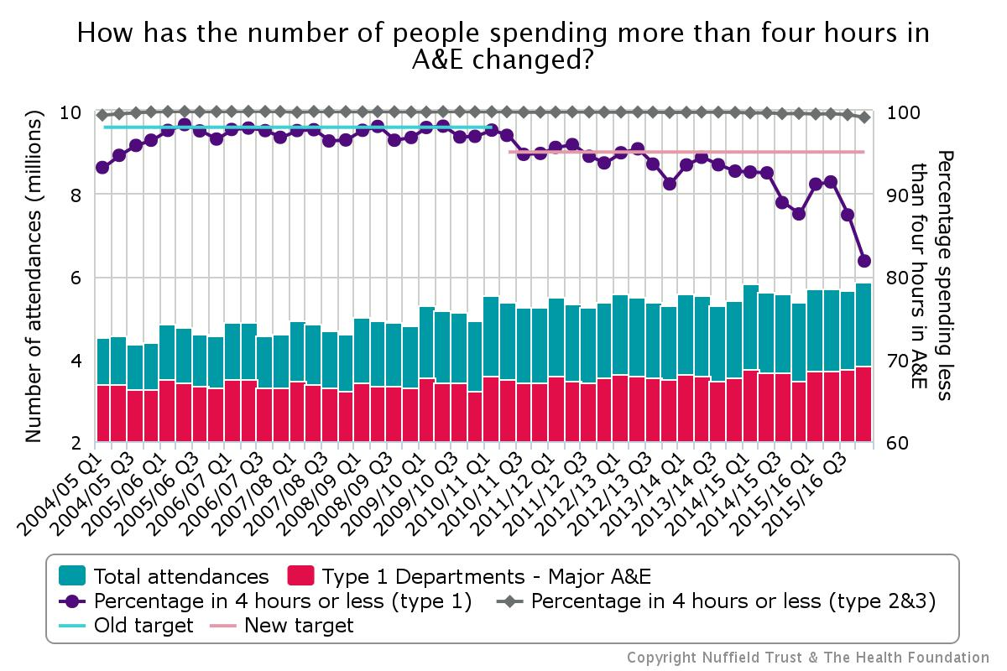

Slide 4
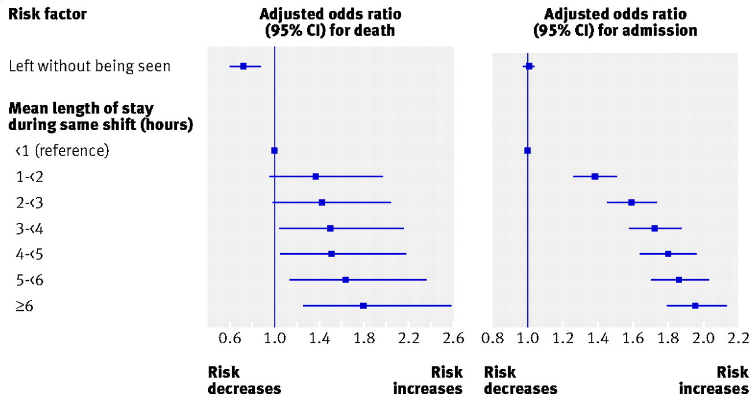
Mortality and admission odds against length of ED stay

Slide 5
Advantages of predicting admission
Identifying as early as possible which patients are likely to be admitted and which are likely to be discharged could promote efficiency:
  Identifying patients for ambulatory care
  Bed management
  Decision support
  Patient streaming
Triage is first clinical assessment made in ED
Triage staff cannot accurately predict admission

Slide 6
Background
Several tools have been created to predict admission at the point of triage
The simpler tools lack accuracy
The accurate tools lack simplicity
We have lacked a simple but accurate tool to assess the probability of admission at the time of triage

Slide 7
Glasgow admission prediction score
Variable |  | Points
Age |  | 1 point per decade
NEWS score |  | 1 point per point on NEWS score
Triage category: | 3 | 5
 | 2 | 10
 | 1 | 20
Referred by GP |  | 10
Arrived in ambulance |  | 5
Admission within 1 year |  | 5

Slide 8
Methods
Multi-centre, retrospective, cross-sectional study
322,846 unscheduled secondary care attendances in North Glasgow over a two-year period
Two-thirds of attendances were selected at random to create the prediction score using variables already available at triage
Score created from mixed-effects multiple logistic regression model
The score was then tested for accuracy on the remaining third by assessing its ROC curve

Slide 9
Results
344,429 adult attendances over 2 years
After discounting transfers between units and missing data, 322,846 attendances were available for analysis in 191,653 patients
123,397 of the 322,846 attendances led to admission (38.22%)
215,231 attendances used to create the score
107,615 attendances used to test the score

Slide 10
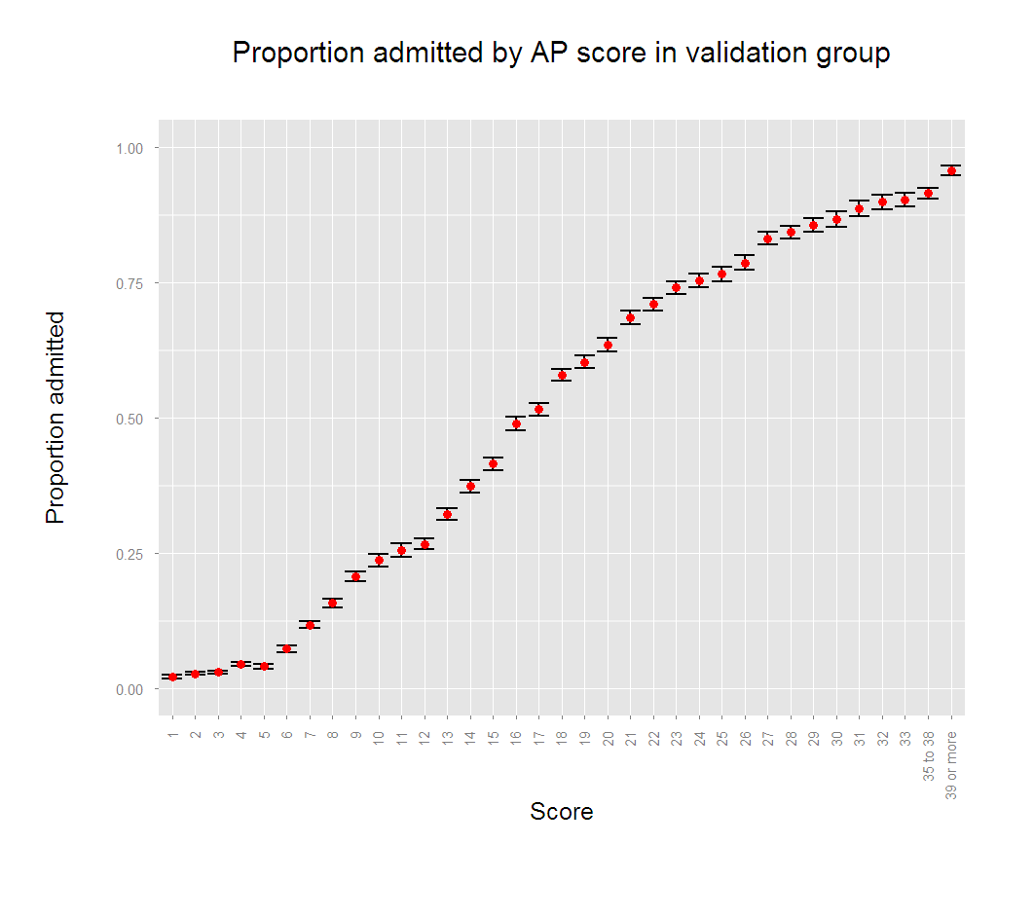

Slide 11
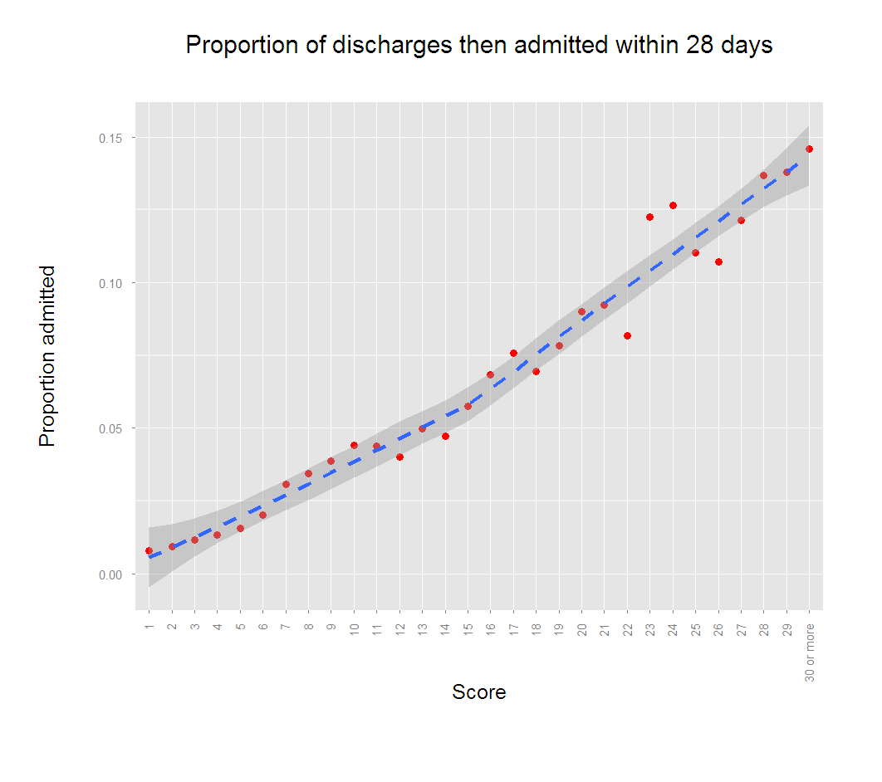

Slide 12
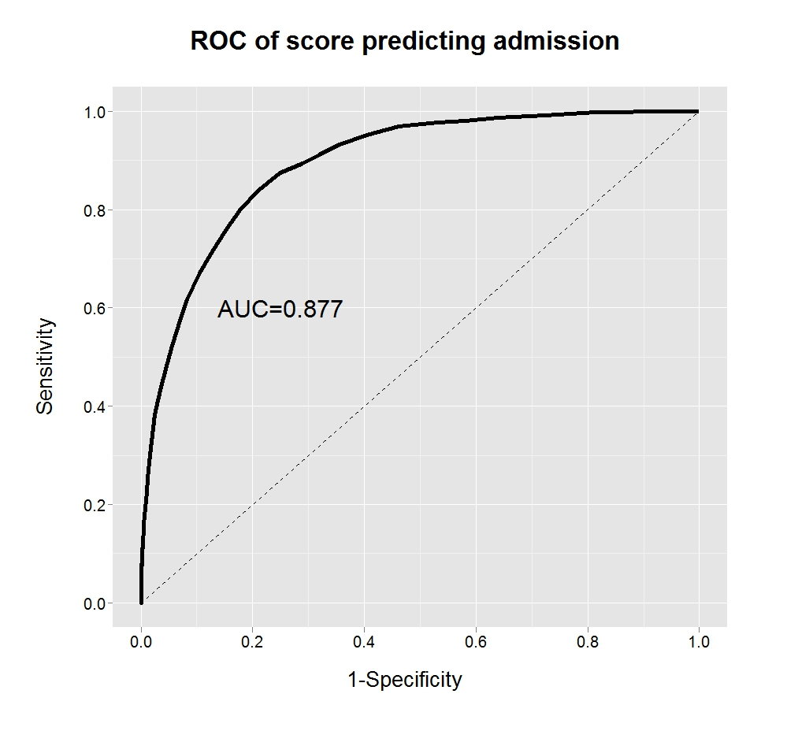

Slide 13
Criticism
Do we really need another score? Whatever happened to clinical judgement?

Slide 14
GAPS versus human judgment
Comparison of accuracy of triage nurses and GAPS
Prospective study of 1,838 ED attendances
Of these, 766 (41.7%) were admitted
Triage staff asked to estimate probability of admission (VAS)
Nurses were only accurate in predicting admission when they were very confident of the outcome (92.4%) but accuracy was poor in the majority of cases (68.8% accurate)
When the nurses were less confident, GAPS was significantly more accurate and better calibrated

Slide 15
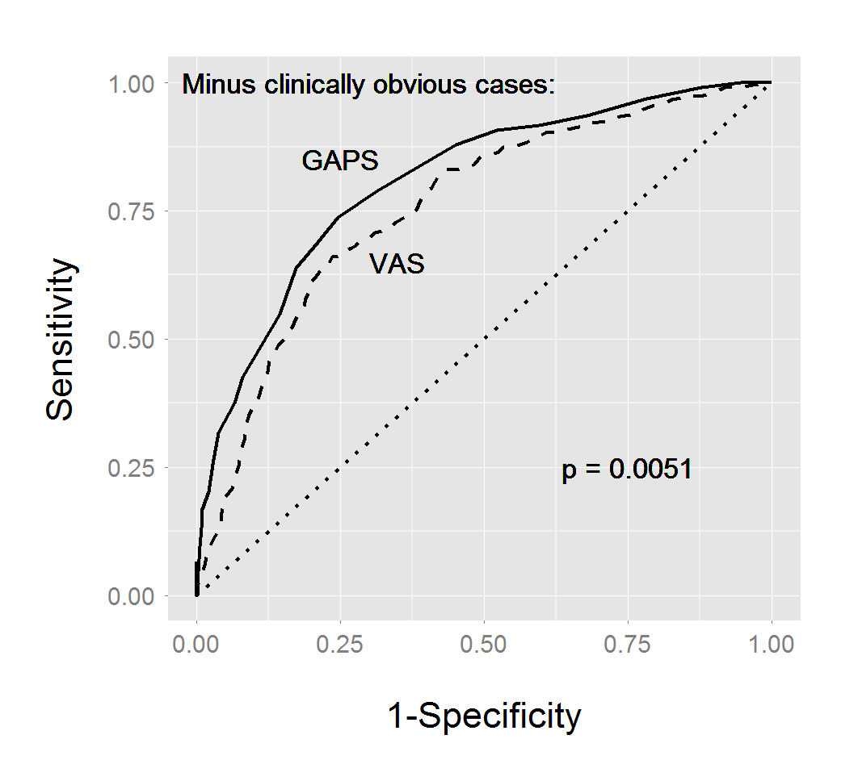

Slide 16
Criticism
This score predicts admissions. How can we use it to facilitate ambulatory care? Don’t we already have a score for that?

Slide 17
GAPS versus Amb Score
Prospective study, GRI-led multi-site collaboration
Consecutive patients presenting for ED triage
Researchers worked in shifts to cover all 168 hours of the week
Each patient interviewed to calculate GAPS and Amb Scores
Patients followed up to 30 days
Endpoint was admission to hospital or ED discharge
Comparison of AUC of ROC using DeLong’s method

Slide 18
Results
1496 adults attending ED triage during study
Of these, 64 IRDs, leaving 1432 for analysis
570 (39.8%) admitted
AUC 0.808 for GAPS, compared to 0.743 for Ambs, p<0.00001
GAPS had net classification improvement of 6% over Amb

Slide 19
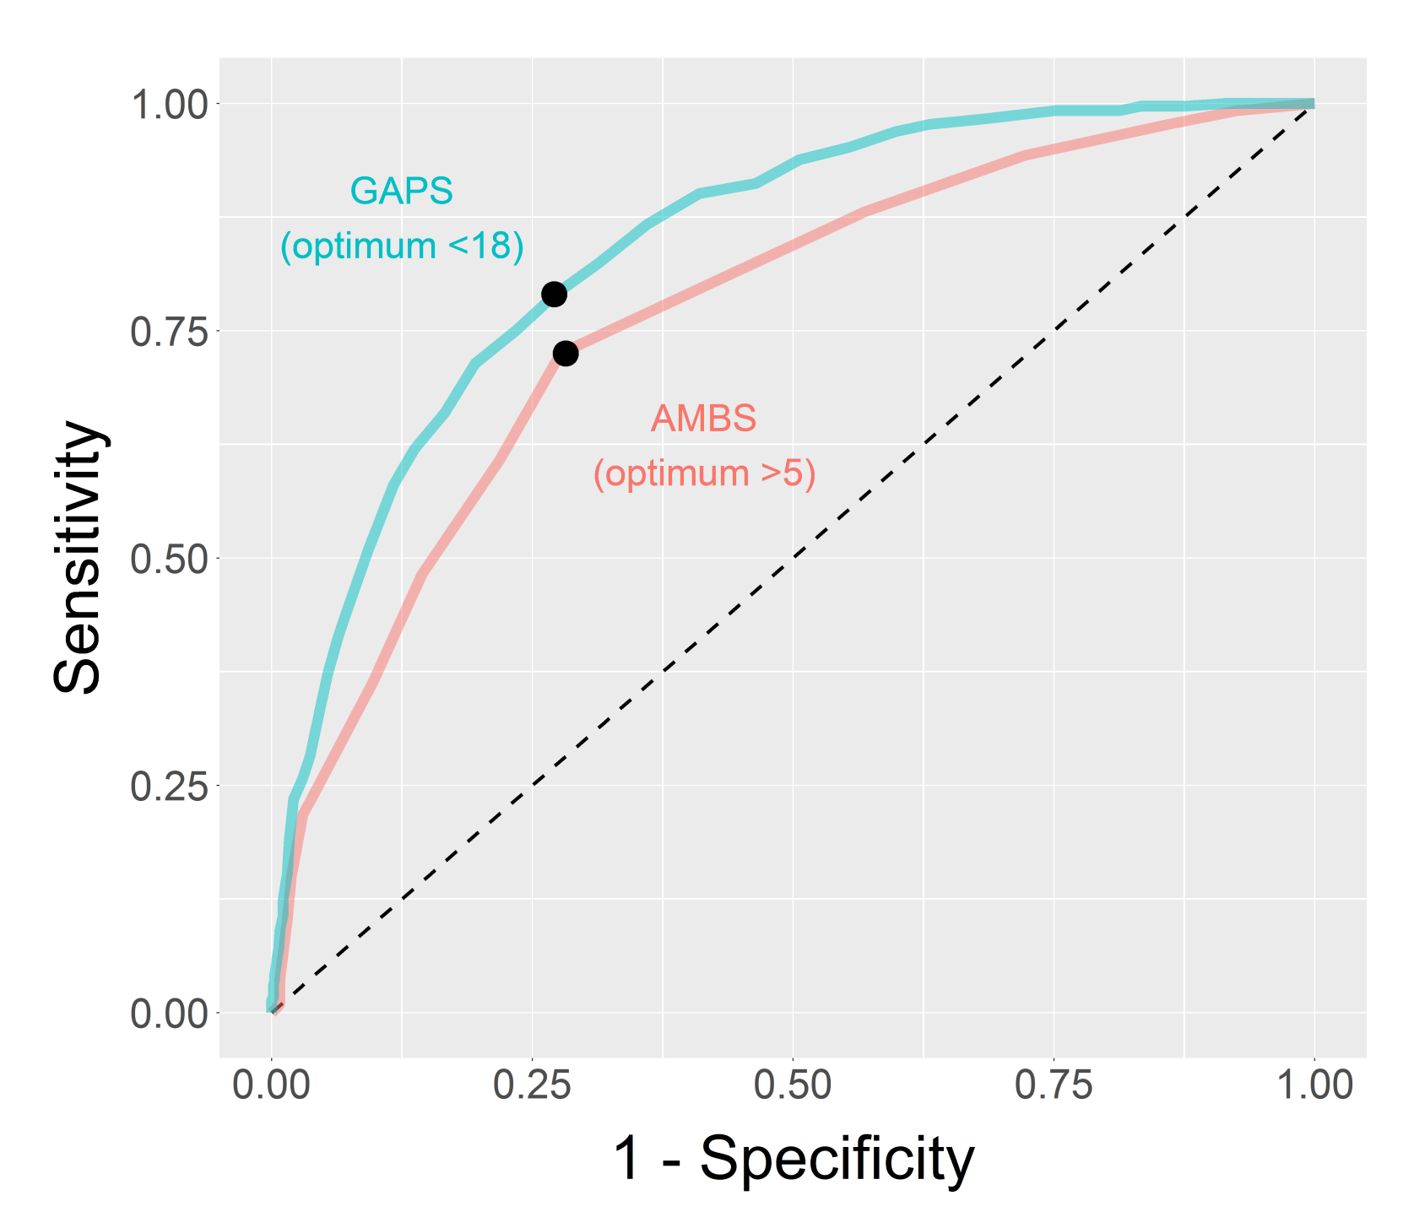

Slide 20
Criticism
Surely this just tells you whether someone will be admitted, not whether they should be admitted?

Slide 21
Prospective follow-up
We followed up all 1432 patients to six months
Split patients into equal 3 tertiles based on GAPS
Survival analysis using all-cause mortality
“Survival” analysis of hospital readmission
“Survival” analysis of hospital length of stay on the 563 patients admitted to hospital (7 lost to follow-up)

Slide 22
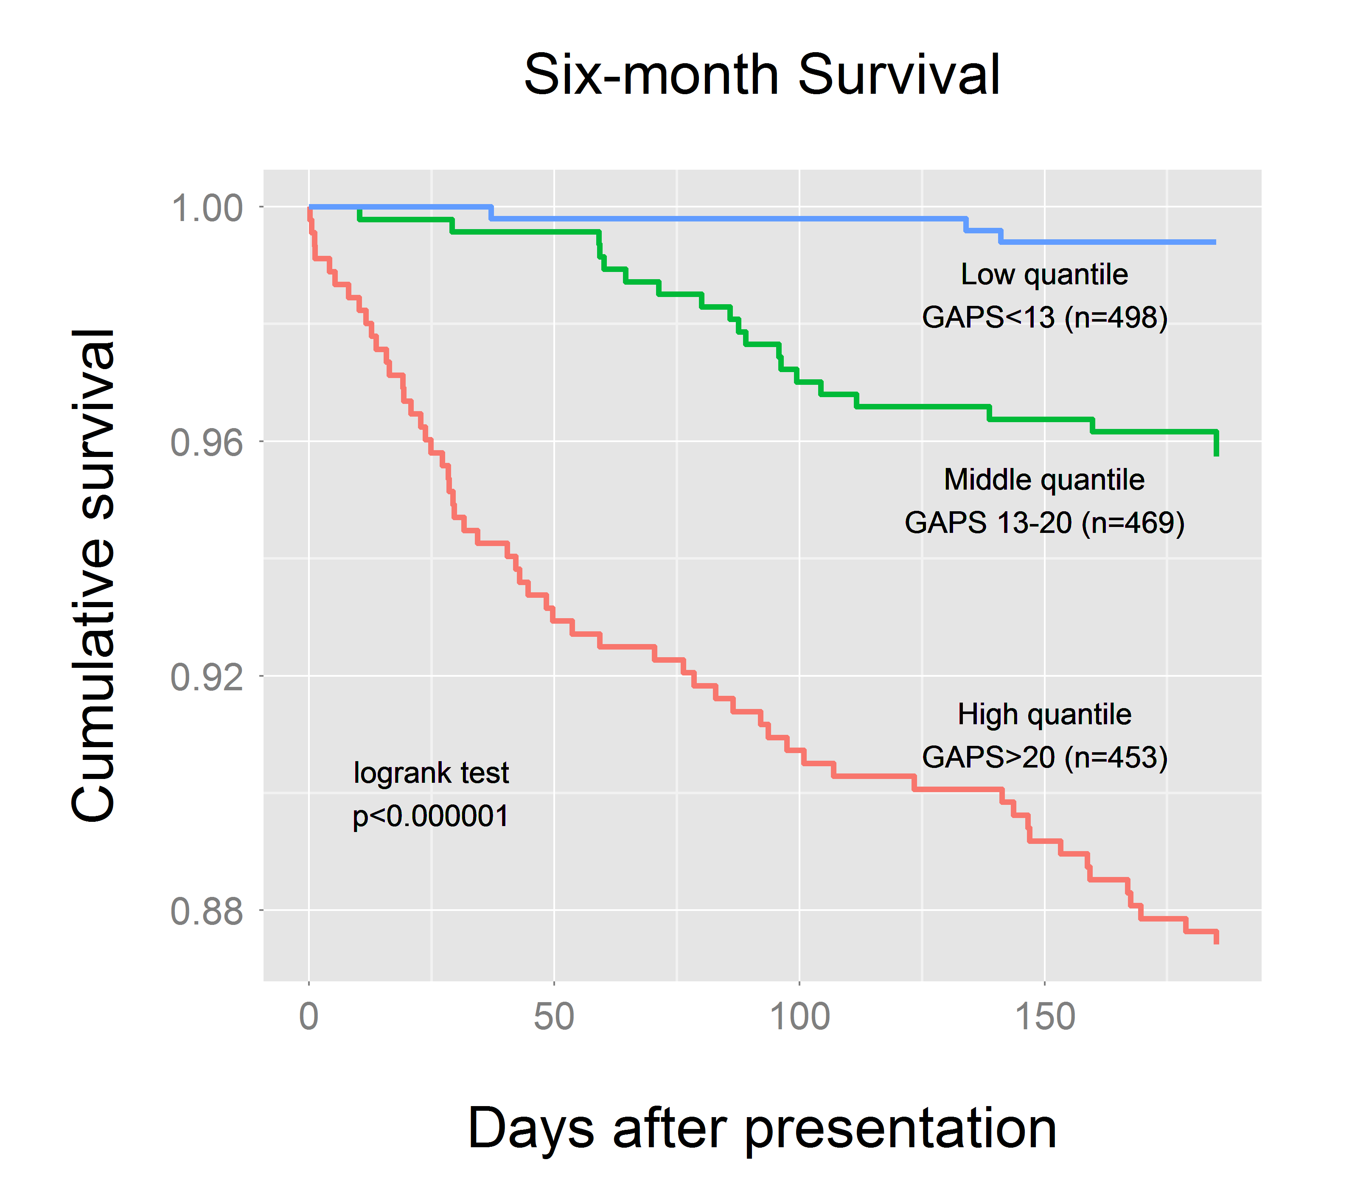
p < 0.0001

Slide 23
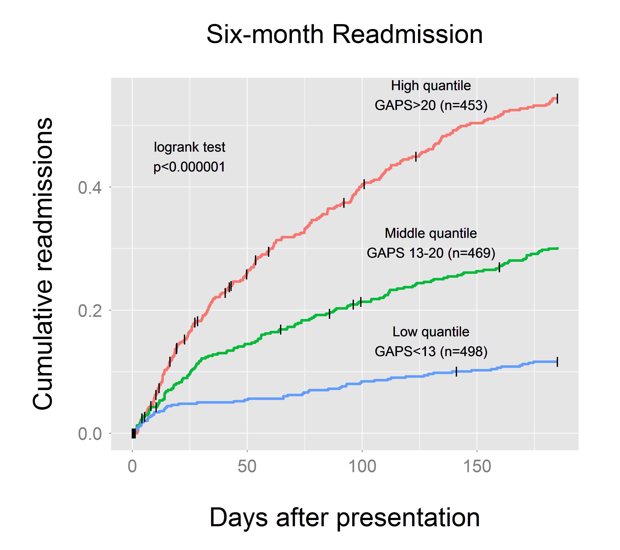
p < 0.0001

Slide 24
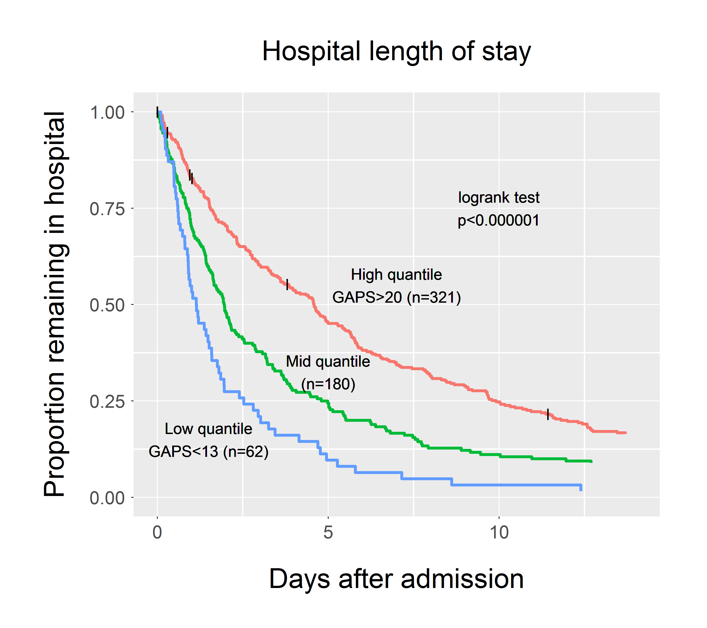
p=0.026

Slide 25
Implementation
We have been using GAPS at our Acute Assessment Unit in Glasgow Royal Infirmary for over two years
Of 1600 monthly GP referred medical attendances, around 30% can be sent directly to our ambulatory unit using the single criterion of low GAPS (<25)
Achieves a high discharge rate from ambulatory first assessment of ~90% with excellent safety record
Allows ambulatory care to be patient-based rather than condition-based
GAPS has now been taken up by several UK sites

Slide 26
Conclusions
We have derived a simple but accurate way to assess probability of admission at triage
It predicts death, reattendance and readmission within 28 days
It usually outperforms experienced triage staff
It outperforms the current method recommended by the RCP toolkit for streaming to ambulatory care
It can be used to measure (or control for) patient factors when looking at admission rates

Slide 27
Further challenges
How can we better use the information GAPS gives us in real time?
How can we use the information GAPS gives us for service planning?
Dissemination and implementation.

Slide 28
See the original papers and this slide set at
www.FrontDoorMedicine.com

