Slide 1
Cryptographic Hash Functions
CS 361S
Vitaly Shmatikov

Slide 2
Reading Assignment
Read Kaufman 5.1-2 and 5.6-7
slide <number>

Slide 3
Hash Functions: Main Idea
hash function H
.
message
“message
digest”
x
.
.
y
.
x’’
.
y’
x’
bit strings of any length
n-bit strings
Hash function H is a lossy compression function
  Collision: H(x)=H(x’) for some inputs x≠x’
H(x) should look “random”
  Every bit (almost) equally likely to be 0 or 1
A cryptographic hash function must have certain properties
slide <number>

Slide 4
One-Way
Intuition: hash should be hard to invert
  “Preimage resistance”
  Given a random, it should be hard to find any x such that h(x)=y
    y is an n-bit string randomly chosen from the output space of the hash function, ie, y=h(x’) for some x’
How hard?
  Brute-force: try every possible x, see if h(x)=y
  SHA-1 (a common hash function) has 160-bit output
    Suppose we have hardware that can do 2³⁰ trials a pop
    Assuming 2³⁴ trials per second, can do 2⁸⁹ trials per year
    Will take 2⁷¹ years to invert SHA-1 on a random image
slide <number>

Slide 5
Birthday Paradox
T people
Suppose each birthday is a random number taken from K days (K=365) – how many possibilities?
  K^{T} - samples with replacement
How many possibilities that are all different?
  (K)_{T} = K(K-1)…(K-T+1) - samples without replacement
Probability of no repetition?
  (K)_{T}/K^{T} ≈ 1 - T(T-1)/2K
Probability of repetition?
  O(T²)

Slide 6
Collision Resistance
Should be hard to find x≠x’ such that h(x)=h(x’)
Birthday paradox
  Let T be the number of values x,x’,x’’… we need to look at before finding the first pair x≠x’ s.t. h(x)=h(x’)
  Assuming h is random, what is the probability that we find a repetition after looking at T values?
  Total number of pairs?
    n = number of bits in the output of hash function
  Conclusion:
Brute-force collision search is O(2^{n/2}), not O(2^{n})
  For SHA-1, this means O(2⁸⁰) vs. O(2¹⁶⁰)
O(T²)
O(2^{n})
T ≈ O(2^{n/2})
slide <number>

Slide 7
One-Way vs. Collision Resistance
One-wayness does not imply collision resistance
  Suppose g() is one-way
  Define h(x) as g(x’) where x’ is x except the last bit
    h is one-way (cannot invert h without inverting g)
    Collisions for h are easy to find: for any x, h(x0)=h(x1)
Collision resistance does not imply one-wayness
  Suppose g() is collision-resistant
  Define h(x) to be 0x if x is (n-1)-bit long, else 1g(x)
    Collisions for h are hard to find: if y starts with 0, then there are no collisions; if y starts with 1, then must find collisions in g
    h is not one way: half of all y’s (those whose first bit is 0) are easy to invert (how?), thus random y is invertible with prob. 1/2
slide <number>

Slide 8
Weak Collision Resistance
Given a randomly chosen x, hard to find x’ such that h(x)=h(x’)
  Attacker must find collision for a specific x… by contrast, to break collision resistance, enough to find any collision
  Brute-force attack requires O(2^{n}) time
Weak collision resistance does not imply collision resistance (why?)
slide <number>

Slide 9
Hashing vs. Encryption
Hashing is one-way. There is no “uh-hashing”!
  A ciphertext can be decrypted with a decryption key… hashes have no equivalent of “decryption”
Hash(x) looks “random”, but can be compared for equality with Hash(x’)
  Hash the same input twice → same hash value
  Encrypt the same input twice → different ciphertexts
Cryptographic hashes are also known as “cryptographic checksums” or “message digests”
slide <number>

Slide 10
Application: Password Hashing
Instead of user password, store hash(password)
When user enters a password, compute its hash and compare with the entry in the password file
  System does not store actual passwords!
  Cannot go from hash to password!
Why is hashing better than encryption here?
Does hashing protect weak, easily guessable passwords?
slide <number>

Slide 11

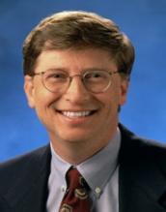

Application: Software Integrity
VIRUS
badFile
goodFile
The Times
hash(goodFile)
BigFirm™
User
Software manufacturer wants to ensure that the executable file
is received by users without modification…
Sends out the file to users and publishes its hash in the NY Times
The goal is integrity, not secrecy
Idea: given goodFile and hash(goodFile),
very hard to find badFile such that hash(goodFile)=hash(badFile)
slide <number>

Slide 12
Which Property Is Needed?
Passwords stored as hash(password)
  One-wayness: hard to recover entire password
  Passwords are not random and thus guessable
Integrity of software distribution
  Weak collision resistance?
  But software images are not random… maybe need full collision resistance
Auctions: to bid B, send H(B), later reveal B
  One-wayness… but does not protect B from guessing
  Collision resistance: bidder should not be able to find two bids B and B’ such that H(B)=H(B’)
slide <number>

Slide 13
Common Hash Functions
MD5
  Completely broken by now
RIPEMD-160
  160-bit variant of MD-5
SHA-1 (Secure Hash Algorithm)
  Widely used
  US government (NIST) standard as of 1993-95
    Also the hash algorithm for Digital Signature Standard (DSS)
slide <number>

Slide 14


Overview of MD5
Designed in 1991 by Ron Rivest
Iterative design using compression function
IHV₀
M₁
M₂
M₃
M₄
Com-
press
Com-
press
Com-
press
Com-
press
IHV₄
slide <number>

Slide 15
History of MD5 Collisions
2004: first collision attack
  The only difference between colliding messages is 128 random-looking bytes
2007: chosen-prefix collisions
  For any prefix, can find colliding messages that have this prefix and differ up to 716 random-looking bytes
2008: rogue SSL certificates
  Talk about this in more detail when discussing PKI
2012: MD5 collisions used in cyberwarfare
  Flame malware uses an MD5 prefix collision to fake a Microsoft digital code signature
slide <number>

Slide 16
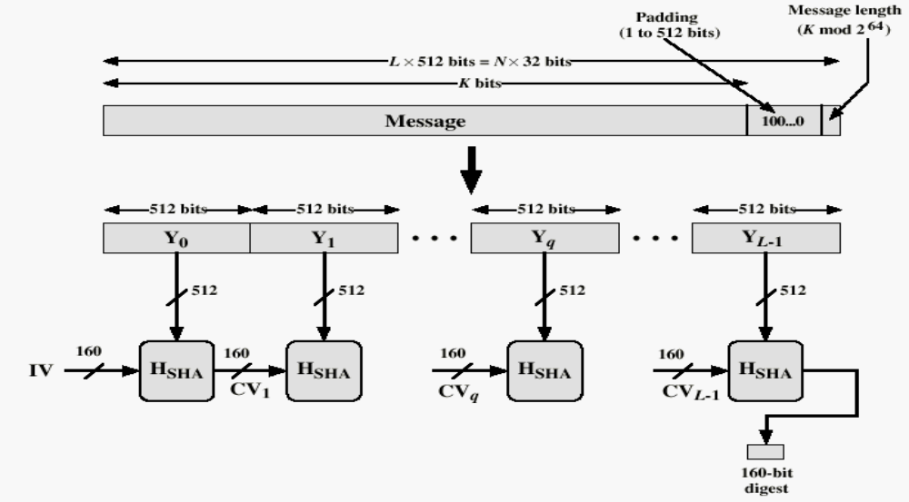
Basic Structure of SHA-1
Against padding attacks
Split message into 512-bit blocks
160-bit buffer (5 registers)
initialized with magic values
Compression function
Applied to each 512-bit block
and current 160-bit buffer
This is the heart of SHA-1
slide <number>

Slide 17
Block Ciphers
Block of plaintext
Key
S
S
S
S
For hashing, there is no KEY.
Use message as the key and
a fixed string as the plaintext
(for example, Unix password hash is DES
applied to NULL with password as the key)
S
S
S
S
repeat for several rounds
S
S
S
S
Block of ciphertext
slide <number>

Slide 18
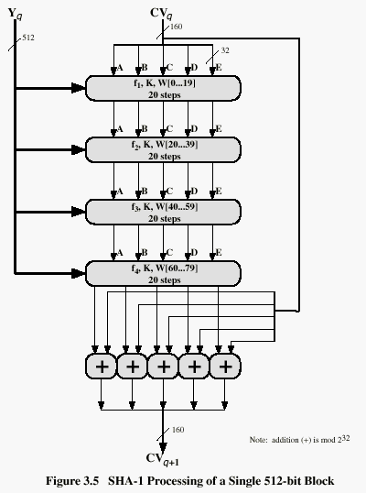
SHA-1 Compression Function
Current buffer (five 32-bit registers A,B,C,D,E)
Current message block
Four rounds, 20 steps in each
Let’s look at each step
in more detail…
Similar to a block cipher,
with message itself used
as the key for each round
Fifth round adds the original
buffer to the result of 4 rounds
Buffer contains final hash value
slide <number>

Slide 19
One Step of SHA-1 (80 steps total)
A
B
C
D
E
+
Logic function for steps
(B∧C)∨(¬B∧D) 0..19
B⊕C⊕D 20..39
(B∧C)∨(B∧D)∨(C∧D) 40..59
B⊕C⊕D 60..79
f_{t}
+
5 bitwise
left-rotate
Current message block mixed in
For steps 0..15, W_{0..15}=message block
For steps 16..79,
W_{t}=W_{t-16}⊕W_{t-14}⊕W_{t-8}⊕W_{t-3}
W_{t}
+
Multi-level shifting of message blocks
30 bitwise
left-rotate
Special constant added
(same value in each 20-step round,
4 different constants altogether)
K_{t}
+
A
B
C
D
E
slide <number>

Slide 20
How Strong Is SHA-1?
Every bit of output depends on every bit of input
  Very important property for collision-resistance
Brute-force inversion requires 2¹⁶⁰ ops, birthday attack on collision resistance requires 2⁸⁰ ops
Some weaknesses discovered in 2005
  Collisions can be found in 2⁶³ ops
slide <number>

Slide 21
NIST Competition
A public competition to develop a new cryptographic hash algorithm
  Organized by NIST (read: NSA)
64 entries into the competition (Oct 2008)
5 finalists in 3rd round (Dec 2010)
Winner: Keccak (Oct 2012)
  Will be standardized as SHA-3
slide <number>

Slide 22
Integrity and Authentication
KEY
MAC
(message authentication code)
KEY
message, MAC(KEY,message)
?
Alice
message
=
Bob
Recomputes MAC and verifies whether it is
equal to the MAC attached to the message
Integrity and authentication: only someone who knows KEY can
compute correct MAC for a given message
slide <number>

Slide 23
HMAC
Construct MAC from a cryptographic hash function
  Invented by Bellare, Canetti, and Krawczyk (1996)
  Used in SSL/TLS, mandatory for IPsec
Why not encryption?
  Hashing is faster than encryption
  Library code for hash functions widely available
  Can easily replace one hash function with another
  There used to be US export restrictions on encryption
slide <number>

Slide 24
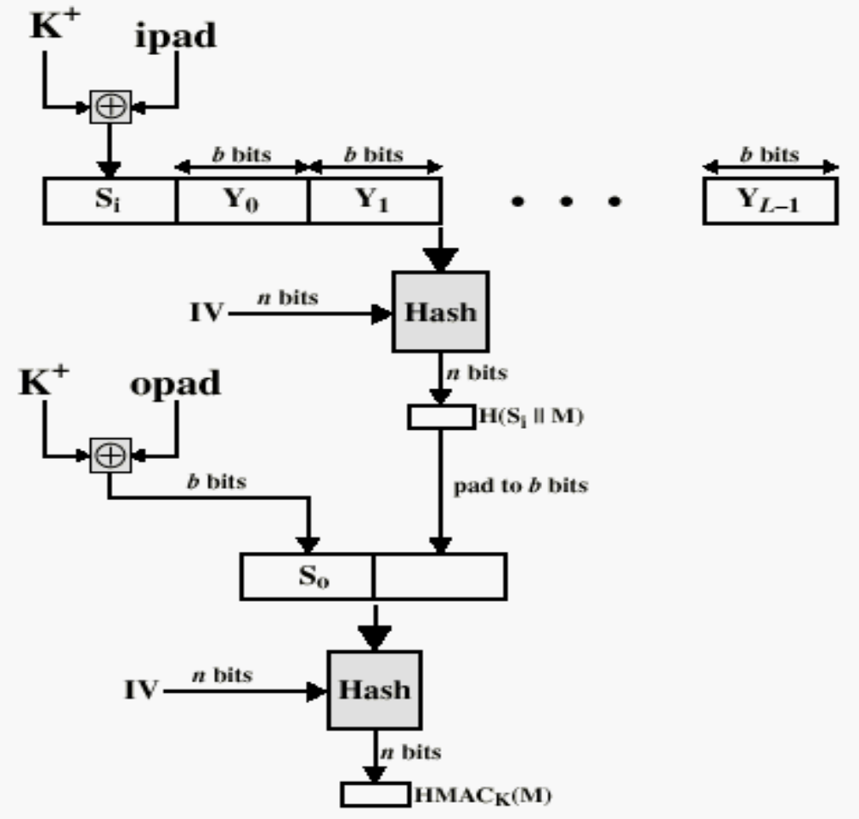
Structure of HMAC
magic value (flips half of key bits)
Secret key padded
to block size
Block size of embedded hash function
another magic value
(flips different key bits)
Embedded hash function
“Black box”: can use this HMAC
construction with any hash function
(why is this important?)
hash(key,hash(key,message))
slide <number>

