Slide 1

Vita_vue

Slide 2
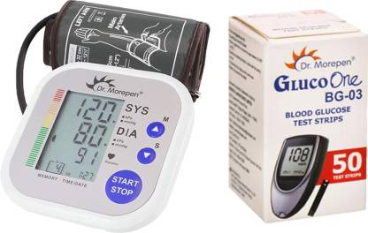
Problem Statement
Traditional methods for monitoring blood glucose, blood pressure, heart pulse, and oxygen levels typically either require invasive procedures or cumbersome devices, leading to patient discomfort, non-compliance, and suboptimal disease management.
Furthermore, the fragmented nature of current monitoring approaches impedes seamless data integration, hindering timely clinical decision-making and proactive interventions.

Slide 3
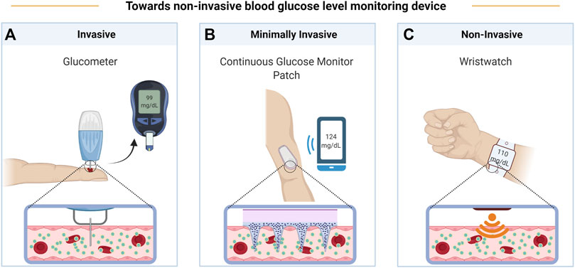
Sensor Based

Slide 4

Solution
Our project introduces an IoT device designed for efficient monitoring of diabetic patients' vital signs. Using near-infrared (NIR) technology, the device measures blood glucose, blood pressure, heart pulse, and oxygen levels non-invasively, ensuring patient comfort.
A user-friendly mobile application will provide patients with personalized dashboards, allowing them to track their health status and receive actionable insights. Healthcare providers will have remote access to patient data, facilitating timely interventions and personalized treatment adjustments.

Slide 5


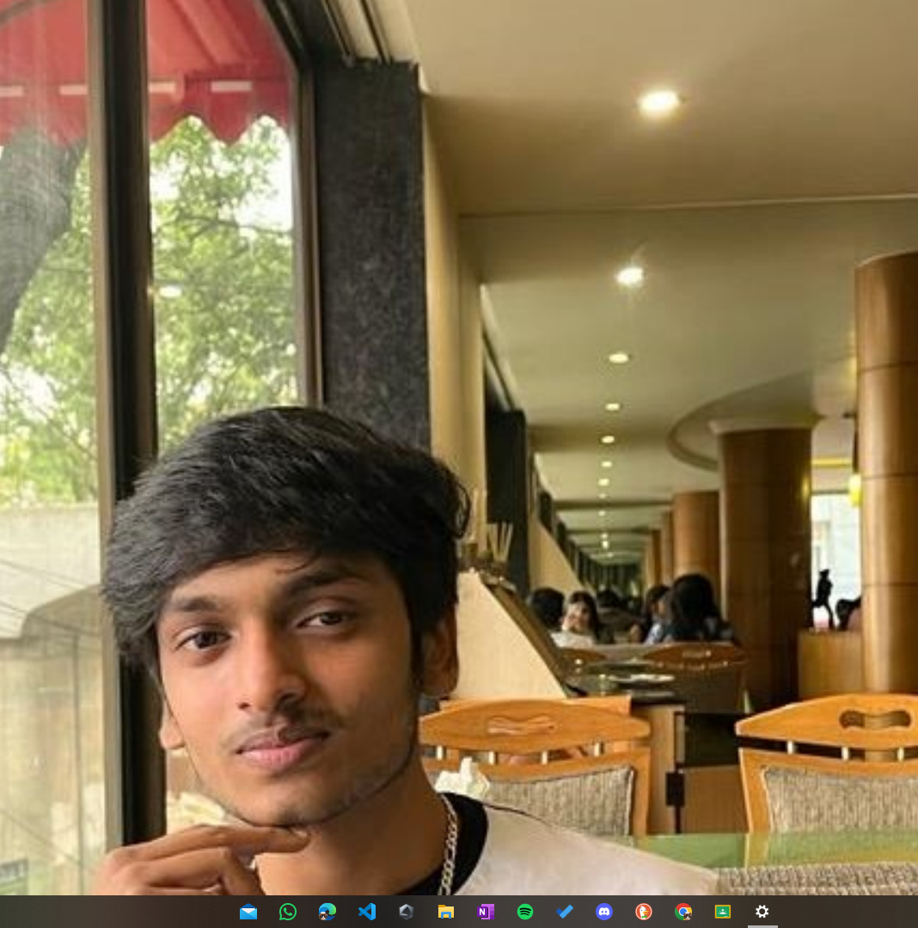

The Team
Dr P Mahesh ,MD
Diabetologist,
Chief Medical Director KVH hospital
Swathi S
Project Manager
Allan Dsouza
Developer
M Thanmay Ram
Developer

Slide 6
Facts Collected From the Field
Diabetic patients face heightened risks of both hyperglycemia and hypertension, necessitating regular monitoring of both parameters to mitigate cardiovascular complications.
Patients often find traditional blood glucose monitoring methods invasive, leading to reluctance in checking their blood glucose levels regularly.
Diabetic and obese patients require diligent monitoring to maintain glycemic control, due to increased risks of complications such as cardiovascular disease. Timely interventions based on monitoring results are vital for optimizing health outcomes.
Recording blood glucose and blood pressure readings allows for the systematic tracking of trends over time, facilitating informed decision-making by healthcare providers and patients alike.

Slide 7
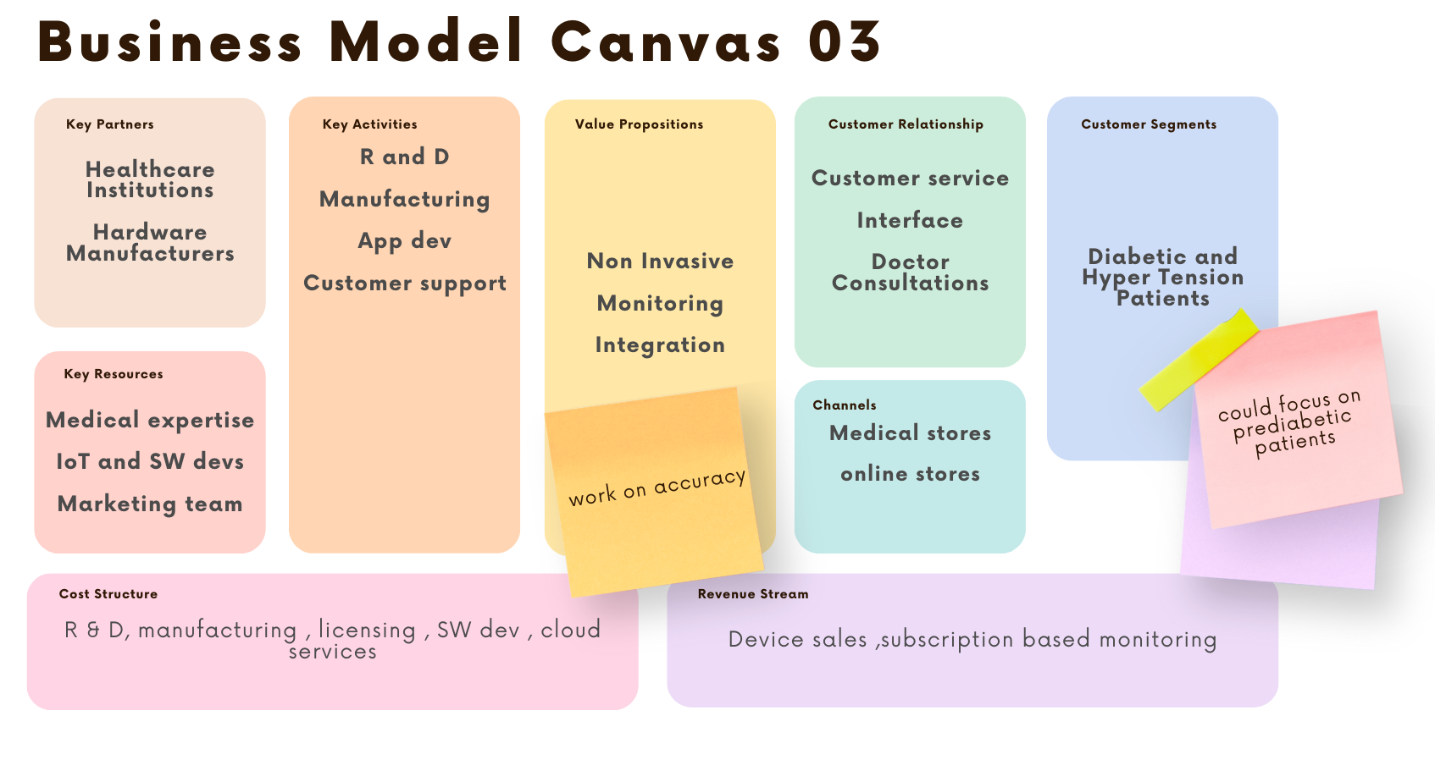

Slide 8
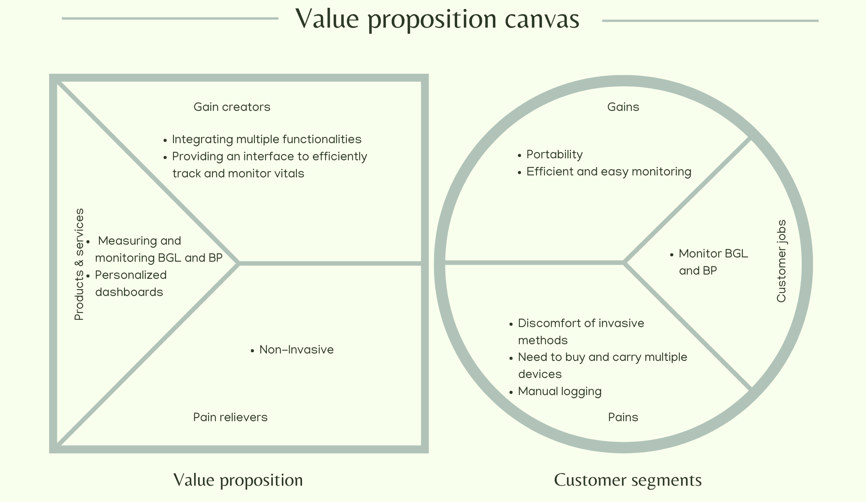

Slide 9

Hypotheis testing

Slide 10
Our Hypothesis
Our hypothesis proposes that utilizing non-invasive methods, particularly Near-Infrared (NIR) spectroscopy, alongside integrating multiple monitoring devices into a single platform, will significantly enhance the efficiency of monitoring diabetic patients' vitals. This integrated approach aims to empower patients in managing their condition effectively while providing healthcare providers with comprehensive data for informed decision-making.

Slide 11
Proposed Changes:
Utilization of Non-Invasive Methods: NIR spectroscopy will be employed to measure and monitor blood glucose levels and blood pressure without the need for invasive procedures. Additionally, this method will also enable the measurement of heart rate and oxygen saturation levels, providing a holistic view of the patient's physiological status
Centralized Database: All collected readings will be stored in a centralized database, enabling seamless access for both patients and healthcare providers. This database will facilitate the generation of personalized dashboards and graphs, offering insightful visual representations of the patient's vital parameters over time with the help of a application.

Slide 12
Impact:
Enhanced Patient Experience: By replacing invasive methods with non-invasive techniques, patients will experience increased comfort and convenience while measuring the readings. This will improve patient compliance with monitoring routines, leading to better overall health outcomes.
Improved Data Accessibility: The centralized database will provide patients and healthcare providers with easy access to comprehensive and real-time data. This accessibility will enable timely interventions, personalized treatment adjustments, and proactive management of potential complications.
Empowerment through Visualization: The use of personalized dashboards and graphs will empower patients to take an active role in managing their condition. Visual representations of their vital parameters' trends and fluctuations will enhance their understanding of their health status, fostering proactive self-care behaviours.

Slide 13
Metrics:
Patient Compliance: We want to see how patients keep up with their monitoring routines before and after they start using the new device
Health Outcomes: We will check if important health signs like blood sugar, blood pressure, heart rate, and oxygen levels get better over time.
Healthcare Provider Efficiency: We The doctors in making good decisions and help patients quickly using the information from the App or the Dashboard.

Slide 14
Time Frame:
1. Evaluation Phase (24-36 months): We will evaluate the impact of the implemented changes on patient outcomes, healthcare provider efficiency, and overall healthcare delivery.

Slide 15
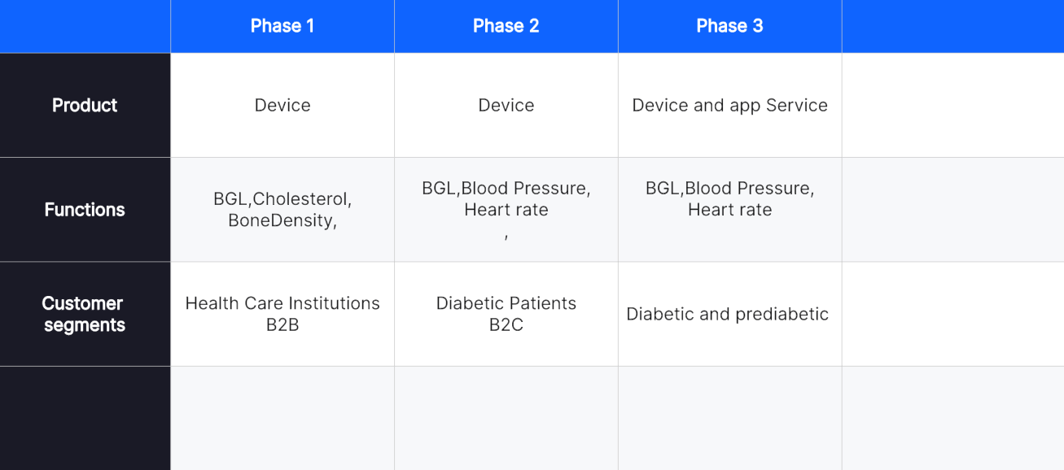

Slide 16

THANK YOU

