Slide 1

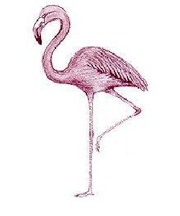


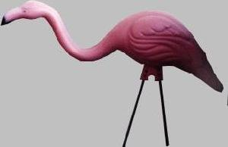


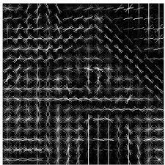
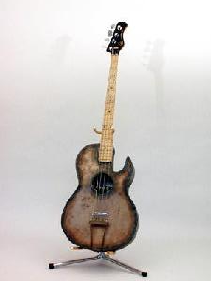
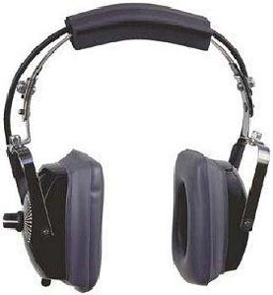

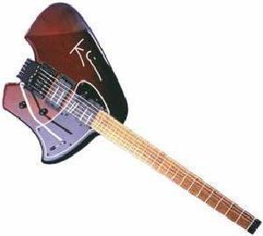
Embedding
RGB-array
Pre-processing
Feature extraction
Cluster labels
tSNE
Color (rgb/gray)
Scale
Resize
PCA
HOG
Clustering and evaluation
Path to image locations
Clustering

