Slide 1
PROJECTIVE DYNAMICS Ricky Arietta Danny Rerucha Paula HueLin Merino
CIS563 Spring 2014 – Final Project

Slide 2
PROJECT OVERVIEW
Simulate deformable bodies (i.e. cloth) using projection of vertices to minimize potential energy of constraints
Implicit solver divided into two stages:
Local Solver:
Handles projection of vertices per constraint
Each constraint is projected independently
Can be parallelized to improve runtime of simulation
Global Solver:
Solve linear system created by constraints and coefficient matrices for weighting, selection
Cholesky decomposition

Slide 3
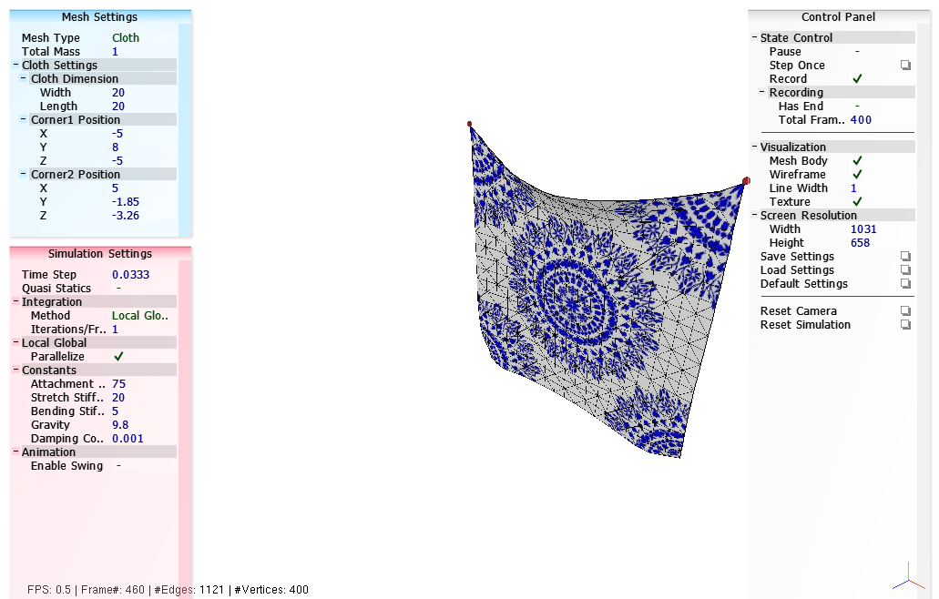
LIVE DEMO

Slide 4
FUTURE WORK
Handle volume preservation using tetrahedral constraints
Improve runtime
Handle collisions – in progress
Self-collisions and mesh-mesh intersections

