Slide 1
DSRH 2026 · GROUP 4
Class locations transfer.
Class geometry does not.
ABSTRACT
We treat Madrid to Amsterdam building-age classification as a domain-adaptation problem rather than a classification problem. From 42 years of Landsat spectra we engineer 81 features, grouped in advance by expected transfer behaviour, and evaluate everything under spatially blocked splits that exclude the entire neighbourhood of every training location. Two results organise our method. Importing Madrid's class geometry — LDA directions, or a CNN's learned embedding — consistently harms transfer. Importing Madrid's class locations as a shrinkage prior on Amsterdam's few-shot prototypes consistently helps. The resulting model scores 0.5954 macro F1 on Madrid and 0.4553 zero-shot on Amsterdam, against baselines of 0.6179 and 0.3427, and beats the baseline transfer method at every label budget by +0.039 mean macro F1 under identical evaluation. A 1D-CNN reads Madrid better (0.6450) yet transfers worse at every budget, retaining 81.6% of its source performance against our 96.8%.
Madrid to Amsterdam building-age transfer from 42 years of Landsat spectra.
0.5954
Madrid macro F1
+0.113
over the baseline zero-shot
+0.039
over the baseline method,
same harness

Slide 2
1
The Problem
What we have | Madrid | Amsterdam
Locations | 76,263 | 25,992
Yearly records | 3,172,765 | 1,062,877
Class boundaries | 1960 / 1984 / 2004 | 1945 / 1984 / 2004
Role | Source city | Adaptation city
THE REAL QUESTION
Not “can you classify building age” — Madrid alone answers that. It is whether the representation you learned on one city is about age, or about that city.
Different light
Different buildings
Different history
Latitude, atmosphere and sensor era shift every band's absolute value.
Brick and stone against concrete and stucco.
Amsterdam's oldest class starts in 1882, Madrid's in 1960.
Six bands on a common 42-year grid, 1984–2025. We grouped records by location, checked duplicates, and saved one age label per pixel.

Slide 3
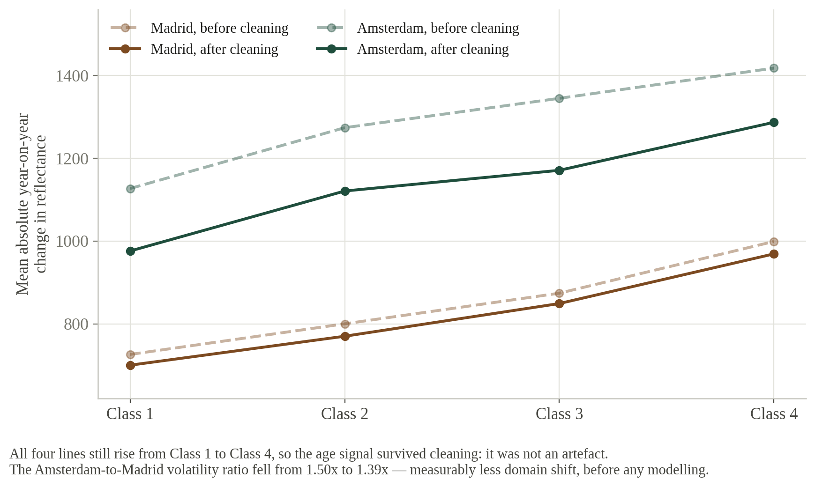
2
Data Cleaning
Where you clean matters more than that you clean
Bad readings rejected at the individual observation slot, before any yearly average. Clean after averaging and the bad reading is already in the mean.
Scene contamination is a different failure mode
A bad scene shifts thousands of locations the same way in the same year. 1998, 2008 and 2002 were the worst.
And it is measurable
The Amsterdam-to-Madrid volatility ratio fell from 1.50x to 1.39x, and all four class lines still rise. The age signal survived.
19,025 / 28,906 rejected readings and 48,447 / 41,318 masked spikes, Madrid / Amsterdam. No complete years removed; interior gaps filled by linear interpolation.

Slide 4
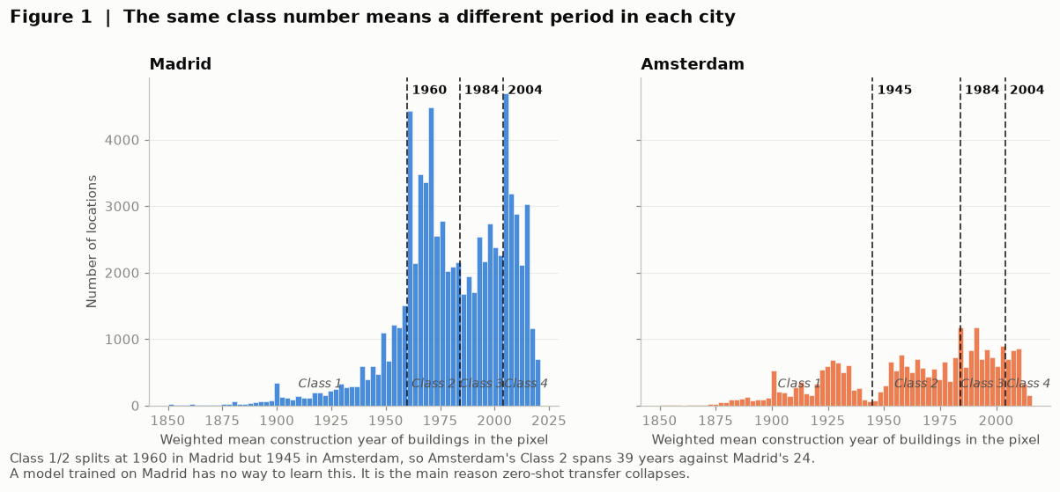
3
The Class Distribution

Slide 5
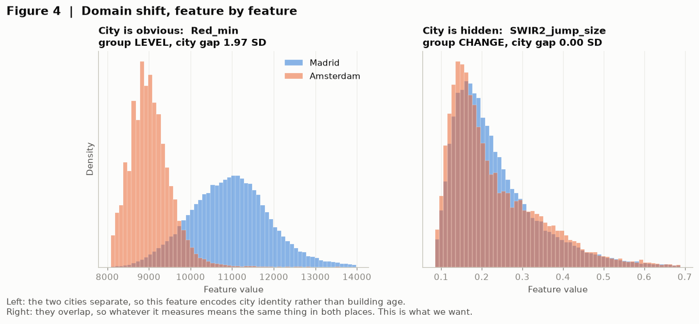
4
Some features describe the city, not the building
The trap
Red_min is a LEVEL feature with a 1.97 SD city gap. It predicts age in Madrid and encodes city identity everywhere.
What we want
SWIR2_jump_size is a CHANGE feature with a 0.00 SD gap. Whatever it measures means the same thing in both cities.
Mean city gap by group: LEVEL 1.37 SD, INDEX 0.87, SHAPE 0.38, CHANGE 0.28. LEVEL was flagged as a city fingerprint before any model was fitted.

Slide 6
5
The Madrid model
Notebook 04. Keeping neighbouring pixels in the same fold gives a harder, honest test.
Madrid model | Random folds | Spatial blocks | Leakage gap
Random forest, 300 trees, balanced | 0.6293 | 0.5954 | +0.034
HistGradientBoosting | 0.6330 | 0.6022 | +0.031
HistGradientBoosting, no LEVEL | 0.6241 | 0.5958 | +0.028
WHY THE SPATIAL COLUMN IS THE REAL ONE
AGAINST THE ORGANISERS' REFERENCE
Neighbouring Landsat pixels are near-duplicates. Random folds put a pixel's neighbour in the test set, which inflates every score by about 0.034. We report the spatial column and we ship the random forest, so the number we claim is the number our saved artifact produces.
0.5954 against their 0.6179 is 1.6 SD, measured under a stricter split than theirs. Dropping the 18 brightness features costs almost nothing on Madrid (0.5958), which already hints that they carry city identity rather than age.
Five spatial folds, blocks about 600 m wide. Stage 1 artifact: class-balanced random forest, 300 trees.

Slide 7
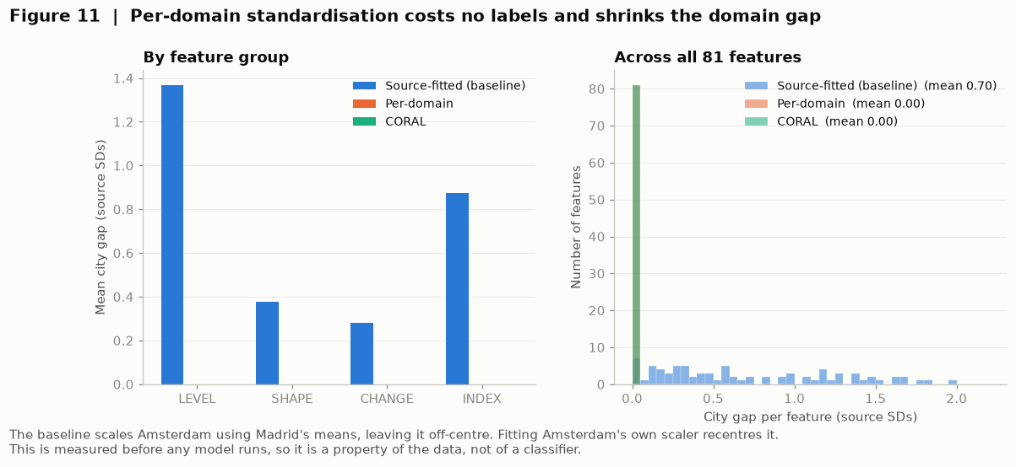
6
The transfer method, in three steps
A prototype is the average example of an age class.
01
Scale each city within itself
Uses no labels at all. Drives the mean city gap from 0.70 SD to 0.00, and is worth +0.014 macro F1 on prototype transfer (0.5258 to 0.5400).
02
Blend the class averages 50/50
Amsterdam's few labels give a noisy class centre. Madrid supplies a prior. Mix them.
03
Assign to the nearest blended centre
No trees cross the border. Four prototype vectors do.
10,998 fixed evaluation pixels, chosen once. Label budgets of 5, 25, 50, 100 and 200 per class. Macro F1 weights all four age groups equally.

Slide 8
7
Results
Madrid cross-validated F1, and Amsterdam F1 at each label budget.
 | Value
Madrid, 5-fold spatial CV | 0.5954 ± 0.0138
Amsterdam, zero-shot | 0.4553
Amsterdam, 5 labels/class | 0.4882 ± 0.0433
Amsterdam, 25 labels/class | 0.5605 ± 0.0125
Amsterdam, 50 labels/class | 0.5651 ± 0.0133
Amsterdam, 100 labels/class | 0.5714 ± 0.0091
Amsterdam, 200 labels/class | 0.5766 ± 0.0028

Slide 9
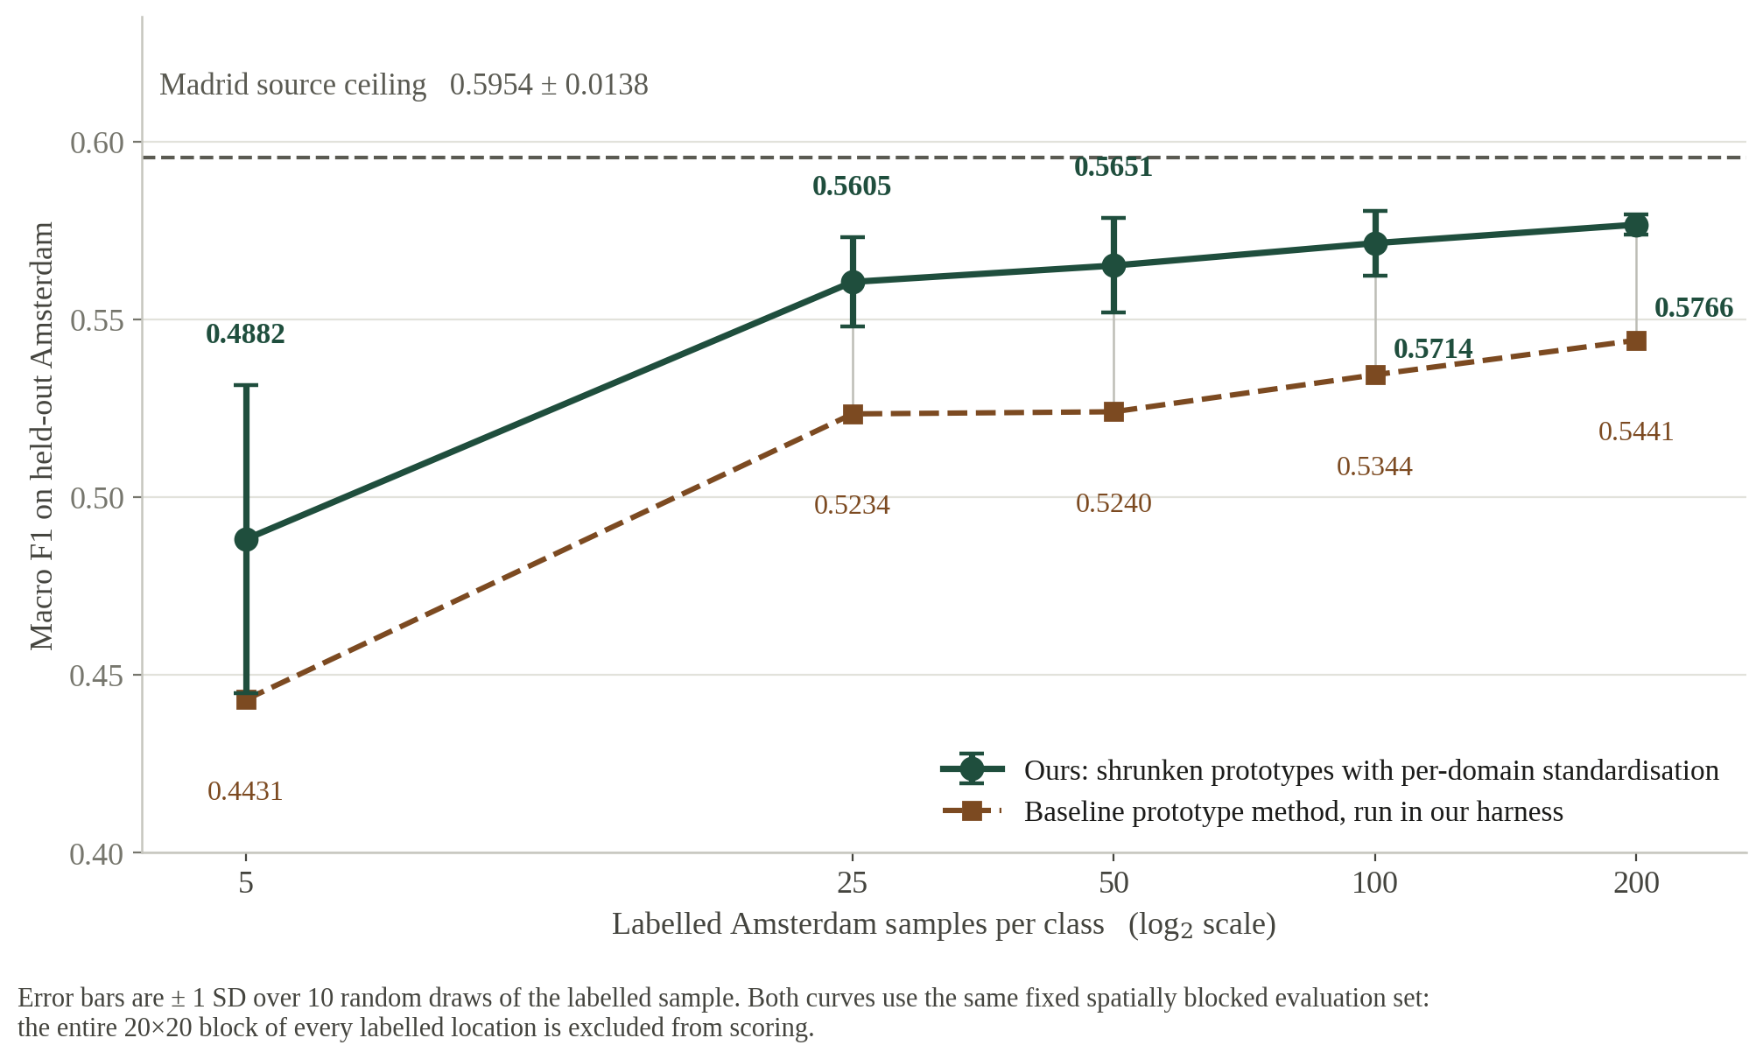
8
Macro F1 against log₂ of the label budget
Required plot. Our method against the baseline's, both under the same blocked evaluation.
The gap is flat
Shrinkage helps most where it should, at 5 labels per class (+0.045), and still helps at 200.
The plateau
Past 25 labels the curve flattens. What is left is domain shift, not a shortage of labels.

Slide 10
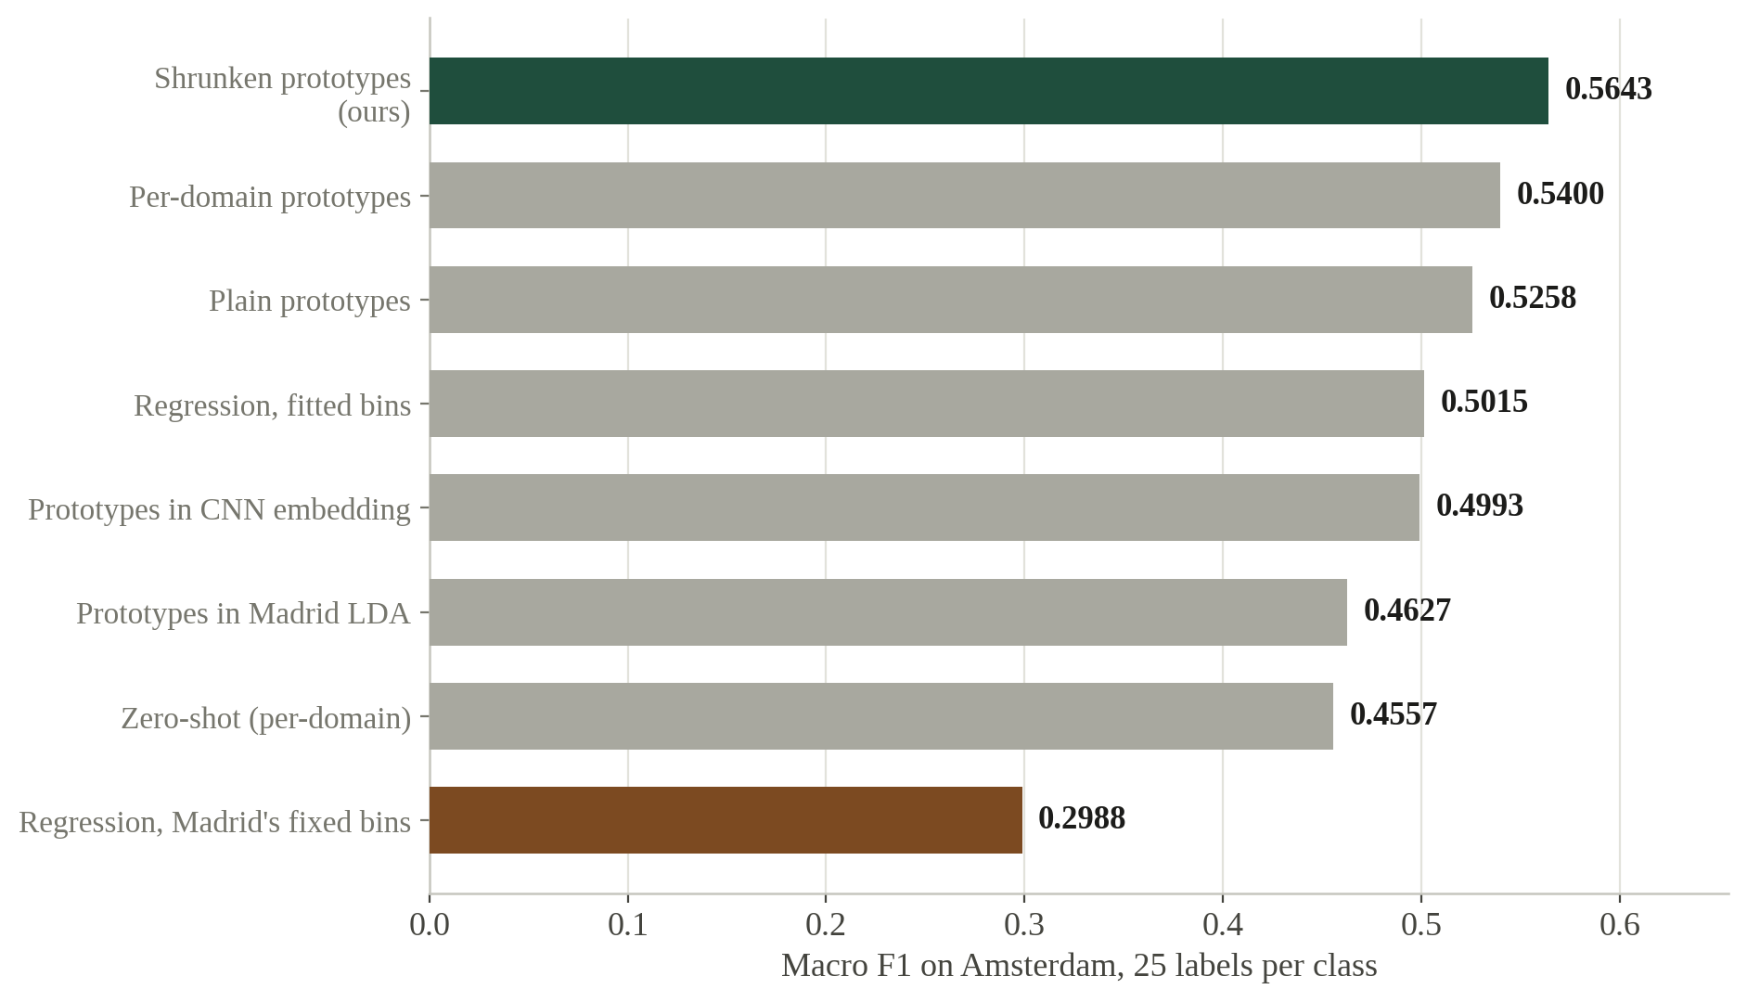
9
Eight methods, one harness: what worked and what did not
25 labels per class, three label draws, one fixed Amsterdam evaluation set.
WORKED
Per-domain standardisation — uses no labels, +0.014 on prototypes
Blending those prototypes toward Madrid's — a further +0.024
Learning the regressor's cut points instead of assuming them — +0.203
DID NOT WORK
Madrid's LDA directions — 0.4627, worse than no projection at all
Metric learning in the CNN embedding — 0.4993, and it was the suggested approach
Regression then Madrid's fixed bins — 0.2988. The regressor's 1st percentile is 1947; Amsterdam's is 1882, so 29% of the city is unreachable
Three label draws per method. The CNN-embedding value is its ten-draw mean (0.4993); its three-draw screen value is 0.5120.

Slide 11
10
What transfers between cities, and what does not
Three independent experiments, all pointing the same way.
Class geometry
Class locations
does not transfer
do transfer
Madrid LDA directions
0.4627
CNN learned embedding
0.4993
Amsterdam centres alone
0.5400
Blended with Madrid's
0.5643
Any structure learned from Madrid's classes is a structure that is specifically Madrid's. Both import it; both lose to doing nothing.
Where the classes sit is a fact about building age. Borrowing it as a prior stabilises a noisy 25-label estimate.
The method follows from the finding: standardise per city, so no geometry is imported, then blend the local prototypes with Madrid's, so the locations are.

Slide 12
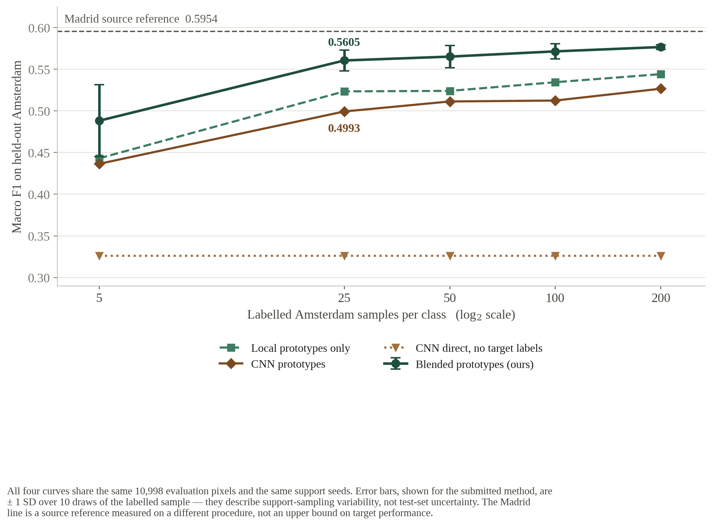
11
The better source model is the worse transfer model
Notebook 06. We built the 1D-CNN rather than arguing about it.
What the CNN bought
+0.050 on Madrid. A 22,084-parameter network free to learn any temporal filter it likes, and every filter it learns is a Madrid filter.
What it cost
It loses at every budget, and retains 81.6% of its Madrid score against our 96.8%. Representational freedom is paid for in generalisation.
The Madrid CNN figure comes from a single spatial holdout rather than five folds, so treat the source gap as approximate. The Amsterdam comparison is exact: same evaluation pixels, same seeds.

Slide 13
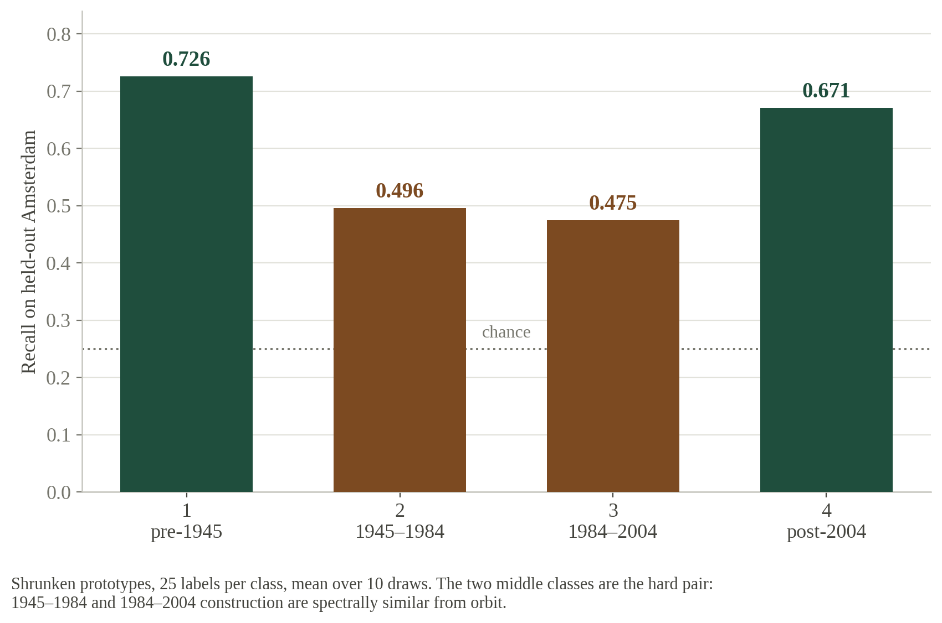
12
Where the errors are, and what we would do next
Blended prototypes, 25 labels per class — the low-data prize condition.
THE HARD PAIR
Classes 2 and 3 — 1945–1984 and 1984–2004 — recall 0.496 and 0.475. Post-war and late-modern construction are spectrally similar from orbit, and that boundary is the one place a 30 m pixel genuinely cannot resolve.
WHERE WE WOULD GO NEXT
Spatial context — a pixel's neighbours carry age information it does not
Ordinal loss — confusing class 2 with 3 should cost less than with 4
A third city, to test whether the finding is general or a Madrid–Amsterdam artefact

Slide 14
CONCLUSION
A city-portable recipe, and a reason to believe it ports.
THE NUMBERS
0.5954
Madrid macro F1
just below the baseline, harder split
The two-city setup is a proxy for deploying in any city with minimal local labelling. Our result says what to carry across and what to leave behind: carry the class locations, re-learn the geometry locally. That recipe does not depend on Madrid or Amsterdam.
0.4553
Amsterdam zero-shot
against the baseline's 0.3427
Stage 1 model
Class-balanced random forest, 0.5954 ± 0.0138
0.5605
Training code
adapt_and_predict(), n parameterised, fixed seed
Amsterdam, 25 labels
the low-data prize condition
This deck
abstract, decisions, required table and required plot
+0.039
Written justification
300 words: design, transfer, interpretation
over the baseline method
same harness, every budget
Every figure measured in our own notebooks. Nothing estimated. Where a comparison is not like-for-like, we said so.

Slide 15
13
Written justification
Deliverable 4. Desgn, transfer strategy and interpretation, in 298 words.
MODEL DESIGN
TRANSFER STRATEGY
INTERPRETATION
We treat the task as domain adaptation rather than classification. From 42 years of Landsat spectra we build 81 features in five groups — absolute level (18), series shape (30), change (12), spectral indices (20), metadata (1) — tagged by expected transfer behaviour before any model was fitted, since absolute brightness is a city fingerprint and series shape is not. Cleaning rejects saturated and contaminated readings at the observation slot, before any yearly average. Stage 1 is a class-balanced random forest of 300 trees. All evaluation uses spatially blocked splits excluding the entire 20×20 block of every labelled location, because neighbouring Landsat pixels are near-duplicates and scoring on them inflates results.
Two steps. First, standardise each city within its own distribution; this uses no labels and is worth +0.014 macro F1 on prototype transfer. Second, estimate Amsterdam class prototypes from the few labels and shrink them halfway toward Madrid’s. We import Madrid’s class locations but not its geometry: projecting through Madrid’s LDA directions scores 0.4627 and a Madrid-trained CNN embedding 0.4993, both worse than importing nothing.
Madrid scores 0.5954 ± 0.0138. Amsterdam reaches 0.4882, 0.5605, 0.5651, 0.5714 and 0.5766 at 5, 25, 50, 100 and 200 labels per class, recovering 96.8% of the source score. The curve rises steeply to 25, then flattens: the first labels buy the city-specific offset, further labels buy little, so the residual gap is domain shift rather than label scarcity. Shrinkage helps most where the local estimate is noisiest (+0.045 at five labels) and still helps at 200 (+0.033). Against the baseline method under our stricter evaluation, we gain +0.039 mean macro F1 and win at every budget. Our few-shot figures are not comparable to the published baseline, which does not exclude spatial blocks; that difference is worth −0.075.
Carried in this file so a single upload holds every deliverable. Not presented aloud.

