Slide 1
Embedding Vectors
Jeff Allard
Lead Data Scientist
5/3 Bancorp

Slide 2
About
Highly effective in several domains e.g. Natural Language Processing (Word2Vec)
Finding more applications across machine learning problems generally
An Embedding Vector is simply a series of numbers that attempts to encode latent features of an object, e.g.
A word / sentence
A customer
A movie
…...

Slide 3
Canonical Example -- Text Encoding
Traditionally, models, say text classification, utilized a bag of words approach or some variant
Length of the variable = size of the vocabulary - the vector is sparse - all zeros except for position “i” which represents the specific term
“Cat”: [0,0,0…,0,0,1,0,0,....0]
“Pet”: [0,0,1…,0,0,0,0,0,....0]
Problems:
Very large sparse vectors are hard to work with in downstream algorithms
Related words encoded orthogonally
Need for heuristics such as word stemming, stop word removal, user maintained dictionaries of synonyms / domain specific words etc

Slide 4
Solution: Word2Vec
Originally published by Google researcher in 2013
Many variants and subsequent alternatives
The basic idea:
Represent a word as as dense vector
“Cat” = [0.2,-1.25,-0.0256,...0.45]
Benefits
Size of the vector is much smaller than Bag-of-Words (e.g. 200)
Related words are similar in vector space terms (e.g cosine similarity)

Slide 5
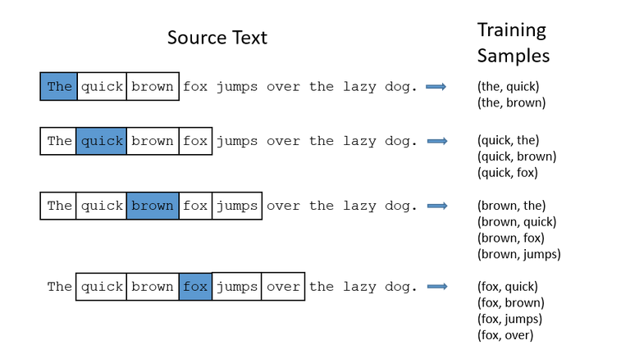
Word2Vec : Basic Idea of Skip-gram method
Window through a corpus
Select a word (e.g. quick)
Predict the likelihood that another word (e.g. fox) is within the context of the word -- context here is a window size of 2
Train a neural network with positive and randomly chosen negative examples
The weights from a shallow net are the vectors for a given word
Words with similar context will have learned representations that are similar
E.g. Cat and Pet, Smart and Intelligent

Slide 6
Word2Vec
Intuitively….the elements of a vector describe concepts or characteristics of a term
E.g. One element of “King” may describe the strength of “gender”
Found that simple operations on these vectors displayed deeper concepts
[king] - [man] + [woman] ~= [queen]
If we take the vector for “king”, subtract the vector for “man” and add the vector of “woman”, the resulting vector will be the closest to….the vector for queen (cosine similarity)
King - man removes the male gender component from the concept of monarch

Slide 7
Word2Vec
[0.5,0.2] - [0.3,0.4] = [0.2,-0.2]
(Man - Woman)
[0.5,0.7] - [0.2,-0.2] = [0.3,0.9]
(King + (Man - Woman)) ~ Queen
https://multithreaded.stitchfix.com/assets/images/blog/vectors.gif

Slide 8
Word2Vec
Closing Thoughts
Intuitively the components of the vectors are concepts or mixtures of concepts
In practice not always interpretable
The vector dimension is often chosen empirically
Easy to train vectors on your own domain if you have enough data, else use pre-trained ones (e.g. trained on massive corpus like wikipedia) and fine tune them (transfer learning) for your task

Slide 9
Entity Embeddings
Generalization - Not just for words or text
A word is just some ‘token’, so extend this idea to things like
Customer IDs
Movie IDs
Zip codes
…...
Being used for state of the art predictive models
Allows use of high cardinality nominal variables like a customer’s census tract
Even used for lower cardinality variables like a customers State (replacing dummy variables)

Slide 10
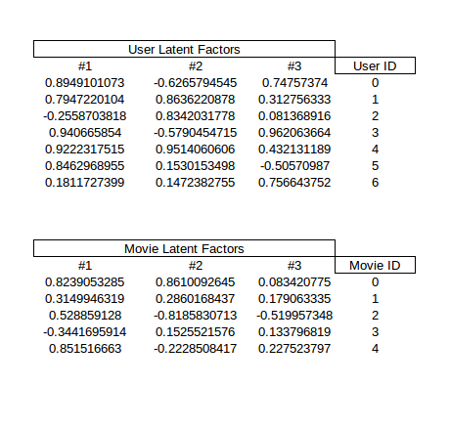
Application : Recommendation Engines
User Factor #1: How much user 0 likes action movies?
Movie Factor #3: How much action movie 0 has?

Slide 11
Demo
Highly effective deep learning model for recommending items to Pintrest users
Using only user and item IDs
Training from scratch with gradient descent
Keras and Tensorflow
https://github.com/AllardJM/DataScience_Meetup_Presentations/tree/master/April_2017_EmbeddingVectors

