Slide 1

Introduction to Vowpal Wabbit
Jeff Allard | March 2015

Slide 2
Contents
Disclaimer
What is VW?
How VW solves the “big data” problem?
Online Learning
The Hashing Trick
The learning algorithm
Capabilities / use cases
How to….
Run
Output
Set up input
Click Through Rate Example

Slide 3
Disclaimer
Vowpal Wabbit is a complex and quickly evolving project
This presentation skims the surface and focuses on applications that may be of interest to data scientists / predictive modelers
What happens “under the hood” is largely ignored but is likely of major interest to software engineers
Amazing speed /efficiency
How reductions are used to expand the core algorithm
Etc.
“It has been used to learn a sparse terafeature (i.e. 10¹² sparse features) dataset on 1000 nodes in one hour”

Slide 4


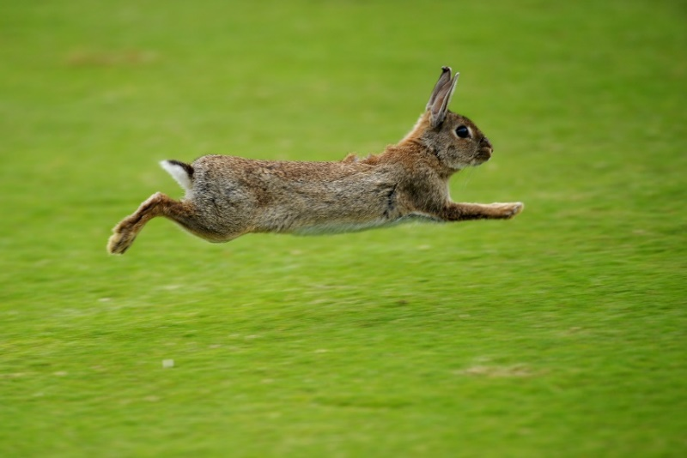
What is VW?
Vowpal Wabbit (aka “VW”, aka “vee-dub”) is an open source project, written in C++, originally began at Yahoo! and currently being developed at Microsoft
https://github.com/JohnLangford/vowpal_wabbit
Linux / OS-X : make command
Windows : Use virtual machine or follow instructions: https://github.com/JohnLangford/vowpal_wabbit/blob/master/README.windows.txt
Brainchild of John Langsford
The name?
Vorpal (sword)
Rabbit
+
Powerful
Fast

Slide 5
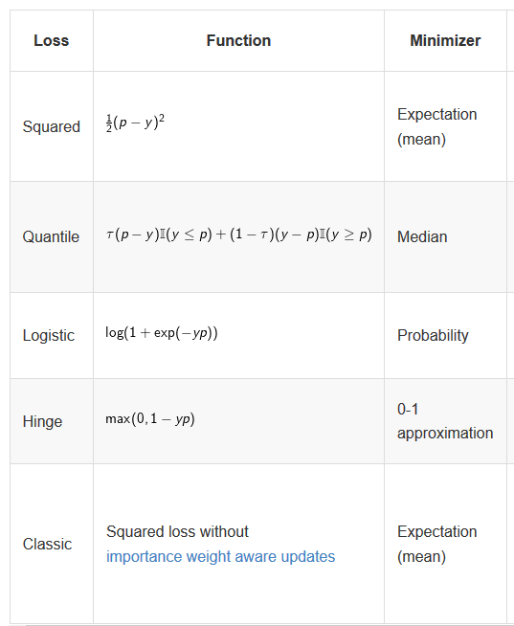

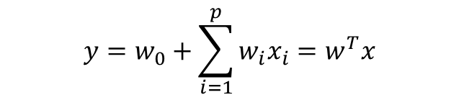
VW fits a Linear Model…
VW’s core algorithm produces a linear model:
But there are many variants and reductions as we shall see…
The optimization problem it solves is to find the weights w that minimize the penalized loss function L
Various loss functions are available, allowing linear regression, logistic regression, quantile regression, SVM…
$$y=w_{0}+\sum_{i=1}^{p}{w_{i}x_{i}}=w^{T}x$$
Constrains how large the weights
can be (to generalize better)
Minimizes the error of the prediction

Slide 6
Online Learning
There is no practical limit to the size of the dataset VW can process
It uses online learning – one or a small number (called a ‘mini-batch’) of records are read from disk, processed (a model is trained, e.g. gradient descent) and removed from memory
Only a small number of records are ever held in memory at a time
The model parameters are updated as data is streaming in (adapts to changes…)
Repeat
Predict the value of the example
See what the true value is
Adjust the model accordingly
Read in a new example

Slide 7
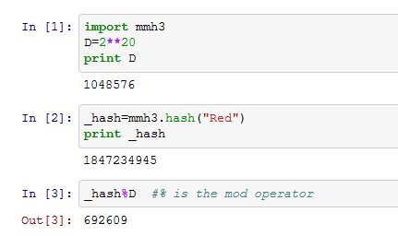
Hashing
The size of the model is constrained via the “hashing trick”
Acts to limit the amount of memory required for the model (there is a pre-set number of hash bins)
Acts as a form of regularization / dimensionality reduction due to (random) collisions in the hash
2^20 “bins” allowed to hash features into. These are later one-hot-encoded (64-bit system allows up to 2^32)
Categorical features are sent through a hashing function (murmurhash3) and the resulting integer is AND’d with a binary version of a pre-set integer. This works just like a mod function, which is demonstrated.
String features are hashed by default
Numeric features are not (this can be overridden)
The feature is “Red”, the hashed value is 1847234945
The new feature is “692609”

Slide 8
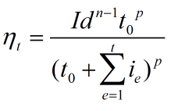
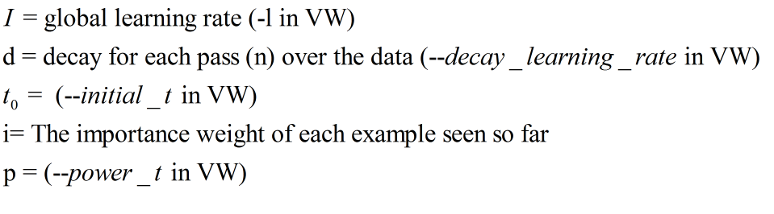
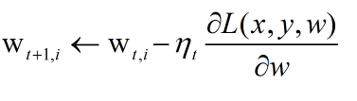

Learning
VW offers numerous optimization routines, but the default is Stochastic Gradient Descent….
Each weight in the model is initialized to a small random value
Each time one (or a small “batch”) of examples is read, the error of the prediction is used to adjust the weights. The weights are updated in the negative direction of the gradient.
At it’s defaults, how much we adjust the weights gets smaller and smaller as a simple function of the number of training examples seen
Weight i at time t
Learning Rate (how big a step we take) at time t

Slide 9
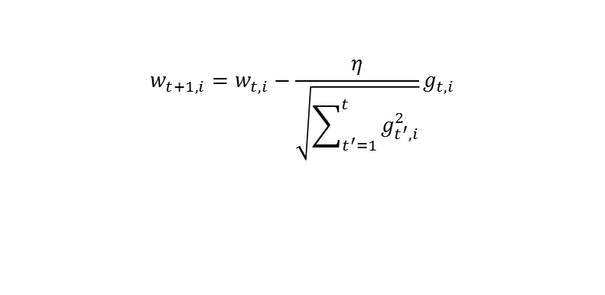
Learning – a bit more detail
with 3 improvements layers on….
Normalized: There is no need to normalize data (i.e. placing all features on the same scale) ahead of time. The algorithm takes this into account when updating weights
Invariant: Each training example can have its own importance weight – putting more emphasis on a rare class, for example.
The importance weight is equivalent of seeing an example repeated in the data (repeated [importance weight] times) without the computational cost
Adaptive: Instead of training using a single learning rate or a global learning rate that decreases as a function of the number of examples seen, each feature can have its own learning rate (“ADAGRAD”)
Adapts to the data, no grid search needed
Common feature weights stabilize quickly
Rare features can have their weight updated in large magnitude when they are seen
Bottom line – many different options / algorithms to update the weights, each with a huge amount of theory and math heavy papers. No slides available for all the combinations….Good news is the defaults usually work really well!
$$w_{t+1,i}=w_{t,i}−\frac{η}{\sqrt{\sum_{t^{′}=1}^{t}{g_{t^{′},i}^{2}}}}g_{t,i}$$
Gradient for example t, feature I
Learning rate for example t, feature I

Slide 10
Capabilities
Although the core is an online generalized linear model, there is much more that has been built from the core (not a comprehensive list)
Models / Uses / Options (*= I have used)
GLM*
SVM (linear and kernel)*
Matrix factorization for recommendation (including classical, factorization machines)*
Topic Models (LDA)*
Contextual Bandit (e.g. what web content to serve)
FTRL (follow the regularized leader)*
Structured Prediction
Single hidden layer NN
Active Learning
Learning 2 Search
Etc.
Utilities
Regularization to combat over fitting L1 and L2 low rank interaction factorization (LRQ) Dropout (works with LRQ) Holdout set with early stopping
Hyper-parameter tuning (e.g. value of lambda in L1)
Model savings and resuming
Various methods for multi-class classification (e.g. one versus all)
Cluster Parallelization
Fast bootstrapping for model averaging
Text processing for feature creation – N-grams, skipping
Quadratic and cubic feature generation

Slide 11
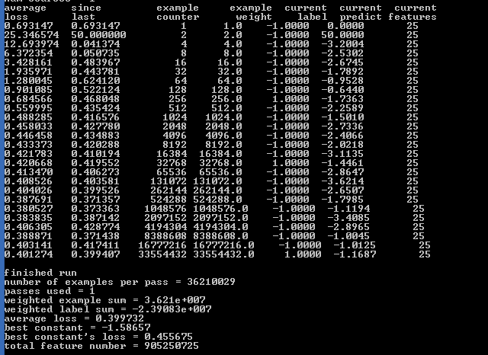
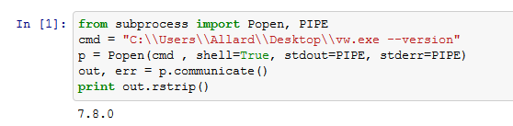
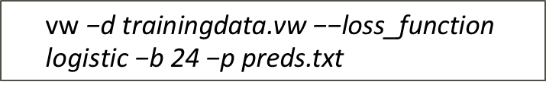
How-to….
Run the program
VW is ran from the command line (but is also a library that can be called from other programs. A python and R wrapper do exist)
Basic command example:
Calls vw to train a model using trainingdata.vw with a logistic loss function using 2^24 hash buckets and save the predicted values to preds.txt
Run from any language allowing access to the command shell
Python:
View the output
With online learning, every example is ‘out-of-sample’ : The output value is predicted before the true output is used to update the weight. As VW runs through data, the “progressive loss” is printed out, showing how well the model predicts. Each example is a training and a test set!
Average loss shows the value of the loss function as data is streamed
$$\text{vw}\text{ −}\text{d} \text{trainingdata}\text{.}\text{vw}\text{ −−}\text{loss}\text{_}\text{function} \text{logistic}\text{ −}\text{b}\text{ 24 −}\text{p} \text{preds}\text{.}\text{txt}$$

Slide 12
Input Data
The basic structure of the input is close to LIBSVM with more complexity (options)
[Label] [Importance [Tag]]|Namespace Features |Namespace Features ... |Namespace Features
Where Namespace=String[:Value] and Features=(String[:Value] )
Label | The target variable. Real valued scalar for regression or {-1,1} for binary classification (multi class is expanded)
Importance | Importance weight for the example (default =1)
Tag | Observation ID (can be blank)
Namespace | A reference (VW uses the first character) for one or more features / fields (can be blank)
Features | The predictor (value is 1 by default)
1 |a CRIM:0.00632 ZN:18.0 B:396.9 |b This text is my input |c birth_Michigan live_Flordia
The target variable is of class 1 (binary classification)
There is a namespace called ‘a’ which contains three numeric variables. E.g. CRIM with value 0.00632
There is another namespace called ‘b’ which contains text. VW will tokenize this string into {‘This’, ‘text’ ,…’input’} each with weight 1. Very powerful! No pre-processing needed.
There is a namespace called ‘c’ with two features : where you were born and where you live. The prefix ‘birth’ and ‘live’ are added in case one is missing. If it just said Michigan is this birth or live?

Slide 13
Input data manipulation
Create interactions between any two or three namespaces
-q aa will create quadratic interactions between all the variables in the name space a
-c aaa will create cubic interactions
-q ab will create quadratic interactions between variables in name spaces a and b
Create n-grams with optional skips
Tip: To allow greater expressiveness, run random forest or GBM (on a sample) and output the leaf nodes as indicators variables to be used by VW!
--ngram 2 will create unigram and bigrams from text
Bigrams of “This text is my input” is {‘this text’, ‘text is’, ‘is my’, ‘my input’}

Slide 14
DEMO
VW excels when data is of high cardinality
Online click through rate (CTR) prediction
Recommendation engines
Text Classification
Avazu sponsored a Kaggle competition regarding prediction of a click on a web ad
11 days worth of click logs
40,428,967 records
22 raw features – some with extremely high cardinality
Device_IP : 6,729,486 unique values
Device_ID : 2,686,408 unique values
Predict if a user will click on the ad (0 or 1)
Train the model on the first 10 days and validate with the 11th
Evaluate the model in terms of a gain table

Slide 15
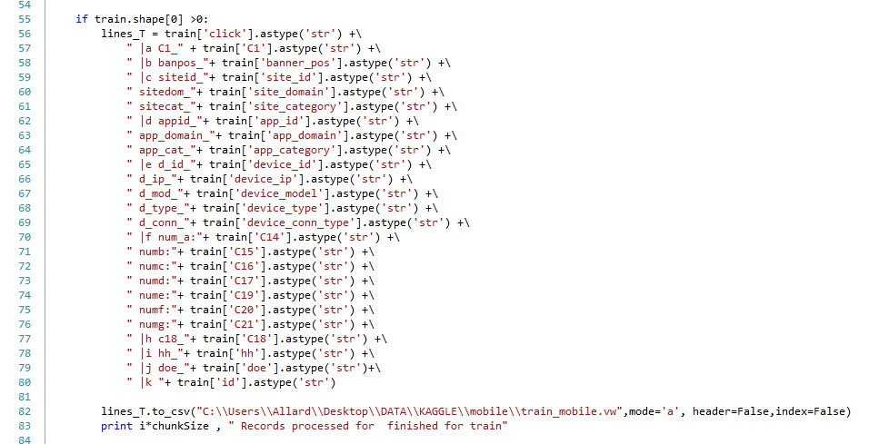
DEMO
Python script to create VW input format. Namespaces created for grouping like features :
Advertiser Site
Application (presenting ad)
Device (viewing the ad)

Slide 16
DEMO
Linear model (build and write out model)
Linear model with select quadratic interactions
Predict
vw -d ./Data/train_mobile.vw --loss_function logistic -f ./Results/model1.vw (1 min 36 seconds)
vw -d ./Data/train_mobile.vw –b 24 --loss_function logistic -f ./Results/model2.vw (1 min 43 seconds)
vw -d ./Data/train_mobile.vw -b 24 --loss_function logistic --ignore k -q cd -q de -f ./Results/model3.vw (1 min 49 seconds)
vw -d ./Data/train_mobile.vw -b 30 --loss_function logistic --ignore k -q cd -q de -f ./Results/model4.vw (3 min 33 seconds)
1,073,741,824 possible weights!
vw -d ./Data/val_mobile.vw –t -i ./Results/model4.vw –p ./Results/scored.vw
Test Only
Model
Predictions

Slide 17
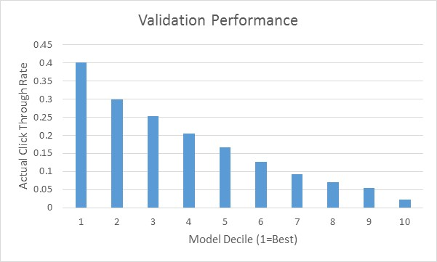
DEMO
Relatively strong discrimination even without….
Feature engineering
Parameter tuning
Regularization

