Slide 1

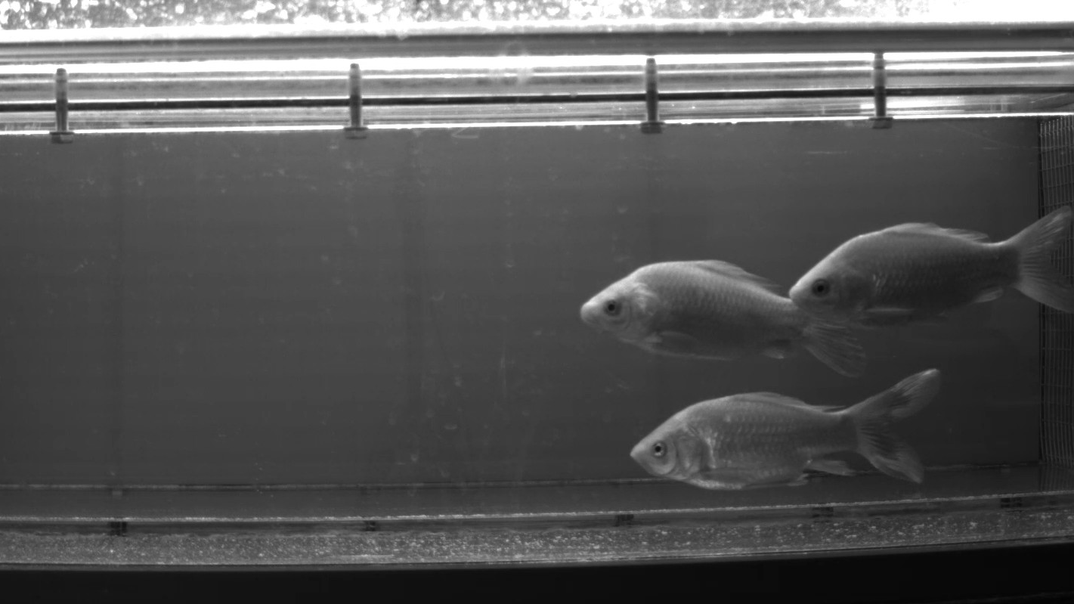
Seminar
DeepShapeKit:
accurate 4D shape reconstruction
of swimming fish
Jonathan Häßler
Visual Computing, Universität Konstanz
[R. Wu, O. Deussen and L. Li (2022)]

Slide 2
Content
Motivation
Contribution
How does it work?
Related Work
Method
Results
Limitations
Own thoughts

Slide 3
Motivation
Study fish movement
Image by [R. Wu, O. Deussen and L. Li]

Slide 4


Motivation
Study fish movement
Interesting for…
“Fish psychology”
Image of Sigmund Freud: SWR / Hykade
Image of fish by [R. Wu, O. Deussen and L. Li]

Slide 5

Motivation
Study fish movement
Interesting for…
“Fish psychology”
Robotics
…
Image of robotic fish adapted from: [Li, Liang et al. (2021)]
Image of fish by [R. Wu, O. Deussen and L. Li]

Slide 6
Motivation
Study fish movement
Idea: use 4D model of fish
3D space
1D time
Image by [R. Wu, O. Deussen and L. Li]

Slide 7
Motivation
Study fish movement
Idea: use 4D model of fish
Why not use other approaches?
↯ Need much training data
↯ Difficult lighting conditions under water
3D space
1D time
Image by [R. Wu, O. Deussen and L. Li]
Notes:
For humans, there are approaches that work fine but one reason for that is that there‘s so much training data available for humans.

Slide 8
Contribution
DeepShapeKit: Framework for creating 4D model from video(s)
Small training data set
Textureless
Good sequential smoothness
Specifically tailored for fish

Slide 9

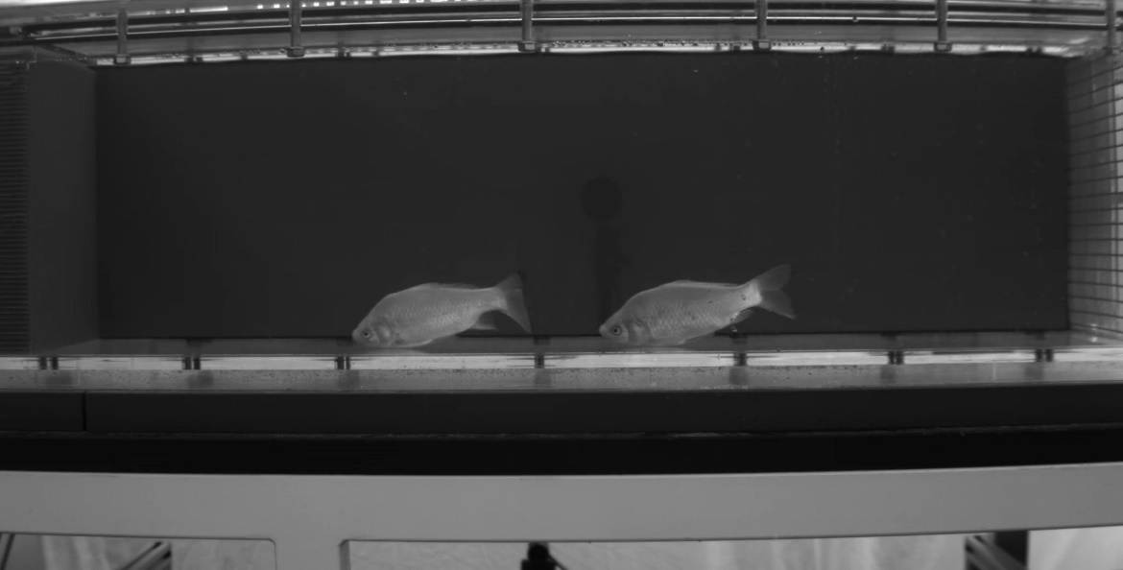
How does it work?
Idea:
[R. Wu, O. Deussen and L. Li (2022)]
Take a fish model
For every frame of a video…
Position the model in the image
Bend the model
Image by [R. Wu, O. Deussen and L. Li]

Slide 10
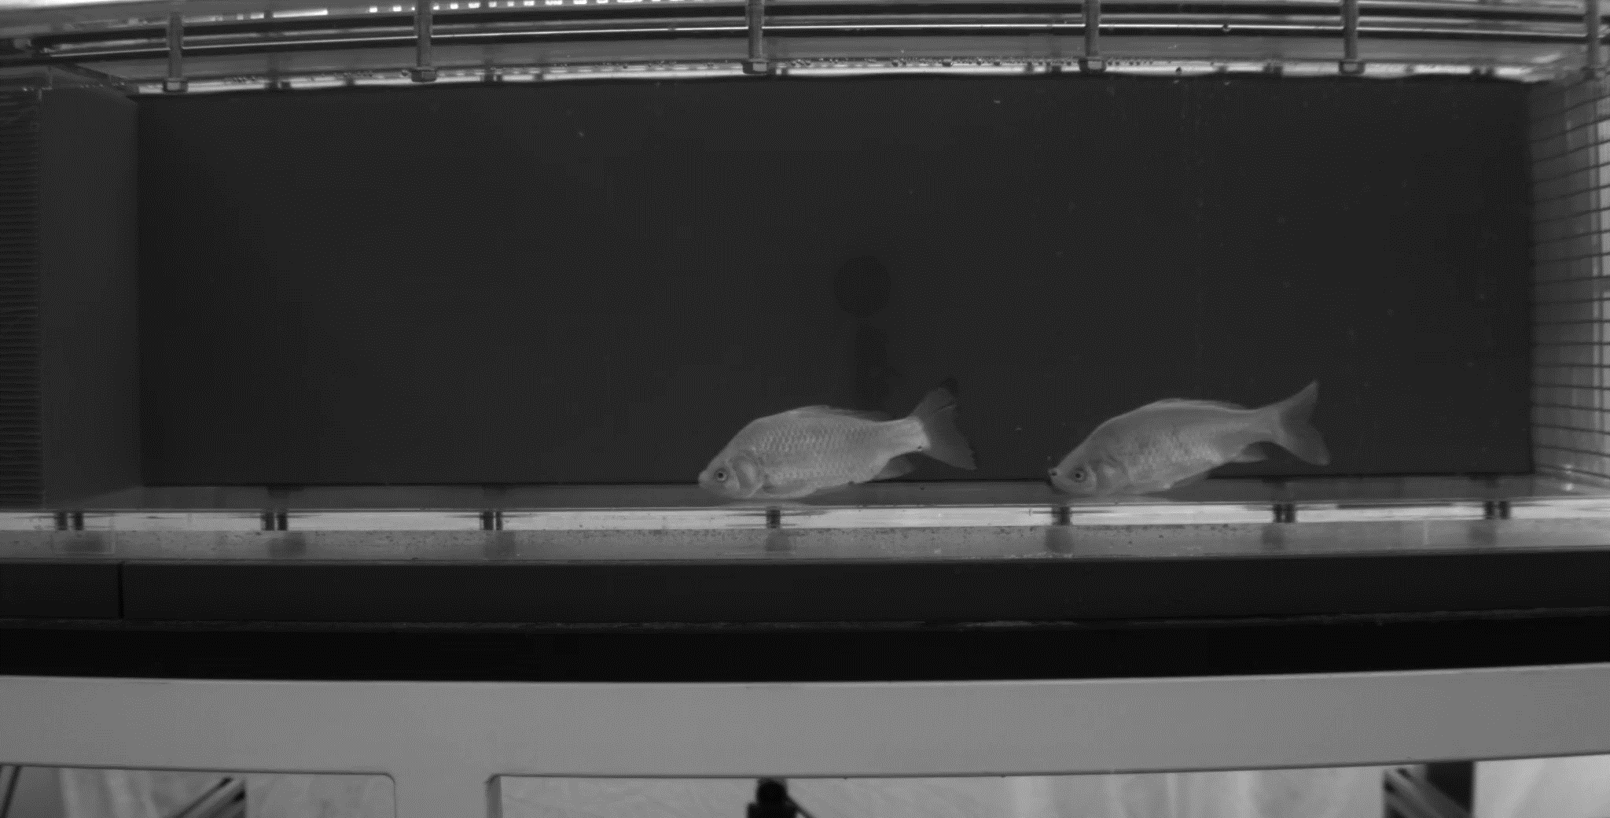
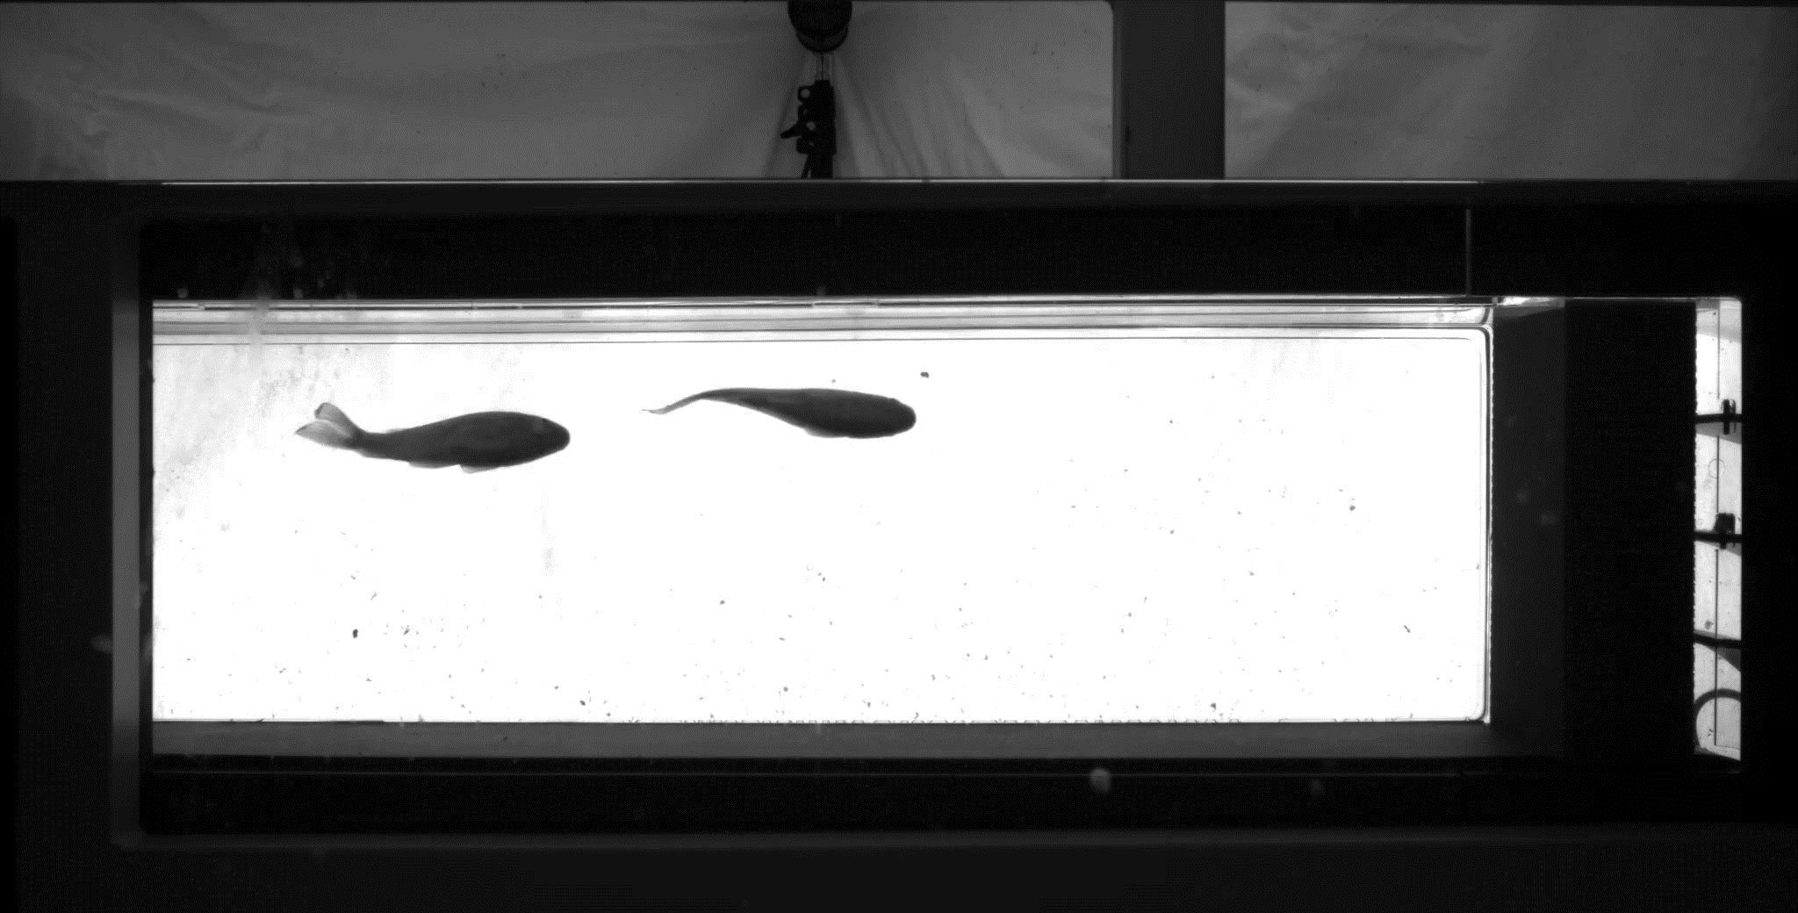
How does it work?
Input:
Videos by [R. Wu, O. Deussen and L. Li]

Slide 11
How does it work?
Take a fish model
For every frame of a video…
Position the model in the image
Bend the model
[R. Wu, O. Deussen and L. Li]

Slide 12
How does it work?
Take a fish model
For every frame of a video…
Position the model in the image
Bend the model
Where is a fish?
[R. Wu, O. Deussen and L. Li]

Slide 13



How does it work?
Take a fish model
For every frame of a video…
Position the model in the image
Bend the model
Where is a fish?
-> Instance segmentation
Adapted from [R. Wu, O. Deussen and L. Li (2022)]

Slide 14
How does it work?
Take a fish model
For every frame of a video…
Position the model in the image
Bend the model
Where is a fish?
-> Instance segmentation
How to position the model?
-> later
Adapted from [R. Wu, O. Deussen and L. Li (2022)]
Notes:
Note that there are no changes to the 3D model yet

Slide 15
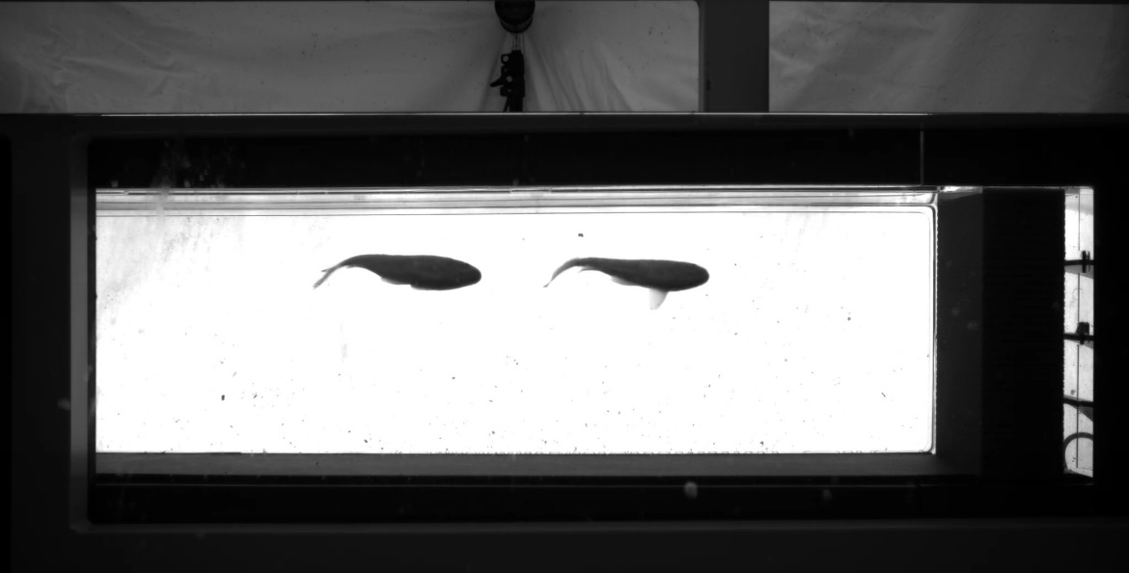
How does it work?
Take a fish model
For every frame of a video…
Position the model in the image
Bend the model
Adapted from [R. Wu, O. Deussen and L. Li (2022)]
Notes:
I chose a frame from the bottom view here because the body bends are more clear but note that the concept of multiple views for one reconstruction is going to become important later on.

Slide 16
How does it work?
Take a fish model
For every frame of a video…
Position the model in the image
Bend the model
What pose does the fish have?
Adapted from [R. Wu, O. Deussen and L. Li (2022)]

Slide 17
How does it work?
Take a fish model
For every frame of a video…
Position the model in the image
Bend the model
4
3
4
3
1
2
6
1
2
6
What pose does the fish have?
-> pose estimation
Adapted from [R. Wu, O. Deussen and L. Li (2022)]

Slide 18

How does it work?
Take a fish model
For every frame of a video…
Position the model in the image
Bend the model
4
3
4
3
1
2
6
1
2
6
What pose does the fish have?
-> pose estimation
How to bend the model?
-> later
Adapted from [R. Wu, O. Deussen and L. Li (2022)]

Slide 19
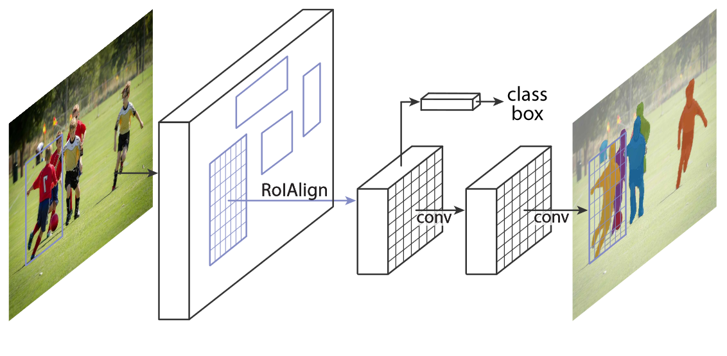
Related Work
Used in DeepShapeKit
Mask R-CNN
For instance segmentation
DeepLabCut
For pose estimation
[He, K. et al. (2020)]
[Mathis, A. et al. (2018)]

Slide 20
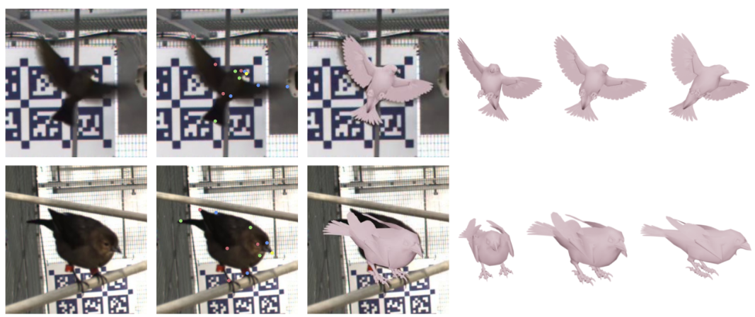
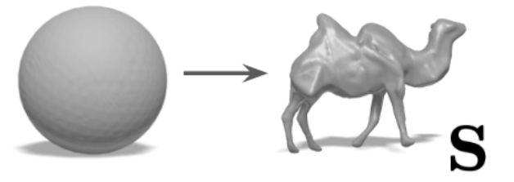
Related Work
Other approaches
AvianMesh
3D reconstruction using a pre-created model
LASR
4D reconstruction by learning how to construct a mesh
[Badger, M. et al. (2020)]
[Yang, G. et al. (2021)]

Slide 21
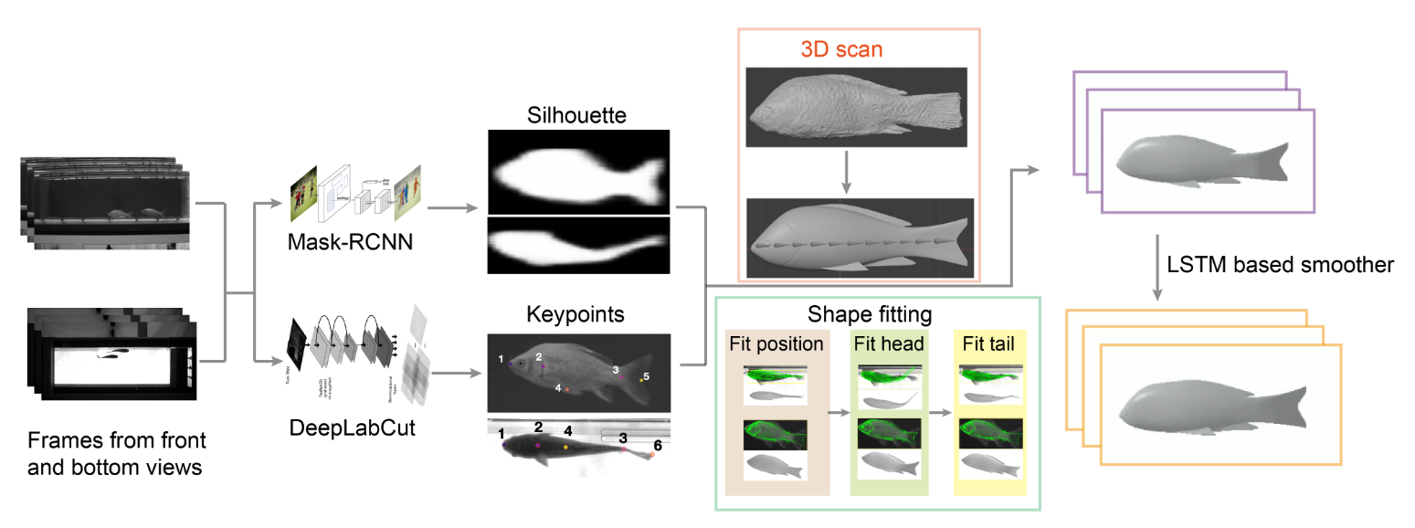
Method
[R. Wu, O. Deussen and L. Li (2022)]

Slide 22
Method
The fish model
[R. Wu, O. Deussen and L. Li (2022)]
Notes:
Model is parameterized

Slide 23
Method
Bone orientation
The fish model
Bone length
[R. Wu, O. Deussen and L. Li (2022)]

Slide 24
Method
Bone orientation
The fish model
Bone length
Head orientation
Tail orientation
Adapted from [R. Wu, O. Deussen and L. Li (2022)]

Slide 25
Method
Bone orientation
The fish model
Bone length
Global orientation
Head orientation
Tail orientation
Adapted from [R. Wu, O. Deussen and L. Li (2022)]

Slide 26
Method
Bone orientation
The fish model
Global location
Bone length
Global orientation
Head orientation
Tail orientation
Adapted from [R. Wu, O. Deussen and L. Li (2022)]

Slide 27
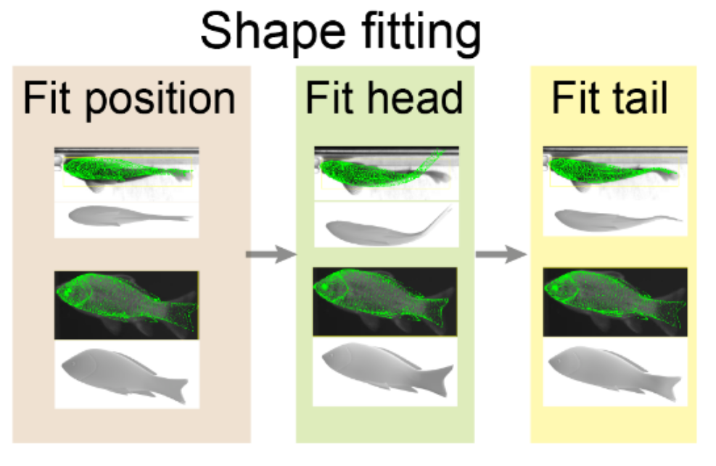
Method
1
2
3
[R. Wu, O. Deussen and L. Li (2022)]
Notes:
Dont spend much time

Slide 28
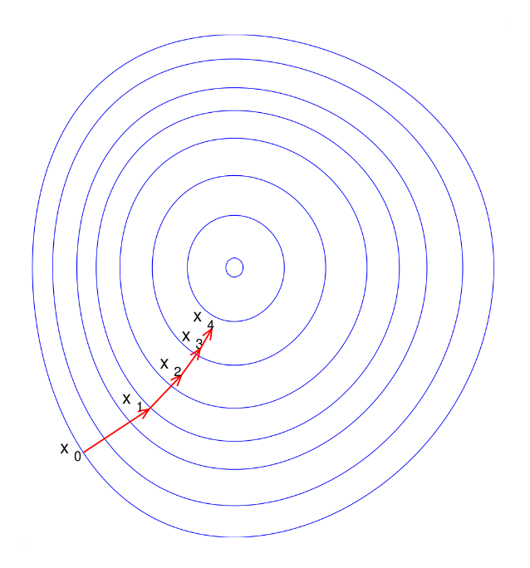
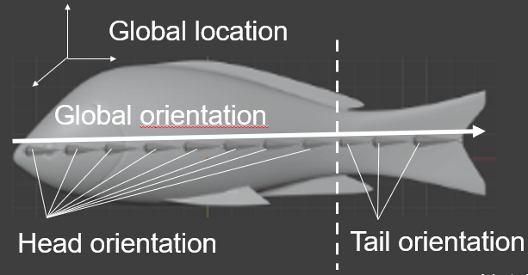
Method
Optimization
Method:
Adam optimizer (gradient descent)
Error function:
Different for each step
Optimization parameters:
Location + different subsets of the orientation
Image: https://en.wikipedia.org/wiki/File:Gradient_descent.svg
by Olegalexandrov
Adapted from [R. Wu, O. Deussen and L. Li (2022)]

Slide 29
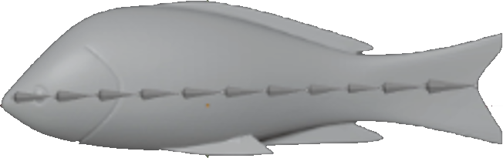

Method
Global location
Parameters:
Error:
Global orientation
4
3
1
2
3
1
2
4
6
6
Silhouette
Keypoints
Adapted from [R. Wu, O. Deussen and L. Li (2022)]

Slide 30
Method
Global location
Parameters:
Error:
Head orientation
2
4
4
1
2
1
Head keypoints
Adapted from [R. Wu, O. Deussen and L. Li (2022)]

Slide 31

Method
Global location
Parameters:
Error:
Head orientation
Tail orientation
3
1
2
4
3
6
1
2
4
6
Result of head fitting
Silhouette
Keypoints
Adapted from [R. Wu, O. Deussen and L. Li (2022)]

Slide 32

Method
Sequential smoothness
Large change between frames is bad
Current frame is initialized with 3D model of last frame

Slide 33
Method
Sequential smoothness
Large change between frames is bad
Current frame is initialized with 3D model of last frame
Use post-processing step
[R. Wu, O. Deussen and L. Li (2022)]

Slide 34
Method
Usage

Slide 35
Method
Usage
Training:
Training data sets for
Mask R-CNN (~300 manually masked images)
DeepLabCut (~200 manually labeled images)

Slide 36
Method
Usage
Training:
Training data sets for
Mask R-CNN (~300 manually masked images)
DeepLabCut (~200 manually labeled images)
Input:
One video each from front and bottom view
Output:
4D model

Slide 37
Results
Quantitative
NVIDIA GeForce RTX 3090 GPU
Avg fitting time: 36s/frame

Slide 38
Results
Quantitative
NVIDIA GeForce RTX 3090 GPU
Avg fitting time: 36s/frame
Intersection over Union
0.68 front
0.65 bottom
Intersection
Union

Slide 39
Results
Comparison to other approaches
Smaller training data than AvianMesh
Smoother than AvianMesh
… but higher keypoint-error
More accurate results than LASR

Slide 40
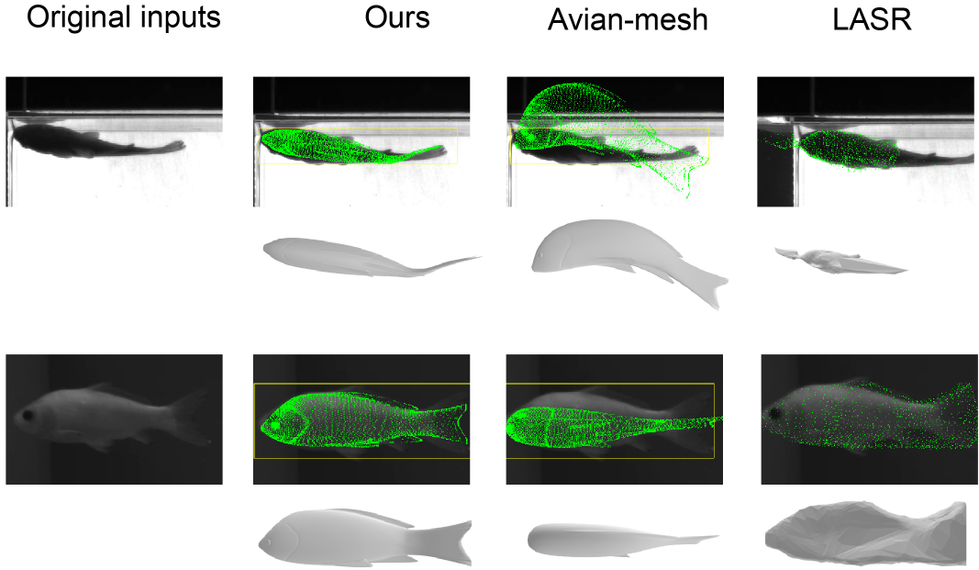
Results
[R. Wu, O. Deussen and L. Li (2022)]

Slide 41
Results
AvianMesh:
Issues with temporal dimension
LASR:
Depends on textures

Slide 42
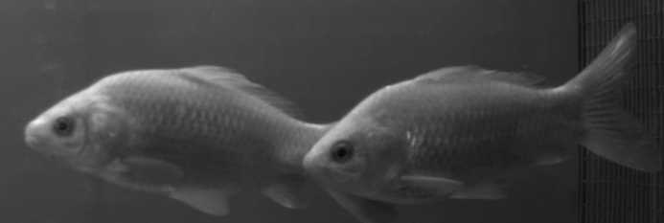
Limitations
Susceptible to fish overlap
Image by [R. Wu, O. Deussen and L. Li]

Slide 43
Own thoughts
Must view it in context of research goals
Created out of necessity since other approaches not suitable for fish
Very special testing conditions:
In one particular environment

Slide 44
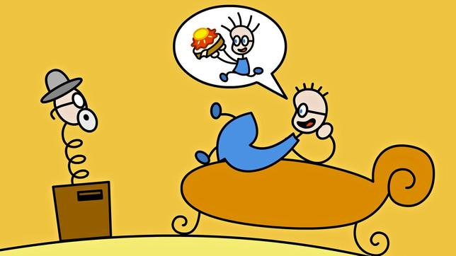

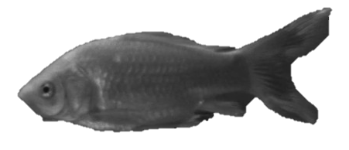
Thanks for your attention!
Image of Tom and the doctor: SWR / Hykade
Image of fish by [R. Wu, O. Deussen and L. Li]

Slide 45
References
Wu, Ruiheng and Deussen, Oliver and Li, Liang. "DeepShapeKit: accurate 4D shape reconstruction of swimming fish." 2022 IEEE/RSJ International Conference on Intelligent Robots and Systems (IROS). IEEE, 2022.
Mathis, A. and Mamidanna, P. and Cury, K.M. et al. DeepLabCut: markerless pose estimation of user-defined body parts with deep learning. Nat Neurosci 21, 1281–1289 (2018). https://doi.org/10.1038/s41593-018-0209-y
Badger, M. and Wang, Y. and Modh, A. and Perkes, A. and Kolotouros, N. and Pfrommer, B. G. and Schmidt, M. F. and Daniilidis, K. “3D Bird Reconstruction: a Dataset, Model, and Shape Recovery from a Single View,” 2020
He, K. and Gkioxari, G. and Dollár, P. and Girshick, R. “Mask R-CNN.” In Proceedings of the IEEE international conference on computer vision, 2017.
Yang, G. and Sun, D. and Jampani, V. and Vlasic, D. and Cole, F. and Chang, H. and Ramanan, D. and Freeman, W. T. and Liu, C. “LASR: Learning Articulated Shape Reconstruction From a Monocular Video,” in Proceedings of the IEEE/CVF Conference on Computer Vision and Pattern Recognition (CVPR), 6 2021, pp. 15 980–15 989.

Slide 46
Seminar
DeepShapeKit:
accurate 4D shape reconstruction
of swimming fish
Jonathan Häßler
Visual Computing, Universität Konstanz
[R. Wu, O. Deussen and L. Li (2022)]

Slide 47

Method
What’s a good fit?
1
2
3
Minimize distance of head joints
Minimize difference of tail joints
Minimize difference of silhouettes
Minimize difference to last result
Optimization parameters
Location,
Global position
Global position,
Head position
Location, Global position, Head position,
Tail position

Slide 48
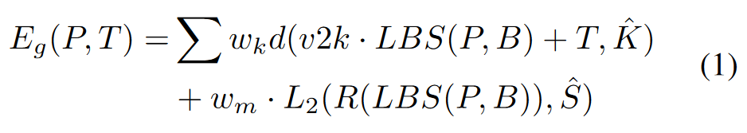
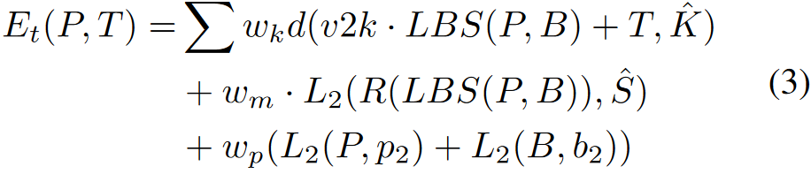
Method

Slide 49
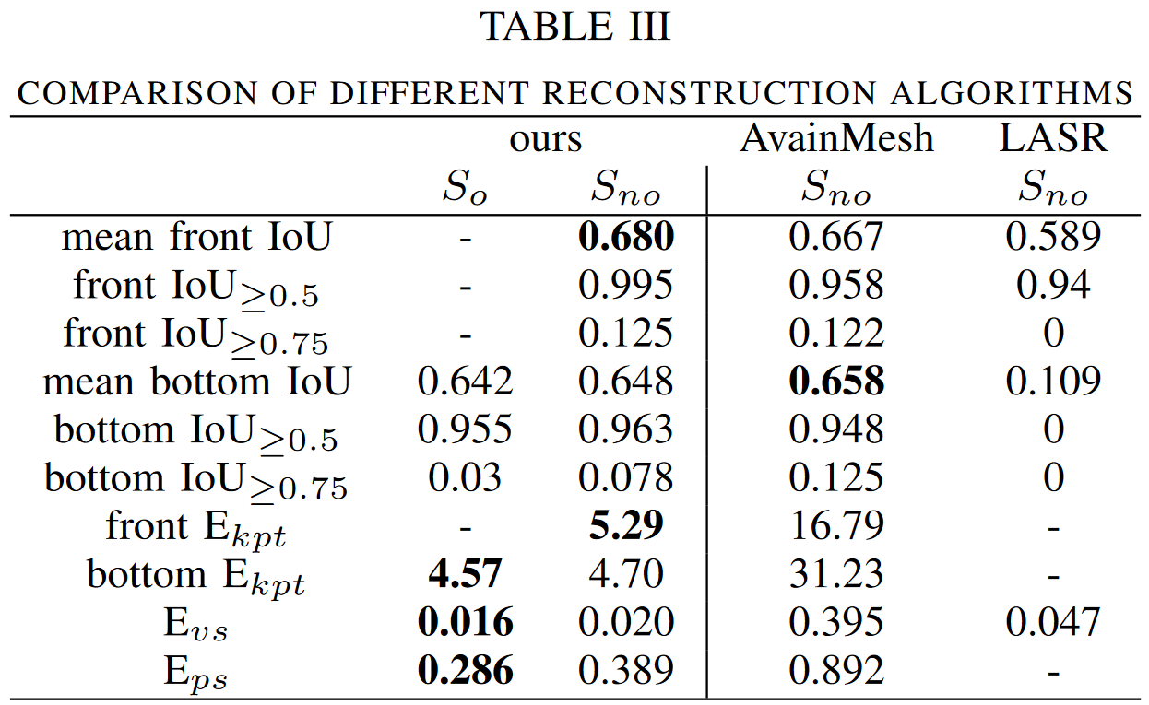
Results
Accuracy measures
Pose distance
(scaled avg) vertex distance
Seq. smoothness measures
(scaled avg) pose distance
[R. Wu, O. Deussen and L. Li (2022)]

Slide 50
Method
The fish model
Bone orientation
Bone length
(used for LBS)
Head orientation
Tail orientation

Slide 51
Thanks for your attention!
Part. I

