Slide 1


NATIONAL INSTITUTE OF TECHNOLOGY, ROURKELA
Product Development Laboratory
(EC3712)
Digital Platform For Internet of Things
Presented By:-
Satwik Sanket Ratha : 122EC0668
Sanseet Suna : 122EC0585
Pratyush Senapati : 122EC0138
Lavanya Tamgade : 122EC0354
Shyamsunder Tard : 122EC0140
1

Slide 2
“Imagination is the beginning of creation. You imagine what you desire, you will what you imagine, and at last, you create what you will.“
- George Bernard Shaw
2

Slide 3
Introduction to IoT
The Internet of Things (IoT) is transforming industries by enabling automation, remote control, and real-time monitoring. By leveraging IoT, appliances like fans, lights, motors, pumps, and AC systems can be efficiently managed to enhance operational performance, reduce human effort, and conserve energy .
This project aims to develop an affordable and scalable IoT platform using cutting-edge technologies like ESP32, Arduino IDE, React/React Native, Node.js, MongoDB/MySQL, and Flutter. The solution is designed for seamless integration into industrial and residential applications, making it a versatile and accessible choice for smart automation.
Additionally, this platform will include advanced features such as real-time data analytics, predictive maintenance, and user-friendly dashboards for monitoring and control. By leveraging secure communication protocols and cloud integration, the system ensures data privacy and reliability. This comprehensive approach positions the solution as a cornerstone for smart automation, driving efficiency and innovation across diverse sectors.
3

Slide 4
Necessity of the Project
Automation and Remote Accessibility :
Many industries and homes rely on manually operated devices. This system enables remote control, increasing convenience.
Energy Optimization :
Avoids power wastage by monitoring and controlling appliances like AC systems, fans, and pumps efficiently.
Precise Control :
Allows users to adjust the speed of devices like fans, motors, or pumps and the temperature of ACs, ensuring optimal operation.
Cost-Effective Monitoring :
Provides a low-cost alternative to industrial-grade controllers for precise and scalable monitoring.
Enhanced Safety :
Prevents accidents caused by overheating or prolonged device usage by integrating alerts and fail-safe mechanisms.
4

Slide 5
Product Description
The Digital Platform for IoT is a comprehensive solution that bridges smart devices with users through cutting-edge technology. By utilizing ESP32 microcontrollers, the platform supports wireless connectivity for sensors and actuators, enabling efficient data exchange. A scalable backend infrastructure, powered by technologies like Node.js and MongoDB/MySQL, ensures real-time data processing and secure storage. The user interface, crafted with React/React Native or Flutter, provides an intuitive and responsive experience, allowing seamless device monitoring, automation, and management across diverse environments.
Key Features:
Real-Time Data Monitoring: Collect and display sensor data.
Remote Device Control: Control actuators from anywhere using a mobile or web interface.
Scalability: Supports multiple devices for applications like smart homes, healthcare, and agriculture.
Data Analytics: Process and store data using Node.js and MongoDB/MySQL for actionable insights.
5

Slide 6



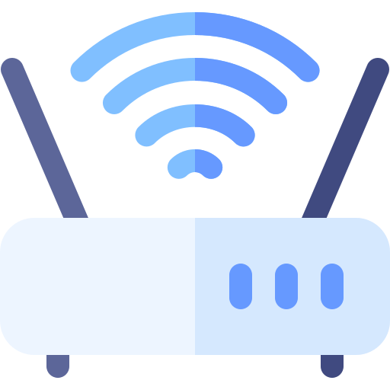






Working Principle Flowchart
API Request
Data Transmit
Networking
Application
(App & Web)
Cloud Backend
(Render)
Wi-Fi / Bluetooth Router
(Data Transmitter & Receiver)
Device Hardware
(Relays, Sensors)
Power Plants and Factories
Home Appliances
Health Industry
Farming Sectors
6

Slide 7
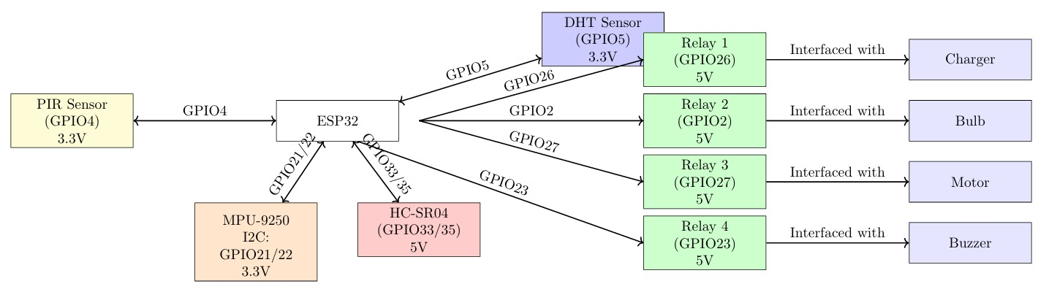
Backend Logic Diagram
7

Slide 8
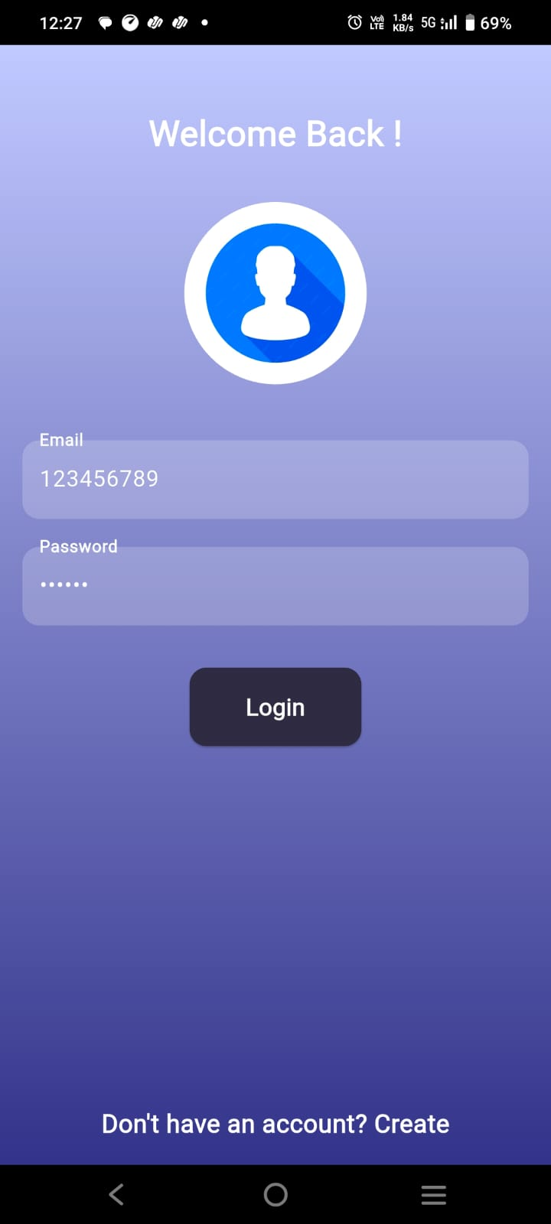
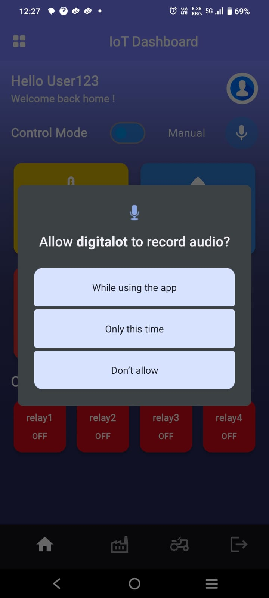
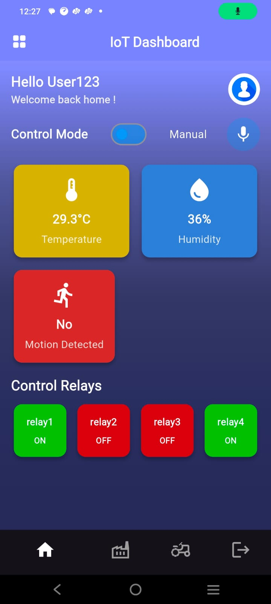
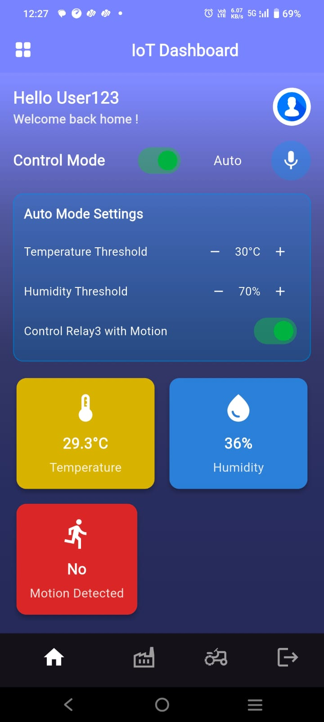
App Prototype
Login Page
Permission Handler
Dashboard
Voice Automation
GitHub: https://github.com/Sanseet/digitalot
App Download Link: https://drive.google.com/file/d/1xPt376kzJAZbqnQ8byHs1rzEPWlfzYwl/view?usp=sharing
8

Slide 9
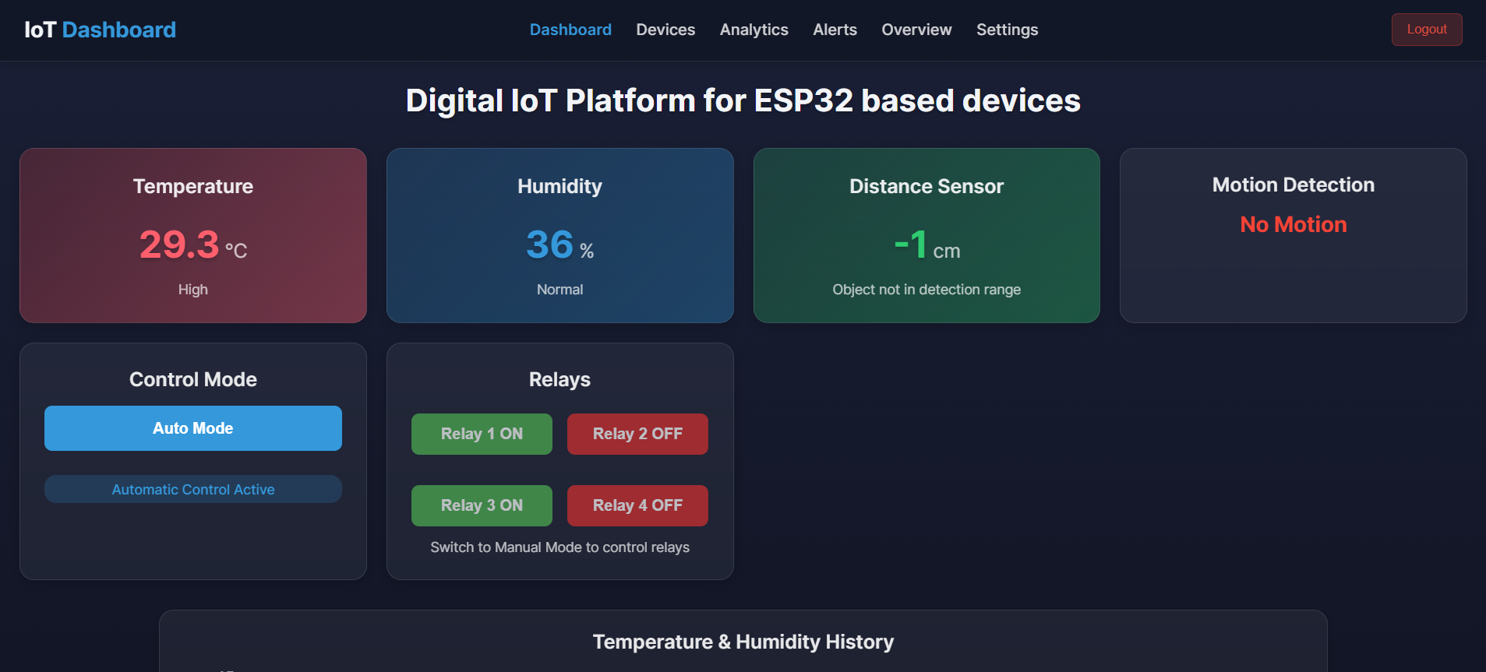
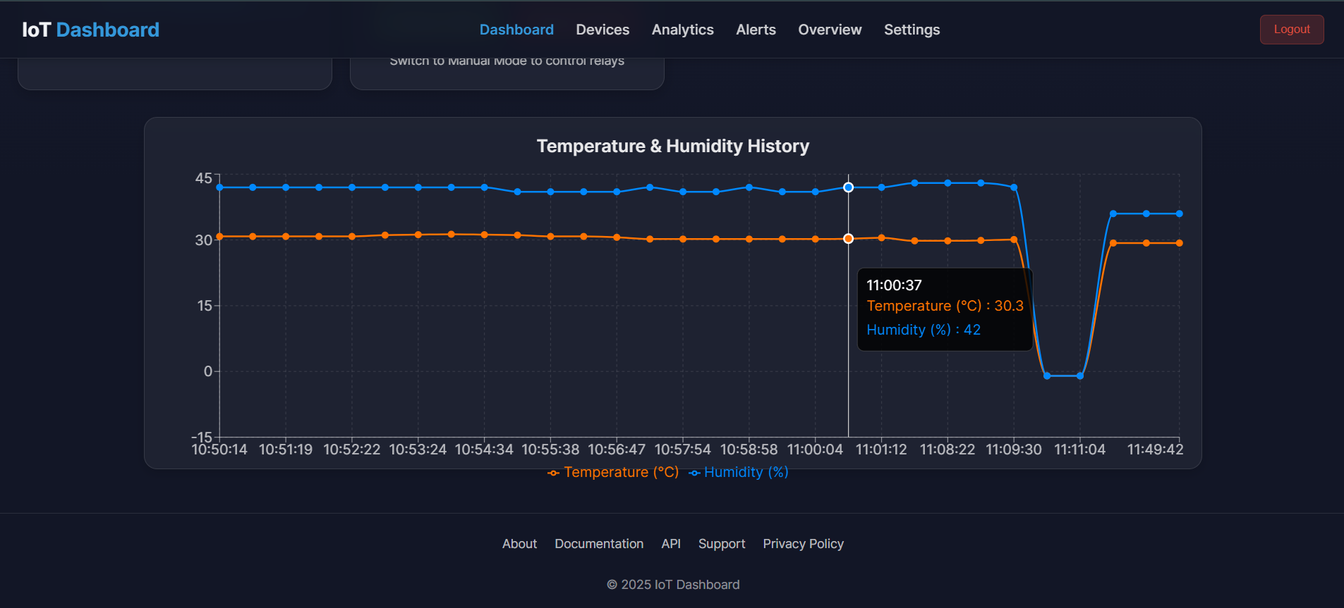
Website Prototype
Dashboard
Track Record
GitHub: https://github.com/SatwikSanket-DraKin/Digital-Platform-for-IoT-Sketch-
9

Slide 10
Product Development
1. Hardware Development :
Sensors (e.g., temperature, humidity, light, proximity) & Actuators (e.g., relays, motors, LEDs).
ESP32 microcontroller for wireless connectivity (Wi-Fi and Bluetooth).
Power supply for sensors and actuators.
2. Firmware Development :
Use Arduino IDE to program the ESP32.
Implement libraries for sensors, actuators, and wireless protocols (e.g., MQTT, HTTP).
Write code for data acquisition, preprocessing, and communication with the server.
3. Backend Development :
Node.js for backend logic and APIs.
PostgreSQL for data storage and retrieval.
10

Slide 11
Product Development
4. Frontend Development
Use React.js or Flutter for the user interface.
Design dashboards for data visualization.
Implement features for device control (e.g., toggling actuators).
Add authentication and security measures.
5. Testing and Deployment
Test the platform in real-world scenarios (e.g., home automation, agriculture).
Deploy the backend on cloud platforms (AWS, Azure, or Google Cloud).
11

Slide 12
Working Principle Process
User Interaction with Application:
Users access the system via a mobile or web app to send commands or retrieve data.
API Request to Cloud Backend:
The application communicates with the Cloud Backend (e.g., MongoDB, MySQL) using APIs to store, process, or fetch data.
Networking via Wi-Fi/Bluetooth:
The backend transfers data through Wi-Fi or Bluetooth to connect with the IoT devices.
Hardware Device Processing:
IoT hardware (like ESP32) equipped with sensors and actuators receives the data, processes it, and performs the desired action (e.g., switching a motor on or recording sensor data).
Feedback Loop to Application:
The hardware sends feedback (e.g., status or sensor data) back to the cloud, which the application displays for the user.
12

Slide 13
Future Scope of IoT
Energy Monitoring :
Measure power consumption for fans, motors, and ACs in real-time.
Voice Control :
Integrate with Alexa or Google Assistant to adjust temperature and speed using voice commands.
Advanced Scheduling :
Add recurring and seasonal schedules for temperature and speed adjustments.
IoT Security :
Enhance security with encrypted communication protocols.
Industrial Integration :
Enable compatibility with SCADA systems for advanced industrial control.
6. Mobile App Accessibility :
Provide a dedicated mobile application for iOS and Android to allow users to remotely monitor and control appliances with ease.
13

Slide 14
Further Enhancements
Multi-Appliance Control :
Manage multiple ACs, fans, and motors from a single dashboard.
Offline Functionality :
Add local control options for speed and temperature adjustments using Bluetooth or physical controls.
AI Integration :
Predict and recommend temperature settings based on weather or usage patterns.
Customizable Dashboard :
Allow users to configure analytics and controls for temperature and speed management.
Battery Backup :
Provide uninterrupted operation for ESP32 during power outages.
14

Slide 15
“The only way to discover the limits of the possible is to go beyond them into the impossible.”
- Arthur C. Clarke
15

Slide 16
THANK YOU
16

