Slide 1
地震工程-期末報告
Student Name : 涂子彧、邱昱倫、周芷琦
Student ID : 11372011、11372009、11372004
Presentation Date : Jun.5 , 2025

Slide 2
Introduction and Motivation for Research

Slide 3
結構基本參數
結構物
TMD
DOF 1
 | 質量m | 84600000 | kg
 | 勁度k | 71200000 | N/m
 | 阻尼係數C | 155226.7529 | (N*s)/m
 | 自然頻率Wn | 0.4083 | rad/s
 | 阻尼比 | 0.0045
DOF 2
 | 質量m | 84600000 | kg
 | 勁度k | 71200000 | N/m
 | 阻尼係數C | 155226.7529 | (N*s)/m
 | 自然頻率Wn | 1.144 | rad/s
 | 阻尼比 | 0.0125
DOF 3
 | 質量m | 84600000 | kg
 | 勁度k | 71200000 | N/m
 | 阻尼係數C | 155226.7529 | (N*s)/m
 | 自然頻率Wn | 1.6531 | rad/s
 | 阻尼比 | 0.018
Mode 1
 | 模態質量 | 84600000 | kg
 | 模態頻率 | 0.4083 | rad/s
Damper7
 | 質量m | 2538000 | kg
 | 勁度k | 389203.72 | N/m
 | 自然頻率Wn | 0.3916 | rad/s
 | 阻尼比 | 0.0857
 | 質量比 | 0.03
 | 調諧頻率比 | 0.9592
Damper8
 | 質量m | 8460000 | kg
 | 勁度k | 1089725.92 | N/m
 | 自然頻率Wn | 0.3589 | rad/s
 | 阻尼比 | 0.1527
 | 質量比 | 0.1
 | 調諧頻率比 | 0.8789
Damper9
 | 質量m | 16920000 | kg
 | 勁度k | 1722875.79 | N/m
 | 自然頻率Wn | 0.3191 | rad/s
 | 阻尼比 | 0.2098
 | 質量比 | 0.2
 | 調諧頻率比 | 0.7815
模態向量 [0.32798528 , 0.59100905 , 0.73697623]

Slide 4
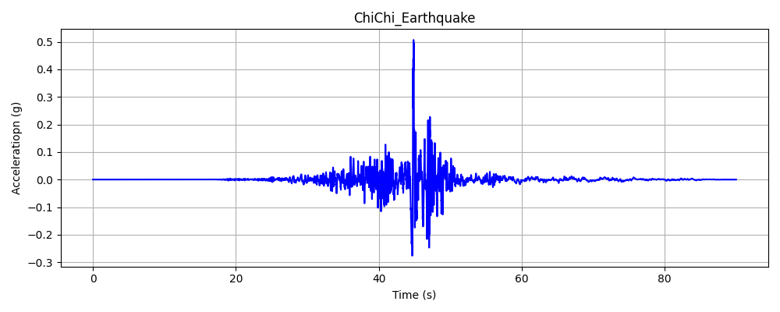
地震地表加速度歷時圖
Average :0.000000 g
RMS : 0.029131 g
Peak : 0.506825 g

Slide 5
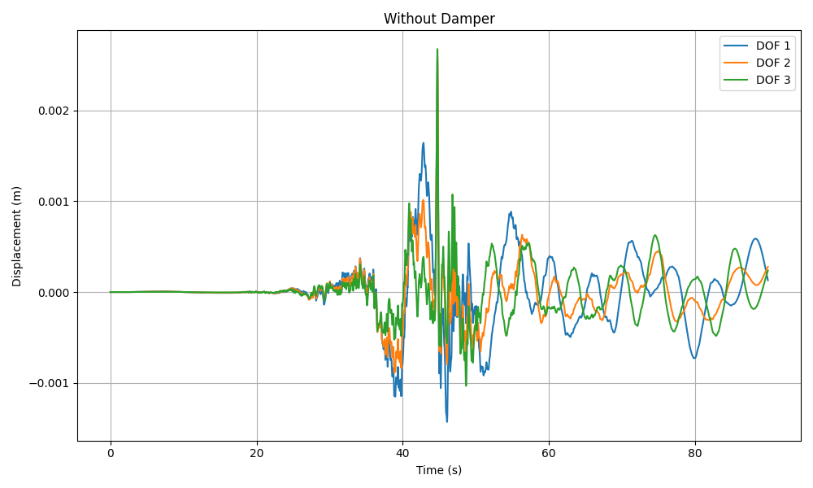
Without Damper
DOF 1
Average | 0.000008m
RMS | 0.00039388m
Peak | 0.00254629m
DOF 2
Average | 0.00000299m
RMS | 0.00027868m
Peak | 0.00259883m
DOF 3
Average | -0.00000014m
RMS | 0.00026798m
Peak | 0.00267715m

Slide 6
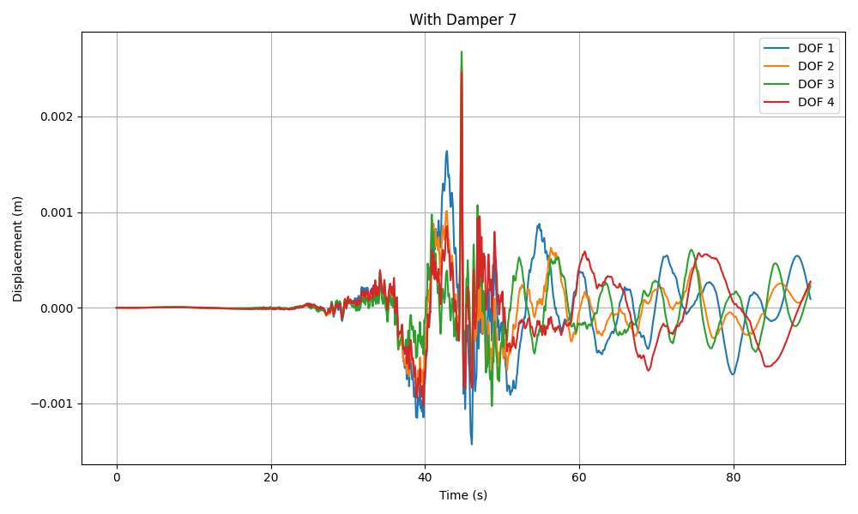
With Damper 7
DOF 1
Average | 0.00000739m
RMS | 0.00038818m
Peak | 0.00254351m
DOF 2
Average | 0.00000262m
RMS | 0.00027525m
Peak | 0.00259790m
DOF 3
Average | -0.00000029m
RMS | 0.00026411m
Peak | 0.00267632m
DOF 4 (damper 7)
Average | -0.00001302m
RMS | 0.00031306m
Peak | 0.00246257m

Slide 7
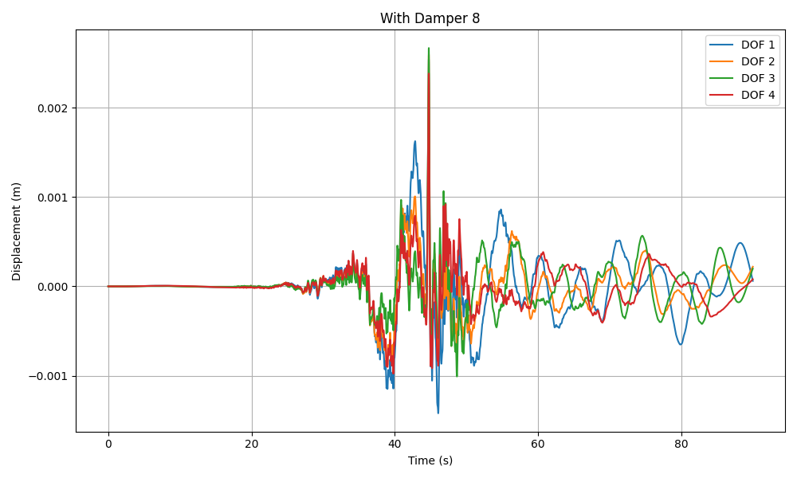
With Damper 8
DOF 1
Average | 0.00000689m
RMS | 0.00037951m
Peak | 0.00254195m
DOF 2
Average | 0.00000251m
RMS | 0.00027137m
Peak | 0.00259597m
DOF 3
Average | -0.00000017m
RMS | 0.00025599m
Peak | 0.00267025m
DOF 4 (damper 8)
Average | -0.00000661m
RMS | 0.00024611m
Peak | 0.00238405m

Slide 8

With Damper 9
DOF 1
Average | 0.00000652m
RMS | 0.00037172m
Peak | 0.00254349m
DOF 2
Average | 0.00000253m
RMS | 0.00026887m
Peak | 0.00259307m
DOF 3
Average | 0.00000003m
RMS | 0.00024758m
Peak | 0.00265894m
DOF 4 (damper 9)
Average | -0.00000422m
RMS | 0.00022282m
Peak | 0.00232563m

Slide 9
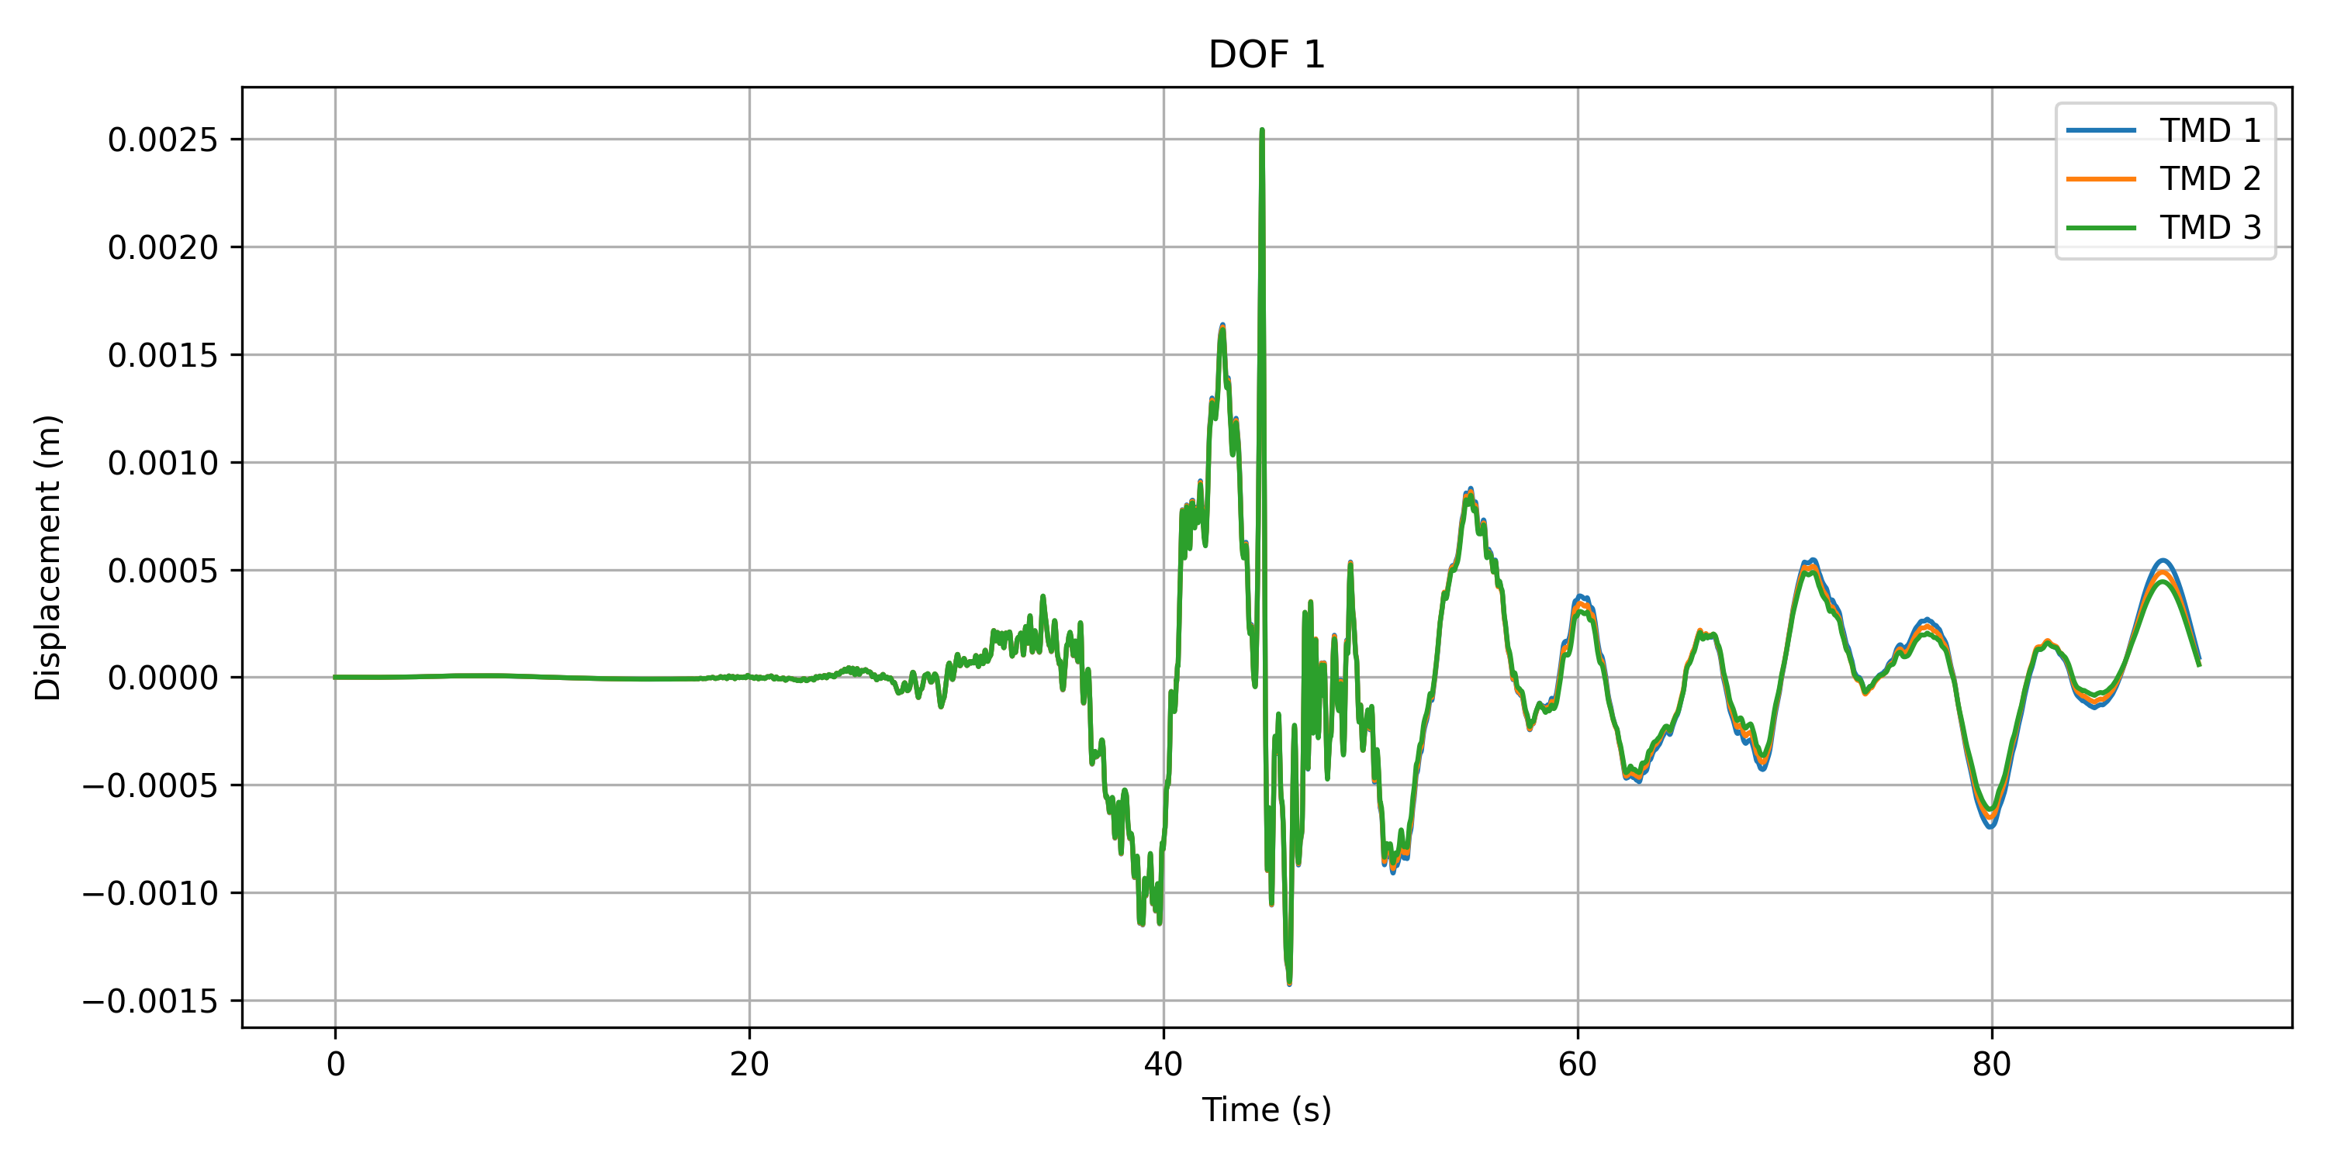
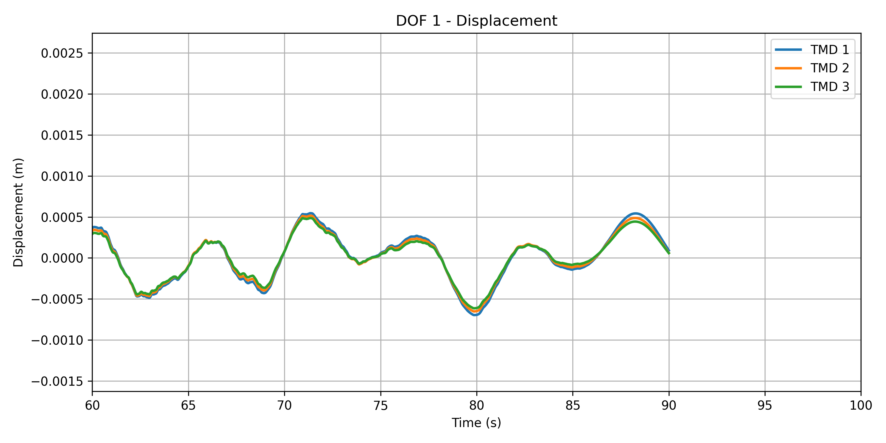
DOF 1 Displacement with different TMD

Slide 10
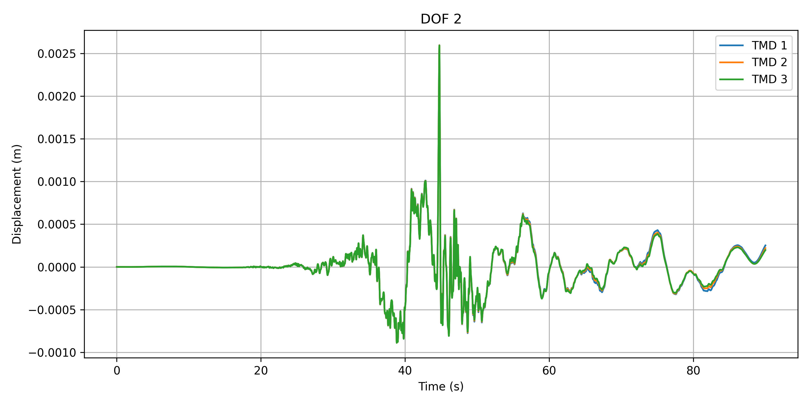
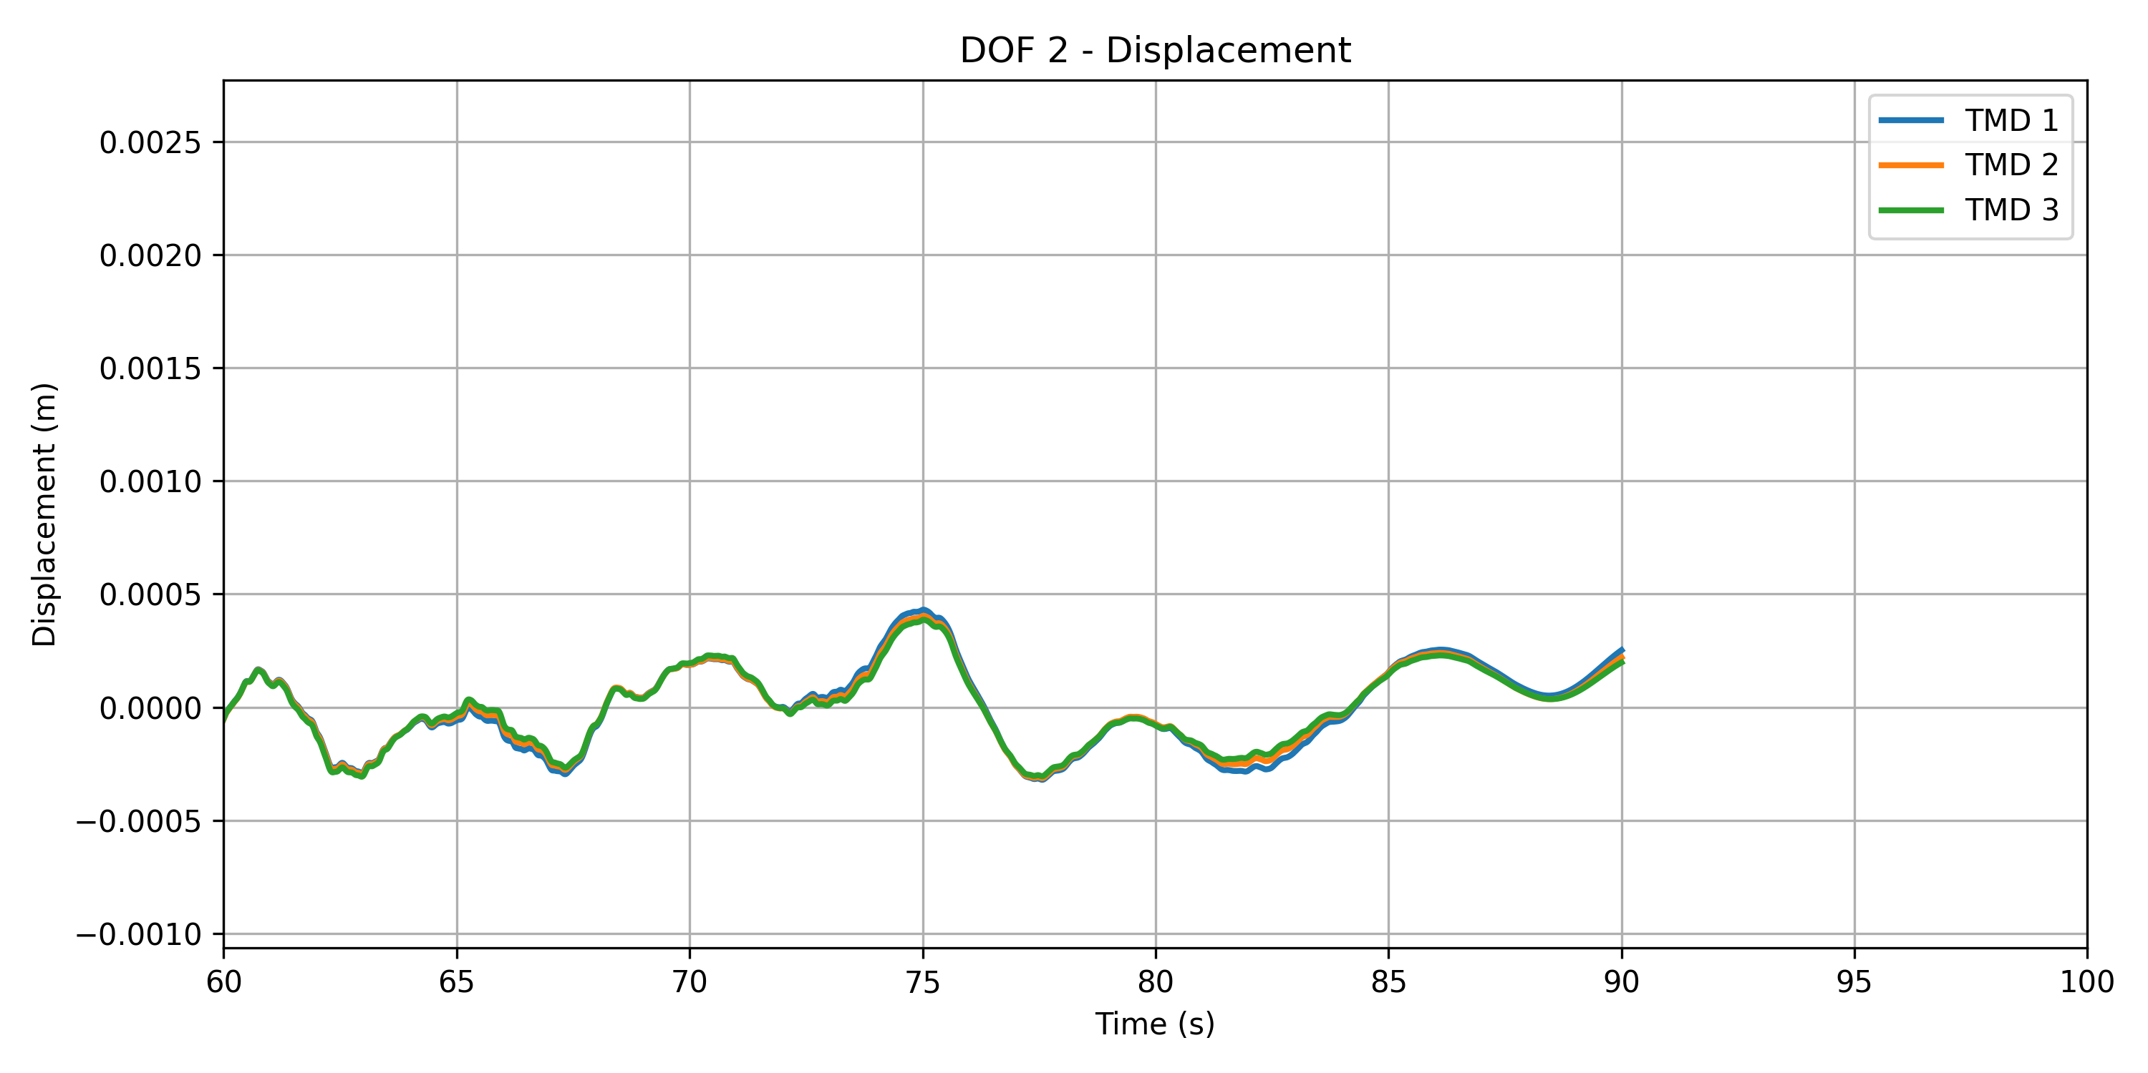
DOF 2 Displacement with different TMD

Slide 11
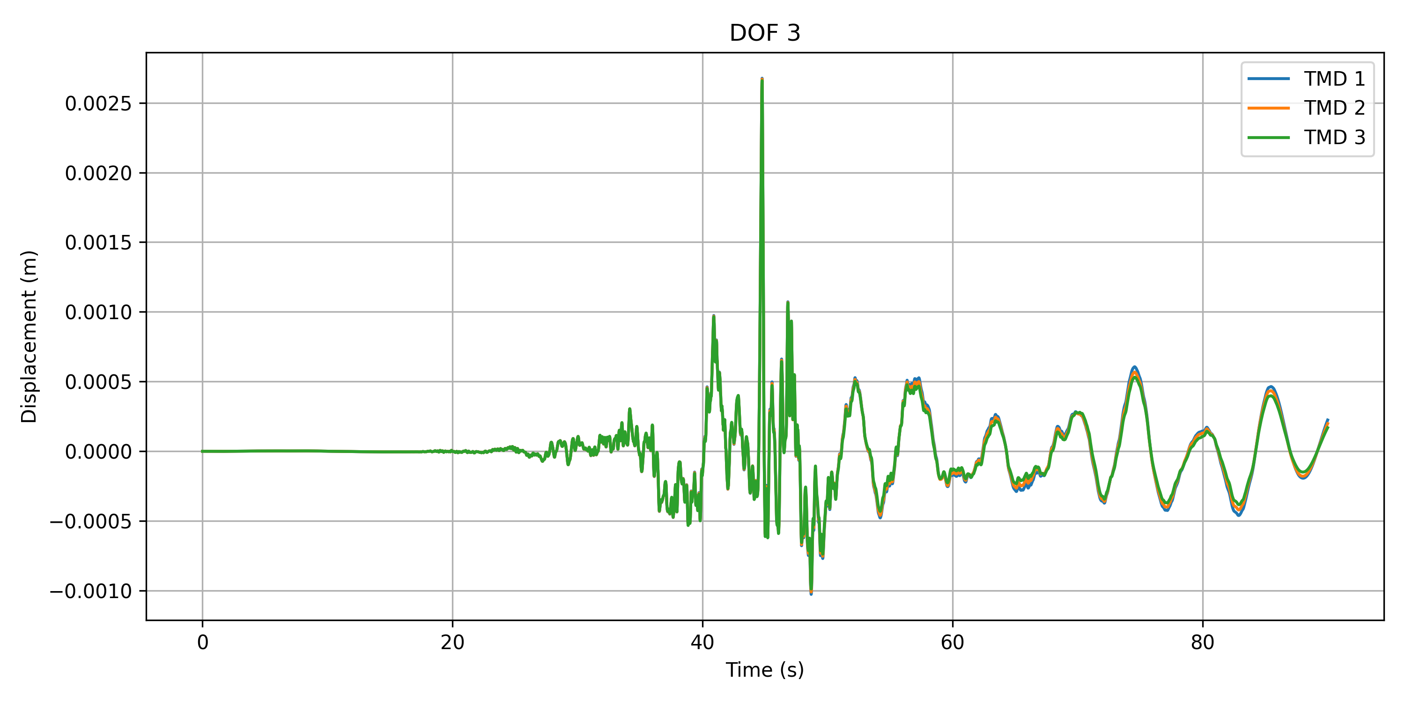
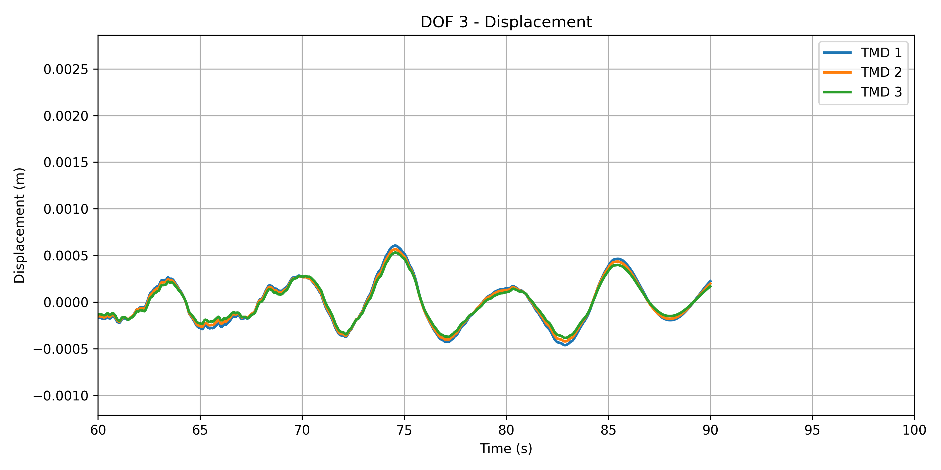
DOF 3 Displacement with different TMD

Slide 12
Conclusion

