Slide 1
EDES 301 PCB Project
<Allen Mikhailov>
Due 05/06/2025 @ 11:59pm

Slide 2
Project Options
Can choose one of two options:
Create a PCB based on your Project #1
Create a PCB based on an example project
See Project #2 assignment for specific details
If choosing Option 1
Replace Background Information and System Block Diagram slides with your slides from the Project #1 proposal
Create a Mechanical Drawing
If choosing Option 2
Used provided Background Information and System Block Diagram slides
Create a Mechanical Drawing
Remove this slide in your submission

Slide 3
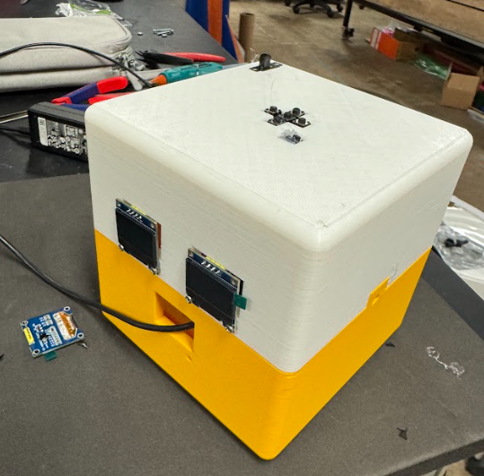
Background Information
Create a PCB for an “Uni-Slime”
Hardware:
I2C Oled Display x3
6 Buttons (DPAD + Home)
One Buzzer
4 Motors controlled by one hbridge driver
Replace this slide with your own if you are doing a PCB around your Project #1

Slide 4
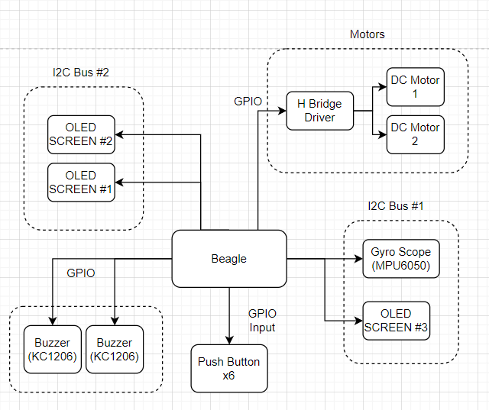
System Block Diagram – “Uni-Slime”
Removed a buzzer

Slide 5
Mechanical Drawing
2.4”
I2C Bus 1(OLED and MPU)
Button GPIO Connections
Motor 2
Pocket Beagle
L293DNE
USB
3”
I2C Bus 2 (OLED x2)
Buzzer
Motor 1
FRONT
BACK

