Slide 1
EDES 301 Desk Pet Proposal
2/21/2025
Allen Mikhailov

Slide 2
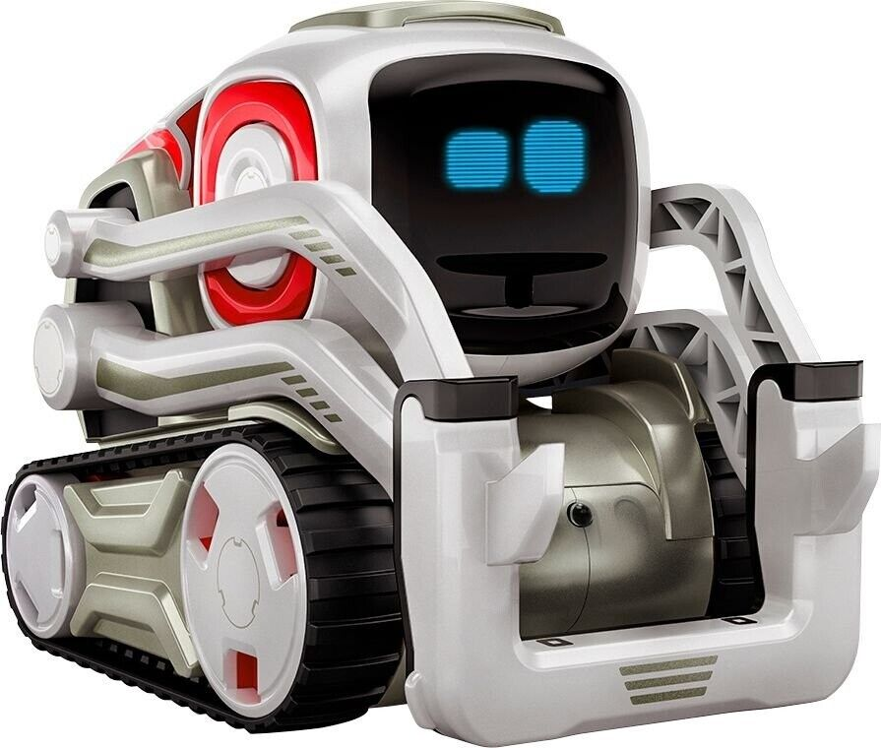
Background Information
I am going to try to make a little robot that can run around my desk and display information.
It will have 4 little wheels that will be powered by two dc motors
It will have these tiny 128x64 OLED displays that will probably display a face of some sort
I imagine the structure to be of a cube with rounded edges
It is inspired by this toy “Comzo”
It will also have a few buttons on top to allow the user to play games with it
It will also make use of a buzzer of some sort to make noise. For example if it drops it will like say “Weeee” or something.

Slide 3
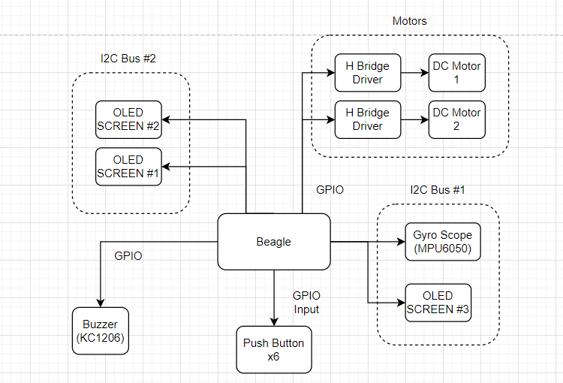
System Block Diagram
Not sure exactly
how many screens I want

Slide 4
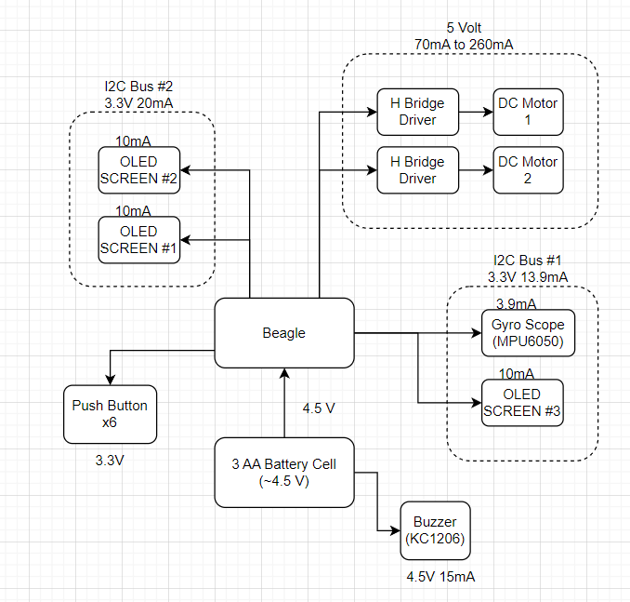
Power Block Diagram

Slide 5
Components / Budget
Component | EDES301 to Buy? | Cost
MPU-6050 | Yes | $2.60 ea
Buzzer | Yes | $0.95 ea
x6 Buttons | No | $8.68 Total
x2 DC Motors | Maybe | $3.23 Total
x3 OLED Screen | No | $9.99 Total
DC Motor Driver | Yes | $4.35
Cost is calculated from amazon price * percentage needed

