Slide 1
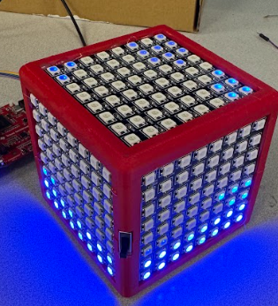
FluiCube
Allen Mikhailov

Slide 2
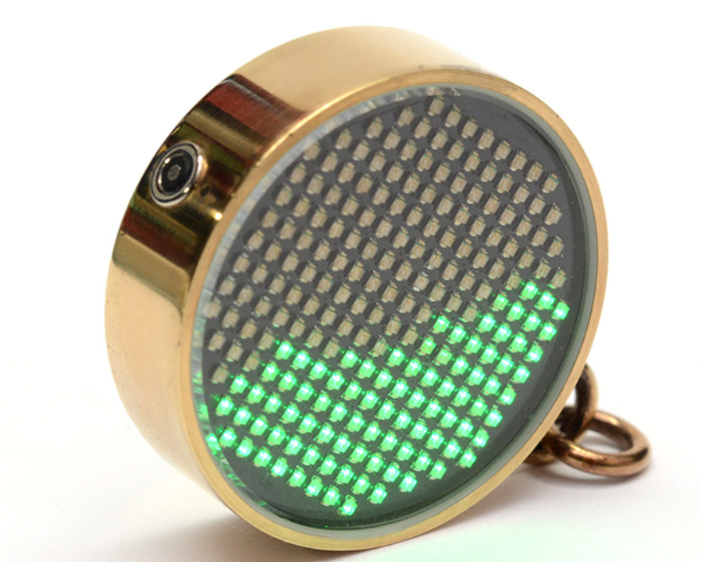
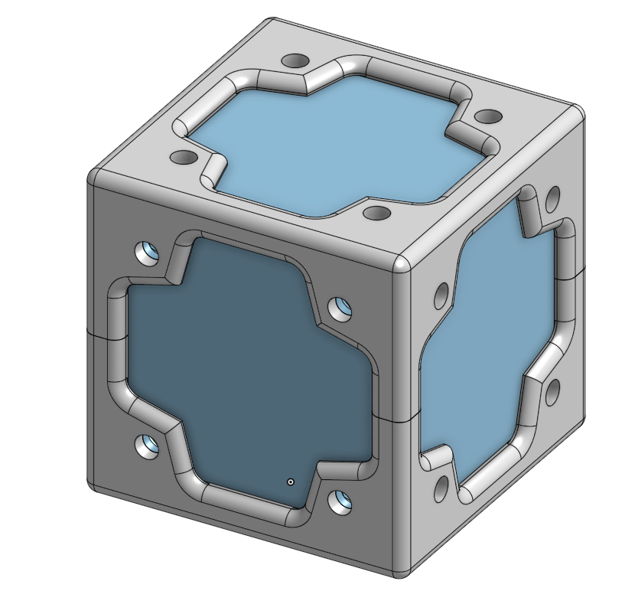
Inspiration
https://www.youtube.com/watch?v=jis1MC5Tm8k
Past Project

Slide 3
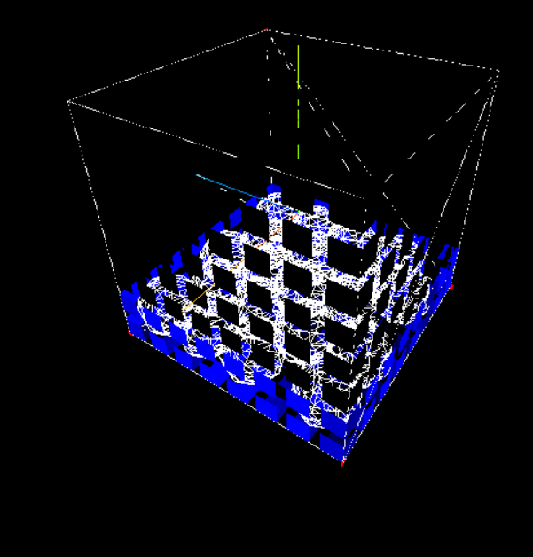
Simulation
There are around 30 particles that all repel each other simulated by the processor. The gravity inflicted on the particles in based on the accelerometer. The particles will light up the leds around them on each face with an intensity of how close they are to that face.

Slide 4
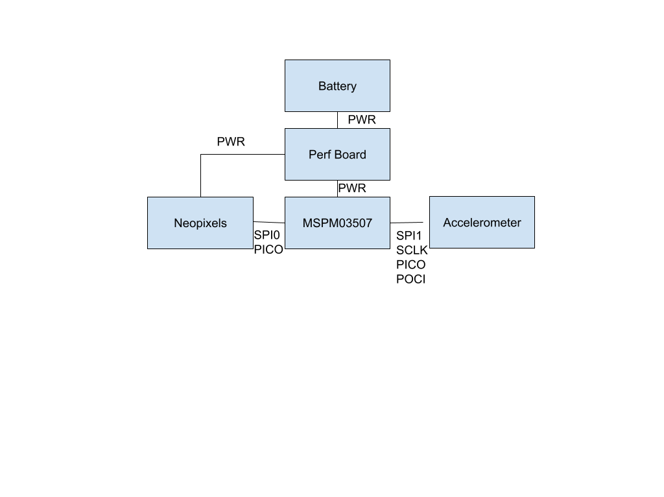
Electronics
The electronics are relatively simple.
The Lights are made up of 6 neopixel 8x8 led grids connected in series
The microprocessor communicates to the accelerometer through SPI while the neopixels are controller by the PICO of the other SPI bus.
Everything is powered by a 3.3V battery pack which is distributed by a perfboard

Slide 5
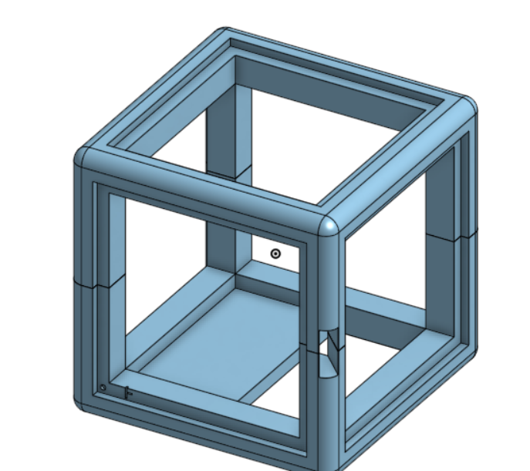
Mechanical
The frame is split into a top and bottom half. They use a male-female interlock to connect. The bottom half has a place for the battery to sit. The simon board and perf board sit on the edges. Everything is hot glued on.

