Slide 1



CAPSTONE PROJECT PRESENTATION
DataMesh Connect: Distributed Open Data Collaboration Platform
CSA0509: Database Management Systems
Presented by
Reg No: 192520055
Judy Allen J
Guided by
Dr R Kesavan
Notes:
1

Slide 2
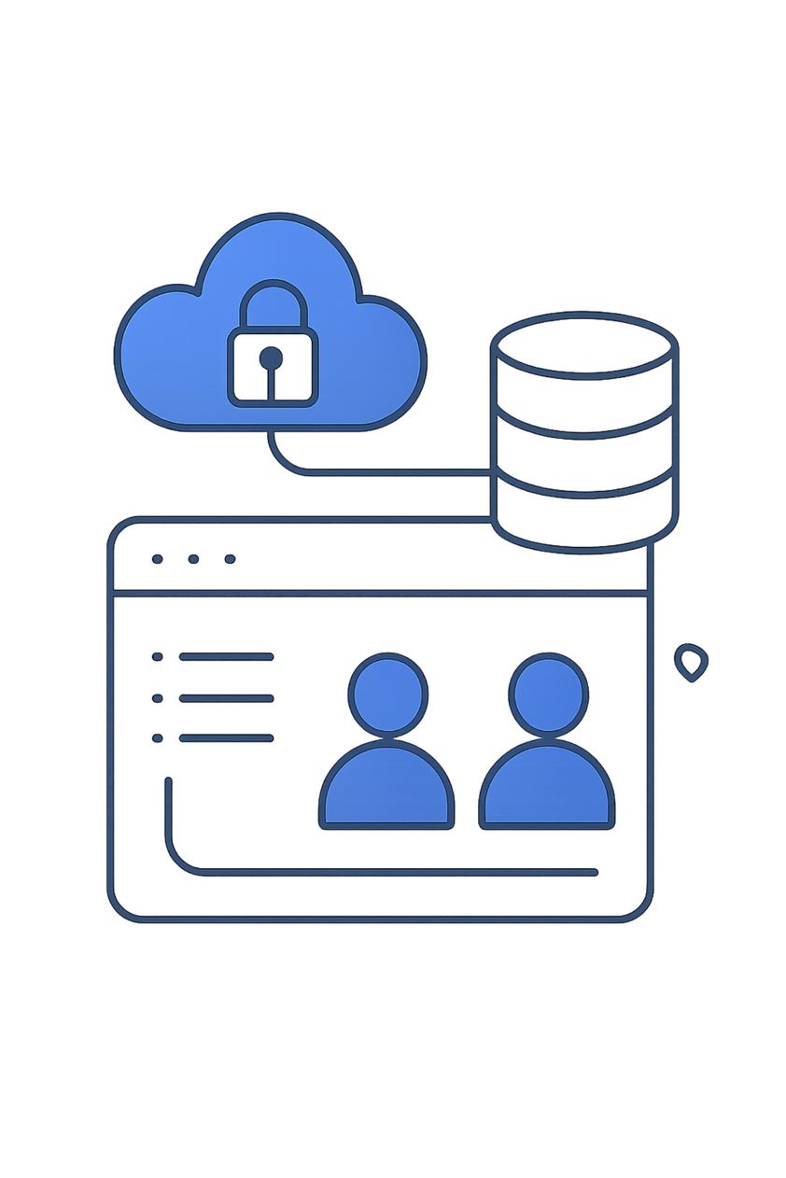
Introduction
DataMesh Connect is a secure platform for storing, sharing, and managing academic datasets.
It provides dedicated interfaces for researchers and administrators, enabling dataset submission, controlled discovery, and request-based access to restricted data.
Authentication and cloud data services are powered by Firebase.
Notes:
2

Slide 3

Problem Statement
Many academic repositories lack strong access control, formal dataset verification, and secure sharing workflows. This creates risks: unauthorised access to sensitive data, duplicate or unsafe submissions, and unclear admin oversight.
DataMesh Connect addresses these gaps with role-based controls, submission approval, duplicate and security audits, and a transparent request/approval process.
Notes:
3

Slide 4

Objectives
Secure repository
Provide a robust system for submitting, storing, and sharing academic datasets with clear status tracking.
Role-based access
Implement distinct researcher and admin interfaces with permissioned actions.
Approval & audits
Enable dataset approval/rejection, restricted-access requests, duplicate detection, and security audits.
Notes:
4

Slide 5


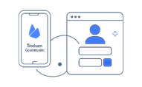
Proposed System — Core Components
Researcher Portal
Admin Portal
Backend Services
Register/login, submit datasets, explore public datasets, request restricted access, and monitor submission status.
Review submissions and access requests, approve/reject, manage users, and run security & duplicate audits.
Firebase Authentication for identity, Firestore for dataset and request storage, and server rules for access enforcement.
Notes:
5

Slide 6
Modules — User & Admin Workflows
USER
ADMIN
Register / Login
Explore datasets (search & filters)
Submit datasets with metadata
Request restricted access & track requests
Admin authentication and dashboard
Review and moderate dataset submissions
Approve/Reject access requests
User management, security, and duplicate audits
Notes:
6

Slide 7

Database Design — Schemas & Key Fields
Users
UserID (Firebase UID), Name, Email, PasswordHash, Role
Datasets
DatasetID, Title, Category, AccessType (Public/Restricted), Status, OwnerID, FileURL, UploadDate
Access Requests
RequestID, DatasetID, UserID, Reason, Status, RequestDate
Audit / Security
ActivityID, DatasetID, Action, RiskStatus, Timestamp, Notes
Notes:
7

Slide 8
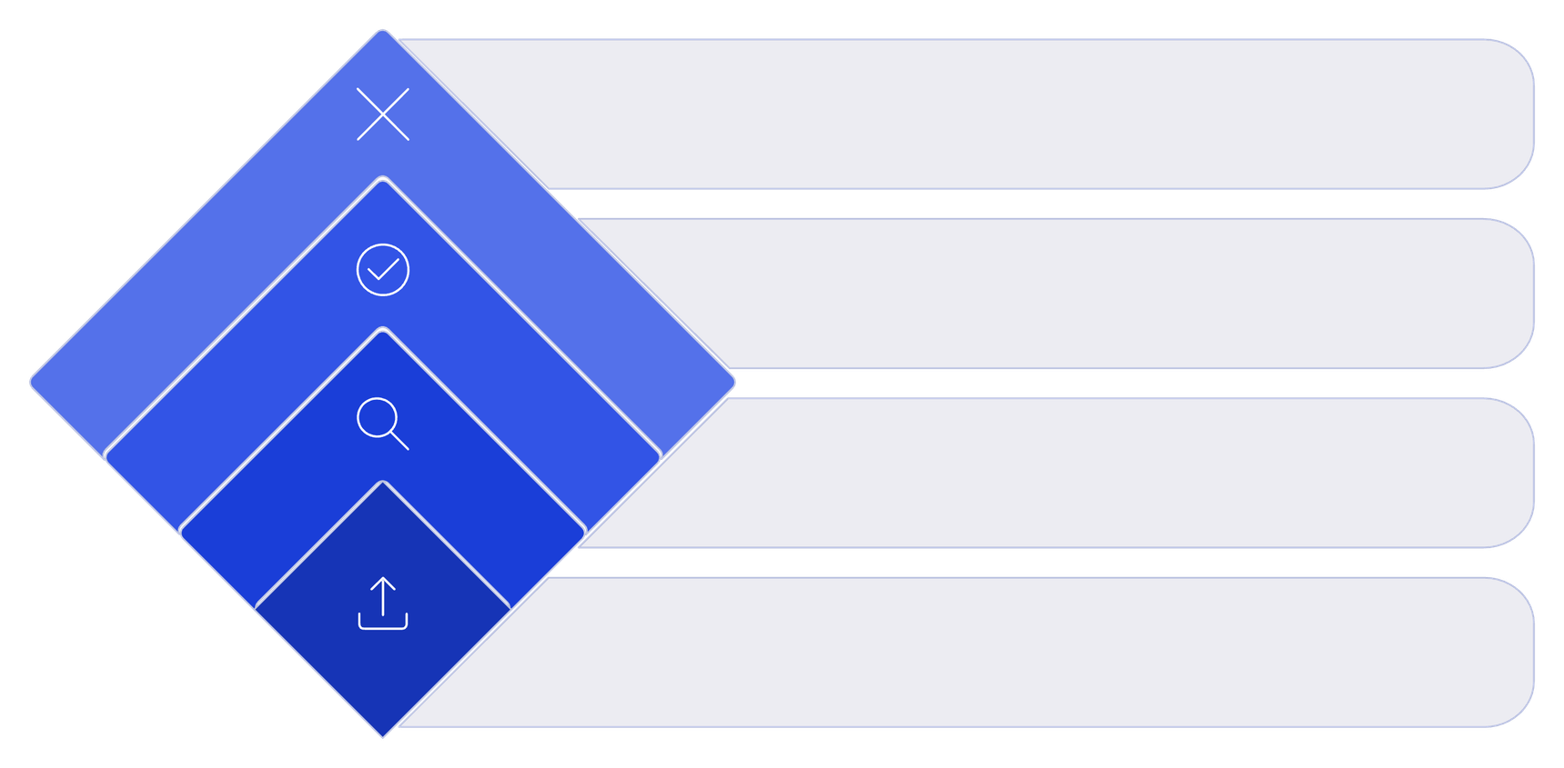
Important Behaviors & Status Flows
Rejected
Notify user with reasons
Approved
Grant access and publish
Review
Assess data and access type
Submission
User submits dataset request
Notes:
8

Slide 9
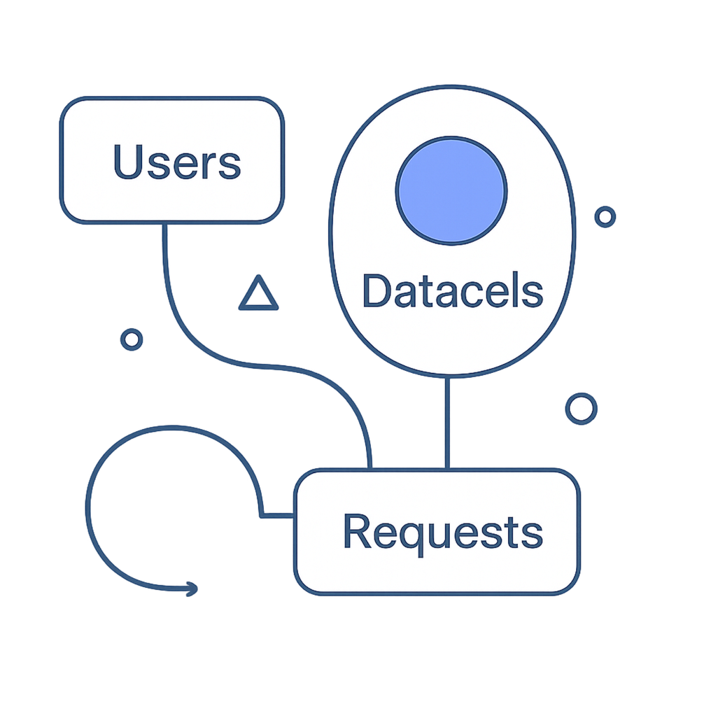
Data Relationships (Cardinality)
USER 1 : N DATASETS — One user can submit many datasets.
USER 1 : N ACCESS REQUEST — Users may request access to multiple datasets.
DATASET 1 : N ACCESS REQUEST — A restricted dataset can receive many requests.
DATASET 1 : N AUDIT RECORD — Each dataset may have multiple audit/security entries.
Notes:
9

Slide 10
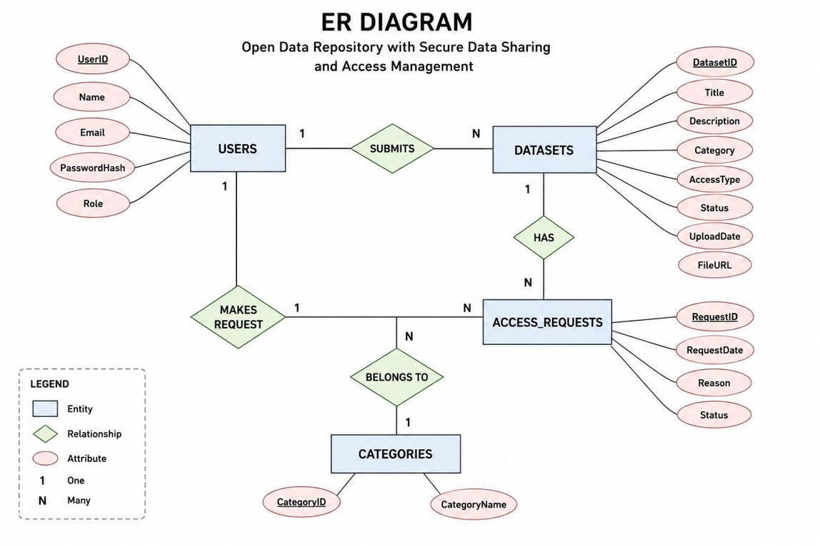
ER Diagram
Notes:
10

Slide 11
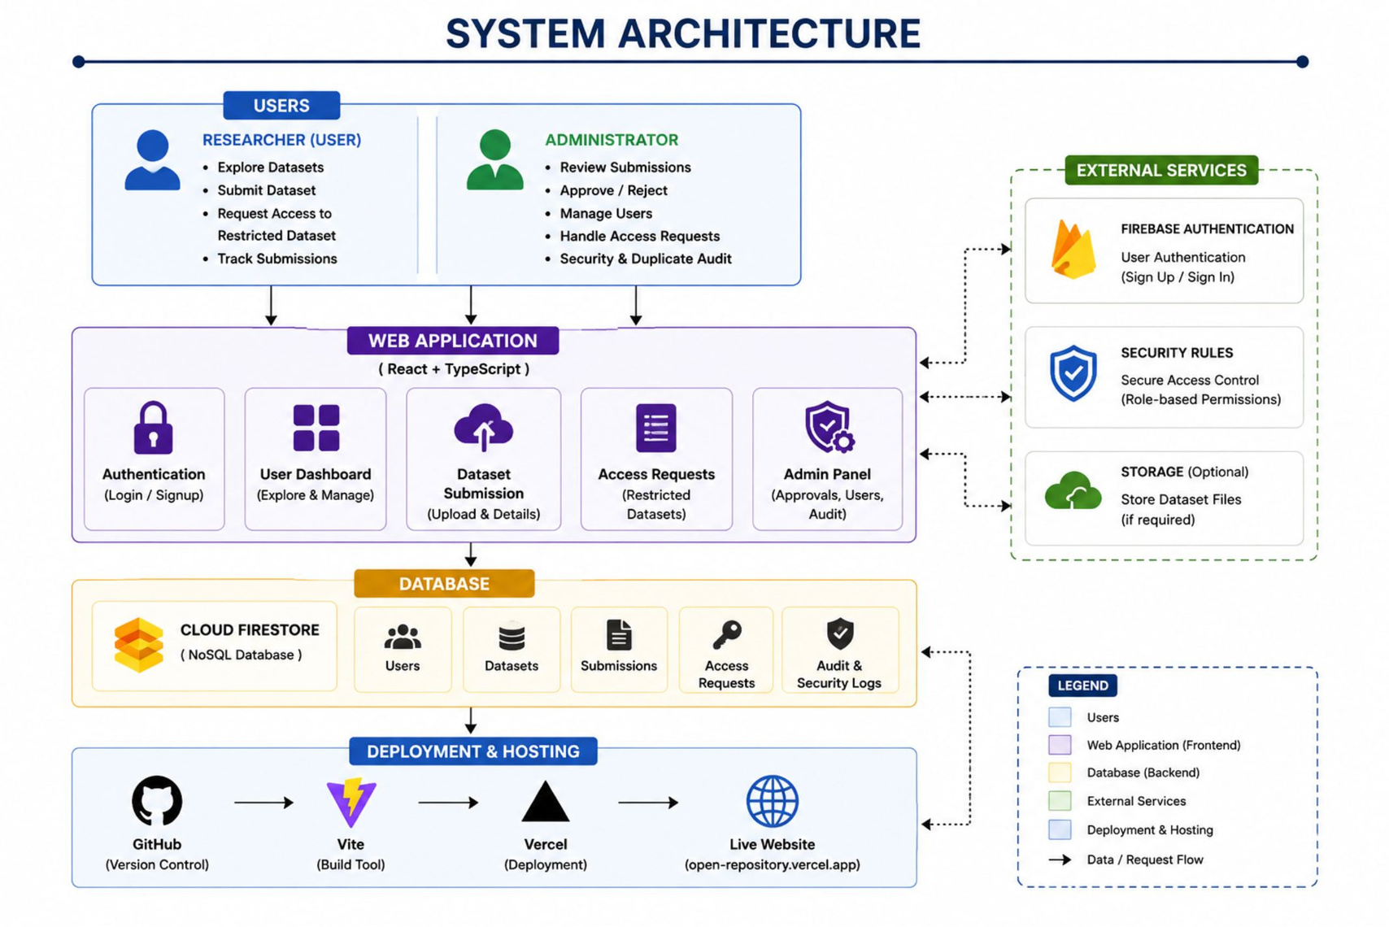
Notes:
11

Slide 12
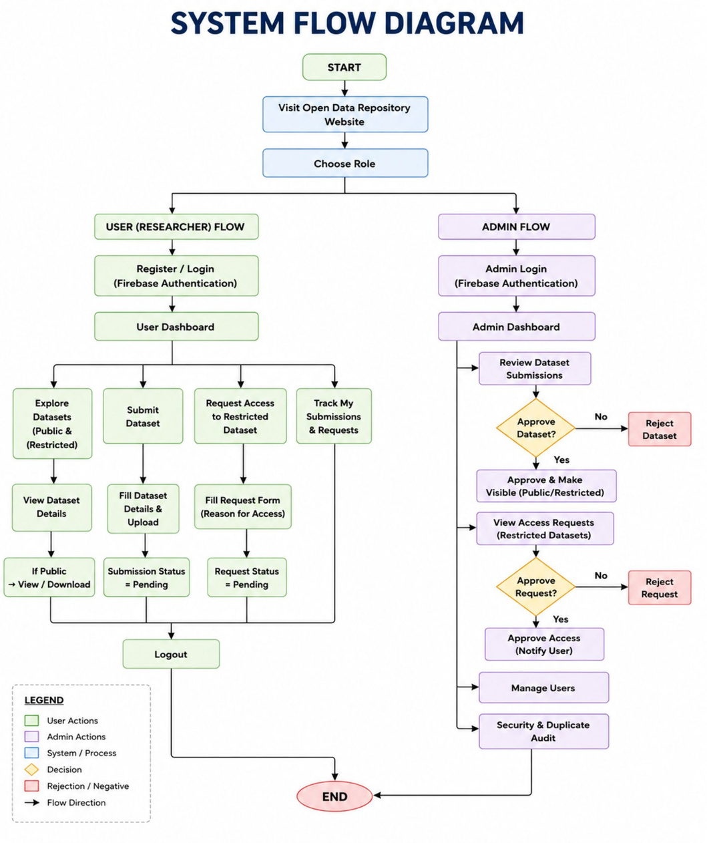
Notes:
12

Slide 13
Implementation
Firebase Database Connection
Code:
const app = initializeApp(firebaseConfig);
const auth = getAuth(app);
const db = getFirestore(app);
Purpose: Connects the application with Firebase Authentication and Cloud Firestore.
Dataset Submission
Code:
await addDoc(collection(db, "datasets"), {
title: datasetTitle,
ownerId: currentUser.uid,
accessType: accessType,
status: "Pending"
});
Purpose : Stores a user's dataset with Pending status for admin review.
Restricted Access Request
Code:
await addDoc(collection(db, "accessRequests"), {
datasetId: datasetId,
userId: currentUser.uid,
status: "Pending"
});
Purpose: Stores the user's request to access a restricted dataset.
Notes:
6

Slide 14
Test Cases & Results
Test Case | Expected Result | Actual Result
User Registration | Account created successfully | Passed
User Login | Valid user enters dashboard | Passed
Dataset Submission | Dataset stored with Pending status | Passed
Admin Approval | Admin can approve/reject dataset | Passed
Restricted Access Request | Request appears in Admin Portal | Passed
Access Approval | Status updates in User Portal | Passed
User Data Isolation | Users see only their own records | Passed
Admin Access Control | Normal users cannot access admin functions | Passed
Result: All major functional workflows were tested successfully.
Notes:
6

Slide 15
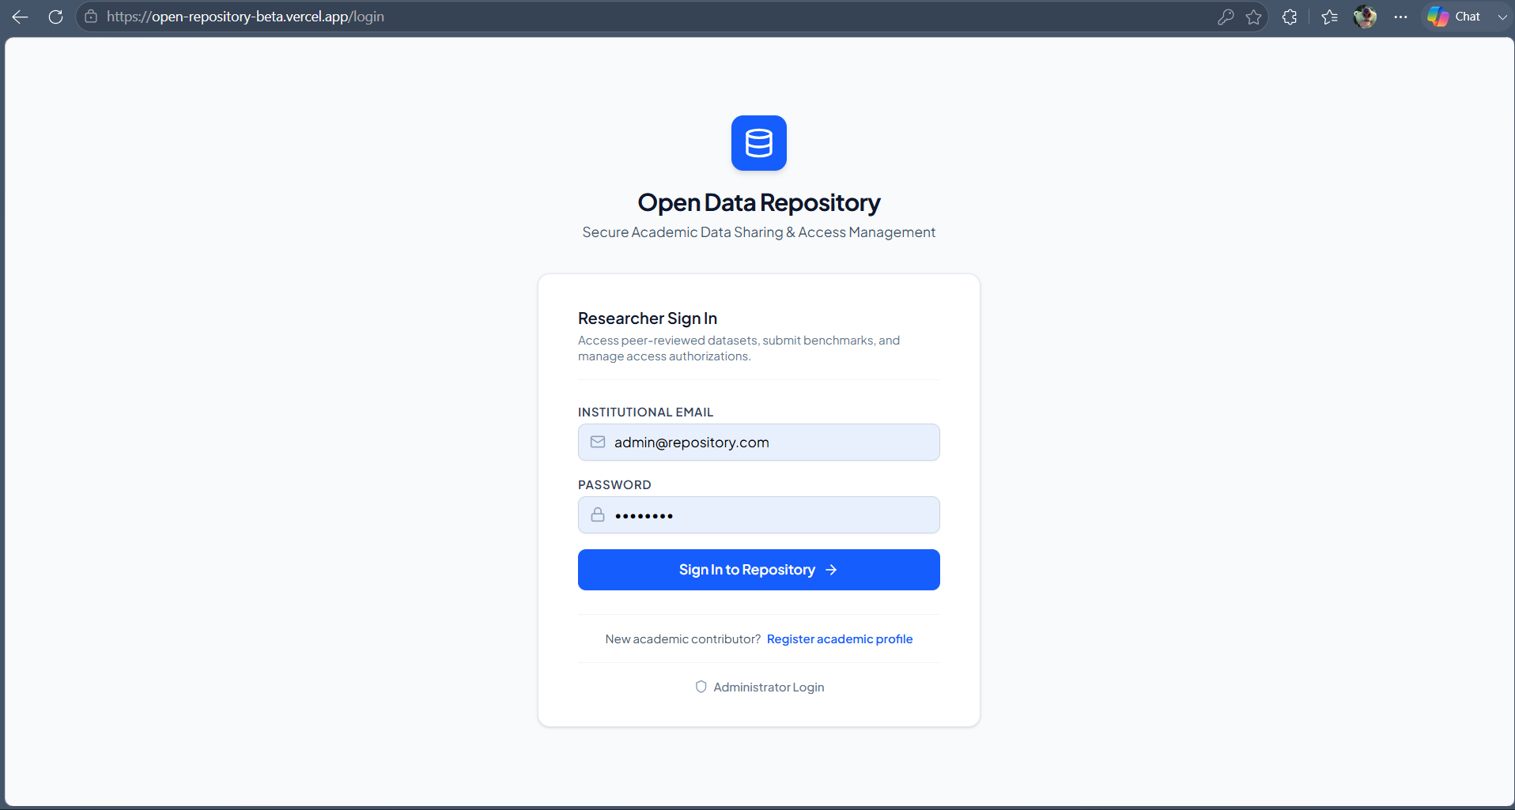
Outcomes
Notes:
17

Slide 16
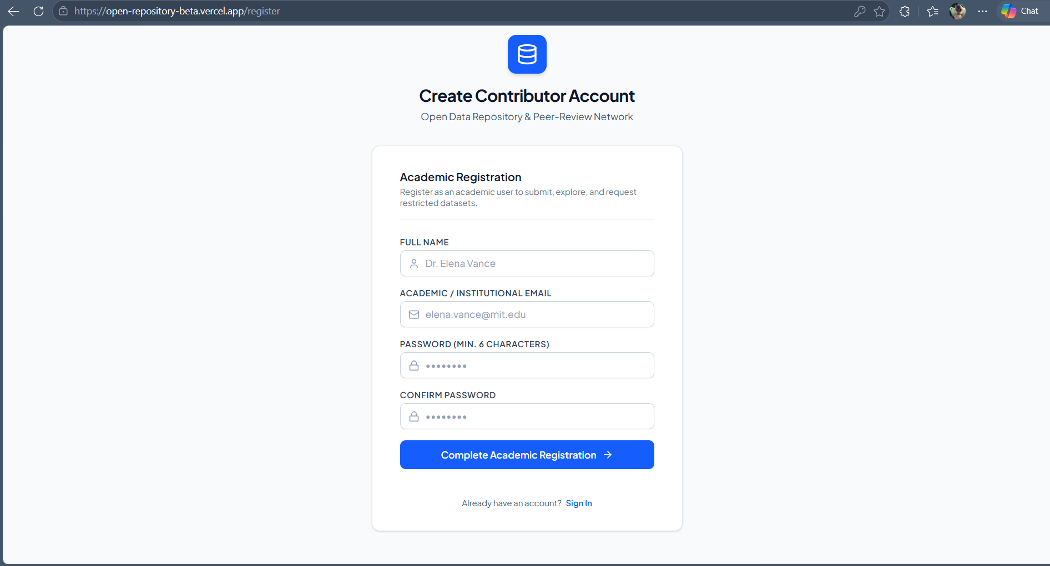
Notes:
17

Slide 17
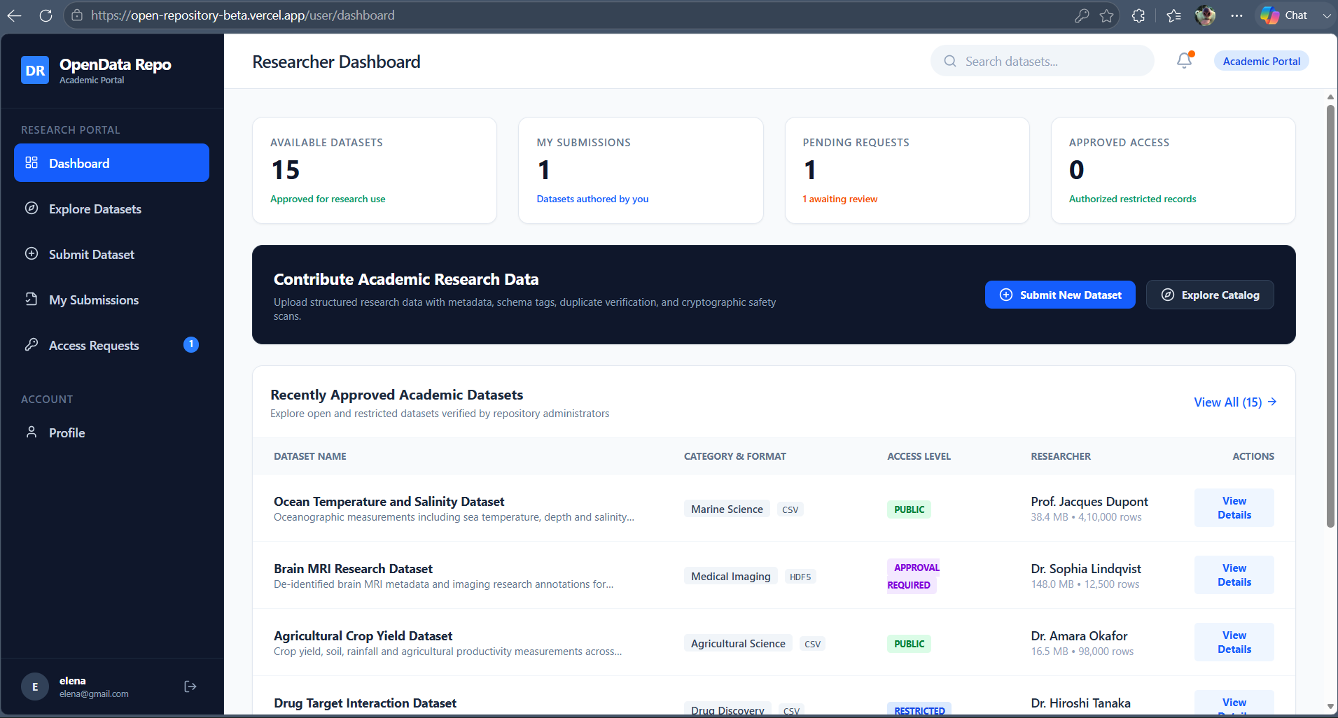
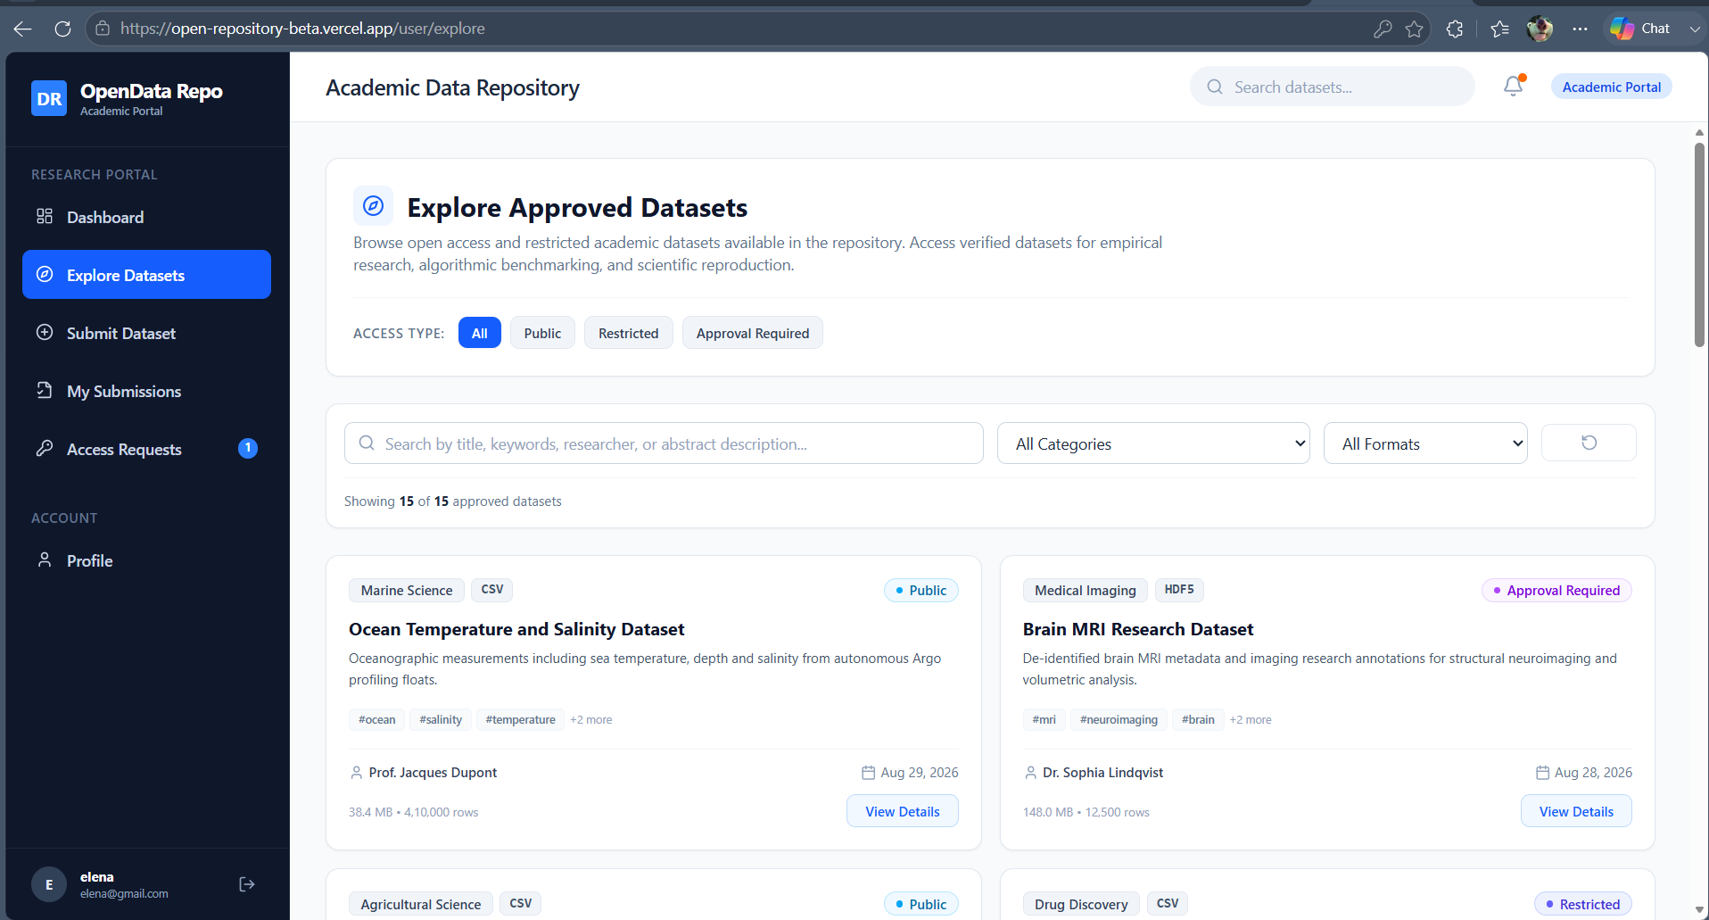
Notes:
17

Slide 18
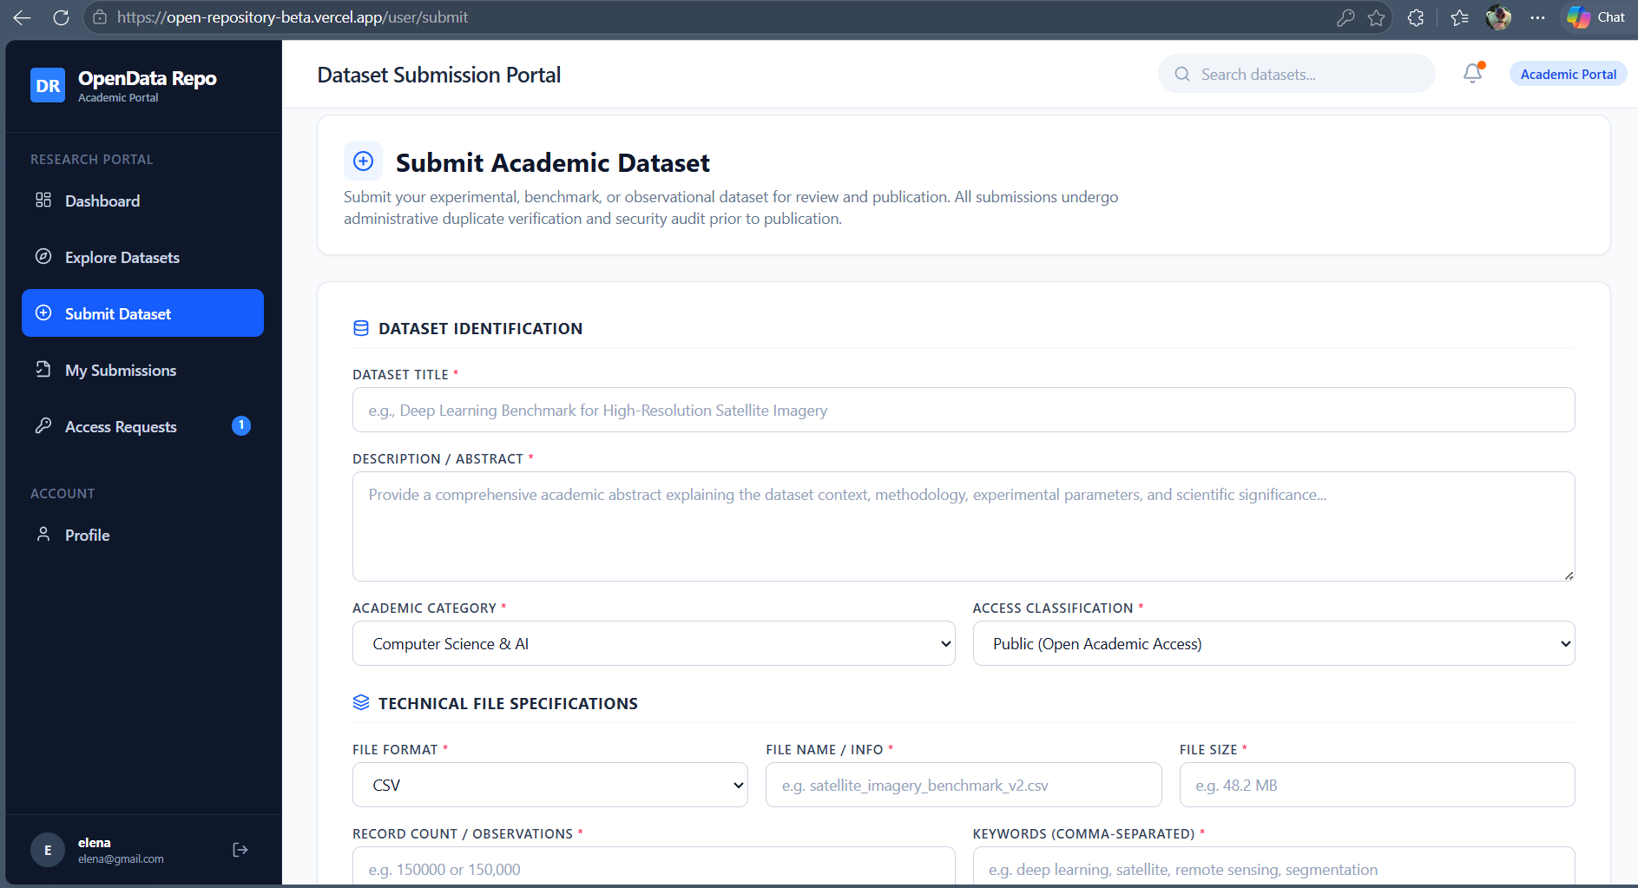
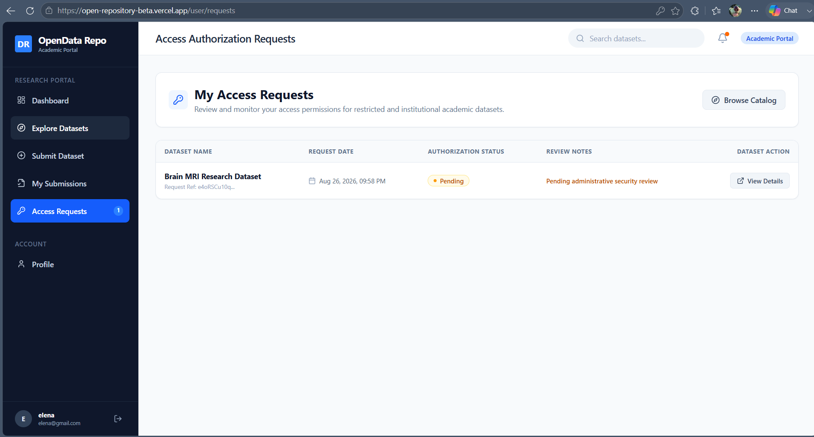
Notes:
17

Slide 19
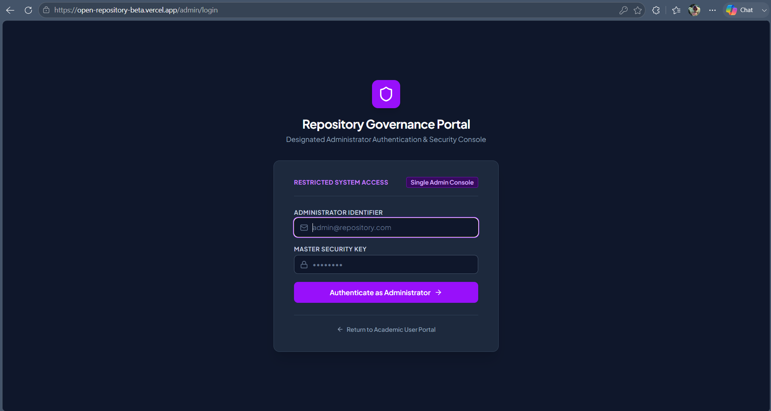
Notes:
17

Slide 20
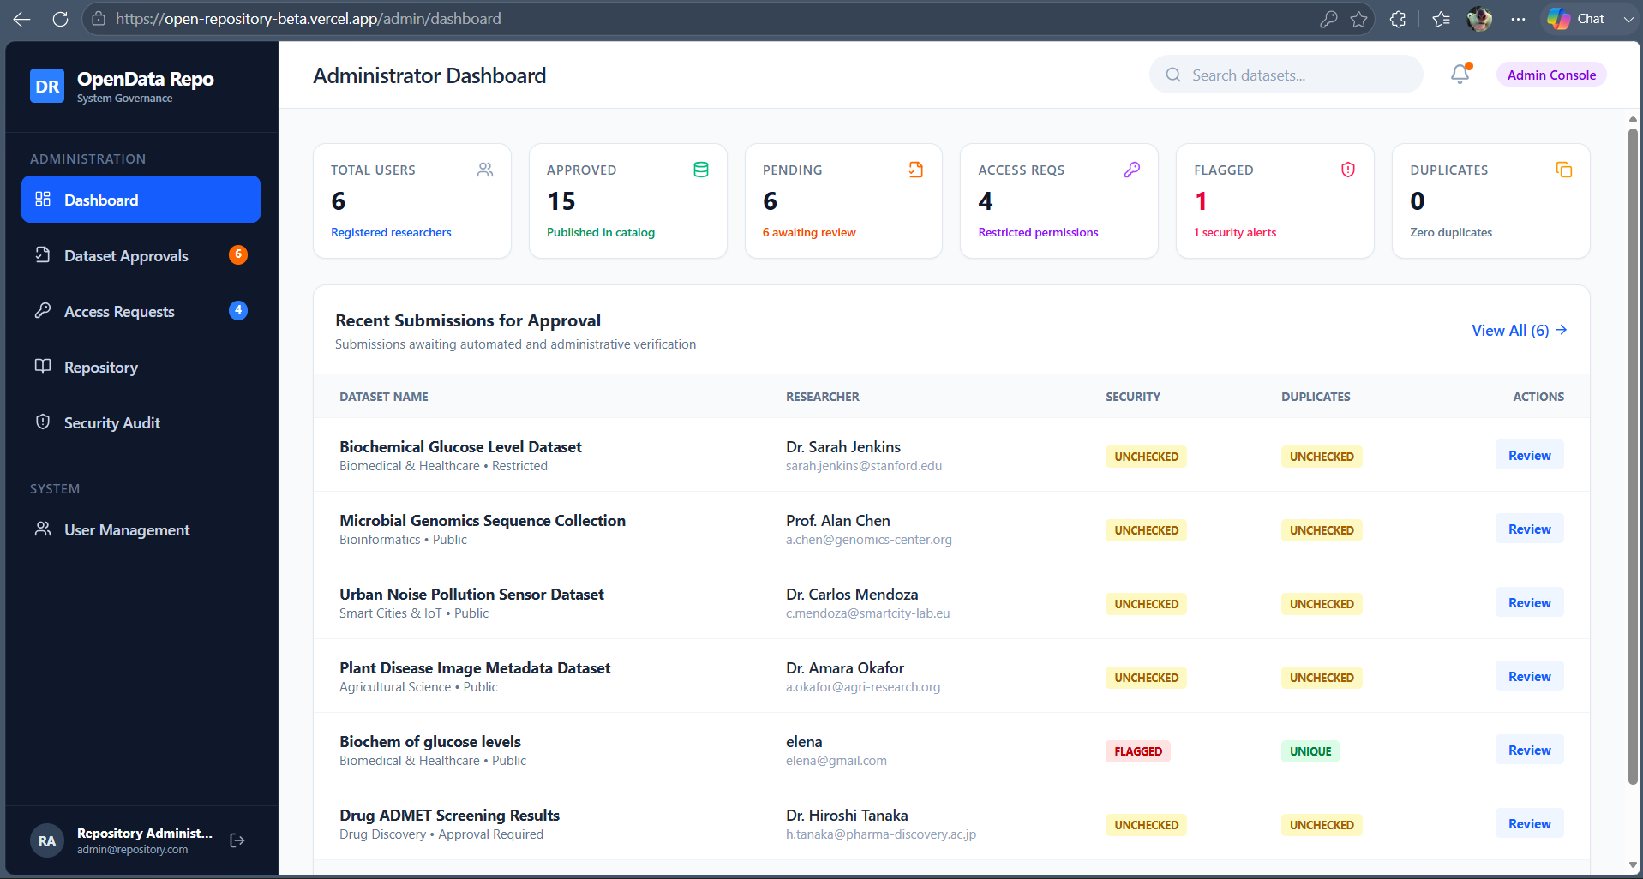
Notes:
17

Slide 21
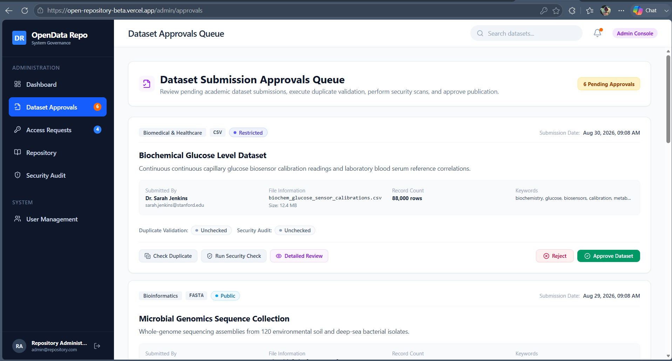
Notes:
17

Slide 22
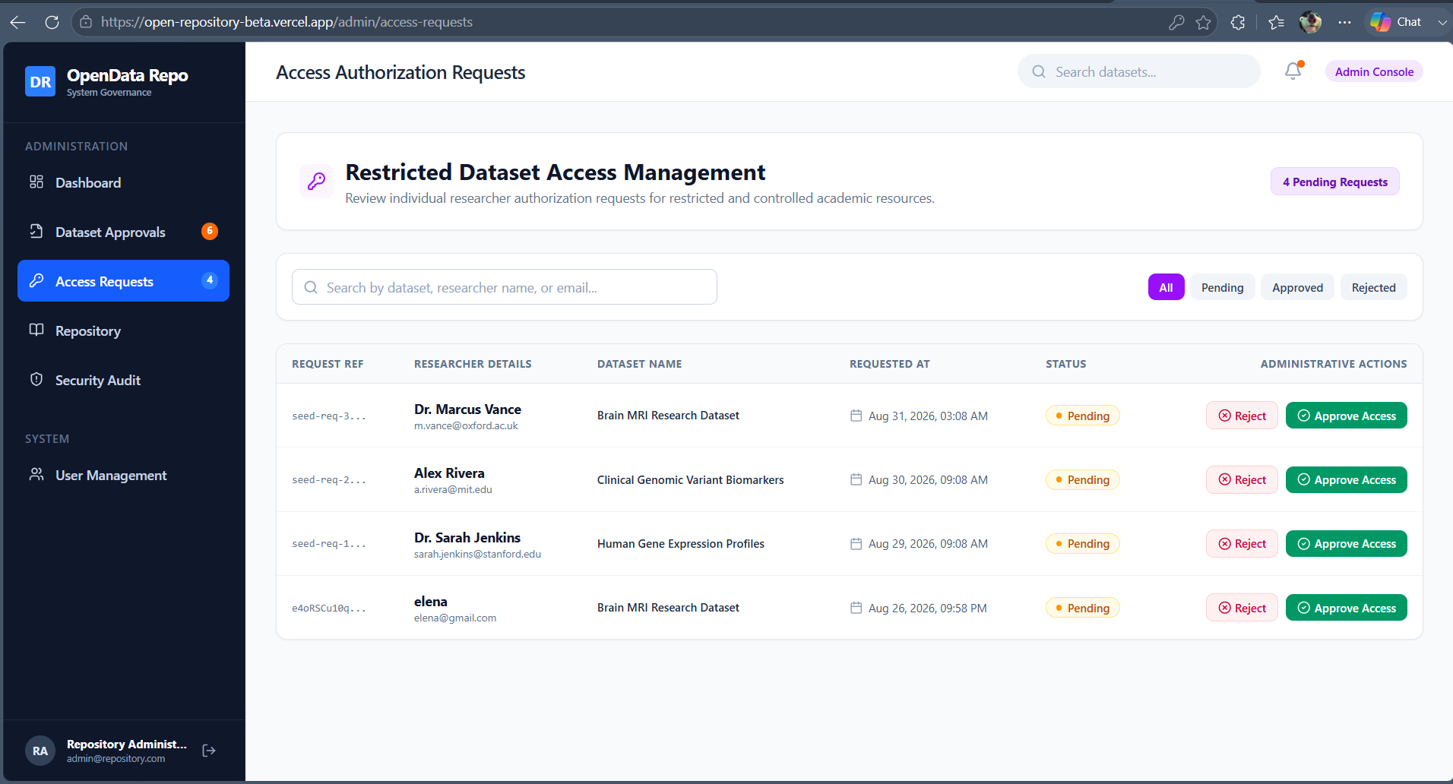
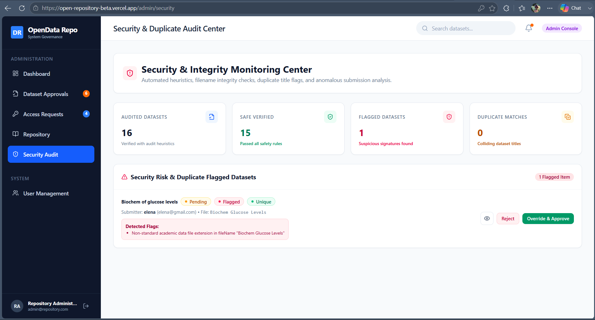
Notes:
17

Slide 23





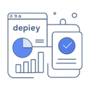
Technologies & Infrastructure
React + TypeScript
Vite
Firebase Authentication
Cloud Firestore
Frontend implemented with React + TypeScript for type-safe, maintainable UI components and fast iteration.
Fast build and dev server for rapid local iteration and optimized production bundles.
Secure sign-up/login with role-based identity supporting both researchers and administrators.
Scalable NoSQL database for datasets, submissions, access requests, and audit logs.
GitHub
Vercel
Source control and CI integration for code reviews and deployment pipelines.
Continuous deployment hosting for the live web application and preview environments.
Notes:
13

Slide 24
Key Advantages
Secure Authentication
Clear Role Separation
Controlled Access
Submission Governance
Firebase Auth provides secure sign-in flows and role separation between researchers and admins.
Distinct researcher and admin dashboards reduce accidental privilege escalation and simplify workflows.
Admins approve restricted datasets and individual access requests to enforce compliance and provenance.
Dataset approval process, visibility controls, and duplicate detection ensure data quality before publication.
Cloud-native & Scalable
Firestore and serverless hosting enable horizontal scaling and low operational overhead.
Notes:
14

Slide 25

Operational Considerations
01
02
Access & Security
Data Governance
Implement strict role-based rules in Firestore security rules and regular duplicate/security audits.
Define metadata requirements, approval criteria, and retention policies for datasets.
03
04
Performance & Cost
Monitoring & Observability
Optimize Firestore indexing and minimize read/write costs with batched operations and caching.
Use logging, alerts, and SLOs for uptime and to track suspicious activity or repeated duplicates.
Notes:
16

Slide 26

Future Scope
AI-driven dataset recommendations to surface relevant data for users
Advanced visualization modules for exploratory data analysis
Email notifications and workflow alerts for approvals and requests
Dedicated cloud file storage for large dataset assets
APIs for integration with external research platforms and tools
Native mobile app for submission & review on the go
Notes:
15

Slide 27
Conclusion
The Open Data Repository delivers a secure, auditable platform for sharing academic datasets with governed access. It balances researcher usability with administrator controls enabling dataset publication, restricted access workflows, and monitoring. Built with modern, scalable cloud tooling, it is positioned to grow with features like AI recommendations, richer visualizations, and API integrations to serve research communities.
Notes:
17

Slide 28
References & Acknowledgements
[1] DBpedia (2007)
[2] Database Systems (2020)
[3] Fundamentals of DB (2016)
[4] MySQL Reference (2025)
Auer, S., et al. DBpedia: A nucleus for a web of open data. ISWC 2007.
Silberschatz, Korth, & Sudarshan — Database System Concepts, 7th ed.
Elmasri & Navathe — Fundamentals of Database Systems, 7th ed.
Oracle Corporation — MySQL 8.4 Reference Manual.
[5] W3C Best Practices (2024)
World Wide Web Consortium — Data on the Web Best Practices.
Notes:
18

Slide 29
Thank You
Notes:
19

