Slide 1
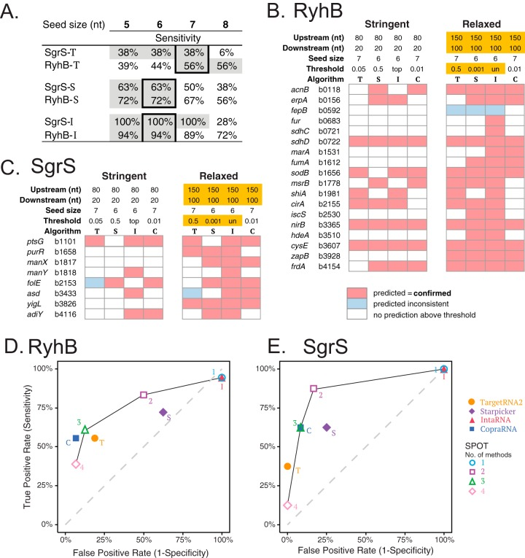
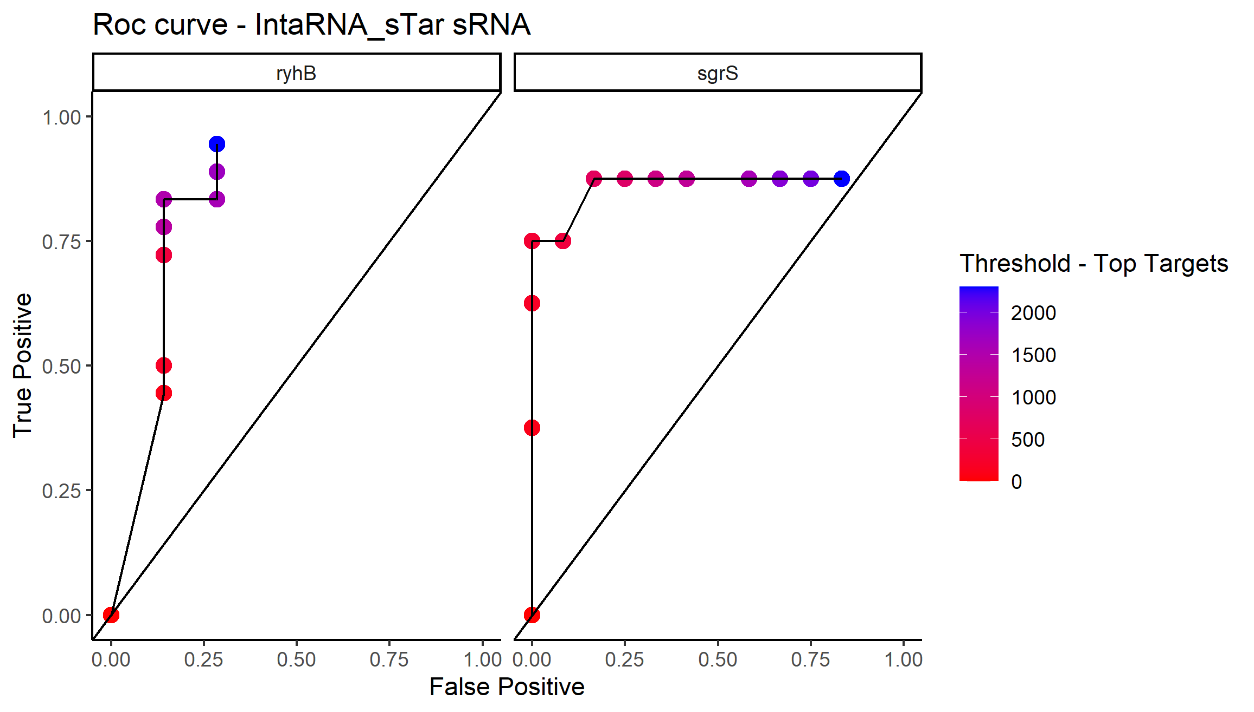
ROC curve for sgrS and rhyB target prediction using IntaRNA_sTar “personality”

Slide 2
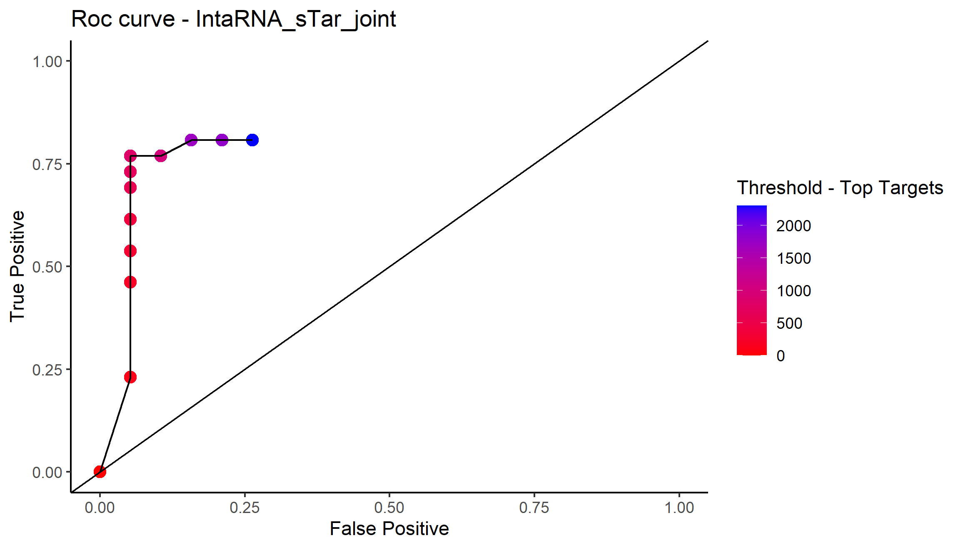
ROC curve for overall target prediction using IntaRNA_sTar “personality”

